Slide 1
Malignant Ovarian Steroid Cell Tumor: A very rare tumor in children
With a glance to the pediatric Ovarian tumors
Presented by : Fatima Malek M.D
Assistant Professor of SBMU Mofid Children’s Hospital
IN The Name OF GOD

Slide 2
Our case
Text
We report a case of an 8-year-old girl with an ovarian steroid cell tumor .She had a history of abdominal pain, that had persisted for three months and a history of an ovarian mass. Of note she had no specific finding in physical examination.
Blood test showed a serum testosterone level of 200ng/dL, and a cortisol concentration within normal range. There were no luteinizing hormone , follicle-stimulating hormone inhibition and alpha feta protein abnormalities.
The computed tomography of pelvis revealed a well difined 35× 50 × 28 mm heterogenous mass in right adnex . Patient then underwent right salpingo-oophorectomy.

Slide 3
Text
On pathological examination,The fibrous capsule was maintained, with no evidence of infiltration, Features in favor of malignancy such as tumor size more than 7 cm, necrosis and high grade nuclear atypia detected. three nuclear divisions were observed in 10 high-power fields .The computed tomography of pelvis revealed a well difined fat containing bimodal mass in right adnex .

Slide 4
Text
according to the rarity of the mentioned tumor in children hence available evidence suggests that cisplatin alone or in combination with etoposide and bleomycin show considerable potency in sex-cord stromal tumors.

Slide 5
Literature review
Text
The incidence, histologic distribution, and clinical manifestations of ovarian tumors in the pediatric population are distinct from those in adults.
Although ovarian neoplasms in childhood are rare, the diagnosis should be considered in young girls with abdominal pain and a palpable mass.
Differential diagnosis in children and adolescents with ovarian tumors should be conducted on the basis of unique clinical manifestations, elevated serum tumor marker levels, and distinctive imaging findings.

Slide 6
Ovarian tumors Diagnosis
Text
Children who present with a palpable mass or symptoms of precocious puberty have a high likelihood of malignancy.
Many ovarian tumors are associated with abnormal hormonal activity and/or abnormal sexual development. Elevated levels of serum tumor markers, including alpha-fetoprotein, the beta subunit of human chorionic gonadotropin, and CA-125, raise concern for ovarian malignancies.
However, negative tumor markers do not exclude the possibility of malignancy. Identification of imaging features at ultrasonography, computed tomography, and magnetic resonance imaging can help differentiate benign from malignant ovarian tumors .

Slide 7
DX
Text
At imaging, malinant ovarian tumors usually appear predominantly solid or heterogeneous and are larger than benign tumors.
Because surgery is the primary treatment for ovarian tumors, ovarian salvage with fertility preservation and use of a minimally invasive surgical technique are important in children and adolescents.

Slide 8
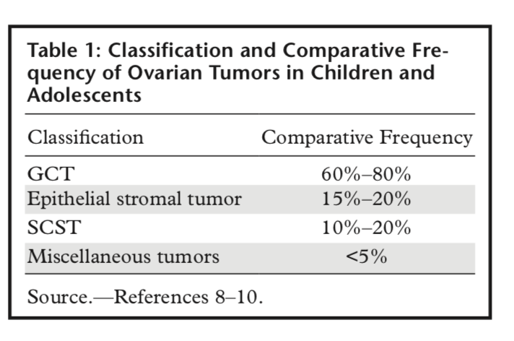
Ovarian tumors
Text
Ovarian tumors that occur in childhood and adolescence encompass a variety of benign and malignant tumors, including germ cell tumors (GCTs), surface epithelial stromal tumors, sex cord–stromal tumors (SCSTs), and miscellaneous tumors (ie, gonadoblastoma, malignant lymphoma and leukemia, small cell carcinoma, and soft-tissue tumors)
Ovarian teratomas are GCTs composed of mature or immature tissues derived from more than one of the three primitive embryonic layers (ectoderm, mesoderm, and endoderm).

Slide 9
Dysgerminoma
Text
Dysgerminoma originates from undifferentiated germ cells that are similar to primordial germ cells, and it is identical to testicular seminoma.
It is the most common malignant GCT in childhood and adolescence
Dysgerminoma is associated with gonadal dysgenesis or abnormal gonads that contain gonadoblastoma.
An association with chromosomal abnormalities (eg,Turner syndrome) has also been reported .
LDH is a useful tumor marker for diagnosis and postoperative follow-up. Rarely, serum β-hCG levels are elevated in some tumors (5%of cases)

Slide 10
Pearls to remember
Text
In contrast to other malignant GCTs, dysgerminoma is highly radiosensitive.
Most patients with dysgerminoma (75%) are diagnosed with early-stage disease, and thus surgery alone is curative \The prognosis is usually excellent.
Yolk sac tumor, also known as endodermal sinus tumor, is a rare malignant GCT.
Yolk sac tumor is usually aggressive, characterized by rapid growth and extensive spread to the abdomino pelvic cavity. Both hematogenous and peritoneal metastases are common, and lymphatic spread is not uncommon

Slide 11
Pearls to remember
Text
Ovarian SCSTs are derived from the coelomic epithelium (sex cords) and ovarian stroma or mesenchyma of the embryonic gonads.
Ovarian SCSTs are composed of various combinations of granulosa cells, theca cells, Leydig cells, Sertoli cells, and fibroblasts of stromal origin .cell tumors, Sertoli-stromal cell tumors, SCSTs of mixed or unclassified cell types, and steroid cell tumors
In children and adolescents, granulosa cell tumor and Sertoli-Leydig cell tumor commonly occur, and thecoma-fibromas are rare.

Slide 12
Text
Abdominal pain is the most common presenting symptom of ovarian tumors (57%), followed by a palpable abdominal or pelvic mass.
Patients may also present with nausea, vomiting, poor appetite, weight loss, constipation, and urinary frequency, or they may be asymptomatic, with the tumor being detected incidentally
Tenderness may be a symptom of torsion, hemorrhage, or rupture of ovarian tumors, especially GCTs and SCSTs

Slide 13
Endocrine abnormalities can be the initial manifestation of hormone- producing ovarian tumors, depending on the patient’s age
Premenarcheal girls may present with symptoms of isosexual precocious puberty, including breast enlargement, abnormal vaginal bleeding, and development of pubic and axillary hair. Menstrual irregularity demonstrated by hy- permenorrhea or amenorrhea may occur in ado- lescent girls. Signs of virilization or masculiniza- tion (eg, acne, deepening of the voice, hirsutism, and clitoral enlargement) may be seen in both prepubertal girls and female adolescents.

Slide 14
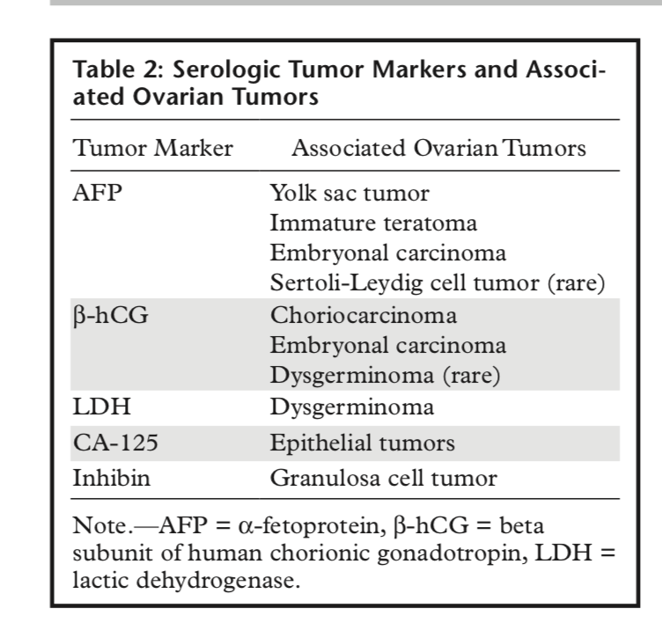
GCT
Text
GCTs are the most common type of ovarian neoplasm, and one-third of ovarian GCTs are malignant in children and adolescents
As defined by the World Health Organization, the histologic subtypes of ovarian GCTs include teratoma (mature, immature, or monodermal), dysgerminoma, yolk sac tumor, embryonal carcinoma, polyembryoma, nongestational choriocarcinoma, and mixed GCT

Slide 15
Text
The diagnosis of steroid cell tumors, NOS, should be made on the basis of the clinical virilizing syndromes, the microscopic pictures, as well as immune reactivity to some immunohistochemical markers.
Inhibin and calretinin were thought to be sensitive and robust markers in differentiating sex cord-stromal from non-sex cord- stromal tumors [.

Slide 16
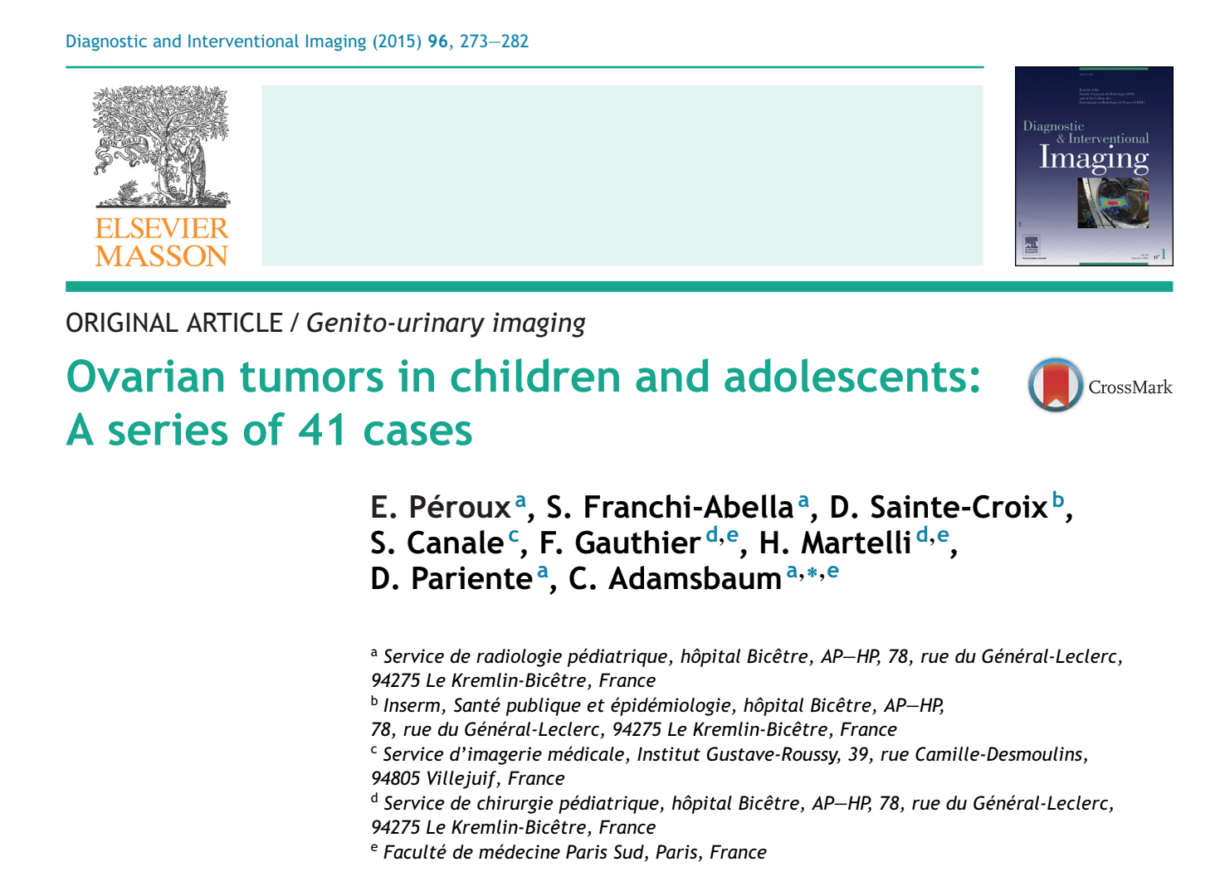
Ovarian tumors imaging
Text
Ovarian tumors in girls and adolescents represent a very heterogenous group of histopathological entities.
Germ cell tumors represent more than 80% of ovarian tumors (77.5% in this series). Mature teratomas, or dermoid cysts, are the most frequent tumors and the onlybenign germ cell tumor.

Slide 17
Ovarian tumors
Text
In pediatrics most ovarian masses are detected withultrasound, which is the first-line test in these cases.
Once an organic disease has been identified, MRI, which hasno radiation, provides good tissue enhancement and the best evaluation of tumor vascularization.

Slide 18
Concise of characteristics

Slide 19
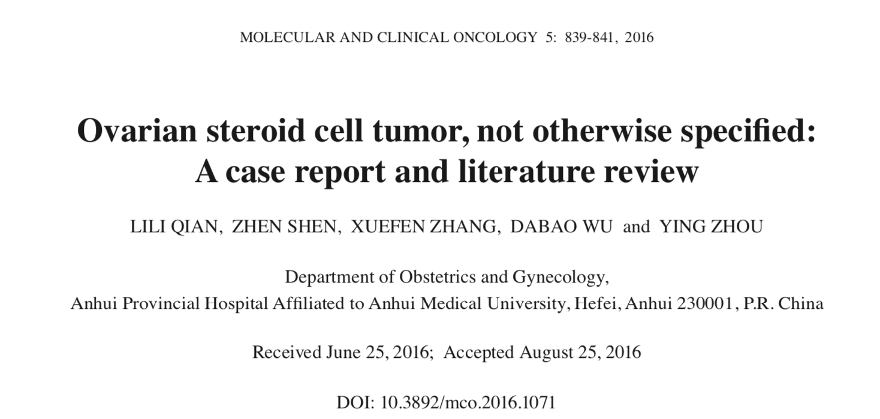
Steroid cell tumor
Text
Ovarian steroid cell tumors (SCT) are rare sex cord-stromaltumors of the ovary and comprise <0.1% of all ovariantumors .Based on the cell of origin, they may be divided intothree subtypes:
Leydig cell tumors arising from Leydig cells inthe hilum of the ovary,
stromal luteomas arising from ovarian stromal cells.
steroid cell tumors not otherwise specified(NOS).
Type to enter a caption.

Slide 20
SCT
Text
SCT-NOS are usually benign; however, clinically malignant behavior, suchas peritoneal metastases, occurs in 25-40% of the cases.
The term ‘steroid cell tumors not otherwise specified’ was firstused by Scully and signifies that the cell lineage is not defined;thus, they cannot be categorized as either stromal luteomasor Leydig cell tumors .
Approximately 56-77% of the cases are clinically associated with androgenic changes, such as hirsutism and virilization; 6-7% of the cases are clinically associated with Cushing's syndrome; and 25% of SCT-NOS are non-functional. Ovarian SCT-NOS may occur at any age
(mean age, 43 years) and, occasionally, before puberty

Slide 21
SCD
According to the study of Hayes and Scully, the following pathological characteristics may indicate malignancy:
≥2 mitotic figures per 10 high‐power fields is associated witha 92% risk of malignancy
necrosis with an 86% risk of malignancy
A diameter of >7 cm with a 78% risk of malignancy;
hemorrhage with a 77% risk of malignancy;
and grade 2 or3 nuclear atypia with a 64% risk of malignancy

Slide 22
Text
To date, very few reports have investigated the efficacy of radiation or chemotherapy for SCTs.
However, malignant SCT-NOS should be managed with total abdominal hyster- ectomy, bilateral salpingo-oophorectomy and sampling of pelvic and mesenteric lymph nodes and omentum followed by combination chemotherapy.

Slide 23
Chemotherapy
Text
Bleomycin, Etoposide and Cisplatin(BEP) is favored and often used. Chemotherapy maybe applied
Using the BEP regimen bleomycin (20 U/m2 ), etoposide (75 mg/m2)on days 1-5,cisplatin (20 mg/m2 )on days 1-5, everyevery 3 weeks

Slide 24
Text
Don’t grieve. Anything you lose comes round in another form
RUMI Iranian Poet

