Slide 1
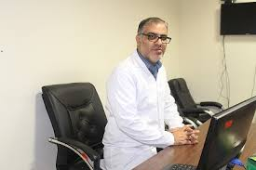
Stroke in isolated mlecular relapse in acute promyelocytic leukemia(APL) webinar
دکتربابک عبدالکریمی
هماتولوژیست آنکولوژیست کودکان
99/11/2

Slide 2
CASE presentation (1)
a 7-year-old boy with APL was periodically evaluated for BMA/B during maintenance therapy witht t)15,17)/PML-RARA transcript.
BMA:no abnormal morphologic changes ,
PML-RARA transcript was positive in BM.
BMA was repeated 2 weeks later t (15,17) again was positive without any evidence of morphological recurrence in the BM.
FLT3-ITD :neg
After 3 weeks of delay in admission (due to clincal symptoms of COVID-19) he was hospitalized for right hemiparesis and speech disorder.

Slide 3
Ph/E:
LOC(-) , slurrede speech (+)
Neurologic exam :right hand paresia with 1/5 & right leg with 3/5 motor power
Sensory loss(-)
DTR:
right bicepes:dec
knee:dec
Plantar:downward
After initiation of DEXA & Enoxa speech & paraparesia corrected after 3 days.

Slide 4
Laboratory TESTS:
WBC =2700 (N = 48, L = 52), Hb =12.2 platelet = 273000.
PT and PT / INR were normal
D-Dimer =4732 micrograms per liter.
Fibrinogen: Normal
LDH: Normal
Other biochemical tests were normal.

Slide 5
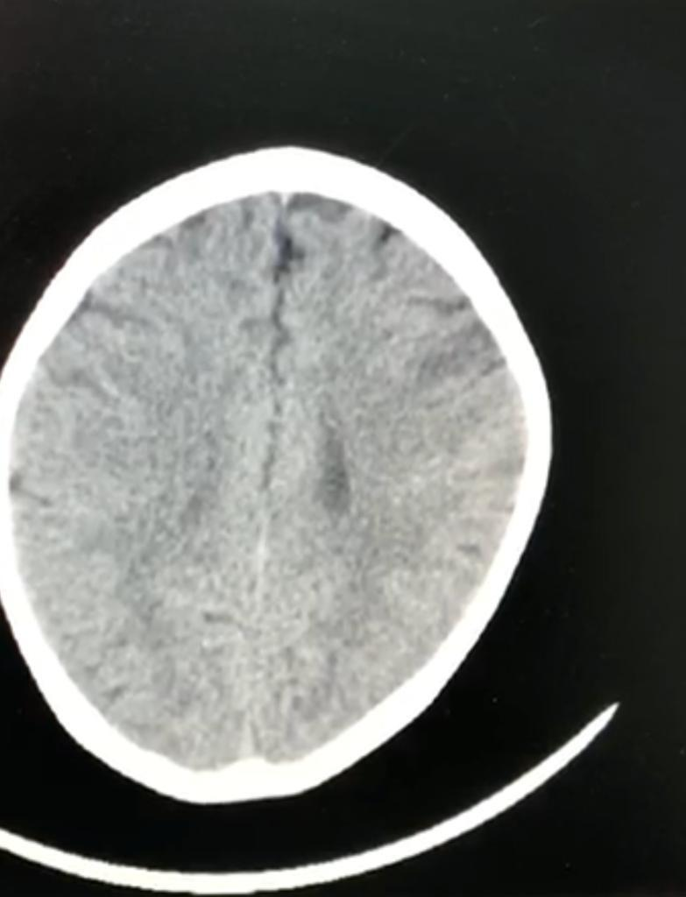
Brain imaging:
Brain CT : a new ill-defined hypodencity in the left region of the middle cerebral artery(MCA )as a stroke like area.
Brain MRI and MR angiography (MRA) and DWI:
Hypoperfusion in left hemisphere, asymmetric venous bulge insensitive weight imaging, and pruning of the left hemisphere peripheral arteries on MR angiography.

Slide 7
Patient management:
1.Dexamethasone 2 mg tds daily until slurred speech and hand paresia resolved then 2 days in week.(diffrentiation syndrome prophylaxis)
2.LMWH subcutaneous (Enoxaparin 2.000 IU. q12h)
3.ATO(0.15 mg/kg/d IV for 35 days)
4.ATRA 20 mg / m2/d(ECHO/ daily QTc +ca,p,mg,Na,k/Inderal )
5.Idarubicin 12 mg/m2 on day 1,3,5
6.ASA:after discharge and enoxa discontinuation (between 2 ATO courses)

Slide 8
Patient novelty:
1.Isolated molecular relapse with non-hematologic clinical presentation
2.rare prevalence
3.Clinical thrombosis+subclinical fibrinolysis

Slide 9
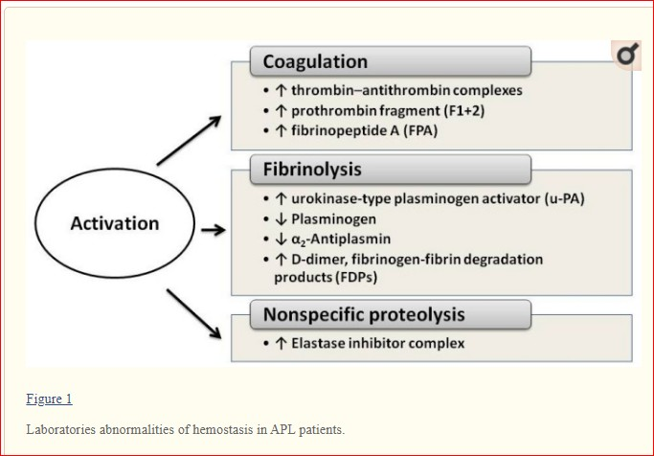
Thrombosis & hemorrhage in APL

Slide 11
Critical points:
1.D-dimer:H,fibrinogen:L-→co-activation of thrombosis & fibrinolysis→DIC/hemorrhagia
2.D-dimer:H,fibrinogen:N-→fixed thrombosis/ischemia & then fibrinolysis
3.MRD monitoring in BM/PB is considered BY t(15,17) or PML-RARA transcript in APL every 3 months for 3 years.
(Although peripheral blood (PB) PCR has good concordance with BM PCR at early stages of therapy, have shown an advantage for BM PCR after consolidation, with 1-5 log greater sensitivity than PB.)

Slide 12
3) Chemotherapy in isolated molecular relapse without any evidence of hematologic relapse is necessary, because isolated molecular relapse in APL is equal positive minimal residual disease(MRD) and need treatment intensification include reinduction with differentiating agents + chemotherapy & consolidation with differentiating agents +_allogenic stem cell transplant( SCT).

Slide 13
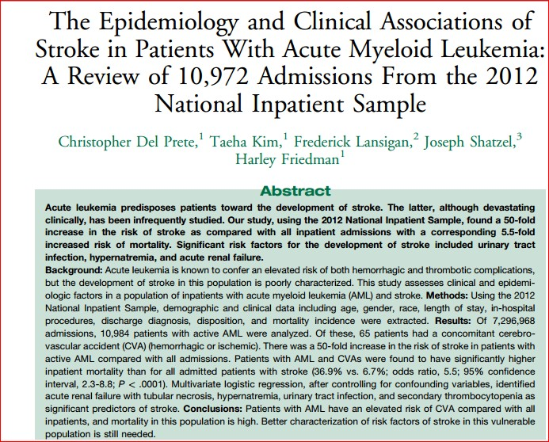
Stroke in AML-2017

Slide 14
Prevalence 6%

Slide 15
Similar case :

Slide 16
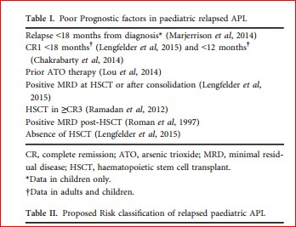

Slide 17
ATO experience in children APL
ATO, +_ATRA, with relapsed APL (Ebinger et al, 2011; Au et al, 2012; Rock et al, 2014).
Au et al (2012) oral ATO/ATRA+ cytarabine/idarubicin+ Maintenance therapy included oral ATO/ATRA for 2 years ATO + ATRA in front-line therapy (Mathews et al, 2010; Zhou et al, 2010 /Zhang et al, 2008). relapsed/refractory APL ATO+HSCT (Fox et al, 2008).
relapsed paediatric APL ATO/ATRA + Chemotherapy / HSCT (Zhang et al, 2008/Bally et al, 2012).
Antracyclin/Ara-C+ATO+HSCT; alive at 14–96 years from relapse (Creutzig et al, 2010).

Slide 18
Treatment algorithm for relapsed pediatric APL that occurs 18–36 months from initial diagnosis in hematologic relapse.

Slide 19
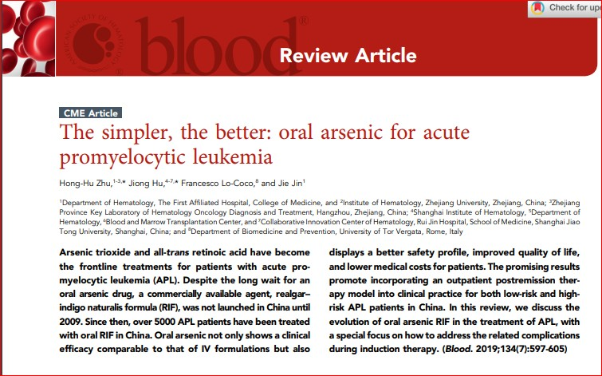

Slide 20
Our treatment plan:
RISK:standard risk with 1 poor prognostic factor
strategy:1:
1.reinduction by ATO+ATRA+Ida+Ara-C
(PML-RARA transcript check)
2.consolidation 1-→3courses oral/IV ATO+ATRA(25+12)
3.consolidation 1-→4courses oral/IV ATO+ATRA(25+12)
(28+3x 36+4x57days=388-400 d)
strategy:2(traditional):
1.reinduction by ATO+ATRA+Ida+Ara-C
(PML-RARA transcript check)
2.consolidation 1-→1courses IV ATO+ATRA(25+12)+BMT

Slide 21
Take home message
We recommend periodic D-dimer,CBC diff,PT,PTT & PML-RARA transcript every 3 months ( detect hematologic/molecular recurrence).
LMWH+_Cryo/plt base on thrombotic or fibrinolysis trend
Antiplatlet agent /thrombolytic therapy are not recommended in APL

Slide 23
Refrence:

