Slide 1
In the name of God

Slide 2
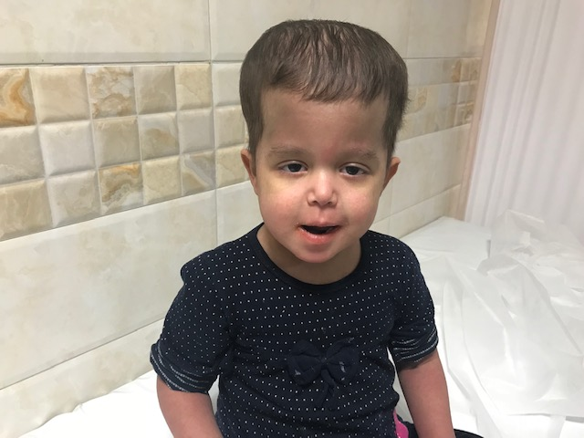
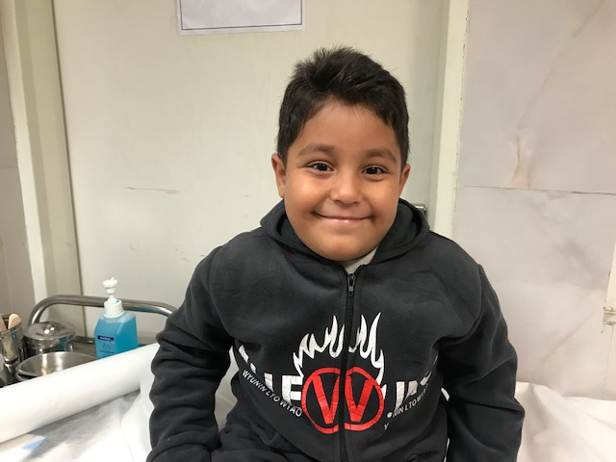
Allogenic HSCT in Congenital Sideroblastic Anemia
BIBI SHAHIN SHAMSIAN. MD

Slide 3
Etiology : Production , Destruction , Blood Loss

Slide 4
SIZE in CLASSIFICATION OF ANEMA

Slide 5
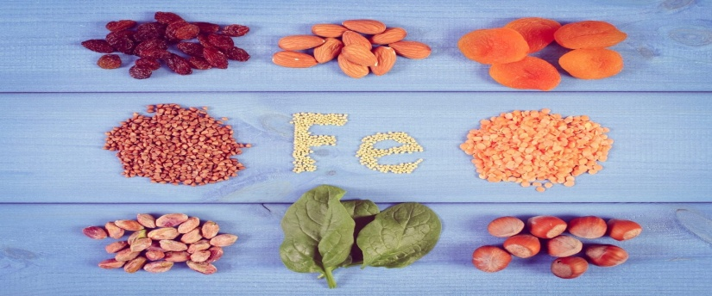
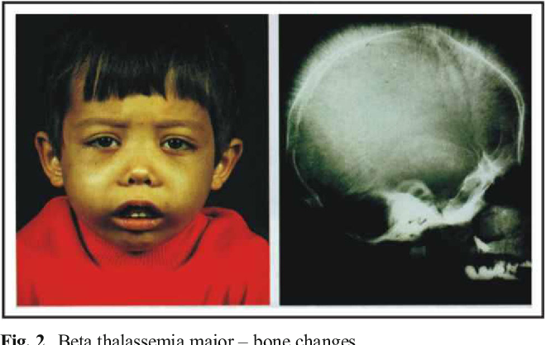
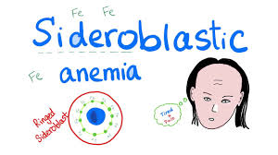
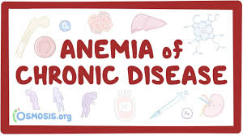
Classification of MICROCYTIC ANEMIA

Slide 6
Sideroblastic Anemias
Heterogeneous group
Inherited (X linked , AR, Syndromic or non Syn)
Acquired :(INH , Chloramphenicol, Penicillamine , Lead,
Copper deficiency, Ethanol
MDS
Anemia of varying severity

Slide 7
Presentation / CSA
Presentation :
Hypochromic –Microcytic anemia
Ineffective Erythropoiesis
Increased total body iron
Presence of large numbers of `Ringed' sideroblasts in the BM
Except : Some rare Syndromes - Macrocytic :
Pearson's syndrome
(DIDMOAD) syndrome; Diabetes Insipidus, Diabetes Mellitus, Optic Atrophy and Deafness
Ragers Syndrome Megaloblastic anemia, progressive sensorineural hearing loss, Diabetes mellitus

Slide 8
CONGENITAL SIDEROBLASTIC ANEMIA
BMA :RING SIDERO+BLST

Slide 9
Diagnosis: Congenital Siderobalstic Anemia
Accumulation of iron-containing granules in normoblasts
RING SIDERO + BLAST
Iron-laden mitochondria form a ring around the nucleus.
RS: Bone Marrow
Ring must encircle a third(1/3) or more of the nucleus & contain 5 or more iron granules

Slide 10
WHO International Working Group on Morphology of MDS (IWGM-MDS)
3 types of sideroblasts:
Type 1 sideroblasts: fewer than 5 siderotic granules in the cytoplasm
Type 2 sideroblasts: 5 or more siderotic granules, but not in a perinuclear distribution
Type 3 or ring sideroblasts: 5 or more granules in a perinuclear position, surrounding the nucleus or encompassing at least one third of the nuclear circumference.
Type 1 and type 2 are found in non-sideroblastic anemias.
Type 3 is found only in sideroblastic anemia.

Slide 11
Congenital Siderobalstic Anemia Perls Prussian blue stain

Slide 12
PLAN –SA ????
Treatment???
XLSA- ALAS2: Piridoxin (B6)
XLSA & Ataxia- ABCB7 : refractory to pyridoxin
Rogers Syndrome (AR) SLC19A2 : Tiamin - (B1)
Blood Transfusion & Iron Chelator Therapy
Allogenic HSCT ???

Slide 13
Hematopoietic stem cell transplantation (HSCT)
HSCT : an intention-to-cure treatment strategy in several:
Heriditary :
Hematologic disorders

Slide 14
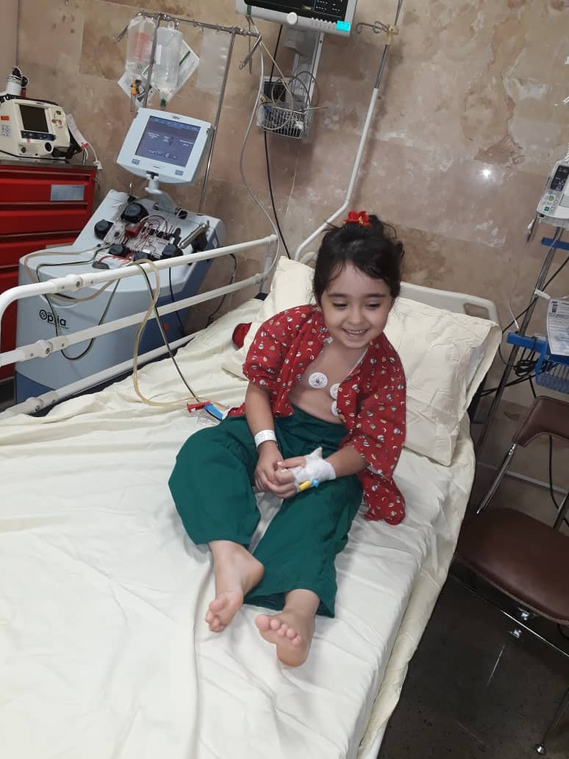
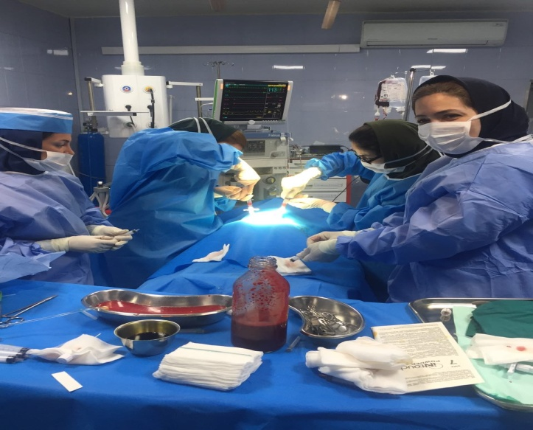
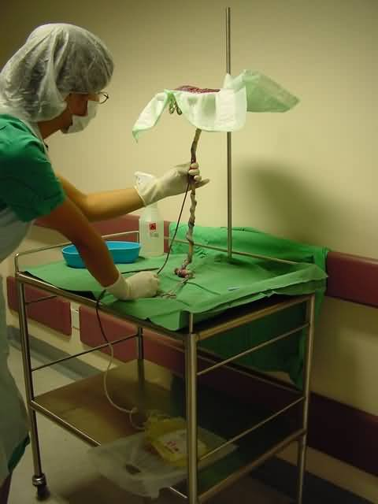
Type & sources of HSCT: Allogenic, BM, PB , CB

Slide 15
3
Case presentation
Congenital
Sideroblastic
Anemia
&
HSCT

Slide 16
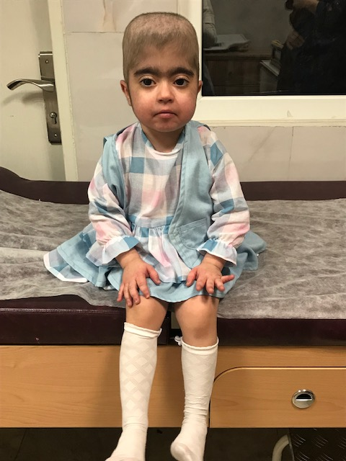
ALLOGEIC HSCT in Congenital Sideroblastic Anemia
P1: Male 4 years . MSD : Sister . 9y Bone Marrow(BM)
P2: Female 3 y. MSD -Sister , 12 years old. Bone Marrow (BM)
P3 : Female 2 Y . MRD. Mother . Peripheral blood (PB)

Slide 17
1 CASE
A3 –y old girl, second child parents : First Cousin
presentation 2 mo old age, pallor(Hb 3 )- severe Hypochrom Microcytic ,no organomegaly
Follow up: Splenomegaly, large head & Frontal bossing
Treatment : Blood Transfusion & Iron Chelator -Osveral
Age 3 mo: WBC :11.400 Hb: 6.4 MCV: 74 MCH: 25 Plate : Nl Diff: NL
NO NRBC/ in PBS Retic : 0.1%
HbA:%92 HbF: 5.6 % HB A2: %2.4
CBC & Hb E parents : Nl
LDH=338 Coombs: Neg ADA; Nl
SGOT 41 /SGPT 39 BILT/D : Nl
Feritin : 923

Slide 18
1 CASE
Mofid hospital :
BMA: Nl Cellularity , Erythroied series increase + Mild Dys erythropoiesis
BMA: (20-25 % cells pos for Ring Sidero blast type 3 Slightly increase Iron stores
Diagnosis : Congenital Sideroblastic Anemia
Start treatment : Pyridoxin - B6 Po, IM ( 100-200mg) ,No response
Plan HSCT , duo to no response to B6 , also Blood Transfusion dependency
Refer to HSCT Clinic

Slide 19
Hematologist Report

Slide 20
1 CASE
Large Head ( Frontal Bossing)
Skull X ray & Brain CT: widening BM and bones Widening diploic space of Skull.
Ca= 8.5 p= 5 ALK: 1138 Vit D = 36 PTH : Nl
Hypo calcemia + Rickets : Treatment
Mental : nL
ECHO - EF : 70%
Ferritin :1153
LDH : 740
Coombs : Neg AB Screening :Neg
KT & LFT : Nl GFR : 91

Slide 21
1 CASE
Plan ; Allo HSCT at age 3 Y
Admission , in HSCT ward
Chemo Condition : Myeloablative(MA)
Condioning: BU + CPM +Low dose ATG ( 1.25 /kg x 2 days)
GVHD Prophylaxia : MTX + Cyclospurine
Donor : MSD, Sister 12 Y, Full match ,BG O+ , CMV IgG Pos Reciep : B + plasma depletion 2 20ml
TNC/kg:4x108 /kg CD34/kg:3x106/kg CD3/kg:260x106/kg
Day 0: Stem Cell infusion( BM) & GCSF : Day +10
Day +2 1: Engrafted
Chimerism : 95%

Slide 22
1 CASE
Complications :
GI GVHD : Severe -Diarrhea Stage 4
Acute – Stage 4 & Chronic Skin GVHD
CMV Reactivation: 22000/ plasma
PRES ( seizure): Posterior Revesible Encephalopathy Syndrome ( hyper tension + seizure, duo to Cyclospurine + prednison)

Slide 23
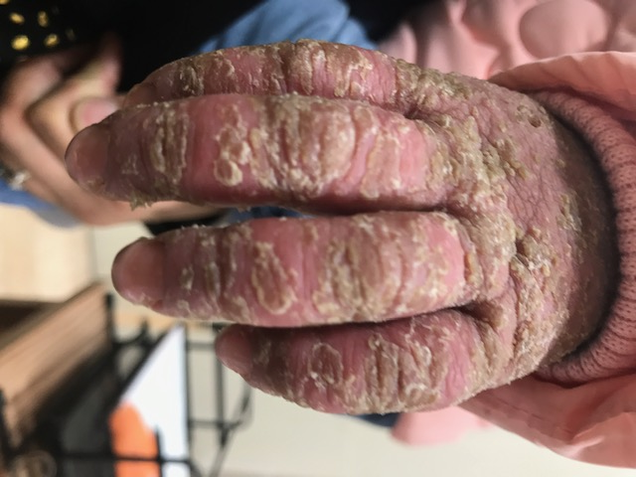
Case1 - ACUTE SKIN GVHD

Slide 24
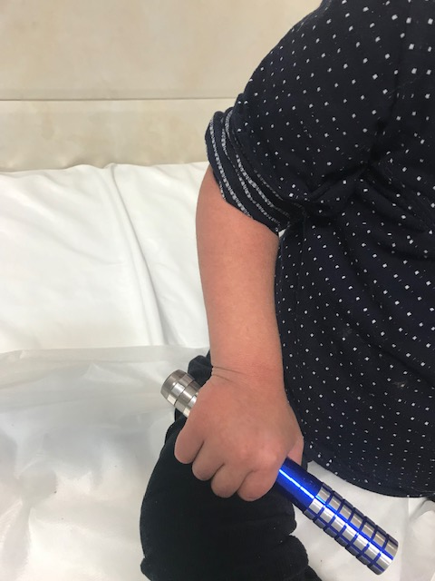
After treatment of Skin GVHD Follow UP: > 3 years : CBC : Nl . Off drugs Chimerism:>95% Neurosurgery consult ( For cosmetic) : No indication

Slide 25
CASE 2
A 2 Y Girl Paretnts : first cousin
1.5 mo :pallor, (Hb: 4) & blood transfusion / Bahrami hospital
Evaluation : Thalassemia even Gene analysis :Neg
Regular BT & Iron chelator ( Exjade)
WBC : 2300 HB: 7 MCV:63 MCH : 19 Plate ; Nl
Retic : o.5% Hb E: NL
SGOT/SGPT :191/105 BIL: Nl Ferritin : 1560
ADA: Nl (13)
PE: No Organomegaly + Large head & mild head deformoity
Skull X Ray & CT Brain :Thick Diploic space of frontal bone is noted , duo to hematopoiesis

Slide 26
CASE 2
BMA : E hyperplasia ,Dyserythropoiesis
BMA; pos for Ring sideroblast , no good for iron storage(dilute BM)
BMB : Shift to the left of Erythroids
No response to B6, pyridoxin
Gene analysis, NGS SLC25A38 Hemozygote variant in favour of Sideroblastic anemia .
Diagnosis : Congenital Sideroblastic anemia

Slide 27
Pathologist Report

Slide 28
Genetic Lab Report

Slide 29
Sideroblastic anaemias : Heterogeneous group of disorders
SLC25A38 (Ch; 3p22.1),AR
SLC25A38 encodes the Erythroid specific mitochondrial Carrier protein, in Biosynthesis of Heme
Pyridoxine-Refractory
Clinical Course ;Very similar of Thalassemia Major
Treatment :Regular Blood transfusion & Iron chelation.
ALLOHSCT : only curative therapy at present
HSCT should be considered for young patients with this congenital sideroblastic anemia

Slide 30
SLC25A38 CSA
Heriditary -Nonsyndromic types of CSA
About 15% of Mutations in the gene encoding the Erythroid specific mitochondrial inner membrane phosphate carrier protein
Most common :after X‐linked sideroblastic anemia( ALAS2)
Most mutations are severe or complete loss‐of‐function mutations.
Severe anemia :at birth or in early childhood & requires lifelong transfusions

Slide 31
CASE 2
Diagnosis : BT + Iron chelation therapy CSA
SLC25A38 CSA
WBC: 7400 HB: 8.4 plate:642000 Retic : 1%
Coombs: neg AB screening :Neg
LDH 440 BILT/D: Nl
Ferritin: 1090
Ca: 10 P:5 ALK: 738 VIT D3: 31
ALT/AST: 46/6 BILT/D: Nl
EF: Nl GFR:102 HBSAB; 238 CMVIgG:Pos

Slide 32
Case 2
Admission : 1/98
Protocol: BU, CY +Low dose ATG x2 days
GVHD Prophylaxia: Cyclospurine + MMF GCSF: Day+10
DONOR: Mother , MRD ,Full match, PB
BG: A neg Reciep: O+ D&R CMVIgG: pos
TNC/kg: 51x108/kg D34/kg:30x106/kg CD3/kg:1188x106/kg Half cells was infused
Day 0 SC infusion Engrafted : Day+18

Slide 33
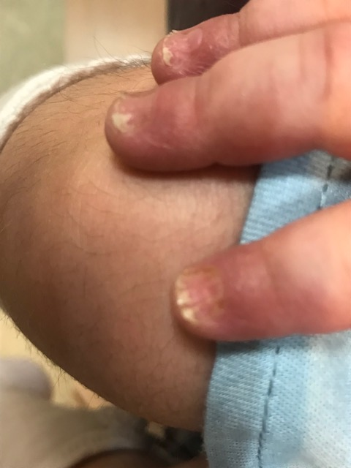
Complication :Skin GVHD , Stage 3 Follow UP :On Cyclospurine , NO GVHD , Chimerism > 95%, ,

Slide 34
CASE 3

Slide 35
CASE 3
A 4 y old boy parents : First cousin , Presentation - severe pallor , 2 mo old age
Blood transfusion & Iron chelator ( Ferritin >2000) in Children Medical Center & Shiraz
Hb Elec Hb A :97.6 HBA2: 2.4 at 2 months old,
BMA 2 Times: 7 month ,Moderate Erythroied Hyper plasia , suggestive sideroblastic anemia
WBC: 11000 Hb:8 PLT:347000 MCV: 78 MCH: 27
Retic : 0.1% LDH: 424 Ferritin : 1685 Coombs: Neg
Bil:0.6/0.2 SGOT/SGPT:155/160
Sono : Splenomegaly
No response to B6

Slide 36
CASE 3
Complication Blood transfusion
Ab screening test (IDC) K and E Positicve .
Anti IgG C3d: pos Anti IgG
N eg K neg E neg Blood transfusion .
He recieved IVIG , Corticosteroieds, 4 course of Rituximab

Slide 37
Resolution of alloimmunization and refractory autoimmune hemolytic anemia in a multi-transfused beta-thalassemia major patient Joseph Philip & Neelesh Jain. 2014
Complicated cases of thalassemia: Alloimmunization along with refractory autoimmunization leading to AIHA, are very difficult to treat.
Corticosteroid drug therapy followed by IVIg and rituximab with the regular transfusion of extended red cell phenotype-matched blood is a very effective regimen for such patients.
This combined approach could be a good regimen for other complicated cases of Auto and/or Alloimmunization also, who require regular periodic blood transfusions.

Slide 38
CASE 3
17/12/98 BMA; All Hemto cells are present with evidence of maturation , E: 25%, BMA , Staining for Sideroblast positive
Plan : HSCT, Age of HSCT :3 . 9Y
ECHO :60% GFR:104
Ferritin : 3400 - 4500 LFT :High
Evaluation for Iron over load : Liver Biopsy ; Heptic Hemosiderosis ( iron storage grade4+ ). no nodule formation ( Dr Nilipour)12/3/95

Slide 39
CASE 3
Admission In HSCT ward .
Chemo Condition: BU ,CY + low dose ATG x 2 days
GVHD -P: Cyclos + MTX + Methyl
Day 0: Stem cell infusion Day +14 GCSF
DONOR: MSD , BM,Sister Full match ,9 years old D&R CMV ;pos BG:AB pos HBsAB: 84 reciep: BG A+
TNC/kg:3x108 /kg CD34/KG: 2x106/kg
Day + 16 Engarftment
Chimerisnm: 90%

Slide 40
CASE 3
Complication :
CMV positive (Day +26)
PRES
High Ferritin level : Desferal
Now> 3 years
Chimerism: 70%
Ferritin : 9/ 98 : 310

Slide 41
Iron Toxicity and Hemopoietic Cell Transplantation: Time to Change the Paradigm. Mediterr J Hematol Infect Dis. 2019; 11(1). Italy
Iron over load :Reactive oxygen species (ROS)
Impair the stem cells clonality capacity, proliferation and maturation & Microenvironment
Important issue: Engraftment
Phlebotomy:Start once Engraftment is sustained & preferably after immunosuppressive therapy ending
Deferasirox : 6 months post-transplanted :Deferasirox at a starting dose of 10 mg/kg/day for 52 weeks or until serum ferritin < than 400 ng/mL on 2 consecutive occasions
Both; same effect in trials ???

Slide 42
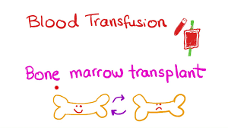
Reduced-toxicity ALLO-HSCT in CSA. Min Hee Kim.
Nonsyndromic types CSA:
4 years old girl , severe anemia , 2 mo , Transfusion dependence, ALLO HSCT
Novel molecular defect in mitochondrial transporter SLC25A38
, Modified reduced-intensity conditioning regimen:BU, FLU, Alemtuzumab (GVHD)
prophylaxis :MTX + Tacrolimus
Iron Overload: Serial phlebotomy at 1 year post-transplant
Healthy 5 years post transplant.
Clin Case Rep. 2018;6:1841–1844..2018.USA
Biol Blood Marrow Transplant 22 (2016)

Slide 43
Congenital sideroblastic anaemia successfully treated using ALLO hSCT .Mouhab Ayas
3 children with CSA
All: Hepatosplenomegaly
No response to trial of high dose pyridoxine
Blood transfusion dependent
Serum ferritin levels prior to SCT ; 856, 209 and 2047 mg/l
No liver biopsies were done
Ages at SCT , MSD , BM at 1, 2 and 8 years.
Conditioning : CPM +Bu +(ATG)
GVHD : Cyclosporin A & MTX
Engrafted, alive & transfusion independent
British Journal of Haematology, 2001, 113, 938±939
British Journal of Haematology, 2001, 113, 938±939

Slide 44
HSCT in Congenital Siderobalstic Anemia
Mutations in genes involved in heme biosynthesis
Among , 6 patients - CSA of undefined cause who were treated with HSCT,
5 received MA conditioning with Bu-Cy +/− (ATG)
1 patient, with comorbidities ; conditioning : FLU low‐dose TBI , & ATG.
Despite full engraftment, he succumbed to GVHD and prior iron overload on day +190.
Biol Blood Marrow Transplant 22 (2016)

Slide 45
Nonmyeloablative allogeneic HSCT for congenital sideroblastic anemia. .2003. USA. BC Medeiros.
Non Myeloablative Allogeneic HSCT : 22 years old
Allo-grafting
Complete donor chimerism was observed day +131.
Early after transplant, transfusion independent
iron chelation: phlebotomy
On day +190: Death

Slide 46
Free Radical Biology and Medicine 133 (2019) 179–185 Pathophysiology-HSCT
Gene Mutations , 3 Subtypes
Heme biosynthesis
Iron–sulfur (Fe–S) cluster Biosynthesis
Mitochondrial protein synthesis

Slide 47
T. Fujiwara, H. Harigae Free Radical Biology and Medicine 133 (2019) 179–185 Heme Biosynthetic pathway in Erythroid Cells

Slide 48
Classification / Sideroblastic Anemias.
Hereditary Syndromic conditions:
X-linked CSA & Spino cerebellar Ataxia (ABCB7)
Myopathy, Lactic acidosis & Sideroblastic anemia ( MLASA1-PUS1, MLASA2-YARS2)
Ragers synrome :Thiamine (B1) –responsive Megaloblastic Anemia,Germline mutations / SLC19A2
Pearson marrow-pancreas syndrome( Mitochondrial DNA deletion)
Acquired Sideroblastic Anemias:
Drug-(Isoniazide ,…………. Ethanol)
MDS : RARS, RARS-T

Slide 49
Congenital Sideroblastic Anemia
ALAS2 XR (δ-amino levulinic acid synthase 37%)
LC25A38-AR 15%
SLC19A2 AR
Other : PUS1, ABCB7 , GLRX5
Gene Analysis :%40 of cases of CSA remains unexplained
Next-generation sequencing technology
&
Gentic Consult

Slide 50
Ring sideroblasts and sideroblastic anemias Mario Cazzola
ALAS2 37%
XLSA : (Xp11.21) , Hemizygous males
Hypochromic Microcytic anemia
Germline mutations in the Eerythroid-specific ALA synthase gene (ALAS2)
Ineffective Erythropoiesis & secondary iron overload
Most patients with XLSA are responsive, to pyridoxine
Haematologica | 2011; 96(6)

Slide 51
Conclusion
Some patients
in group of CSA may be cured BY HSCT

Slide 52
THANK YOU

