Slide 1
PET/CT scan and Lymphoma
ABTIN DOROUDINIA MD
Assistant professor of nuclear medicine and molecular imaging
Masih Daneshvari hospital
Shahid Beheshti University of medical sciences
Tehran-Iran

Slide 2
Lymphoma

Slide 3
Hodgkin and Non-Hodgkin

Slide 4
Stage defines prognosis

Slide 5
Stage defines prognosis

Slide 6
Staging: What’s recommended?

Slide 7
Staging

Slide 8
Staging

Slide 9
Staging

Slide 10
NHL: Extra-nodal

Slide 11
Pulmonary involvement

Slide 12
Pulmonary involvement

Slide 13
Pulmonary involvement

Slide 14
Pleural and Pericardial effusion

Slide 15
PET

Slide 16
PET

Slide 17
PET

Slide 18
FDG-PET positive?

Slide 19
FDG-PET positive?

Slide 20
Staging

Slide 21
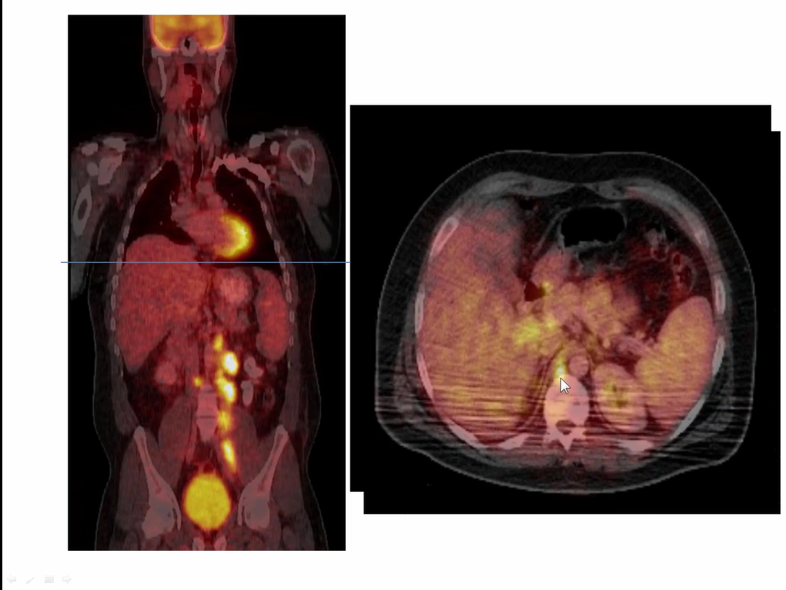

Slide 22
Bone marrow?

Slide 23
Therapy response: PET

Slide 24
Lugano Classification

Slide 25
Lugano Classification

Slide 26
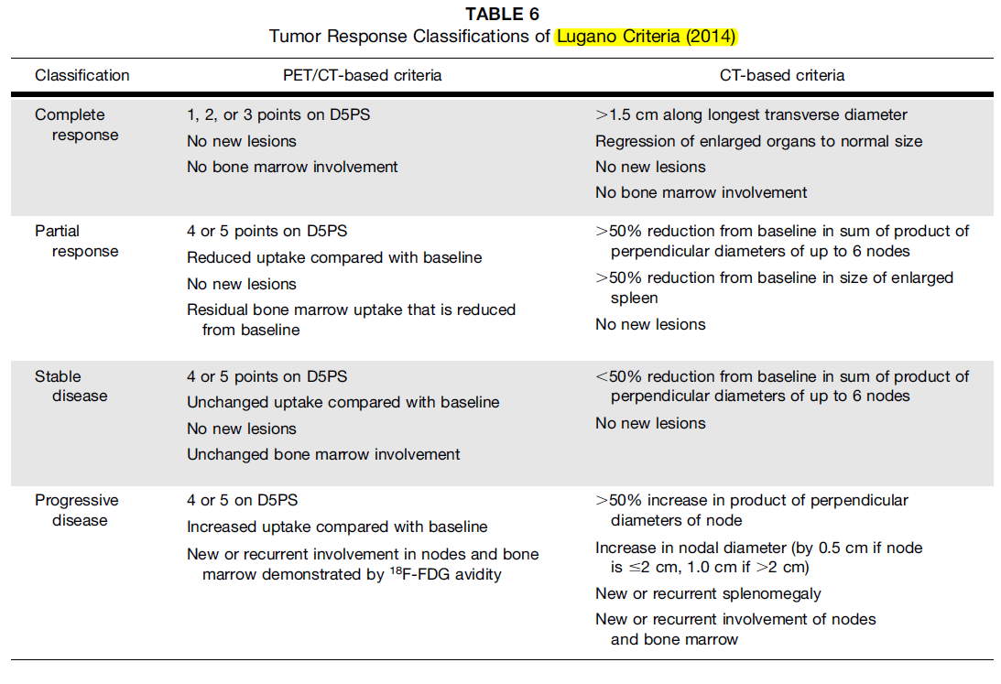

Slide 27
Lugano: Checkpoint inhibitors

Slide 28
Lyric

Slide 29
Lyric

Slide 30
Lyric

Slide 31
Lyric

Slide 32
How do you assess response?

Slide 33
How do you assess response?

Slide 34
When do you assess response?

Slide 35
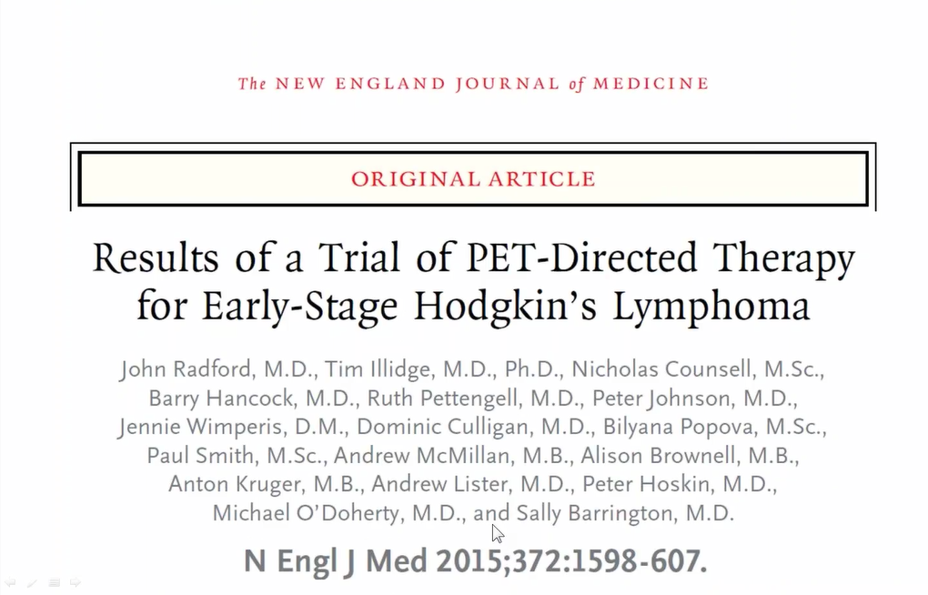
iPET: RAPID trial

Slide 37
When do you assess response?

Slide 38
G-CSF

Slide 39
G-CSF

Slide 40
Follow-up

Slide 44
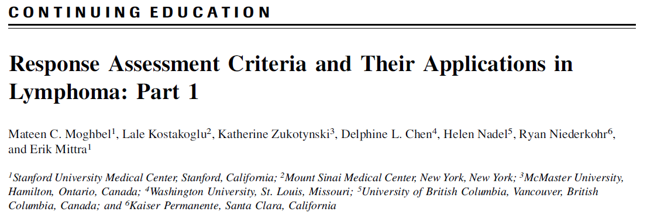
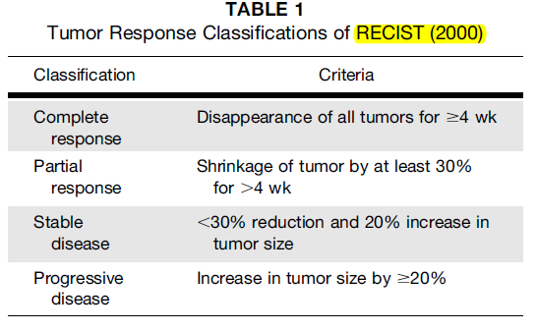

Slide 45
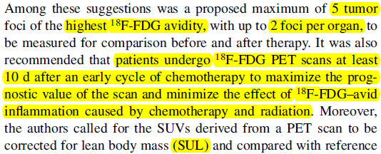
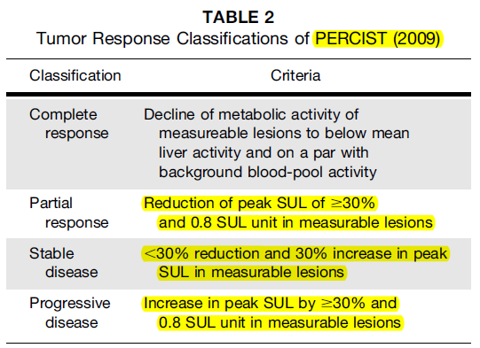

Slide 46
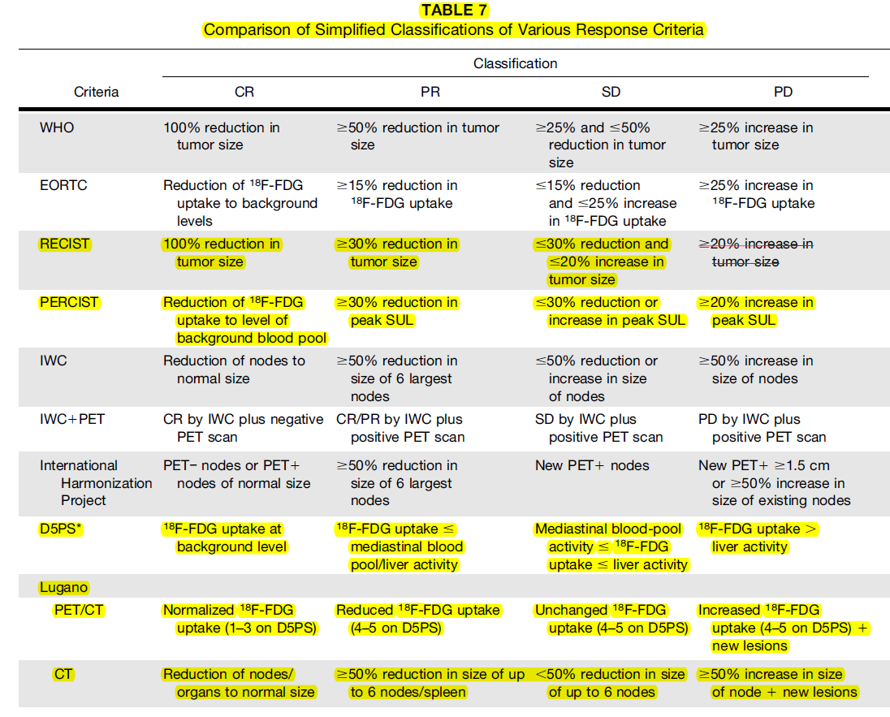

Slide 47
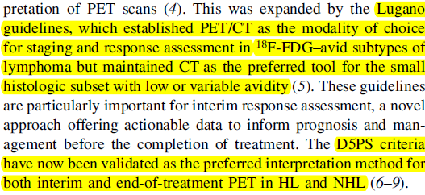

Slide 48
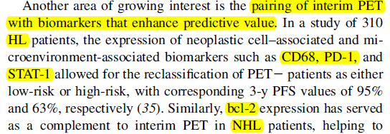
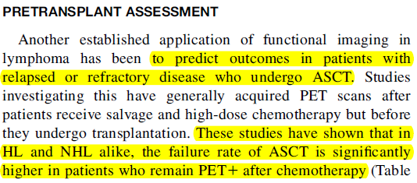

Slide 49
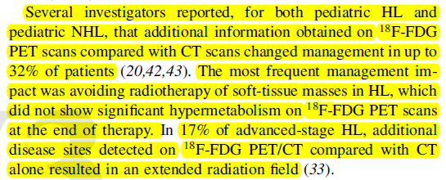

Slide 50
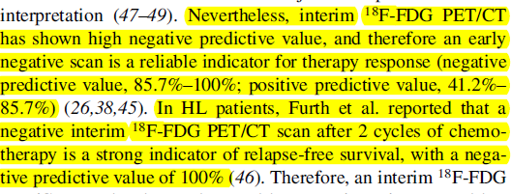

Slide 51
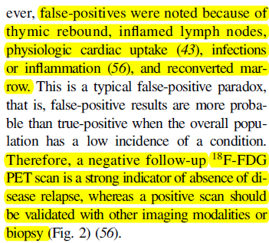
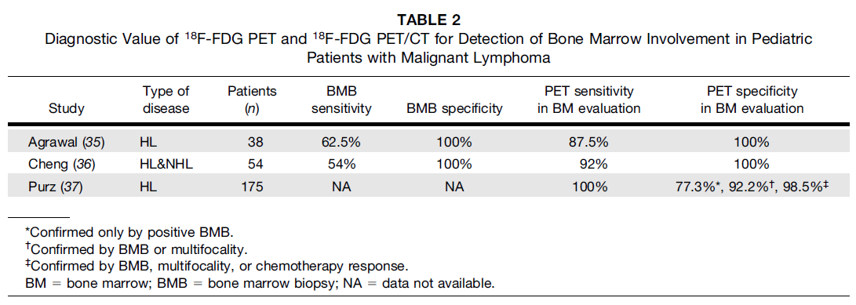

Slide 52
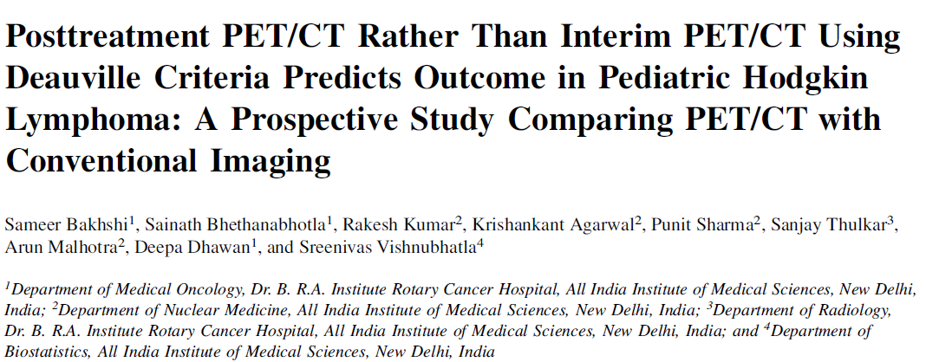

Slide 67
Take Home

