Slide 2
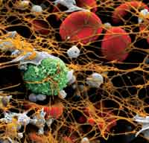
Dr.A.Eghbali
Pediatric Hematologist &oncologist
Arak University of Medical Sciences

Slide 3
NOACs
Novel Oral Anticoagulants
Non-vitamin K antagonist oral anticoagulants

Slide 5
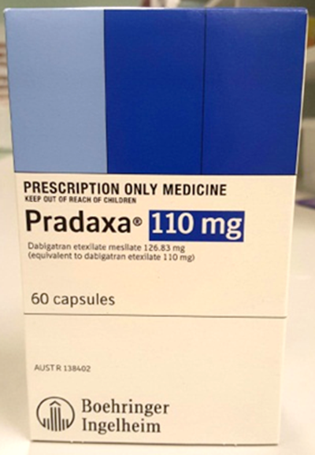
There are currently three NOACs registered ;
One direct thrombin inhibitor:
Dabigatran (Pradaxa®)
September 2016 Version 2
Notes:
Three NOACs are registered in Australia. They work on different parts of the clotting cascade.

Slide 6
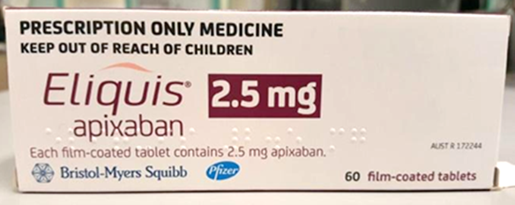
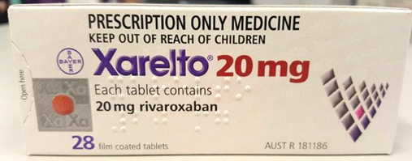
Two Factor Xa inhibitors:
Apixaban (Eliquis®)
Rivaroxaban (Xarelto®)
September 2016 Version 2

Slide 7
INTRODUCTION
Traditional anticoagulants in clinical use for the prevention or treatment of thromboembolic disease are heparin and its analogues and warfarin .
However, they have two major limitations:
1-a narrow therapeutic window of adequate anticoagulation without bleeding,
2- and a highly variable dose-response relation among individuals that requires monitoring by laboratory testing

Slide 8
INTRODUCTION
The variability of unfractionated heparin is due in part to differences in :
bioavailability of subcutaneous heparin and to competitive occupation of binding sites by plasma proteins ,by proteins secreted by platelets (platelet factor 4), and by endothelial cells .

Slide 9
INTRODUCTION
Furthermore, some of the heparin-binding proteins are acute phase reactants, the concentrations of which are increased in sick patients.

Slide 10
INTRODUCTION
Another limitation to heparin is a reduced ability to inactivate thrombin that is bound to fibrin and factor Xa that is bound to activated platelets within a thrombus .

Slide 11
INTRODUCTION
This may be due to the large size of the complex and to masking of the binding site(s) for heparin and AT on the thrombin molecule following the attachment of thrombin to fibrin or arterial wall matrix .
As a result, a thrombus may continue to grow during heparin therapy or clotting may be reactivated after heparin has been discontinued.

Slide 12
INTRODUCTION
These limitations have provided the impetus for the development of other antithrombotic agents .
The major examples of these newer anticoagulants are the factor Xa inhibitors and the direct thrombin inhibitors; some of these newer agents are orally active.
The direct thrombin inhibitors, in contrast to heparin , can inactivate fibrin-bound thrombin

Slide 13
OVERVIEW OF HEMOSTASIS
The three components of hemostasis
platelet activation,
clotting cascade,
fibrinolysis,
while often discussed separately, are closely related to each other in vivo.

Slide 14
OVERVIEW OF HEMOSTASIS
Thrombin as an anticoagulant target — Thrombin is the final enzyme of the clotting cascade, and therefore the target of most of the current clinical anticoagulants.

Slide 15
DIRECT THROMBIN INHIBITORS
Recombinant hirudin,
Argatroban ,
Bivalirudin
Dabigatran
Part of the rationale for the clinical use of these drugs is their ability to inactivate clot-bound thrombin, which is not a property of heparin

Slide 16
DIRECT THROMBIN INHIBITORS
Such clot-bound thrombin acts as an important thrombogenic stimulus, such as at a site of coronary thrombosis, particularly following clot disruption by thrombolytic agents.

Slide 17
DIRECT THROMBIN INHIBITORS
In comparison to heparin, the direct thrombin inhibitors, which are AT-independent, inhibit clot-bound thrombin because their sites for binding thrombin are not masked by fibrin .
Direct thrombin inhibition can also overcome some of the other limitations of standard heparin therapy

Slide 18
DIRECT THROMBIN INHIBITORS
The absence of binding to PF4 is important clinically since antibodies responsible for HIT are provoked by the complex of heparin and platelet factor 4 (PF4) on the platelet surface.
Thus, it might be expected that a direct thrombin inhibitor can be used to treat HIT and, in fact, both lepirudin and argatroban have been approved for this purpose.

Slide 19
DIRECT THROMBIN INHIBITORS
Hirudin
— Hirudin is a 65-amino-acid protein originally extracted from the salivary gland of the medicinal leech (Hirudo medicinalis).
A few hirudin analogs are commercially available (eg, bivalirudin and desirudin ) .

Slide 20
DIRECT THROMBIN INHIBITORS
Hirudin binds to thrombin via direct interaction with the active site, .
The anticoagulant activity of hirudin is monitored by the aPTT.
Its potential disadvantages are cost and the lack of an effective antidote.
Subjects receiving desirudin appear to develop antihirudin antibodies at a rate similar to that seen in patients with heparin -induced thrombocytopenia who received lepirudin.

Slide 21
DIRECT THROMBIN INHIBITORS
Anaphylactoid reactions have been reported with hirudin and hirudin analogs.

Slide 22
DIRECT THROMBIN INHIBITORS
Bivalirudin
— Bivalirudin (hirulog) is a direct thrombin inhibitor frequently used for anticoagulation in the setting of invasive cardiology, particularly percutaneous coronary intervention (PCI).
It has a short half-life of approximately 25 minutes

Slide 23
DIRECT THROMBIN INHIBITORS
Its affinity for thrombin is intermediate between that of lepirudin and argatroban ,

Slide 24
Argatroban
It is a small molecule that, in contrast to hirudin, interacts with the active site of thrombin but does not make contact with exosites I or II.
It has a short in vivo plasma half-life, and is monitored by the aPTT,
Dosing precautions are recommended in patients with hepatic dysfunction;
Dose adjustment is apparently not required in the presence of renal impairment .

Slide 25
Thrombin molecule

Slide 26
Argatroban
Argatroban was approved in June 2000 by the FDA for prophylaxis or treatment of thrombosis in HIT.
Argatroban has also been evaluated as an adjunct to thrombolysis in patients with acute myocardial infarction .

Slide 27
Lepirudin
— Lepirudin is a recombinant hirudin approved for the treatment of (HIT) .
However, this drug is no longer available.

Slide 28
Lepirudin
The administration of lepirudin (0.1 to 0.4 mg/kg bolus followed by 0.1 to 0.15 mg/kg per hour infusion) was associated with a rapid increase in platelet count in 89 percent of patients, .

Slide 29
Lepirudin
Caution should be used in patients with renal insufficiency since the drug is cleared by the kidney and its anticoagulant effect is not easily reversed.

Slide 30
lepirudin
Approximately 40 to 70 percent of patients treated with lepirudin for more than five days develop antihirudin antibodies .
These are not neutralizing antibodies and may actually enhance drug potency, perhaps by delaying its clearance from the circulation .

Slide 31
lepirudin
Marketing of lepirudin discontinued —
The manufacturer of lepirudin (Bayer HealthCare) has discontinued marketing of this product as of May 31, 2012.

Slide 32
Dabigatran
Orally active agents

Slide 33
Dabigatran
Dabigatran etexilate the prodrug, is converted in the liver to the active compound dabigatran
which then binds directly to thrombin with high affinity and specificity .

Slide 34
Dabigatran
Pharmacokinetics and dosing
— Dabigatran has a half-life of approximately 12 to 14 hours in adult volunteers with normal renal function, which requires twice daily dosing.
Its absorption is unaffected by food.
Maximum anticoagulant effects are achieved within two to three hours of ingestion .

Slide 35
Dabigatran
Renal excretion of unchanged drug is the predominant elimination pathway, with about 80 percent of an intravenous dose being excreted unchanged in the urine .
Drug clearance is longer in older adults and those with reduced renal function .

Slide 36
Dabigatran
Dose reduction has been recommended for those with a creatinine clearance in the range of 15 to 30 mL/min,
since such patients otherwise have had marked increases in bleeding events when taking full doses (ie, 150 mg twice daily) .

Slide 37
Dabigatran
In the Canadian, UK and European Medicines Agency labeling, dabigatran is contraindicated for use in patients with a creatinine clearance <30 mL/min
In the United States labeling, dabigatran is not recommended for use in those with a creatinine clearance <15 mL/min or in those who are hemodialysis dependent.

Slide 38
Dabigatran
The revised drug labeling indicates that renal function be assessed before starting dabigatran and at least annually in those >75 years of age or in those with a creatinine clearance <50 mL/min.
It is unclear how to use dabigatran in individuals with low body weight or those who are morbidly obese.

Slide 39
Dabigatran
Drug interactions
— Dabigatran does not interact with the cytochrome P450 system.
Its use in those taking certain P-glycoprotein inducers or inhibitors and those agents that alter dabigatran bioavailability
(eg, rifampin , quinidine , ketoconazole , verapamil , amiodarone , clarithromycin ), has been considered contraindicated in some labeling.

Slide 40
Dabigatran
In other labeling, concurrent use of these agents should either be avoided, administration separated by at least two hours, or the dose of dabigatran should be appropriately modified .

Slide 41
Dabigatran
Drug stability —
Due to the potential for product breakdown from moisture and loss of potency, dabigatran capsules should only be dispensed and stored in the original bottle (with desiccant) or blister package.

Slide 42
Dabigatran
Patients should not store or place this agent in any other container, such as pill boxes or pill organizers.
Once the bottle is opened, the pills inside must be used within four months .

Slide 43
Dabigatran
The capsules should not be crushed or opened before being administered.
Accordingly, dabigatran should not be used in patients who require a feeding tube for ingestion of medications.

Slide 44
Dabigatran
Coagulation testing —
Because of its predictable pharmacokinetics, routine monitoring of coagulation is not recommended for patients taking dabigatran .

Slide 45
Dabigatran
While the ecarin clotting time, which is not generally available, is the best method to assess bleeding risk in patients taking dabigatran, the dilute thrombin time and aPTT, and to a limited extent the activated clotting time, are the most accessible qualitative methods .

Slide 46
Dabigatran
A study that compared the PT, aPTT, and TT in plasma to which dabigatran had been added found that the TT was the most sensitive test for detecting low levels of dabigatran .
Some clinicians find the TT too sensitive, and prefer to use the aPTT to assess the presence of dabigatran.

Slide 47
Dabigatran
Despite the utility of these tests, none of these tests can universally identify patients taking dabigatran as being anticoagulated,

Slide 48
Dabigatran
Reversal of dabigatran activity —
There is no antidote for dabigatran .
Drug discontinuation is usually sufficient to control bleeding in most clinical settings, since its half-life is relatively short (12 to 14 hours) in subjects with normal renal function.

Slide 49
Dabigatran
Dabigatran is about one-third protein bound. It can be dialyzed in patients with renal impairment, with about 60 percent being removed after two to three hours of dialysis .
Charcoal hemofiltration has been suggested; and enhanced diuresis, if tolerated, is used to hasten renal excretion.
Other drugs that may potentiate bleeding should be discontinued, if possible.

Slide 50
Dabigatran
Use of activated charcoal may remove unabsorbed drug from the GI tract if given within two hours of ingestion.
The use of unactivated 4 factor (PCC), activated PCC (eg, FEIBA), or recombinant Factor VIIa in high doses has been suggested .

Slide 51
Idarucizumab
A monoclonal antibody capable of rapidly and completely inhibiting dabigatran ’s anticoagulant activity in vitro and in vivo in a mouse bleeding model has been developed .
It is currently under further development for use in clinical settings.

Slide 52
Dabigatran
as well as more detailed information regarding other situations in which the drug should not be used (eg, severe hepatic impairment, age <18 years, lesion at risk of major bleeding, concomitant treatment with another anticoagulant, concomitant treatment with strong P glycoprotein inhibitors ketoconazole , cyclosporin, itraconazole , tacrolimus ) .

Slide 53
Dabigatran
A meta-analysis of seven randomized trials of the use of dabigatran indicated that use of this medication (when compared with warfarin , enoxaparin , or placebo controls) was associated with a significantly higher risk of myocardial infarction (MI) or acute coronary syndrome (ACS)

Slide 54
Two Factor Xa inhibitors:
Apixaban (Eliquis®)
Rivaroxaban (Xarelto®)
September 2016 Version 2

Slide 55
FACTOR Xa INHIBITORS
Idraparinux
— The synthetic heparin pentasaccharide fondaparinux catalyzes factor Xa inactivation by AT without inhibiting thrombin .
Idraparinux is a longer acting analogue of fondaparinux that can be given only once per week.

Slide 56
FACTOR Xa INHIBITORS
Because of the concern about excessive bleeding following use of this agent, the development of idraparinux has been halted and focus has turned to a biotinylated version, Idrabiotaparinux .

Slide 57
FACTOR Xa INHIBITORS
Idrabiotaparinux
— Idrabiotaparinux (SSR 126517) is a biotinylated version of idraparinux.
The rationale for this modification is that it provides a means to remove the drug from the circulation by intravenous infusion of avidin, which binds to the biotin molecule attached to the drug.

Slide 58
Rivaroxaban
— Rivaroxaban (BAY 59-7939, Xarelto) is an orally available direct factor Xa inhibitor with a bioavailability of 80 percent and peak plasma concentrations occurring 2.5 to 4 hours after oral administration.

Slide 59
Rivaroxaban
In vitro studies have shown that rivaroxaban did not cause platelet activation or aggregation in the presence of HIT antibodies
Furthermore, it did not cause the release of, or interact with, platelet factor 4, suggesting the potential use of this agent in patients with (HIT).

Slide 60
Rivaroxaban
Dosing and safety issues —
Rivaroxaban has been approved in the United States, European Union (EU), and Canada for the prevention of venous thromboembolism in adults undergoing elective hip or knee replacement surgery, at a fixed oral dose of 10 mg/day beginning after hemostasis has been established.
This dose does not require laboratory monitoring or adjustment.

Slide 61
Rivaroxaban
Monitoring can be accomplished through the (PT), (aPTT), or measurement of anti-Xa activity,
The aPTT may be the more reliable test .

Slide 62
Rivaroxaban
The study protocol of the ROCKET-AF trial suggested discontinuation of the drug approximately two days before elective surgery without bridging anticoagulation .
It can be resumed 6 to 10 hours after surgery, provided that hemostasis has been established, but it should not be given earlier than six hours after surgery .

Slide 63
Rivaroxaban
The use of rivaroxaban is not recommended for those with a
creatinine clearance <30 mL/min,
and is considered contraindicated in those with a creatinine clearance <15 mL/min,
as well as in those with significant hepatic impairment.

Slide 64
Rivaroxaban
Rivaroxaban has not been tested in individuals less than 18 years of age and is not recommended in this age group .
Due to potential reproductive toxicity, rivaroxaban is contraindicated in pregnancy and not recommended during breastfeeding.

Slide 65
Rivaroxaban
Rivaroxaban interacts with drugs (eg, systemic ketoconazole , itraconazole , voriconazole , posaconazole or ritonavir ), and concurrent use is contraindicated by Canadian product information .

Slide 66
Rivaroxaban
Reversal of rivaroxaban activity —
there is no specific antidote for rivaroxaban .

Slide 67
Rivaroxaban
Drug discontinuation is usually sufficient to control bleeding in most clinical settings, since its half-life is relatively short (five to nine hours) in subjects with normal renal function.
Rivaroxaban is over 90 percent protein bound. Accordingly, it cannot be dialyzed; charcoal hemofiltration has been suggested.

Slide 68
Rivaroxaban
Use of activated charcoal may remove unabsorbed drug from the gastrointestinal tract.
Where there is life-threatening bleeding, the use of unactivated or activated prothrombin complex concentrates (PCC) has been suggested.

Slide 69
Apixaban
— Apixaban (BMS-562247-01, Eliquis) is an orally active factor Xa inhibitor that can be administered at a fixed dose without monitoring.

Slide 70
Apixaban
Pharmacokinetic and safety issues
No antidote is available
Apixaban is approximately 87 percent protein bound. It is not expected to be dialyzable
Renal excretion of the unchanged drug is 25 percent
Its half-life is 8 to 15 hours
Apixaban has minimal impact on the PT, INR, or aPTT at therapeutic concentrations, but factor Xa inhibition seems appropriately sensitive to detect its presence .

Slide 71
Edoxaban
— Edoxaban is an orally active factor Xa inhibitor used at a single daily dose of 30 mg .
The half life of edoxaban is in the range of the other factor Xa inhibitors (ie, 6 to 10 hours), but unlike apixaban and the direct thrombin inhibitor dabigatran , edoxaban is administered once daily, and its absorption is unaffected by food.
Edoxaban is renally excreted.

Slide 73
Advantages & Disadvantages of NOACs & Comparison to Warfarin
Safety data
NOACs are new drugs with a lack of long-term safety and tolerability data; rivaroxaban is a ‘black triangle’ drug
Warfarin used for many years; long-term safety data available
Antidote
NOACs have no specific antidote
Warfarin has specific antidote

Slide 74
Half-life
Dabigatran: 12-14 hours (normal renal function)
Rivaroxaban: 5-9 hours (young); 11-13 hours (elderly)
Warfarin: 40 hours
NOACs may be suitable for patients who are compliant with warfarin treatment, and yet are not well controlled .

Slide 75
Swallowing difficulty
Dabigatran: cannot be crushed or administered by nasogastric tube
Rivaroxaban: can be crushed
Warfarin: can be crushed; oral solution available
Suitability for monitored dosage systems (MDS)
Dabigatran and warfarin: not suitable
Rivaroxaban: suitable

Slide 76
Risk of GI bleeding
Dabigatran standard dose (150mg twice daily) causes a higher risk of GI bleeding, and at both doses is associated with increased GI side effects, compared to warfarin
Rivaroxaban causes a higher risk of GI bleeding, and is associated with increased major GI bleeding and increased GI side effects, compared to warfarin
Notes:
RE-LY exclude pmh GI bleed
Se dyspepsia

Slide 77
Renal impairment
Dabigatran: avoid if creatinine clearance <30ml/min; caution advised if eGFR 40-50
Rivaroxaban: avoid if creatinine clearance <15ml/min; caution if creatinine clearance 15-29ml/min; caution advised if eGFR 40-50
Warfarin is not contra-indicated in renal impairment
Notes:
Renal function monitoring see p.15
Calculate Cr Cl prior to rX

Slide 78
Hepatic impairment
Dabigatran: avoid in liver disease, hepatic impairment expected to impact on survival, elevated liver enzymes >2 upper limit of normal
Rivaroxaban: contraindicated in hepatic disease
Warfarin: caution with unstable liver function

Slide 79
Risk of MI
The standard dose of dabigatran (150mg twice a day) was associated with a small but significant increase in MI;
Avoid dabigatran if high risk of coronary heart disease
r
Notes:
?clinical benefit of warfarin?

Slide 80
Effects on coagulation tests
Dabigatran
Rivaroxaban
APTT and TT prolonged
NOT ACCURATE MEASURE OF ANTICOAGULATION
D-dimers lowered!
Haemoclot Thrombin Inhibition
PT prolonged
(Do not use INR)
NOT ACCURATE MEASURE OF ANTICOAGULATION
D-dimers lowered!
Anti-Xa specific for Rivaroxaban
Notes:
Dabig: APTT MAY BE LINEAR- beware high APTT in case may not be linear- assay dep. Steep increase at low levels If>2x high risk bleeding
TT may be too sensitive- if normal not therapeutic at least- linear response
Clauss fib false low results- varies with agent
Riv: PT linear- inf normal at least not therapeutic
Clauss fib false low result pos I Dabig. No effect I Riv.
Standard comments from lab

Slide 81
Management of bleeding on NOACs -specific measures
Dabigatran
Rivaroxaban
Oral activated charcoal (if last dose in last 2 hours)
Haemodialysis/haemofiltration and charcoal haemoperfusion
APCC (FEIBA), PCC (Octaplex/Beriplex), or rVIIa if ongoing life-threatening
PCC (Octaplex/Beriplex), APCC (FEIBA) or rVIIa if ongoing life-threatening

Slide 82
Advantages of NOACs
Standard dosing
No routine monitoring
No food interaction
Fewer drug interactions
Monitored dosage system possible (Rivaroxaban)

Slide 83
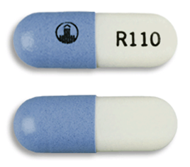
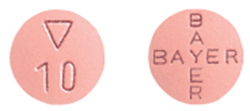
NOAC administration instructions:
Dabigatran (Pradaxa®) | Swallow whole with or without food Do not chew or open capsule Keep in original packaging Do not transfer capsule to a dose administration aid
Apixaban (Eliquis®) | Swallow whole with or without food Can be used in dose administration aids
Rivaroxaban (Xarelto®) | 10 mg tablet may be taken with or without food 15 mg and 20 mg tablet should be taken with food Can be used in dose administration aids
Images courtesy of MIMS Australia
September 2016 Version 2

Slide 84
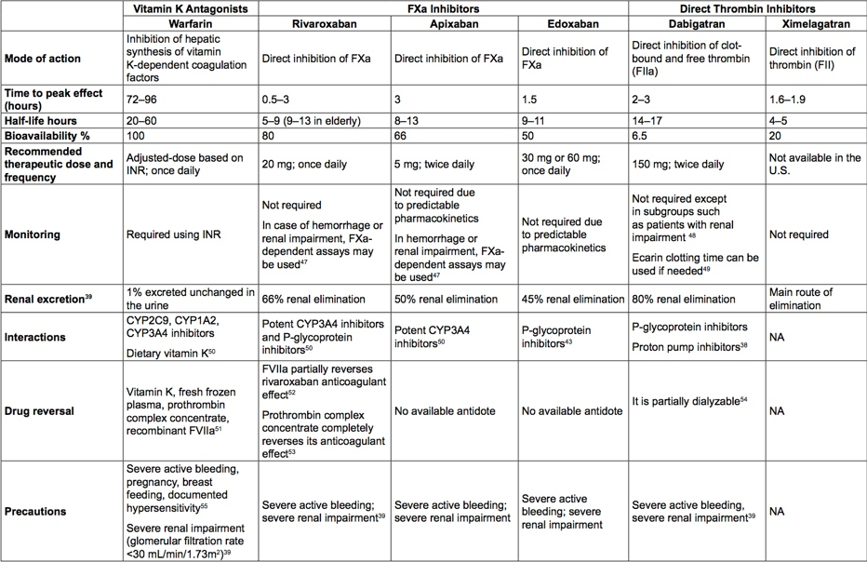
Notes:
Dosage
Monitoring
Interactions
Drug reversal

Slide 85
Dabigatran reversal with Idarucizumab:
Idarucizumab (Praxbind®) is used to reverse the anticoagulant effects of dabigatran
It is indicated when rapid reversal of dabigatran is required:
for emergency surgery/urgent procedures
in life-threatening or uncontrolled bleeding
Idarucizumab may not be available in all facilities
Reversal agents for apixaban and rivaroxaban are currently not available.
September 2016 Version 2

Slide 86
NOAC adverse effects
 | Dabigatran | Apixaban | Rivaroxaban
Common | bleeding anaemia nausea dyspepsia gastritis abdominal pain | bleeding anaemia dyspepsia GI bleeding | bleeding anaemia peripheral oedema itch, skin blisters muscle spasm
Infrequent | increased liver enzymes | thrombocytopenia increased liver enzymes | increased liver enzymes
Rare | allergic reactions | allergic reactions | allergic reactions
September 2016 Version 2

Slide 87
WHEN TO USE THESE NEWER ORAL ANTICOAGULANTS
— The direct thrombin inhibitors (ie, dabigatran ) and the factor Xa inhibitors (ie, rivaroxaban , apixaban ) differ significantly from the vitamin K antagonists in terms of their
onset of action,
half-life,
drug-drug interactions,
need for monitoring,

Slide 88
WHEN TO USE THESE NEWER ORAL ANTICOAGULANTS
Patients already taking warfarin for atrial fibrillation with excellent INR control may have little to gain by switching to dabigatran or rivaroxaban .

Slide 89
WHEN TO USE THESE NEWER ORAL ANTICOAGULANTS
In contrast, warfarin monitoring with frequent INR checks is less convenient than these newer agents, which typically do not require monitoring.

Slide 90
WHEN TO USE THESE NEWER ORAL ANTICOAGULANTS
Warfarin is preferred over dabigatran and rivaroxaban in those with reduced renal function (eg, creatinine clearance ≤30 mL/min).
Patients with gastrointestinal diseases, especially those with a history of bleeding, may not be ideal candidates for treatment with dabigatran or rivaroxaban because of the lack of an antidote to these newer agents.

Slide 91
WHEN TO USE THESE NEWER ORAL ANTICOAGULANTS
For patients with unexplained poor warfarin control, with a significant portion of time in sub-therapeutic INR range, the NOACs should be considered .
However as mentioned above, it is critical to determine that the INR instability is not due to poor compliance.

Slide 92
WHEN TO USE THESE NEWER ORAL ANTICOAGULANTS
Patients with a poor level of INR control because of unavoidable drug-drug interactions (such as frequent need for antibiotics or a large number of concomitant and variable medications) may do better with the NOACs.

Slide 93
EMERGENCY TREATMENT OF BLEEDING
— The use of any anticoagulant is associated with an increased risk of bleeding.
Unlike heparin and warfarin , the actions of which can be reversed using protamine and vitamin K, respectively, most of these newer anticoagulants do not have reversing agents or antidotes .

Slide 95
Warfarin; Blocks the carboxylation of several glutamate residues in prothrombin & factors VII, IX and X as well as the endogenous anticoagulant proteins C and S.
Heparin; interacts with antithrombin (heparin cofactor) to change its conformation and enhance its ability to inhibit thrombosis by inactivating clotting factor proteases, especially thrombin (IIa), IXa and Xa by forming equimolar complexes with them.

Slide 96
Enoxaparin; inhibits clotting factors IIa (thrombin) and Xa
Dabigatran; Both free and clot-bound thrombin, and thrombin-induced platelet aggregation are inhibited
Rivaroxaban; Direct Xa inhibitor
Apixaban; Direct Xa inhibitor

Slide 97
Argatroban;
Direct Thrombin Inhibitor (Parenteral)
Lepirudin (recombinant hirudin); Direct Thrombin Inhibitor (Parenteral)
Fondaparinux; Factor Xa inhibitor

Slide 98
 | Dabigatran Group | Warfarin Group
Mean age | 8.62 | 8.25
Gender
Recurrent thrombosis | None | None
Bleeding | None | 1 Case
RFT | N/L | N/L
LFT | N/L | N/L
Stop taking medicine | None | 1 Case
6
6
6
2
4
4
6
6

