Slide 1
Aggressive NK leukemia
Parastou molaei tavana
98/7/18

Slide 2
Case presentation
A 9 years old boy child with acute respiratory distress
PMH : negative
P/E : small submandibular lymphadenopathy
CBC : wbc 22500 HB:9/7 PLT:115000
Diff : neut 8% lymph 7% blast 85%
Uric acid :2/8 LDH:843

Slide 3
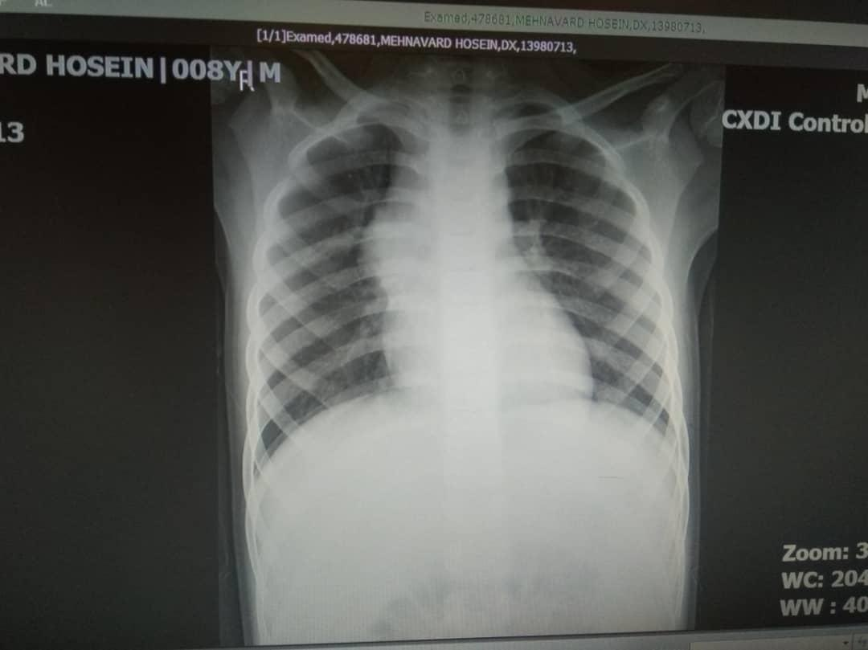

Slide 4
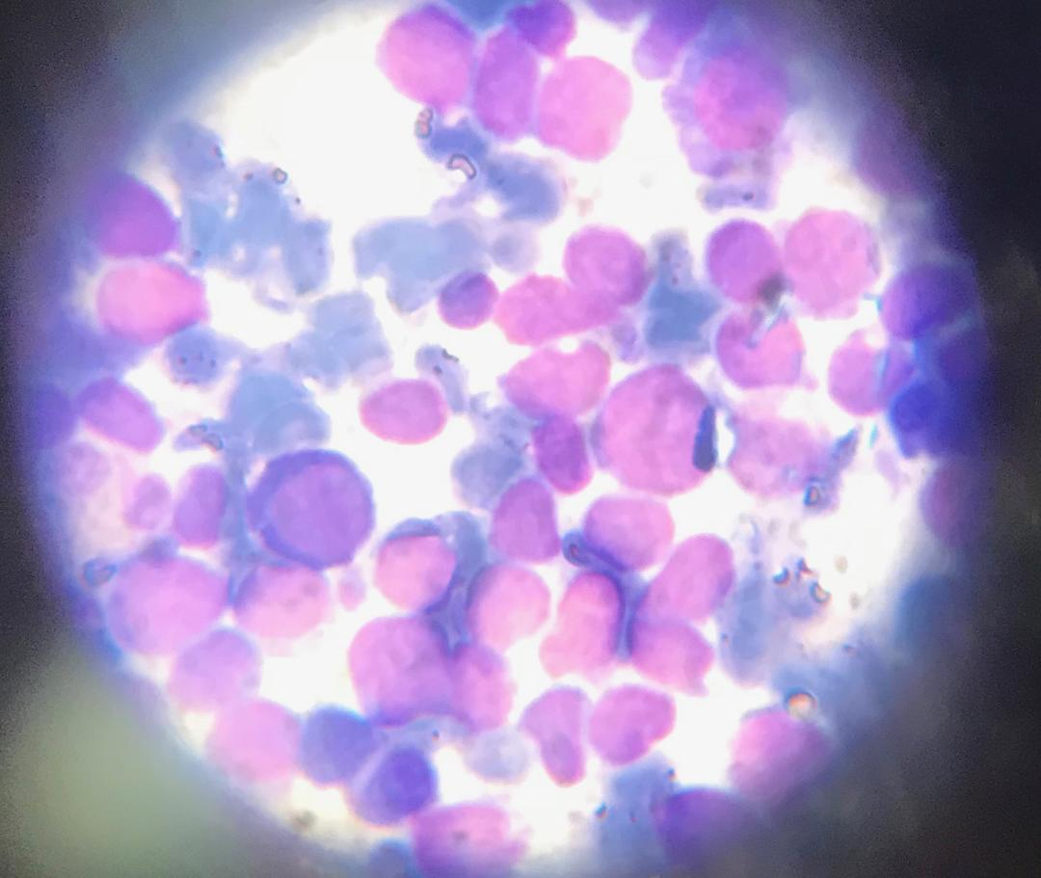

Slide 5
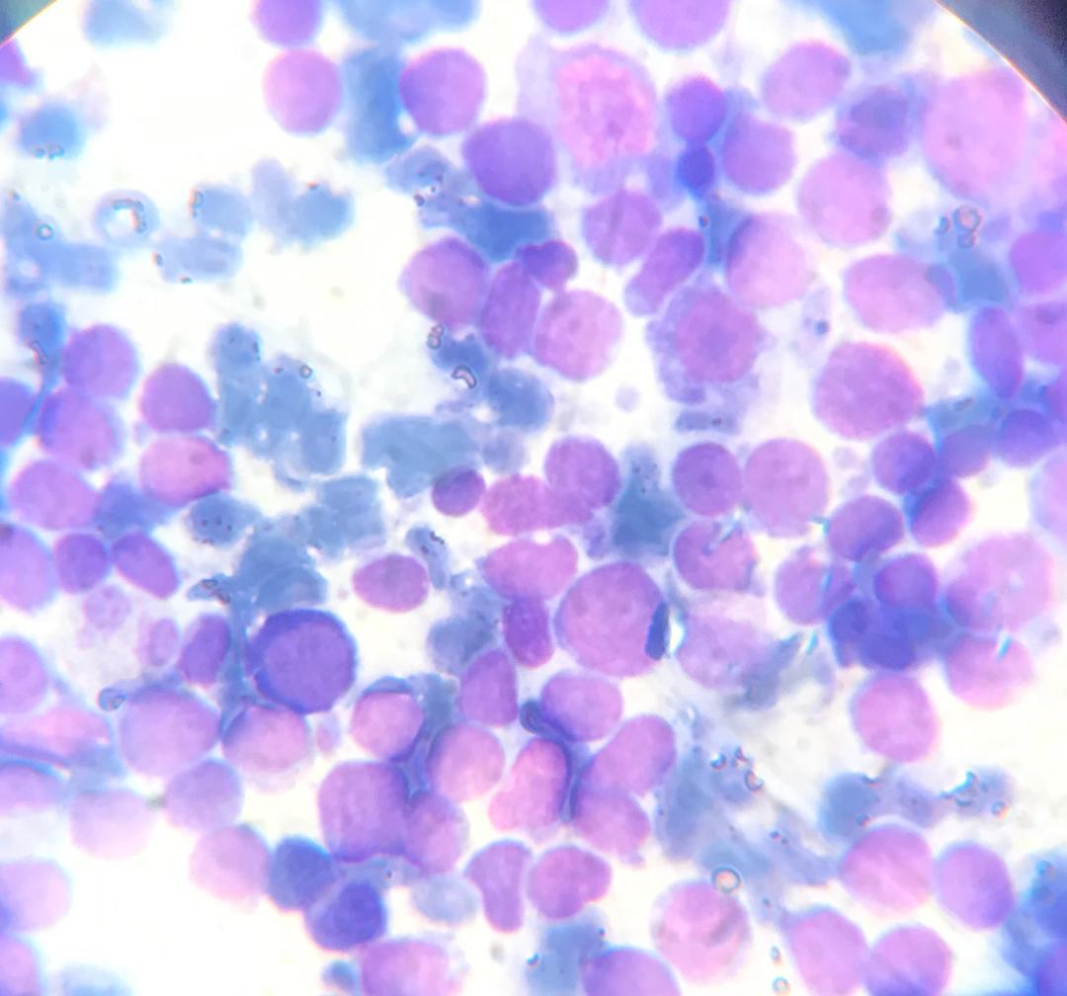

Slide 6
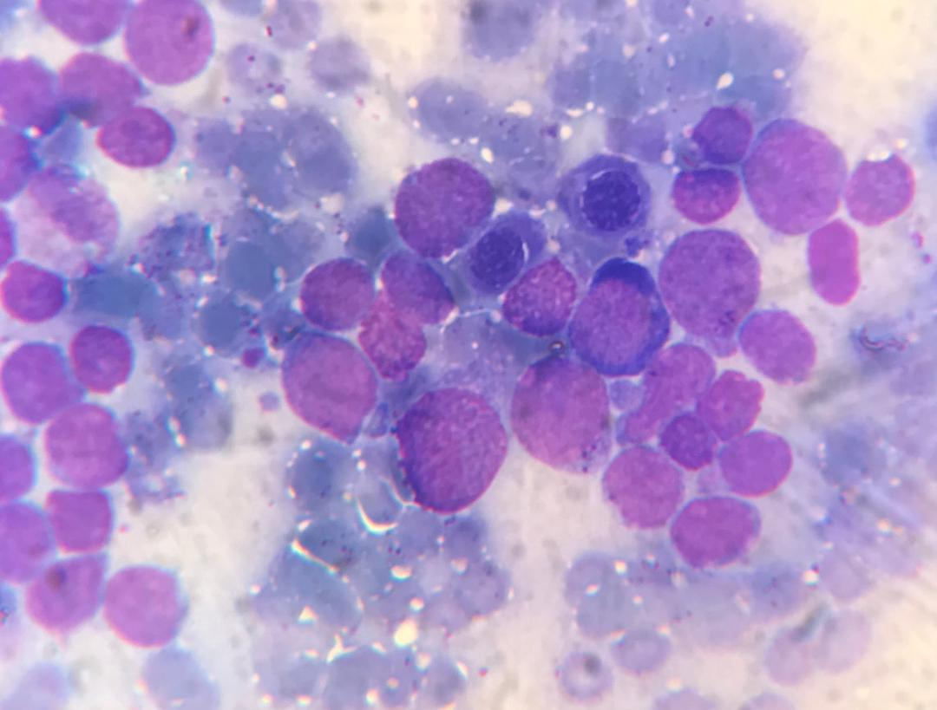

Slide 7
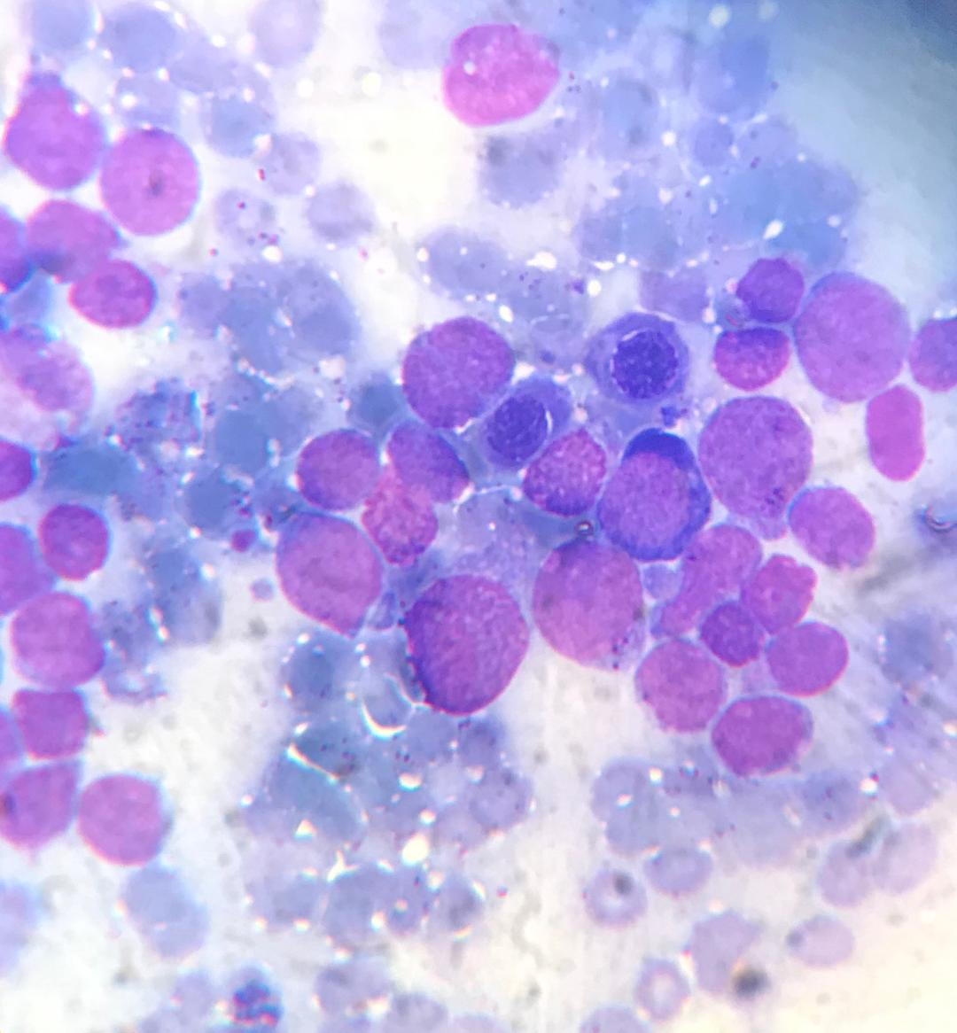

Slide 8
Case presentation
CXR : right para hilar is prominent suggestive for pathologic lymphadenopathy
Chest CT scan : anterior mediastinal mas measuring 56*33*56mm/ subcarina lymphadenopathy up to 16mm
Abdominopelvic sonography : NL
Abdominal CT scan : splenomegaly , para aortic lymphadenopathy up to 10 mm
Bone survey : suspicious lytic lesion 15 mm in frontal and temporal bone

Slide 9
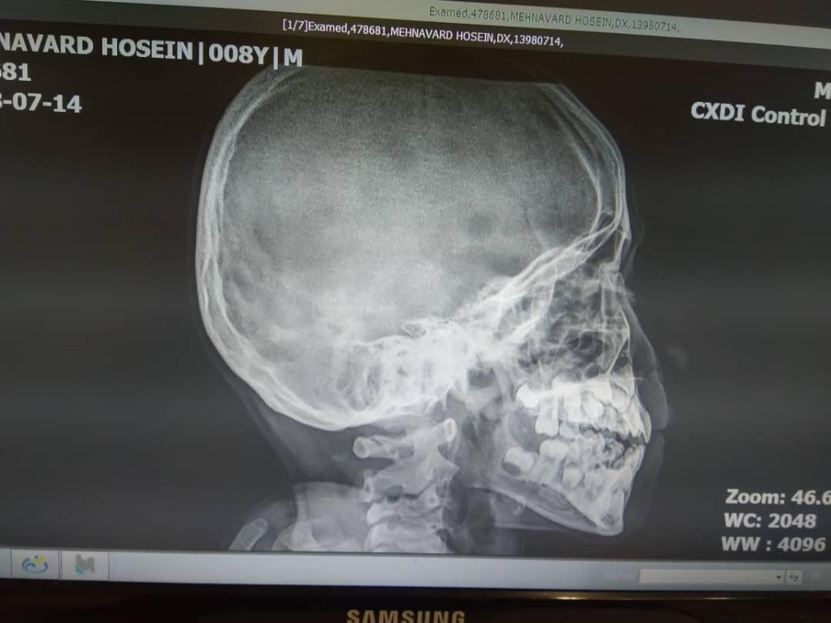

Slide 10
Case presentation
CD flow cytometry
CD2:55%
CD3:2/7%
CD5:5/4%
CD7:98%
CD10:0/4%
CD19:8/4%
CD33:11/9%
CD34:57%
CD38:87%
CYTO CD3:45/7%
CD56:94/7%
Notes:
5

Slide 11
Diagnosis
Aggressive natural killer leukemia

Slide 12
INTRODUCTION
Aggressive NK cell leukemia (ANKL) :rare malignant lymphoproliferative disease of mature NK cell type
Eastern Asian populations
closely associated with Epstein-Barr virus)90%)
better prognosis of EBV-negative ANKL than EBV-positive ANKL
median survival duration shorter than one year
large granular lymphocyte (LGL) leukemia based on its morphological features

Slide 13
TERMINOLOGY
ANKL be classified as an EBVassociated mature malignant NK cell neoplasm and discussed in special relation to ENKL and/or EBV-positive T cell and NK-cell lymphoproliferative disease of childhood, rather than indolent LGL leukemia, such as T cell LGL leukemia or CLPD-NK, based on the current molecular and clinical recognition of ANKL

Slide 14
EPIDEMIOLOGY
ANKL :between 20 and 50 years of age but has also been reported in teenagers and patients in their 70s
Transformation into ANKL from EBV-associated NK/T lymphoproliferative disorders, such as chronic active EBV infection(younger age )
Approximately 400 cases have been reported
An increasing number of patients being reported from Caucasian populations and Latin America

Slide 15
MOLECULAR PATHOGENESIS
In 48% of cases, mutations in molecules of the JAK-STAT3 system were detected
TP53 mutations were also recognized in 34%
plasma IL-10 levels were significantly elevated
increased expression of MYC
IL-10-STAT3-MYC transcription regulation in ANKL

Slide 16
Genetic Abnormalities
gain of 1q23.1-q23.2 and 1q31.3-q44
loss of 7p15.1-q22.3 and 17p13.1
Granulysin , a cytotoxic molecule in the cytotoxic granules of NK cells

Slide 17
THE DIAGNOSIS OF ANKL
The diagnosis of ANKL should be made based on three factors:
the cellular characteristics, involved sites, and clinical features
The tumor cells morphologically resemble large granular lymphocytes
immunophenotypically CD2+ surface CD3-, CD3epsilon+, CD16+, and CD56+, with a lack of myeloid and B-cell markers
The main involved sites :bone marrow, peripheral blood, liver, and spleen
clinical features :fever, hemophagocytosis, liver dysfunction, disseminated intravascular coagulation and a progressive course of weeks or sometimes months

Slide 18
CHEMOTHERAPY FOR ANKL
The optimum chemotherapy regimen as an initial treatment for ANKL has not been established
With anthracycline-containing chemotherapy, some patients have achieved a complete response
In vitro, ANKL cell lines and tumor cells from these patients were shown to be sensitive to L-asparaginase, leading to apoptosis
Various L-asparaginase-containing regimens, such as SMILE (dexamethasone, methotrexate, ifosfamide, etoposide, and L-asparaginase), AspaMetDex (L-asparaginase, methotrexate, and dexamethasone) or VIDL (etoposide, ifosfamide, dexamethasone, and L-asparaginase) in addition to L-asparaginase monotherapy

Slide 19
A complete response, including negativity for EBV DNA in the blood after treatments, was associated with a better outcome
even patients who achieved a CR after chemotherapy including L-asparaginase rarely survived for more than one year without further treatments, especially allogeneic hematopoietic cell transplantation (HCT)

Slide 20
ROLE OF HSCT FOR ANKL
Although patients have responded to chemotherapy including Lasparaginase , almost all patients eventually died of their disease
A total of 21 ANKL patients registered between 2000 and 2014 in the International Bone Marrow Transplantation Registry (IBMTR) database underwent allogeneic HCT, with most receiving L-asparaginase-containing chemotherapy before proceeding to HCT
Patients with a CR prior to HCT showed a significantly better survival after two years than those without a CR (38 vs. 0%). However, 76% of all patients died

Slide 21
targeted therapy
Immune checkpoint inhibitors : pembrolizumab or nivolumab
JAK inhibitor ruxolitinib and the BCL2 inhibitor navitoclax to be highly effective against malignant NK cell lines

Slide 22
REFERENCES
1-Fumihiro Ishida* Department of Biomedical Laboratory Sciences, Shinshu University School of Medicine, Matsumoto, Japan , Front. Pediatr)2018(
2-Aggressive NK-cell leukemia: clinical subtypes, molecular features, and treatment outcomesوTang et al. Blood Cancer Journal (2017(
3-Aggressive NK Cell Leukemia (ANKL): Experience with 34 Patients and Therapeutic Potentials of L-Asparaginase and Allogeneic Hematopoietic Cell Transplantation - A Japan-Korea Multicenter Study for ANKL , Blood (2010)

