Slide 1
Case presentation Neuroblastoma stage IV with leptomenigeal metastasis
Dr Abdolkarimi
Pediatric oncologist
Lorestan university of medical science

Slide 2
Case presentation
Female 2.5 y –mlltigravidity(4)- hospitalized for limping
Lab test:ESR=145 ,CBC:pancytopenia CRP=105
Brain CT:subdural hematoma
Bilateral frontal lesion with bone involvement
Lung & abdominopelvic CT:multiple hyperechoic lesions
Para-aortic mass with right pararenal infilteration(LAP or NB ?)
Brain MRI:left frontal &right frontotemporal mass with infilteration to dura and calvarium

Slide 3
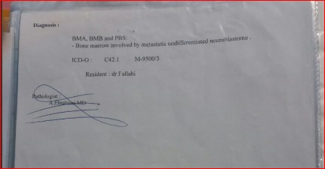
BMA/B+flowcytometry &IHC:
60% involvement with small round cell tumor and NB confirmed by IHC

Slide 6
Whole body bone scan:
Multifocal hypermetabolic bone disease in lower limbs & frontal bone

Slide 7
First CSF cytology:Neg

Slide 8
RT consult
Coformal RT(base on Iran facilities)

Slide 9
CASE importance
1.brain metastasis
2.primary leptomeningeal metastatic high risk NB
3.radiation limitation in RT in IRAN
4. Brain metastasis is an uncommon problem in childhood.
(In our experience, parenchymal brain metastasis occurred innearly 5% of 611 children with sarcoma, neuroblastoma, or Wilms’ tumor)
5.inoperable brain metastasis

Slide 10
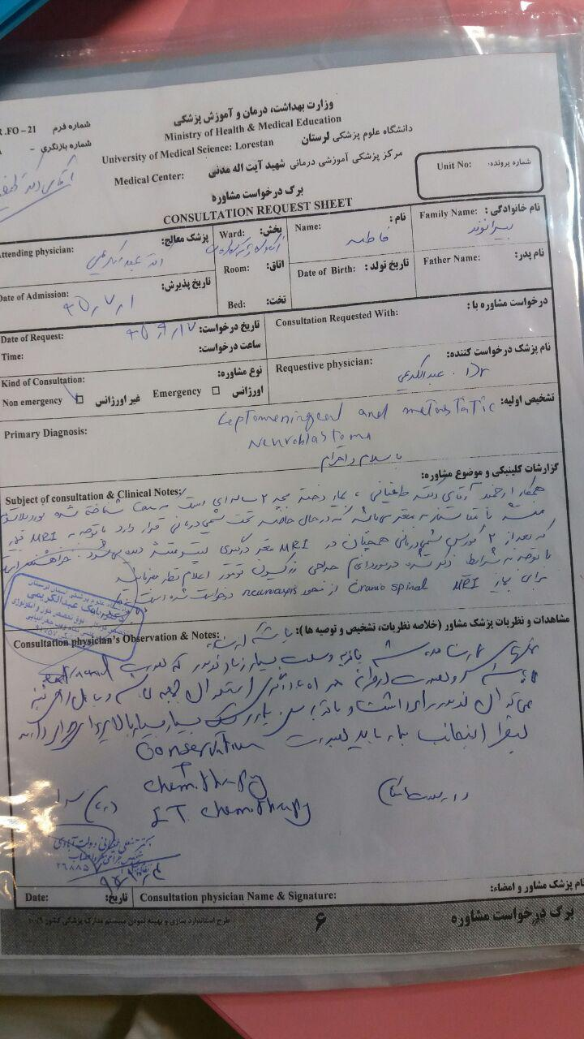
Neurosurgery consult after 2 course chemotherapy
Inoperable tumor
Suggest:intra-CSF chemotherapy

Slide 11
Brain MRI after 2 course chemotherapy

Slide 12
Brain MRI report:
Dura involvement overlying on cerebral hemispher +vasogenic edema

Slide 13
BMA/B after 7 course chemotherapy:Nl

Slide 14
Whole spine MRI need?
Existence of MIBG as a specific & sensitive diagnostic & therapeutical modality

Slide 15
Sonography after 7 course chemotherapy
Normal without any mass or LAP

Slide 16
BMT consult
MIBG-I 123 will do:
If MIBG will be have avid-→MIBG therapy+ABMT
If MIBG will be haveN,T avid-→ABMT

Slide 17
Our treatment strategy:
1.induction: 2 courses TOPO+CPM
2.3 courses classic protocol(DOX+ETP+VCR+Cis+CARBO)
3.3 Courses TMZ+Irino+VCR
4.IT chemotherapy with MTX+DEXA
5.Brain RT/MIBG therapy
5.autologus BMT

Slide 20
IT protocol
4 IT twice a week+3 IT every week(<8 IT/month)
Then every month
MTX:10 mg+DEXA:4 mg

Slide 21
Review Of litretures

Slide 23
Extracted points :
1.most patients eventually died from relapse.
2.The overall incidence of brain metastasis in neuroblastoma after treatment ranges from 1.7% to 11.7%
3.Base on Shamberger criteria is poor prognosis
4. intensity-modulated radiation therapy (IMRT)
Is choice RT modality after surgery
5.salvage chemotherapy(TMZ+VCR+Irino) 1 to 6 courses
6. 13-cis-retinoic acid is administered following the completion of consolidation therapy.(100–160 mg/m2 in two divided doses for consecutive 7 days every 14 days, lasting 1 year)

Slide 24
Shamberger criteria for surgery
the tumors were classified into three types:
1.complete resection without macroscopic residual tumor,
2.subtotal resection with ≤20% residual tumor
3. partial resection with 21%–50% residual tumor.

Slide 25
Salvage chemotherapy protocol
Vincristine 1.5 mg/m2 onday 1,
Irinotecan 20 mg/m2 on days 1–5,
Temozolomide 100 mg/m2 on days 1–5
1–6 cycles of chemotherapy at 3-weekadministered 1 h before Irinotecan.

Slide 29
8H 9 intratechal

Slide 30
intratechal cRIT(anti-GD2 I-131)

Slide 32
تشکرازتوجه شما

