Slide 1
Surgical Treatment
for Bone Tumors
By Kh M.Jamshidi,MD,
(Iran University of Medical Science)
Day mah, 95

Slide 2
Surgical treatment for Bone Sarcoma
For low or moderate grade of BS, limb salvage has been performed for more than a century.
For high grade, amputation was the treatment of choice before 1970 (chemotherapy) and only 20% survived.
Only determining the correct level of amputation was the basic principle of surgical oncology conferences.

Slide 3
treatment for Bone sarcoma
Nowadays 70% of the patients with high grade BS survive and limb-salvage is possible in about 95% of patients.
This is owed to Advances in :
Adjuvant and neoadjuvant chemotherapy.
Diagnostic imaging.
Surgical technique for reconstruction.

Slide 4
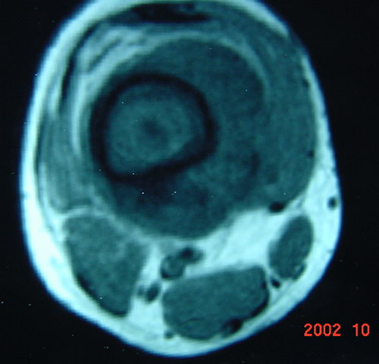
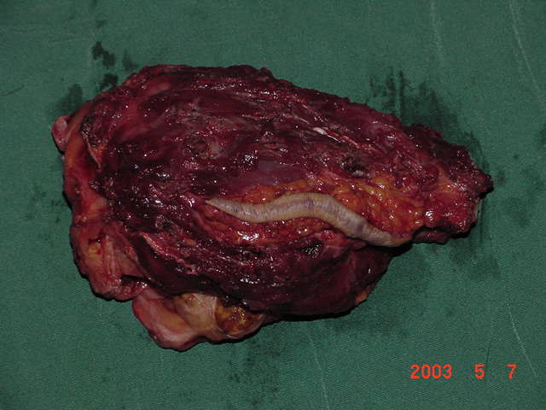
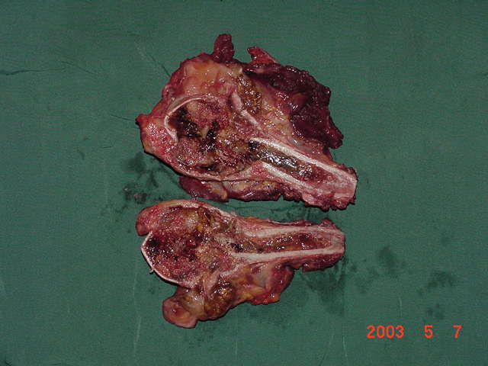
Limb-salvage indication
Absence of involvement of the NV. Bundle.
Ability to resect the tumor with surrounding cuff of normal tissue and biopsy tract(oncologic margin).

Slide 5
Limb-salvage indication(conti)
Oncologic Margin can not be overstated.
Tumor care must never be compromised.
Inadequate margin.
Delay of postoperative chemotherapy due to reconstructive complications are contraindications of L.S
How good is the function of the salvaged limb?

Slide 6
Limb Salvage Technique
Resection is the first stage of a Limb-Sparing procedure.
Reconstruction a stable, painless skeletal reconstruction must be obtained.
Restoration of soft-tissue coverage for optimal function is often necessary for proximal tibia reconstruction.

Slide 7
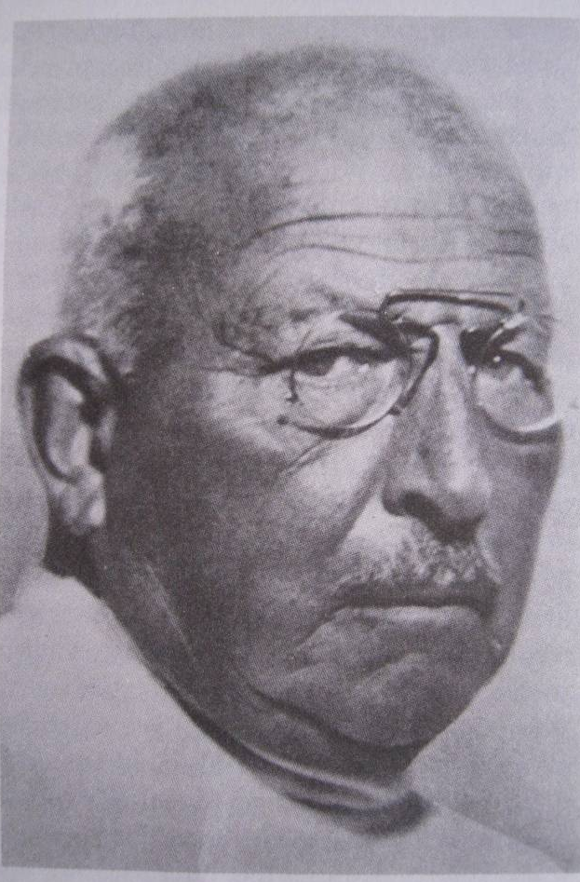
Massive Allograft(history)
A german surgeon ,Eric Lexer, inovated osteoarticular allograft surgery for the first time in 1908.
During the next 50 years this type of surgery has rarely been reported
In 1954 Herndon and Chase published the results of fresh and frozen allograts in dogs.

Slide 8
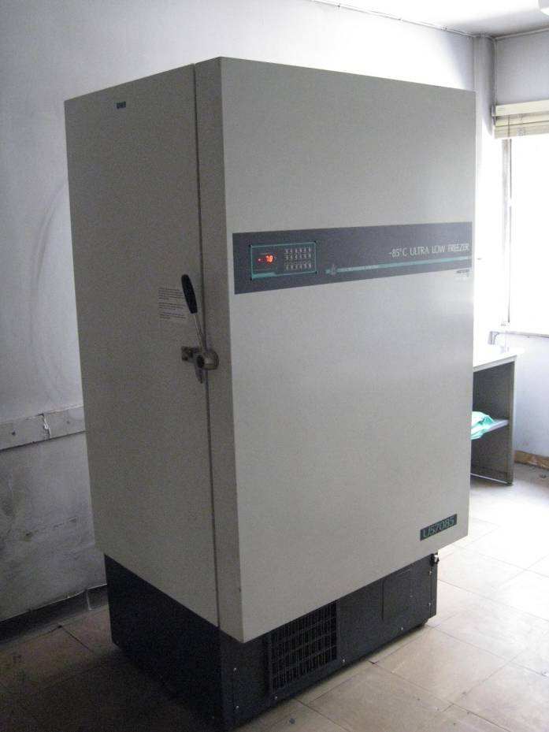
Allograft(varieties)
fresh allografts cause host immune reaction and graft resorbtion.
freezing allografts (<-60) will decrease immune resoponse.
freeze-drying significantly reduces the immunogenic response and strength of the graft.

Slide 9
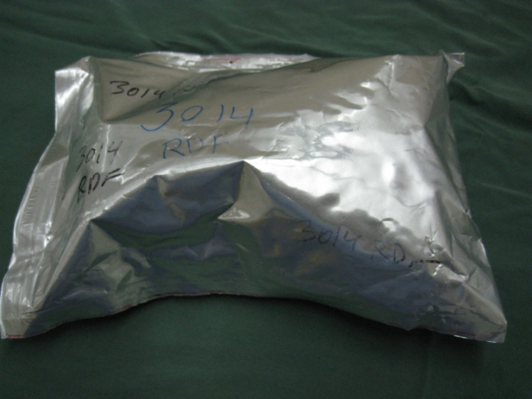
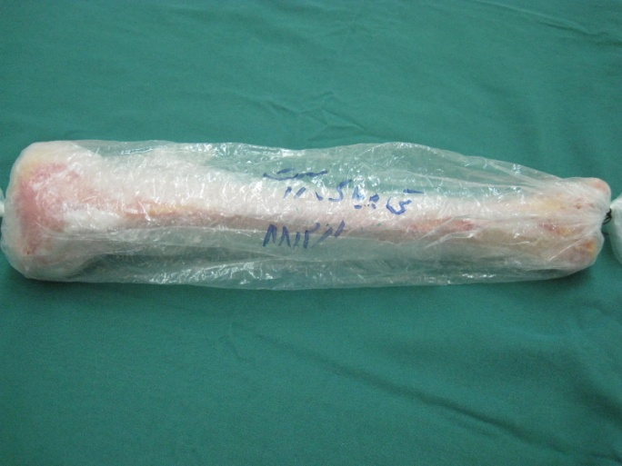
Allograft(varieties)
gamma sterilization at least 30000 Rads is necessary and reduce the strength.
ethylene sterilization associated w/ unacceptable host reaction.

Slide 10
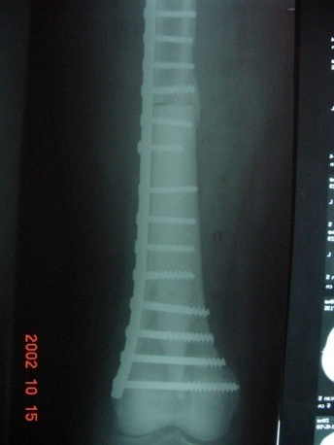
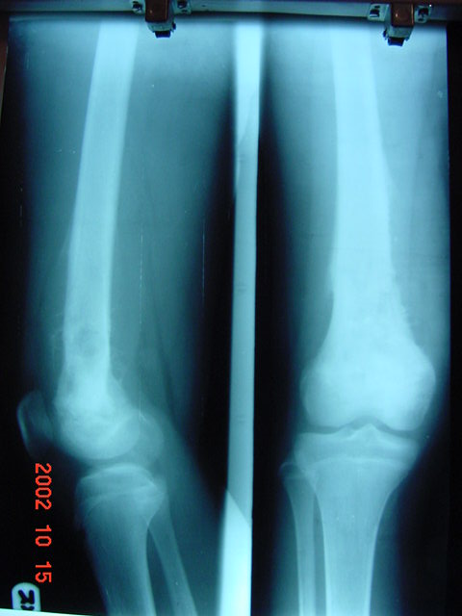
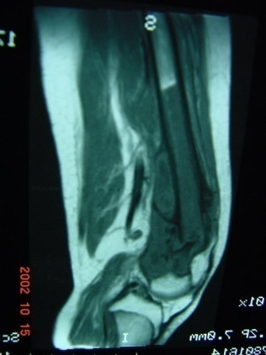
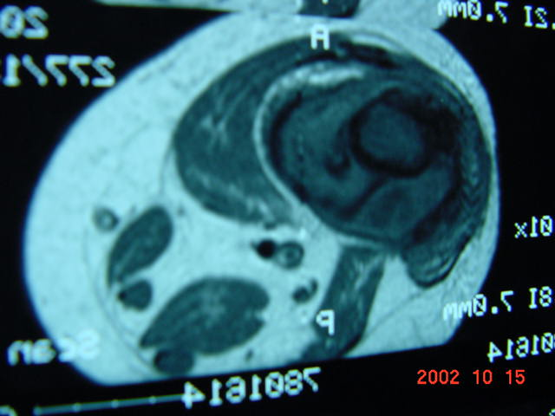
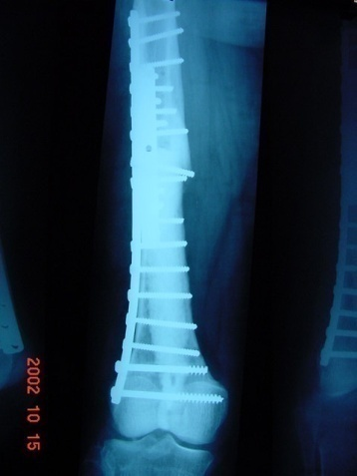
Reconstruction (Osteoarticular allograft)
A 14-year old boy
2 years post-op

Slide 11
Reconstruction osteoarticular
A 16- year old boy, 2 yrs post Op

Slide 12
Reconstruction with osteoarticular Allograft (complication)
Early:
infection 7% late up to 20%
Nonunion and failure of fixation 23%
Joint instability?
Late:
Allograft FX 14%
Charcot joint (which is the fate of nearly all osteoarticular allograft after 5 to7 Yrs.)

Slide 13
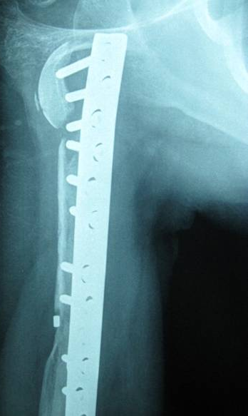
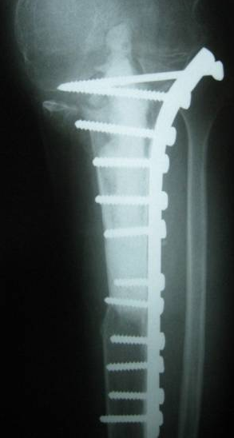
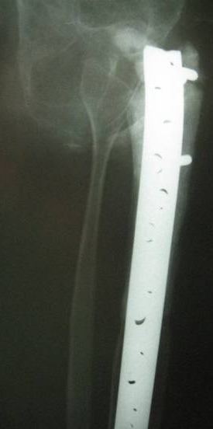
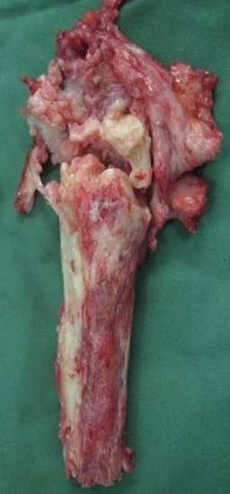
Reconstruction with osteoarticular Allograft (complication)
After 2 Yrs (late FX)
After 3 Yrs
After 9 months

Slide 14
Usually after 5 to 7 Yrs osteoarticular Allograft should be replaced by prosthesis due to charcot joint.
After 2 years
After 5 years
After 8 months
Notes:
After 5 years

Slide 15
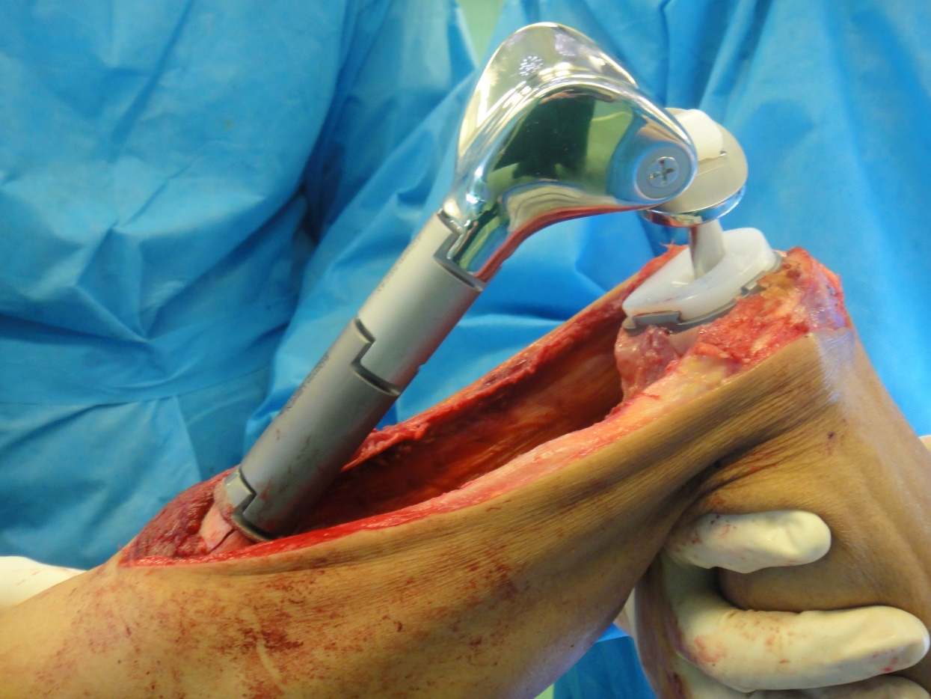
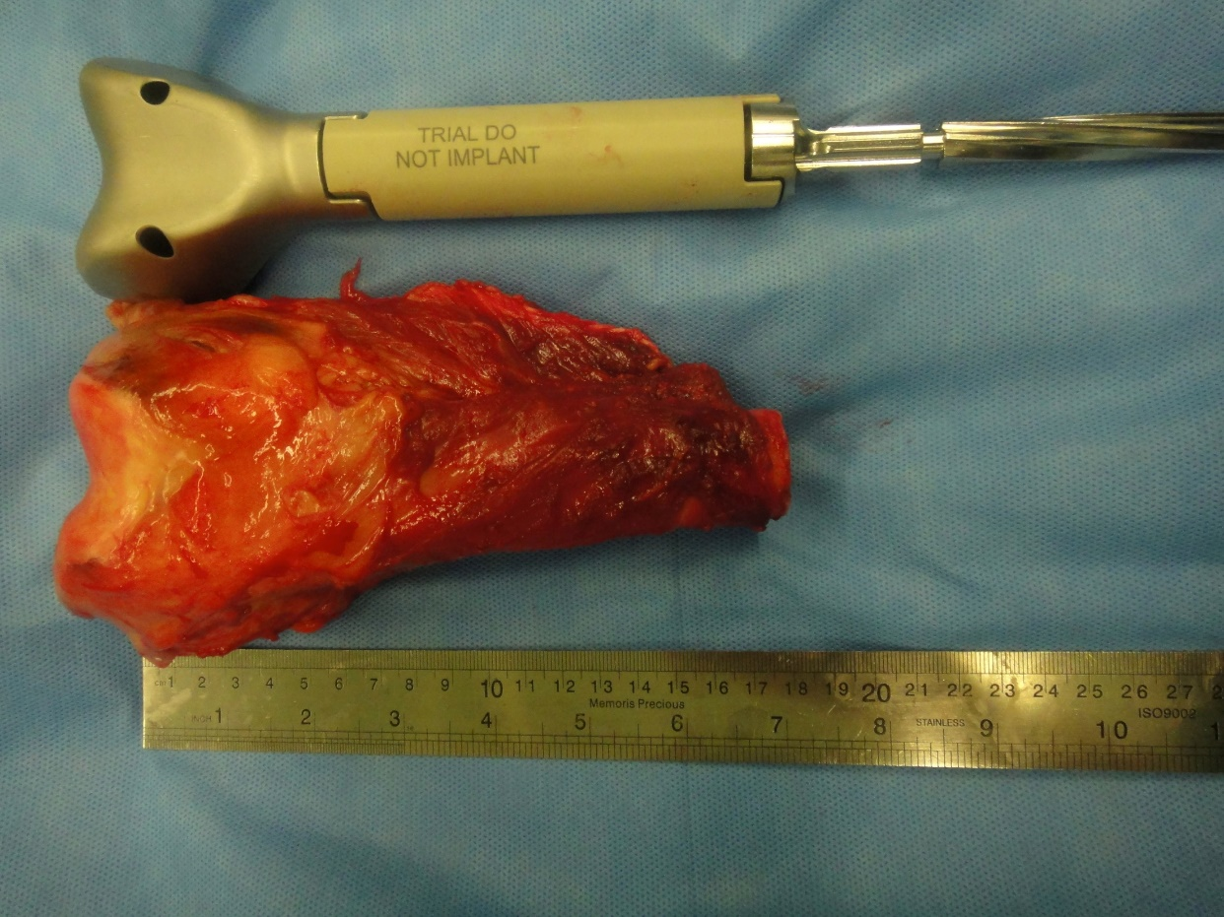
Reconstruction with Modular Replacement System

Slide 16
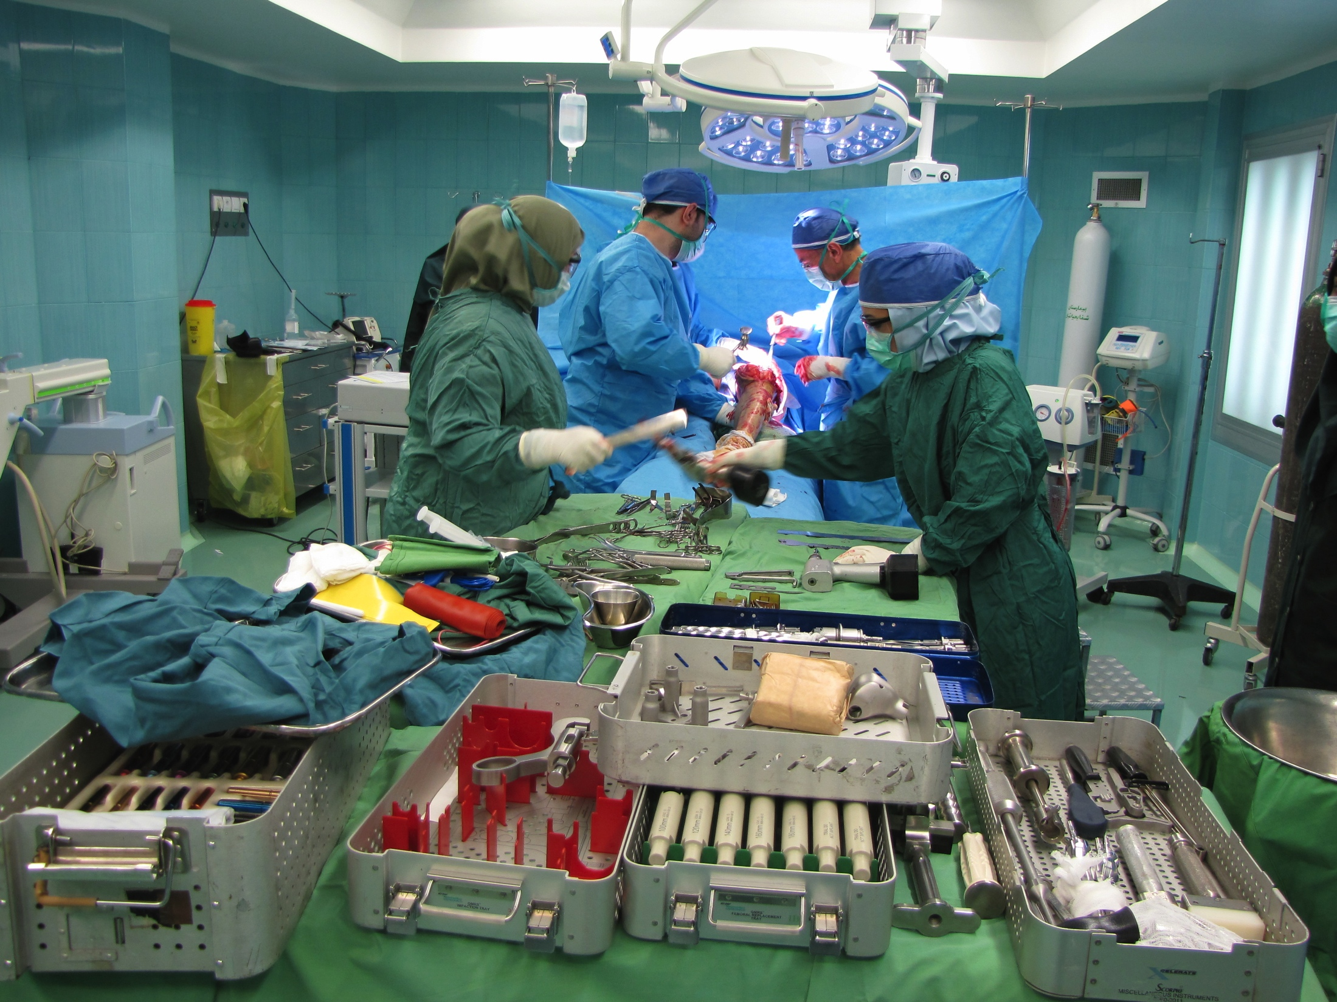
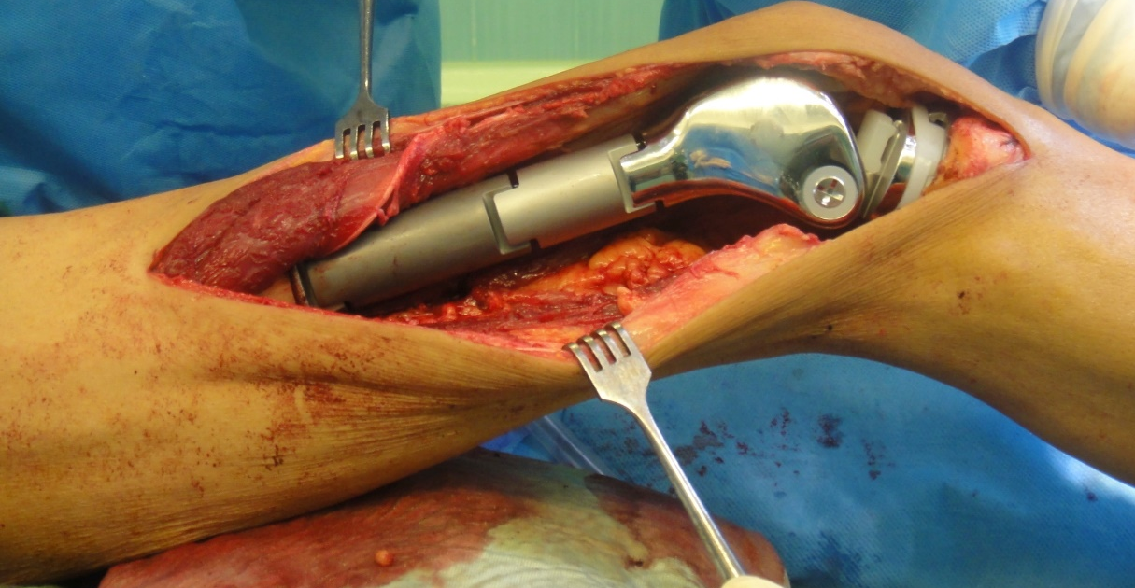
A 43 year old male with osteosarcoma

Slide 17
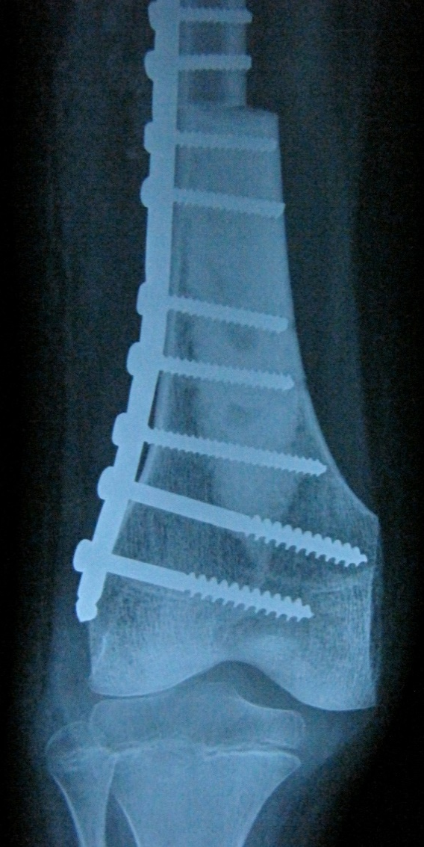
Limb Salvage Technique (osteoarticular)
Osteoarticular allograt has the advantage of not disturbing the adjacent growth plate.
The problem is obtaining a graft of appropriate size.
The use of graft with open growth plate is not advised. (they will fracture through the allograft physis)
For children older than 10 Yrs, it is possible to use adult small bone.

Slide 18
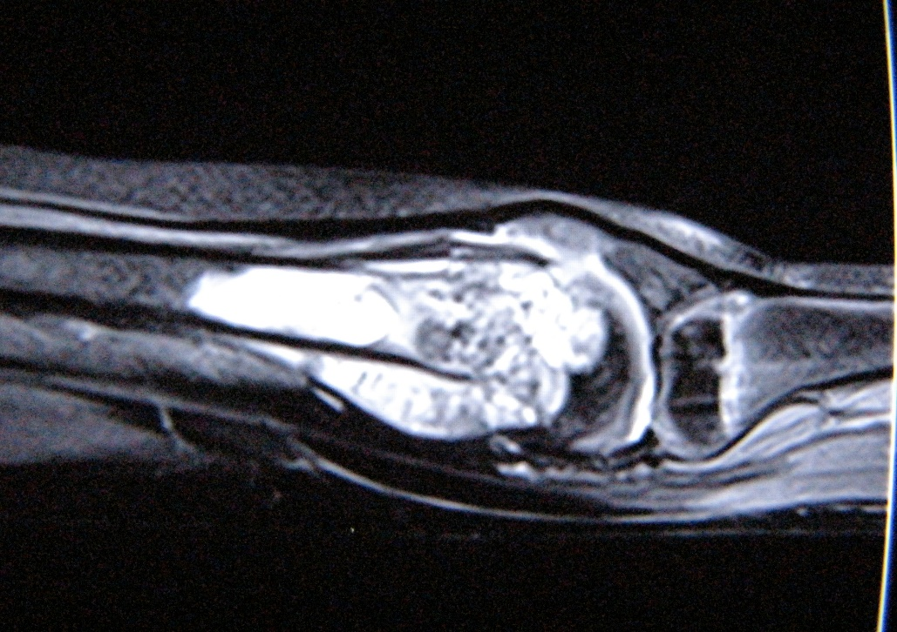
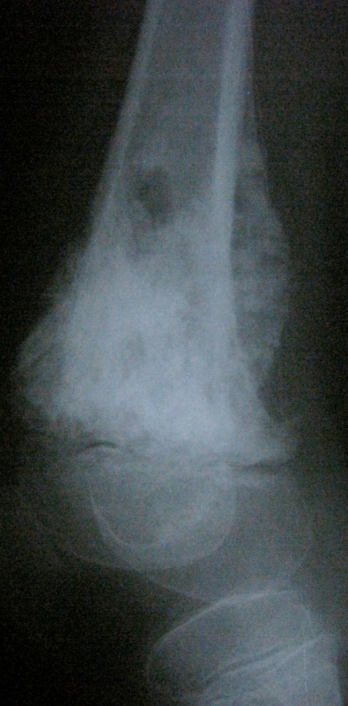
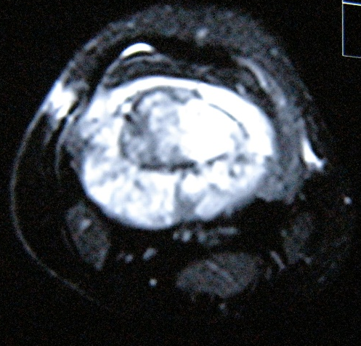
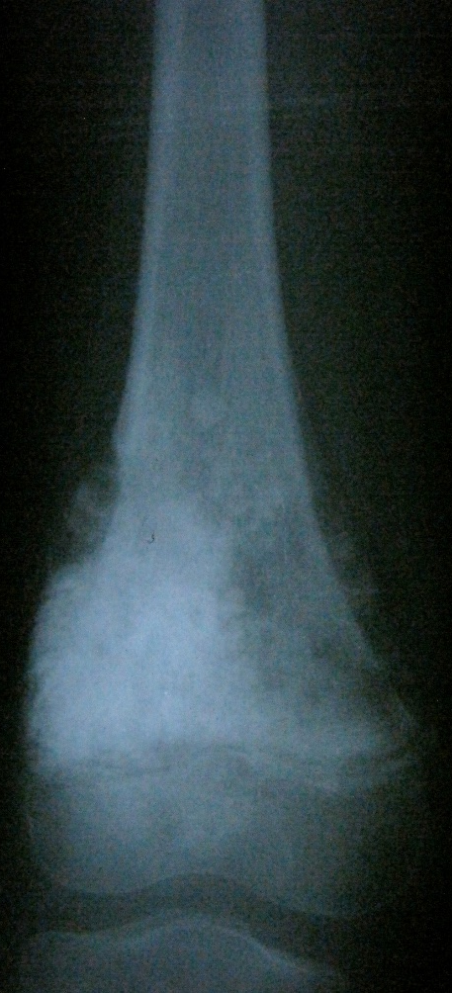
A 9 Yr. boy with osteosarcoma after neo-adjuvant chemotherapy

Slide 19
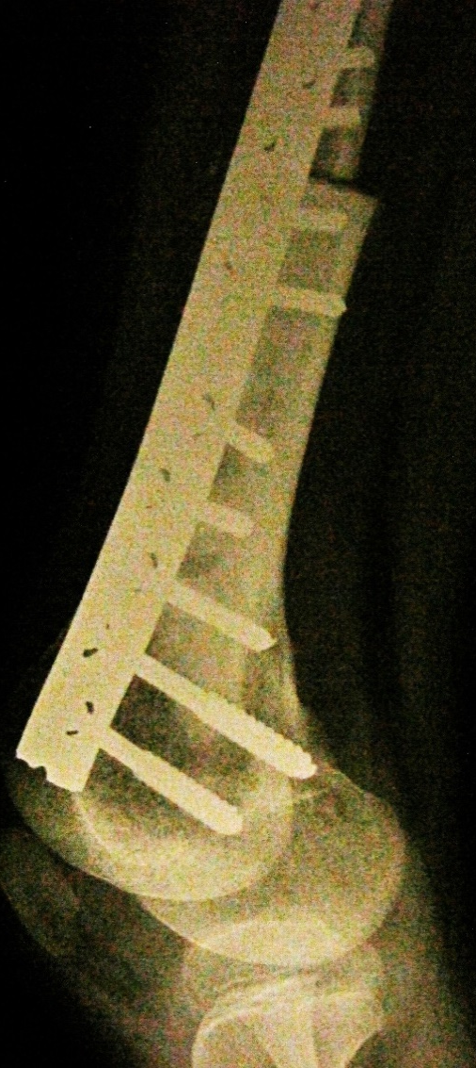
6 months after surgery

Slide 20
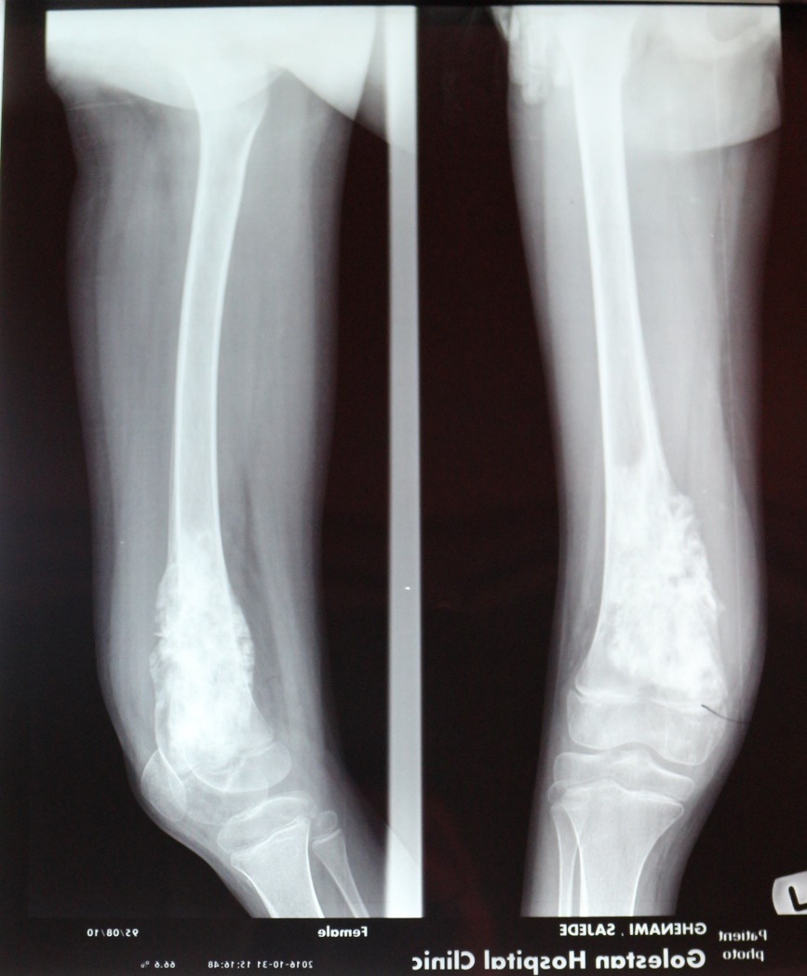
Reconstruction (Osteoarticular allograft)
A 8-year old girl

Slide 21
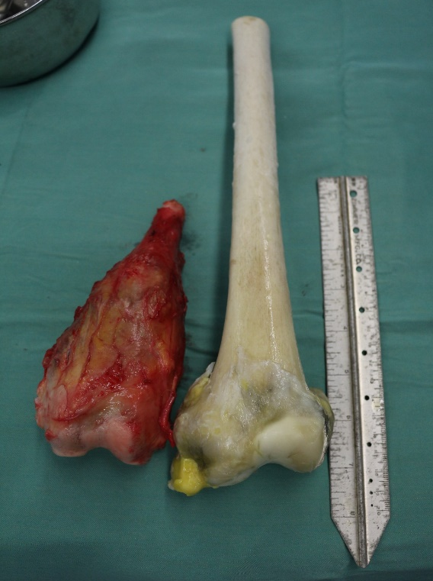
Reconstruction (Osteoarticular allograft)
A 8-year old girl

Slide 22
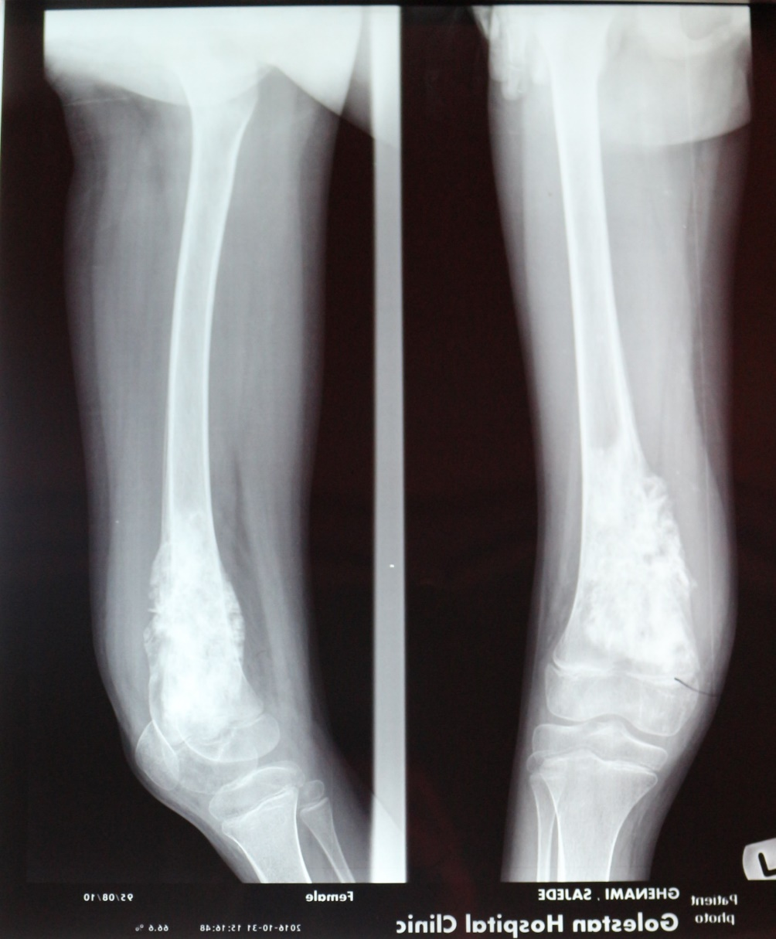
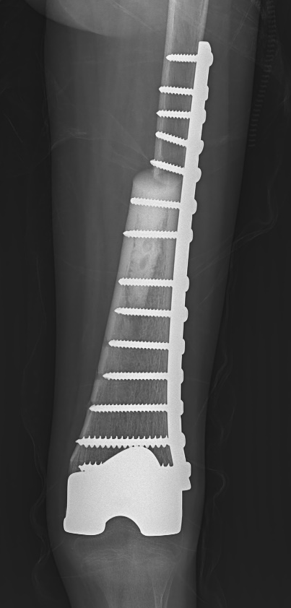
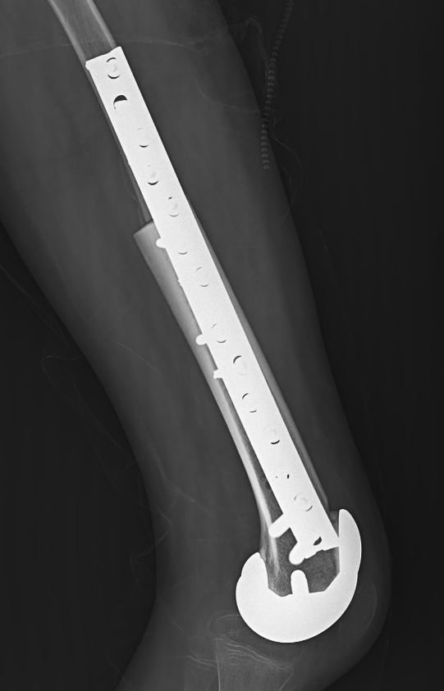
Reconstruction (Osteoarticular allograft)
A 8-year old girl

Slide 23
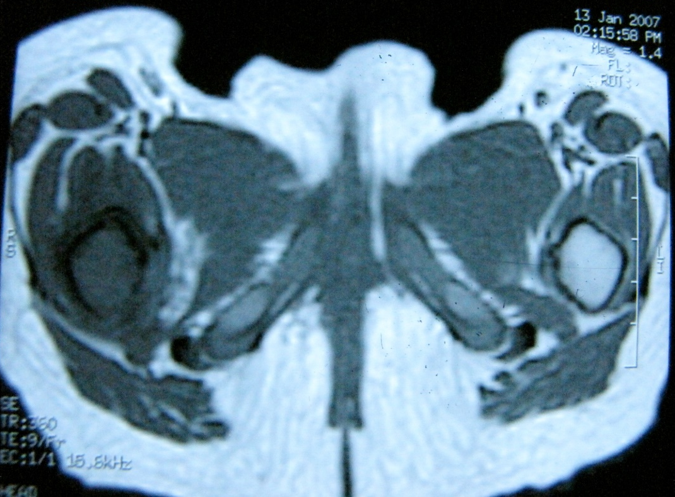
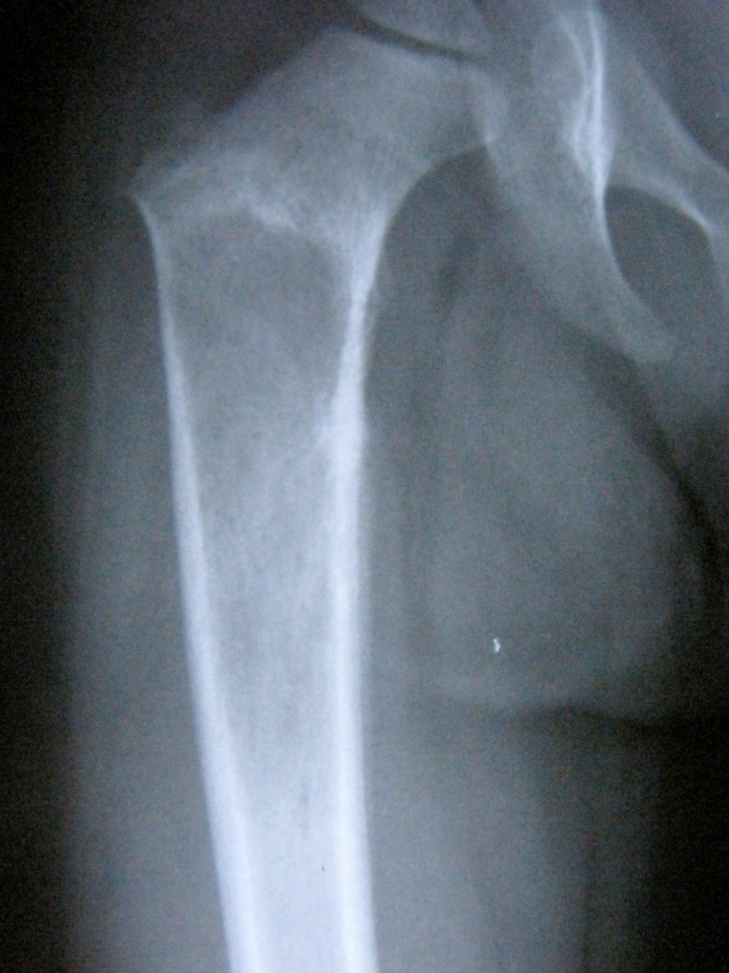
A 3 Yr. old girl with a 2 months history of hip pain and limp and tissue diagnosis of Ewig sarcoma

Slide 24
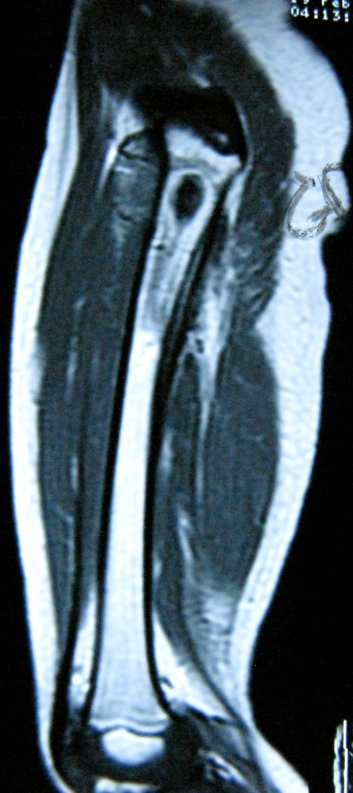
A 3 Yr. girl with a history of ES after Neo adjuvant Chx

Slide 25
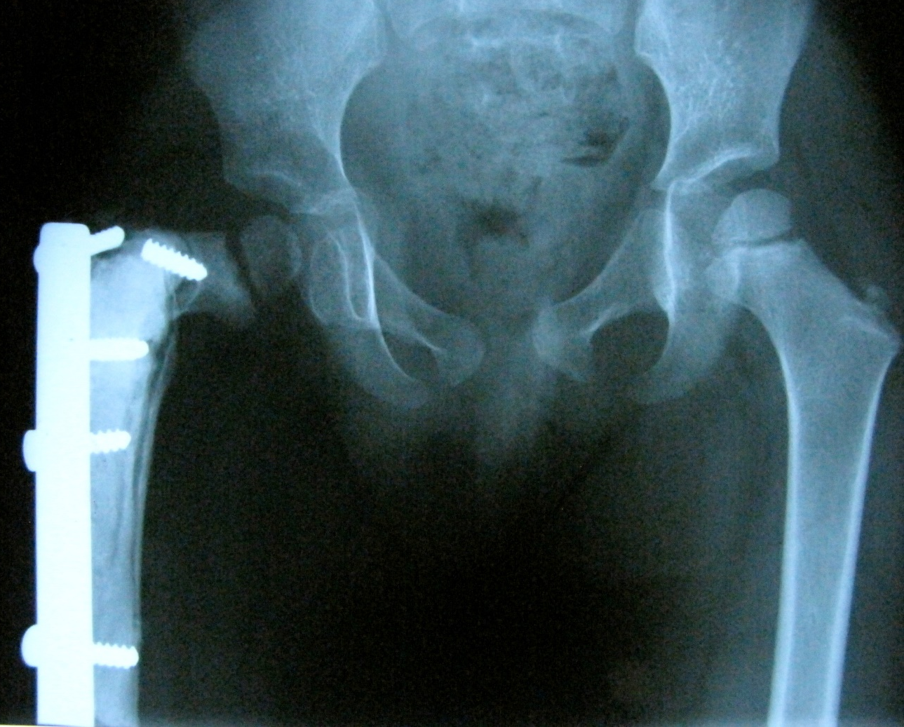
6 months after surgery

Slide 26
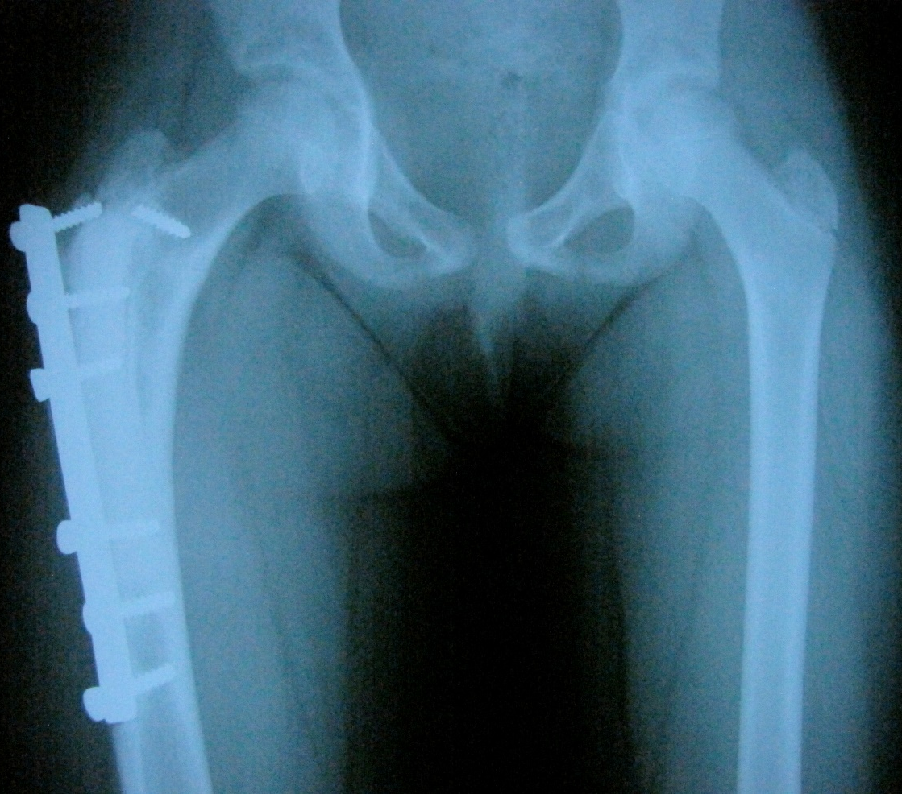
6 months after surgery
6 years after surgery

Slide 27
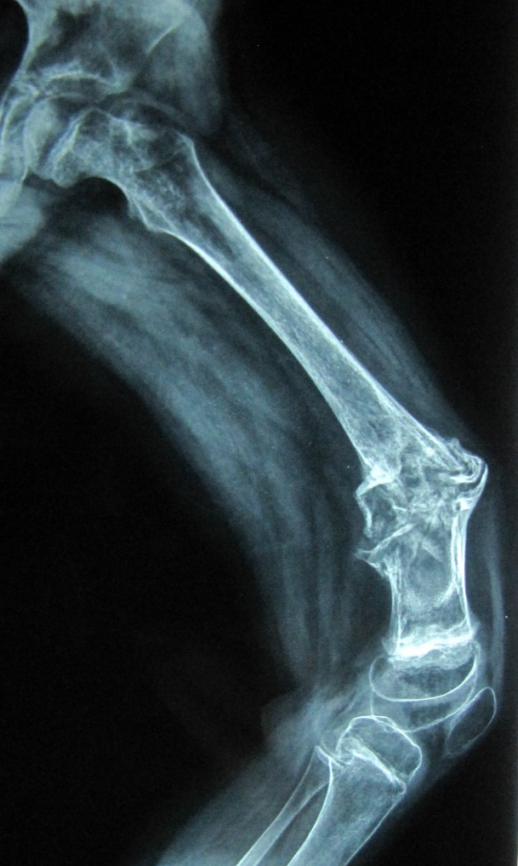
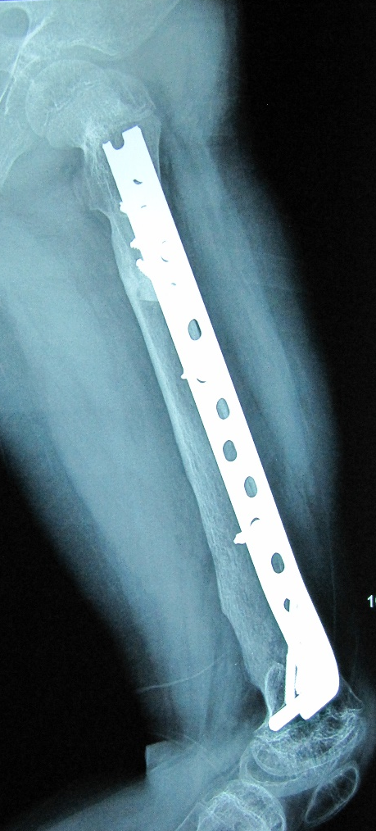
Pathologic Fractures through Primary Malignant Tumors
2 Yrs. Post-op
A 7 Yr. old girl with osteosarcoma. After Neo adjuvant Chx

Slide 28
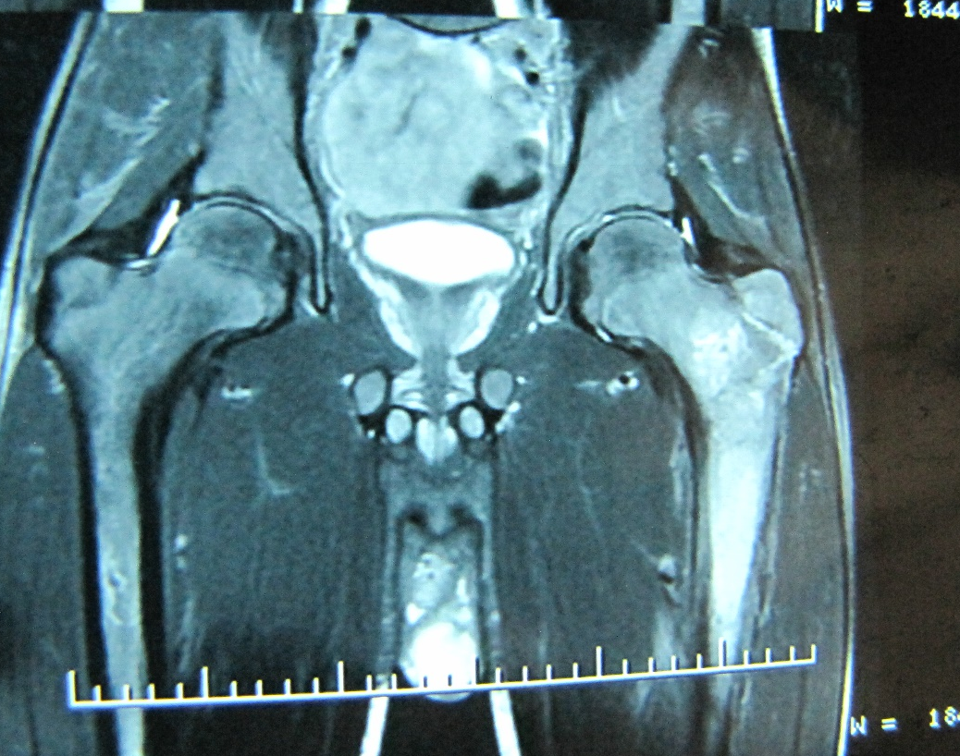
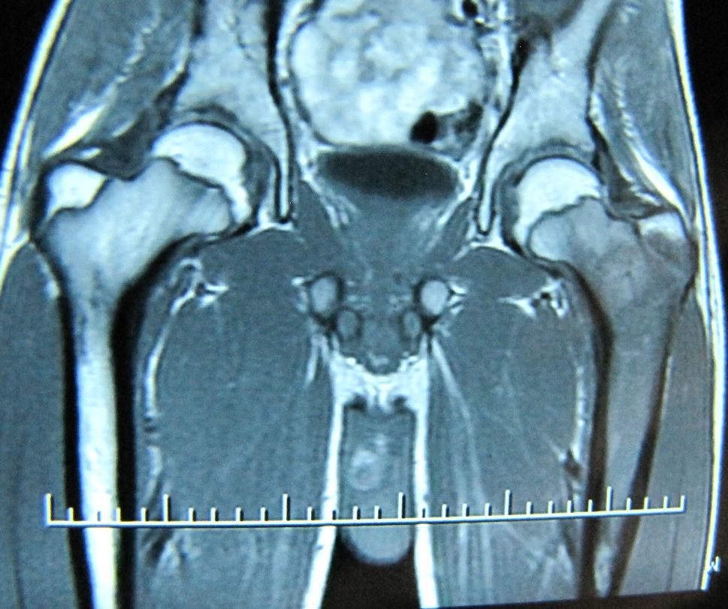
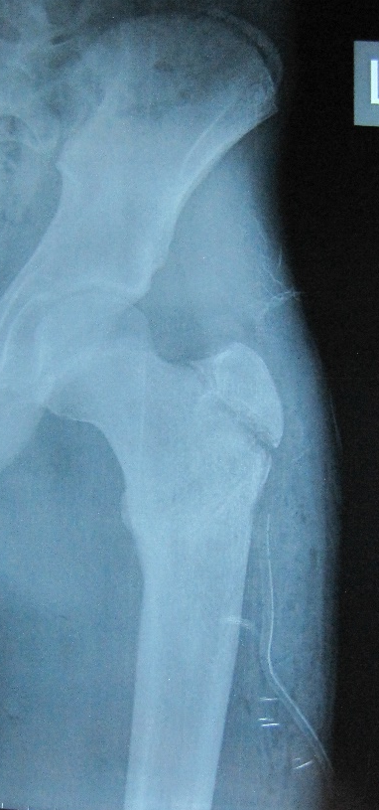
Pathologic Fractures through Primary Malignant Tumors
A 16 Yr. old boy with Ewing sarcoma

Slide 29
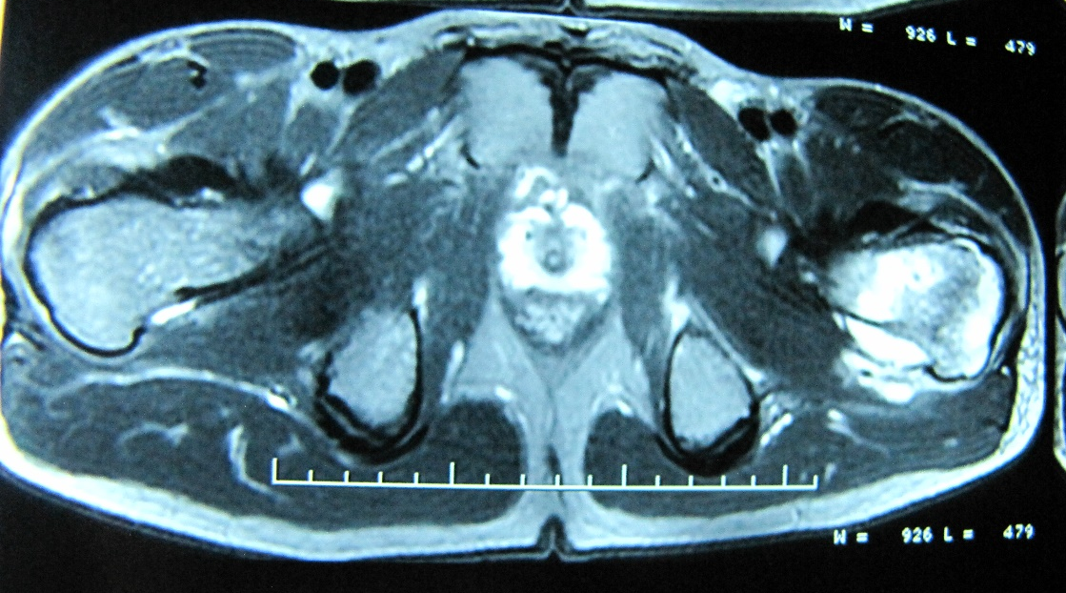
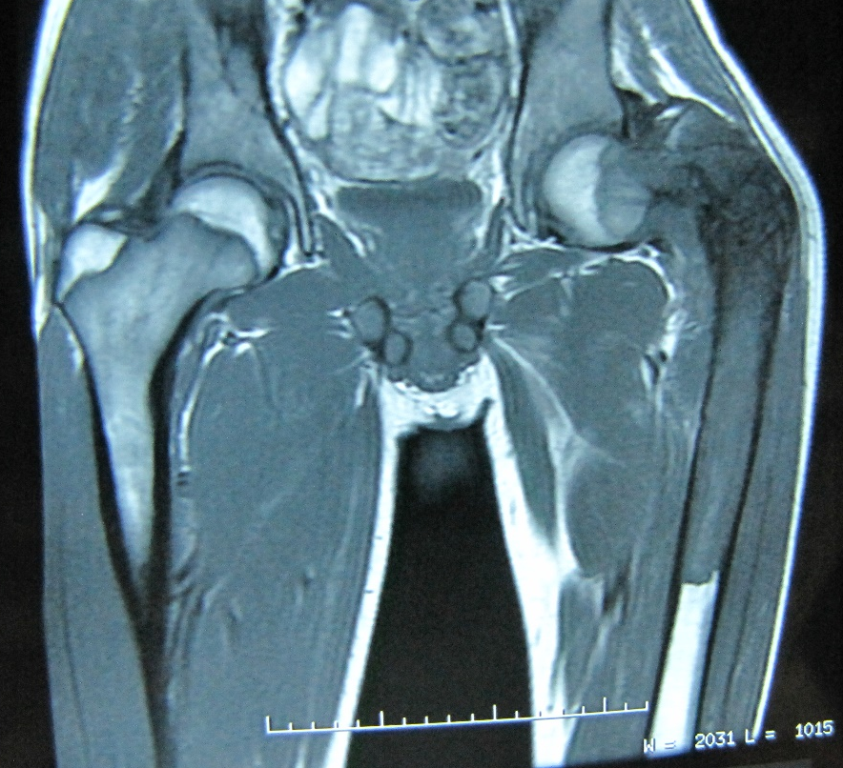
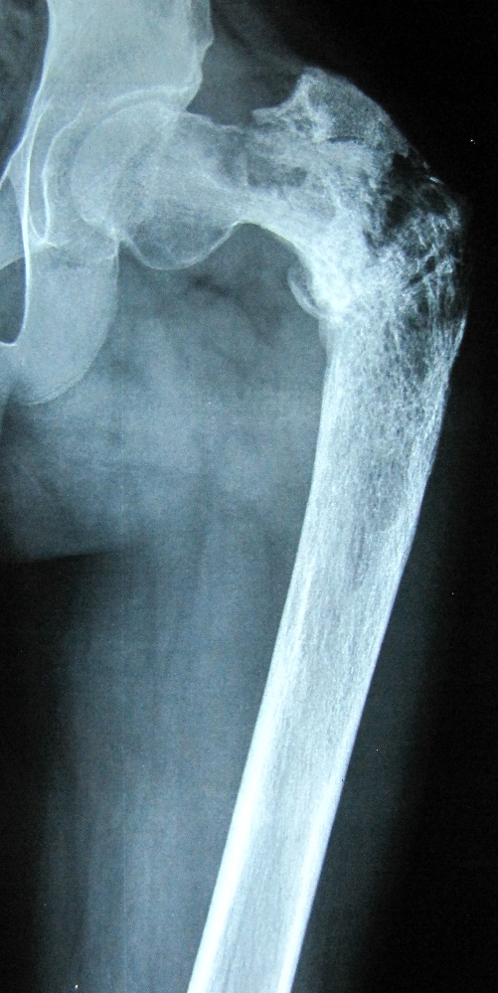
Pathologic Fractures through Primary Malignant Tumors
A 16 Yr. old boy with Ewing sarcoma

Slide 30
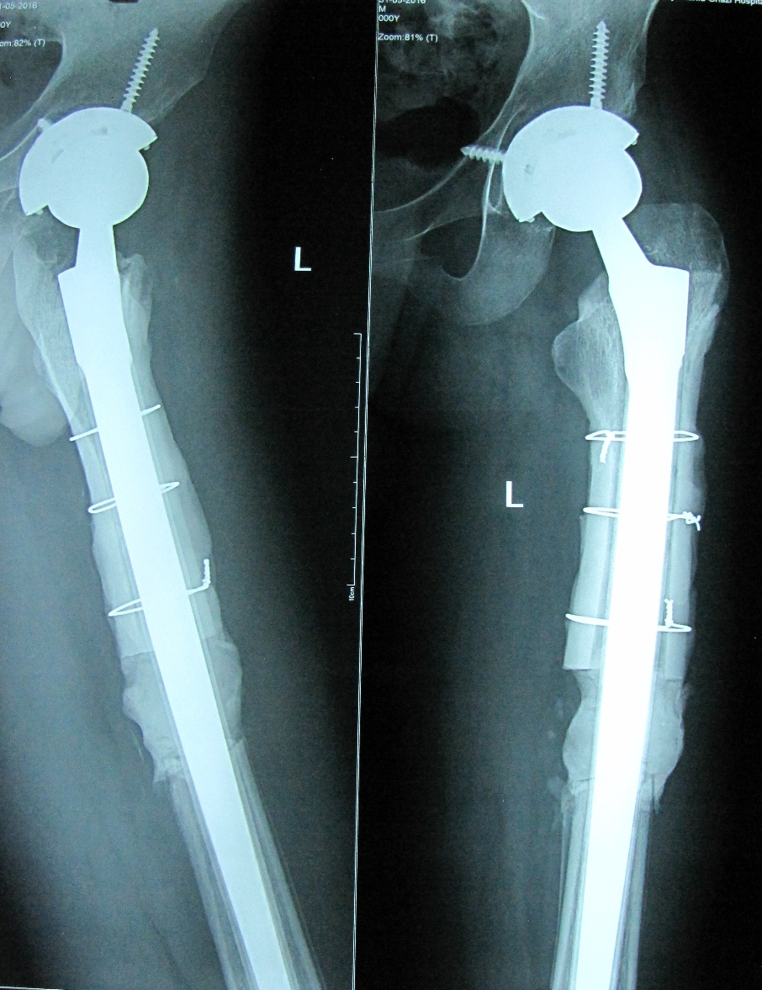
Pathologic Fractures through Primary Malignant Tumors
A 16 Yr. old boy with Ewing sarcoma
2 Yrs. post-op

Slide 31
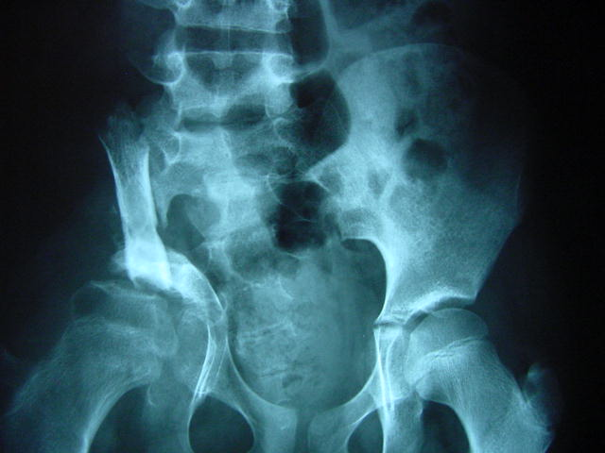
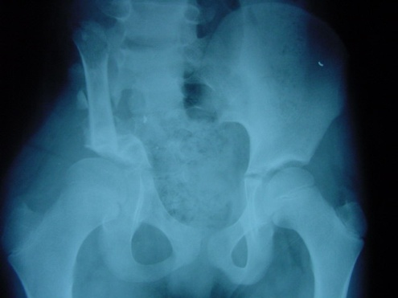
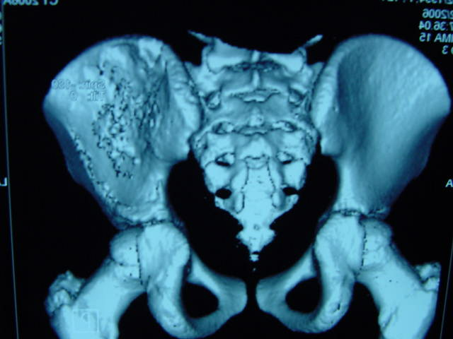
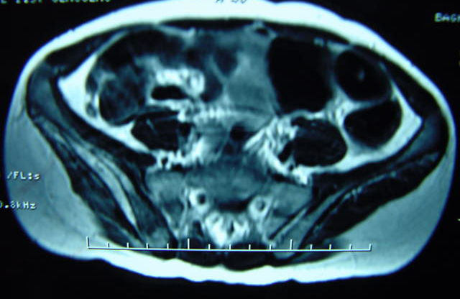
Pelvic Reconstruction After Resection of a Bone Tumor
After 2 Yrs
After 10 months
After Neo Adju ChX
A 10 Yr old girl with Ewig sarcoma of ilium

Slide 32
Expandable prosthesis
Between 6 and 10 expandable prosthesis
Custom-created
Failure of expansion is not uncommon
Many Pts require 10 operation for equalization of limbs
Bone cement is an alternative

Slide 33
Bone cement
A 7 year old girl
After 4 years
After 9 years
Notes:
After 9 years

Slide 34
Conclusions:
Patient with Osteosarcoma under 6 Amputation
Between 6-10 varies (expandable prosthesis is not affordable for many Pts so we use Bone cement)
For those Older than 10 Allograft is the right choice because the uninvolved E.P is preservable.
More than 14 Yrs. old we can use adult modular endoprosthesis.
Prognosis of ES is depends on the effect of chemotherapy.
More conservative surgery can be applied for younger patients.
Pathologic Fx can be manage with Limb salvage after Neoadjuvant Chx.

Slide 35
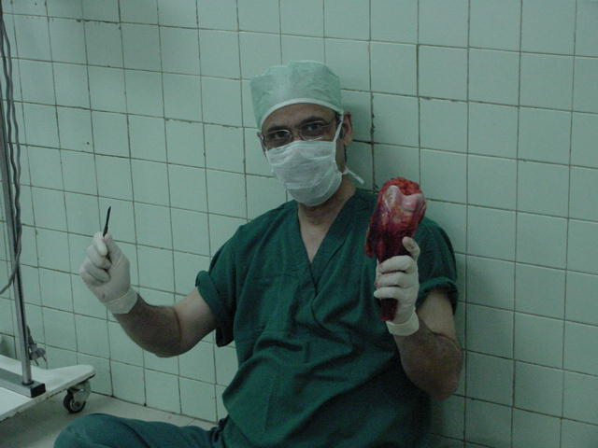
Thanks
For your attention

