Slide 2
Case presentation
9 year old boy child with acute abdominal pain
PMH:negative
Primary physical exam….
CBC perfect
BIO:NL
Primary sonography : heterogeneus solid mass(70. 96mm)in pelvic area.solid heterogeneus hypoechoic mass in RLQ(54 . 88mm)

Slide 3
Primary abdominopelvic CT scan
Mild splenomegaly , significant mucosal thickening of small bowel loop with aneurysmal dilatation ,distal part of large bowel loops , suspicious pelvic lymphadenopathy lymphoproliferative disorder

Slide 4
Abdominopelvic MRI
Aneurysmal dilatation and nodular wall thickening of ileum loop (90mm length)
A 50.37.54mm peritoneal mass lesion in LUQ
Significant mesentric lyphadenopathies in mid abdomen and RLQ
Larg 107.90.88 lobulated presacral mass lesion

Slide 5
Surgury
resection of 2 masses in jejunum and rectum and jejunojejunal anastomosis

Slide 6
Pathology
B cell non hodgkin lyphoma , burkitt type
Tumor size:10.10.5
Involves entire wall thickness , extending to mesentery with multiple mesenteric tumor nodules
Mesenteric lymph node : negative

Slide 7
IHC study
CD 10:positive
CD20:positive
CD45:positive
CD3:negative
CD5:negative
PAX5:positive
Ki67:positive in more than 98%of tumoral cells

Slide 8
bl
BMA &BMB:NL
CSF:NL

Slide 9
Burkitt lymphoma stage III
Group B :intermediate risk
Stage I or II unresected disease
Stage III
Stage IV with,25%BM

Slide 10
Post surgury CT scan
There is a large infiltrative mass 126x94x92 mm in pelvic cavity extending from aortic biforcation to lower parts of presacral space encasing internal iliac vessels and bilateral ureters and cause bilateral hydrouretronephrosis and anterior displacement of bladder

Slide 11
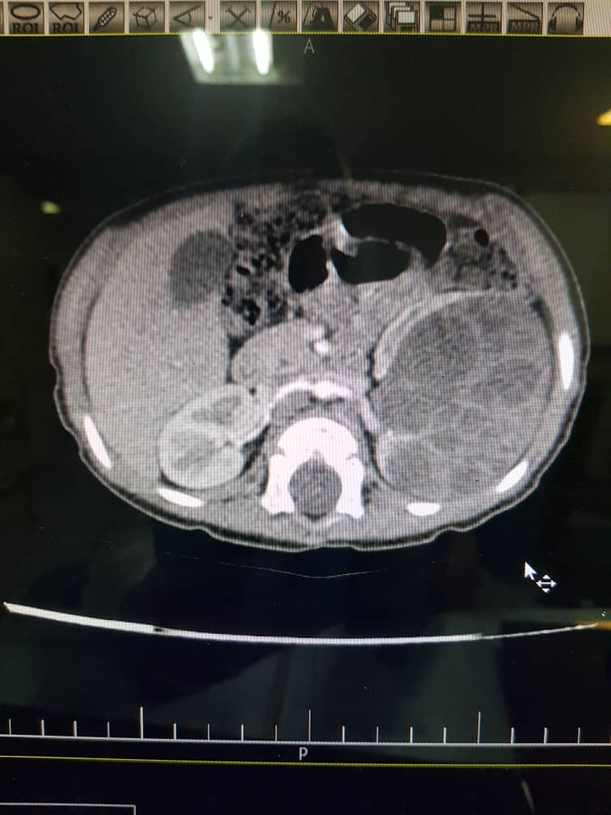

Slide 12
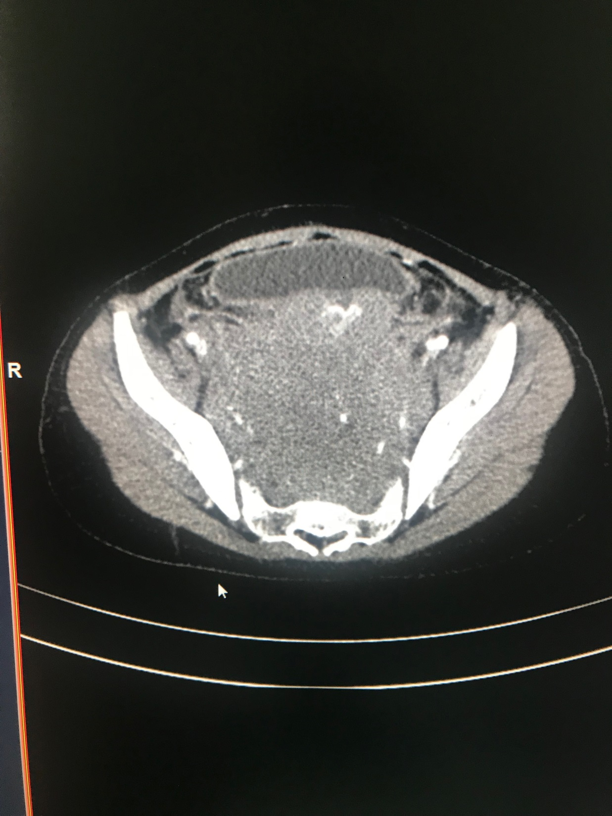

Slide 13
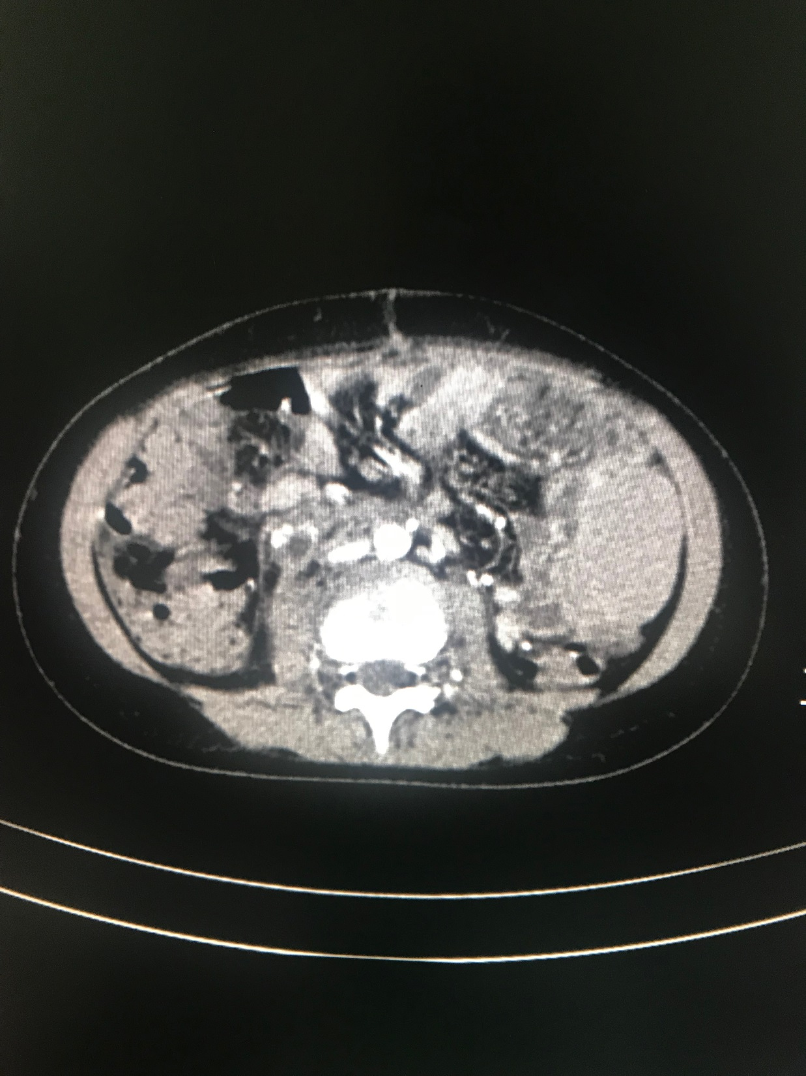

Slide 14
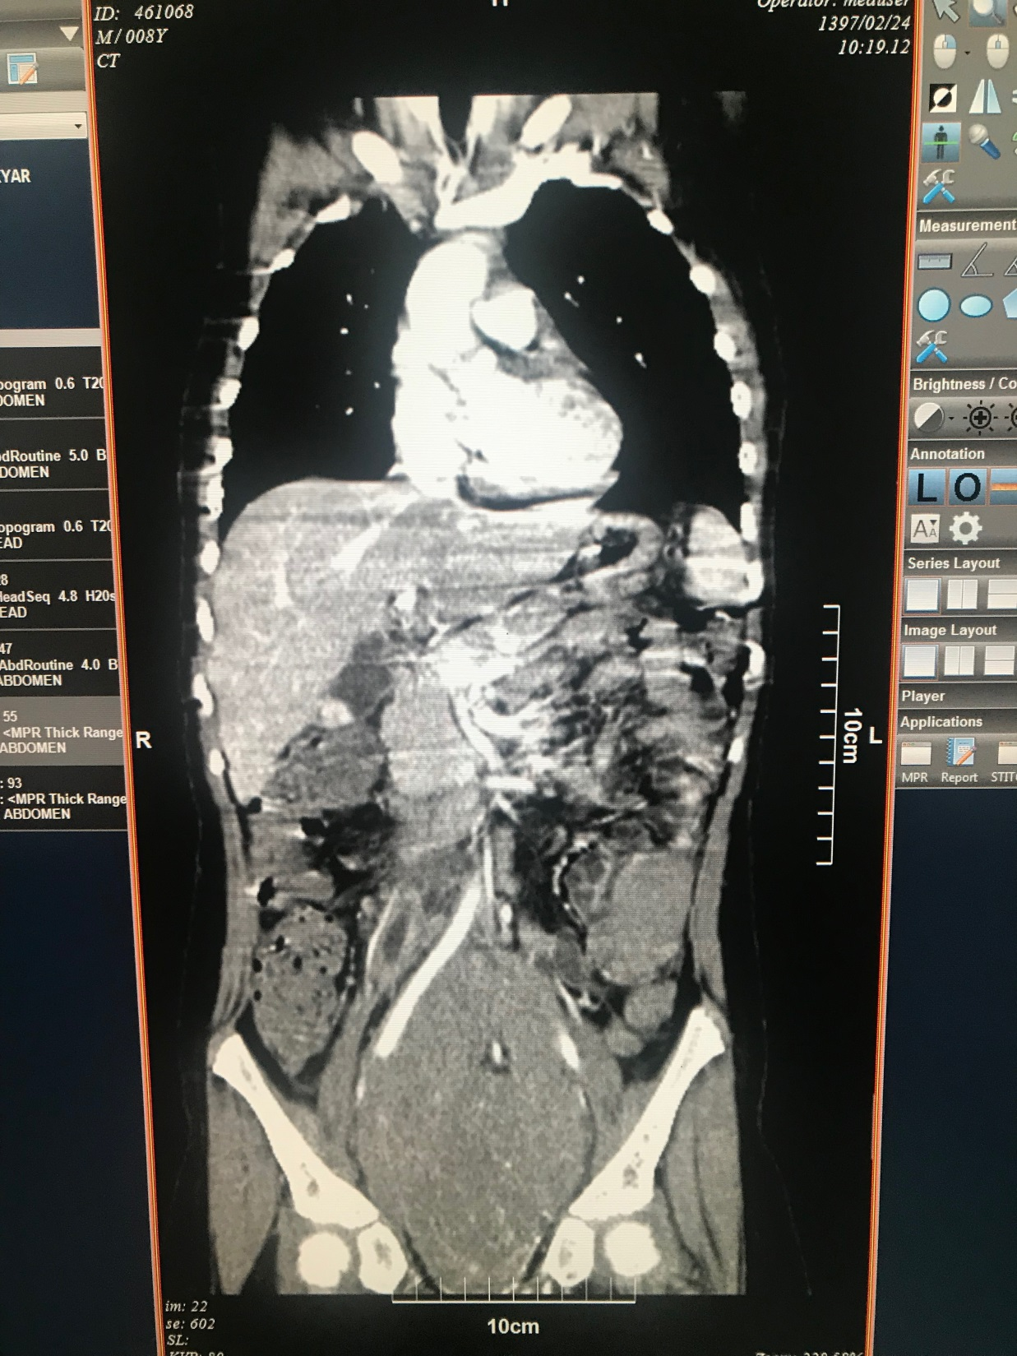

Slide 15
LMB96 protocol –intermediate risk BL
COP COPADM1 COPADM2 CYM1 CYM2

Slide 16
Ct scan after 2 course chemotherapy
Soft tissue density in right presacral measuring 4x33x11 mm is seen suggestive of tumoral remnant with mild extension around right ureter

Slide 17
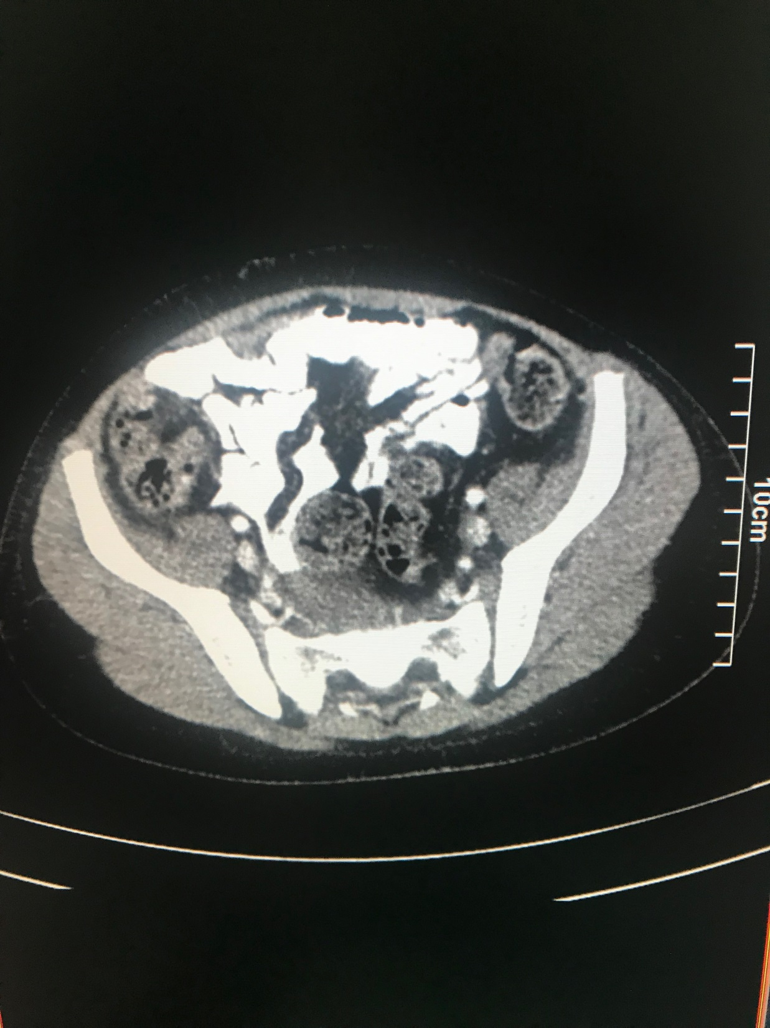

Slide 18
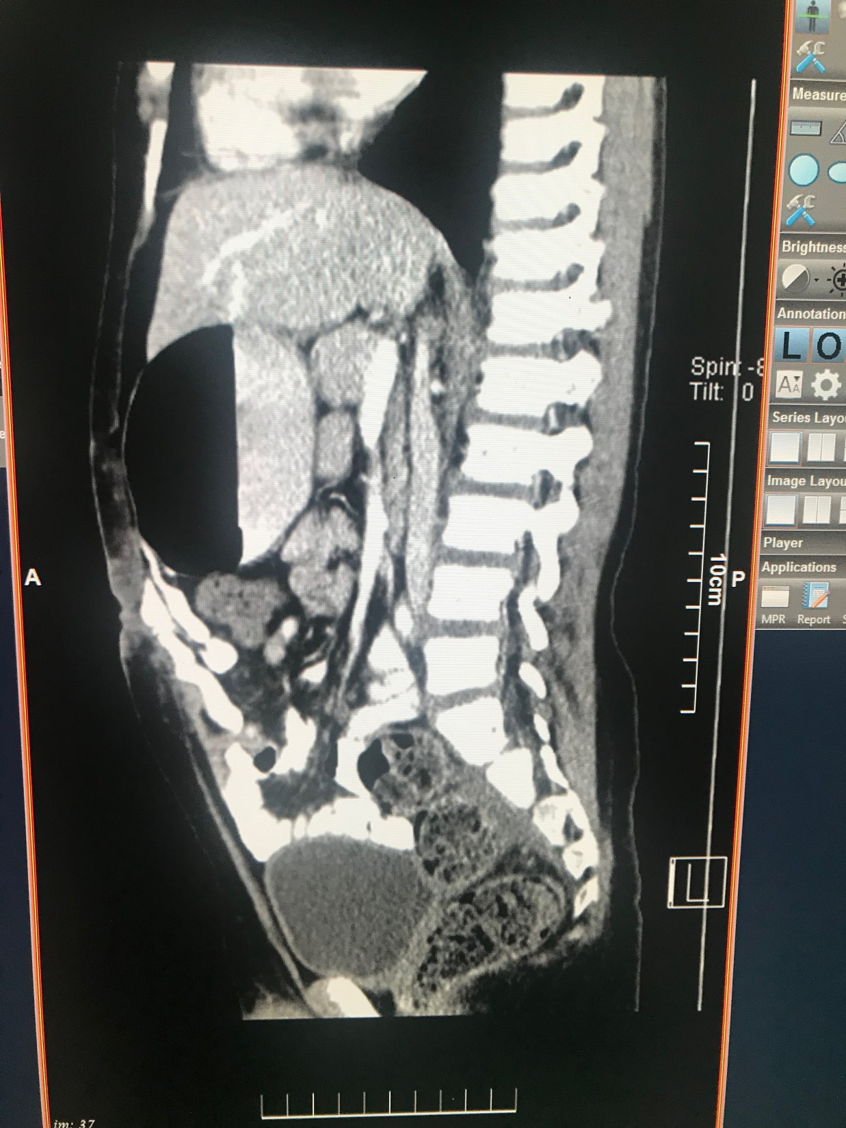

Slide 19
SURVIVAL/GROUP B Bcell NHL
1. All stages: 90.2% 4-year event-free survival.
2. Stage I and II non-resected: 98.4% 4-year event-free survival.
3. Stage III: 89.8% 4-year event-free survival.
4. Stage IV: 85.6% 4-year event-free survival.
5. LDH less than twice normal: 95.8% 4-year event-free survival.
6. LDH greater than twice normal: 85.7% 4-year event-free survival.

Slide 20
Maintenance therapy in NHL
?

Slide 21
Treatment protocol(LMB-96) intermediate risk
Reduction phase
COP
Cyclophosphamide 300 mg/m2 IV Day 1
Vincristine 1 mg/m2 (maximum 2 mg) IV Day 1
Prednisolone 60/mg/m2/day PO or IV Days 1–7
Methotrexate (MTX) and
Hydrocortisone (HC)
Induction: 2 courses of COPADM started on day 8 after first day of reduction (COP) phase
COPADM 1 & 2
Vincristine 2 mg/m2 (maximum 2 mg) IV Day 1
MTX high dose (HD) 3 g/m2 (over 3 hours) IV Day 1
Folinic acid (FA) 15 mg/m2 PO q 6 hr 3 12 dosesb Days 2–4
MTX and HC 15 mg ITa Day 2, Day 6
Cyclophosphamide 250 mg/m2/dose IV q 12 hr Days 2–4 (6 doses total)
Doxorubicin 60 mg/m2 IV 6 hour infusion Day 2 (after
cyclophosphamide)
Prednisolone 60/mg/m2/day PO or IV Days 1–5
G-CSF 5 micrograms/kg/day Day 7 until ANC .3,000/mm3
CYM 1 & 2
MTX high dose (HD 3 g/m2 (over 3 hours) IV Day 1
Folinic acid (FA) 15 mg/m2 PO q6hr 3 12 dosesb Days 2–4
Cytarabine 100 mg/m2/day 24 hour
continuous IV infusion
Days 2–6, inclusive
MTX 15 mg ITa Day 2
HC 15 mg ITa Day 2, Day 7
Cytarabine 30 mg ITa Day 7
G-CSF 5 micrograms/kg/day Day 7 until ANC .3,000/mm3

Slide 22
Main Subtypes of Pediatric NHL Subtype of lymphoma Frequency
Precursor lymphoid neoplasms:
T-lymphoblastic lymphoma 15%–20%
B-lymphoblastic lymphoma 3%
Mature T-cell neoplasms:
Anaplastic large cell lymphoma, ALK positive 15%–20%
Peripheral T-cell lymphoma (NOS) Rare
Mature B-cell neoplasms:
Burkitt lymphoma 35%–40%
Diffuse large B-cell lymphoma 15%–20%
Primary mediastinal B-cell lymphoma 1%–2%
Pediatric follicular lymphoma Rare
Pediatric nodal marginal zone lymphoma Rare

Slide 23
Mature B-Cell Lymphomas
mechanism of lymphomagenesis:
abnormal proliferation(children,pro prolifrative proteins)
defective apoptosis (adult B-cell lymphomas)

Slide 24
burkitt
Endemic
Sporadic
Immunodeficiency related

Slide 25
Morphologically
intermediate-sized homogeneous cells
round to oval nuclei
basophilic nucleoli with
basophilic cytoplasm, vacuolated(lipid droplets)

Slide 27
tissue sections
“starry-sky”appearance
reactive macrophages scattered among the malignant lymphoid cells that are engulfing apoptotic debris from the rapidly dividing tumor cells

Slide 29
Burkitt
B cell (sIg+) CD19,CD20, CD22, CD10 germinal center origin
t(8;14)(q24;q32)IgHcMYC(80%)
t(2;8) (p11;q24) Igκ- cMYC(15%)
t(8;22)(q24;q11)Igλ-cMYC(5%)

Slide 30
Chromosome 8 breakpoint
endemic BL :breakpoints upstream of cMYC
sporadic BL: breakpoints within or very near to the cMYClocus

Slide 31
additional cytogenetic abnormalities
deletion 13q
duplication 1q
deletion 6q
17p abnormality
11q abnormality

Slide 32
bl
characteristic finding of BL:lack of expression of the antiapoptotic protein BCL2
BCL2 expression is more commonly in DLBC
IHC for cMYC protein is positive in BL( DLBCL)
doubling time of 12 to 24 hours
Ki-67 or MIB-1(99% of the tumor cells)

Slide 33
Endemic burkitt lymphoma
Peak:4-7 y
male>female
Malaria belt:equatorial africa.new guinea.amazonian bbrezil.turkey
10 in 100000
Jaw.abdomen(mesentery and
omentum).cns(1/3)csf. orbital tumors
Starry sky pattern
CD10,20,usually Igm,ᶄ or λ,BCL2 –
95%EBV DNA in tumor cells
Breakage:upstream of cmyc
Site of cell origin :Germinal center of lymph node

Slide 34
Sporadic burkitt lymphoma
Peak:6-12y
Male>female
United state,europe
0.2 in 100000
Abdomen(massive disease :mesentery, retroperitoneum, kidneys, ovaries, and peritoneal surfaces), head and neck,BM(20%)
Histologic and immonologic feature (same)
EBV DNA(15%)
Breakage:within cmyc
Site of cell origin: Bone marrow

Slide 35
Risk Stratification Schema
B-cell NHL (FAB/LMB)
A: Completely resected stage I and abdominal stage II
B: Multiple extra-abdominal sites.
Nonresected stage I and II, III, IV (marrow <25% blasts, no CNS disease)
C :Mature B ALL (>25% blasts in marrow) and/or CNS disease

Slide 36
Risk Stratification Schema
B-cell NHL (BFM)
R1: Completely resected stage I and abdominal stage II
R2: Nonresected stage I/II and stage III with LDH <500
R3: Stage III with LDH 500 -999 ,Stage IV, B-ALL (>25% blasts), no CNS disease and LDH <1,000
R4 :Stage III, IV, B-ALL, and LDH ≥1,000 Any CNS disease

Slide 37
Adverse prognostic factors
High LDH
CNS disease at diagnosis
slow response to the early phase of chemotherapy (days 1 to 7)
deletion of 13q and duplication of 7q

Slide 38
Therapy course
Group A :Stage I completely resected disease
Stage II abdominal completely resected disease
COPAD COPAD(EFS&OS:98.3 and 99.2)
Group B :Stage I or II unresected disease
Stage III
Stage IV with,25%BM
COP COPADM1 COPADM2 CYM1 CYM2
Group C BM 25% involvement
Stage II abdominal resected disease
Stage III
Stage IV with <25% BM
Any CNS involvement*
COP COPADM1 COPADM2 CYVE1 CYVE2 M1-M4

Slide 39
SURVIVAL GROUP B
1. All stages: 90.2% 4-year event-free survival.
2. Stage I and II non-resected: 98.4% 4-year event-free survival.
3. Stage III: 89.8% 4-year event-free survival.
4. Stage IV: 85.6% 4-year event-free survival.
5. LDH less than twice normal: 95.8% 4-year event-free survival.
6. LDH greater than twice normal: 85.7% 4-year event-free survival.

Slide 40
SURVAIVAL GROUP C
a. Bone marrow involvement only: 91% 4-year event-free survival
b. CNS involvement only: 85% 4-year event-free survival
c. Bone marrow and CNS involvement: 66% 4-year event-free survival
d. CNS patients who received high-dose methotrexate (without cranial RT) had
similar overall survival to those on prior studies who received cranial RT.

