Slide 2
Case presentation Refractory BLBL in 6 yr old boy
Elham Shahgholi MD
Maryam Behfar MD

Slide 3
6 year old boy presented with weight loss and Anorexia. Fever and bone pain negative

Slide 4
Physical examination:
Massive hepatosplenomegaly
No lymphadenomegaly

Slide 5
Investigations:
CBC:
Wbc: 2100 (nut 32%, lym:60%, mo:3%, Eo:2%, lyn v.:3%)
Hb: 10.9
Plt: 134000
Coagulation test:
PT, PTT: normal
ESR: 13

Slide 6
Investigations:
LFT
AST: 73
ALT: 16
Alk P.: 529
LDH: 869

Slide 7
Investigations:
Other
HBV: Neg
TSH: 12 ↑
BHCG: <0.5
AFP: 2.1
2MP: Neg
EBV: IgG→pos, IgM→Neg
CMV: Neg

Slide 8
Investigations:
Sonography:
Heterogeneous spleen, 132 mm
Heterogeneous liver, 140 mm,
Multiple hypo-echo lesions without vascularity in liver
No Ascites
No LAP
CXR:
Normal

Slide 9
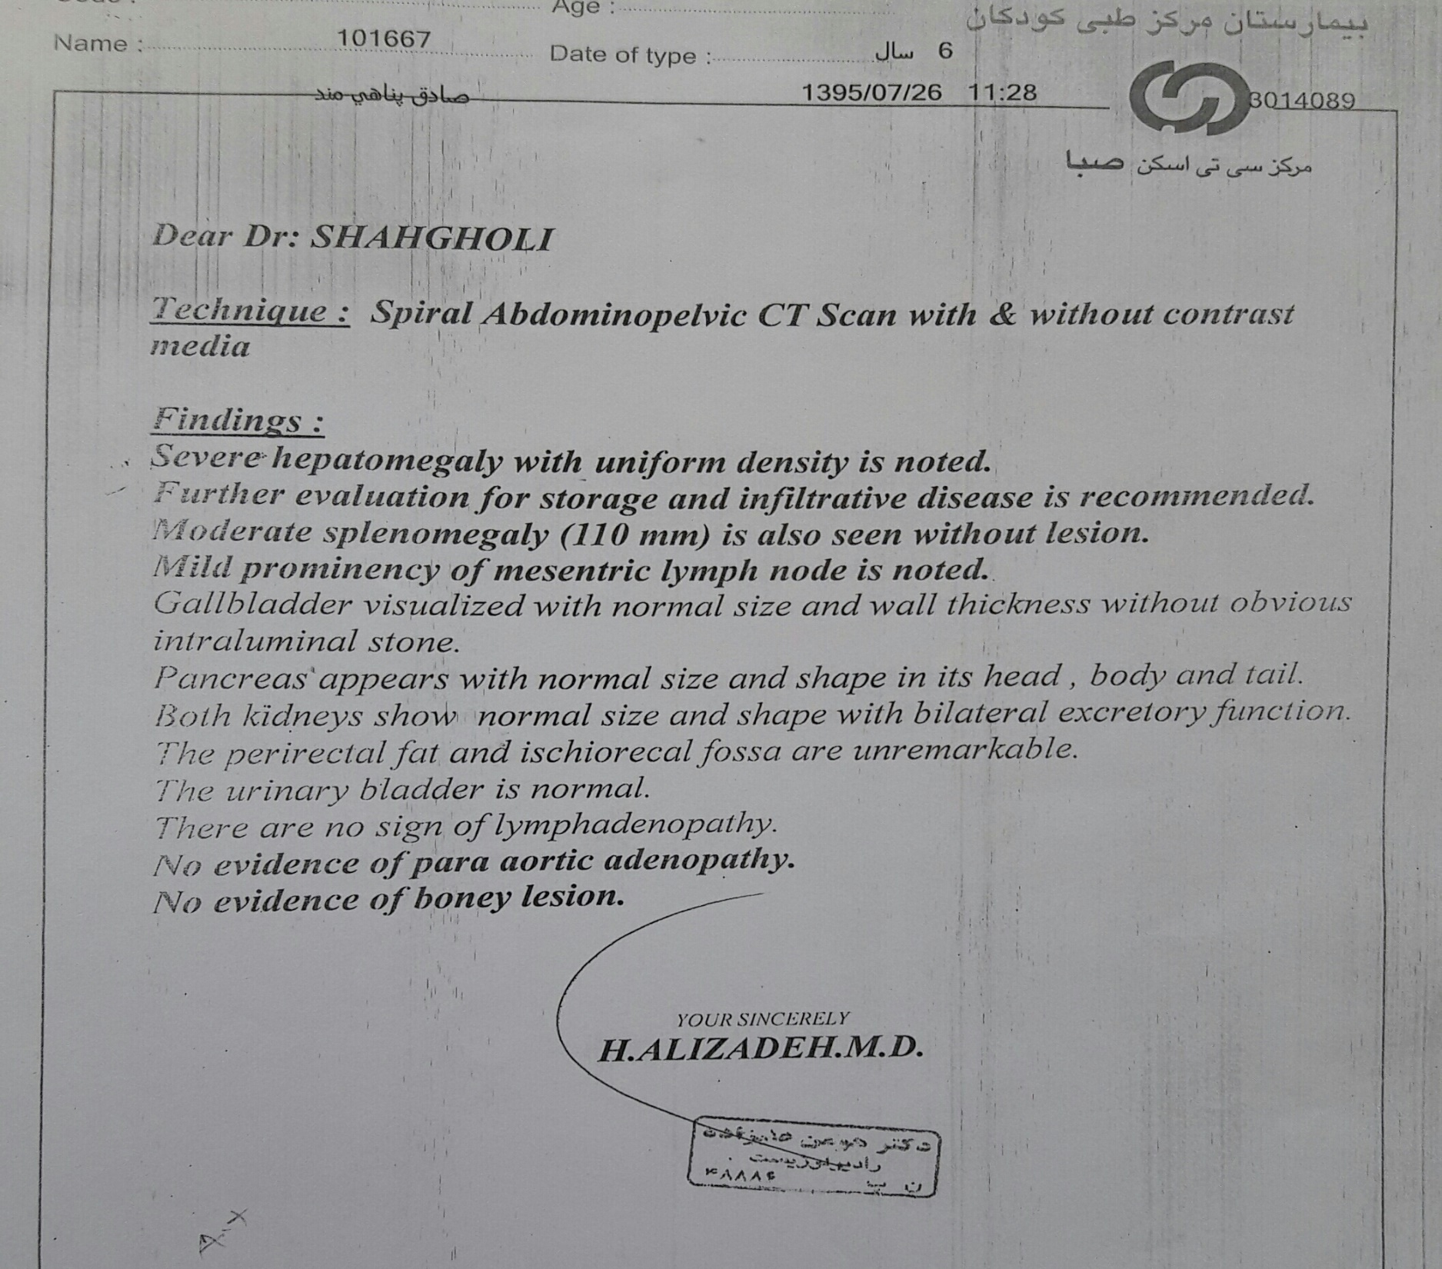
CT scan:

Slide 10
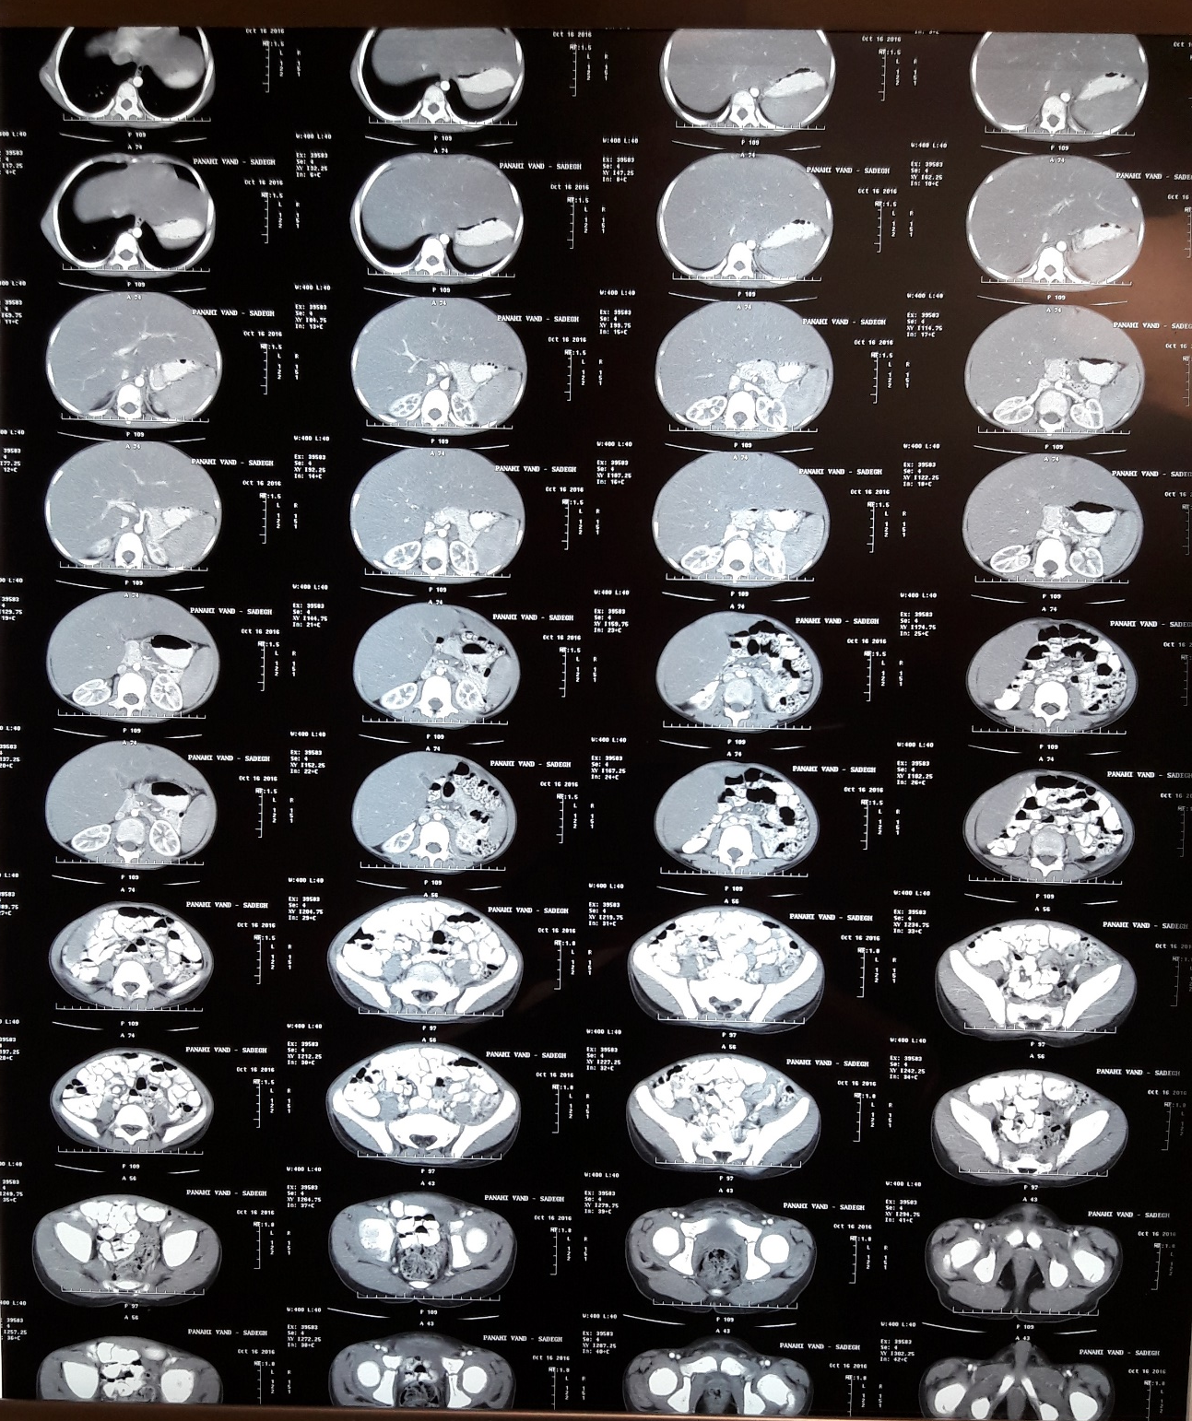
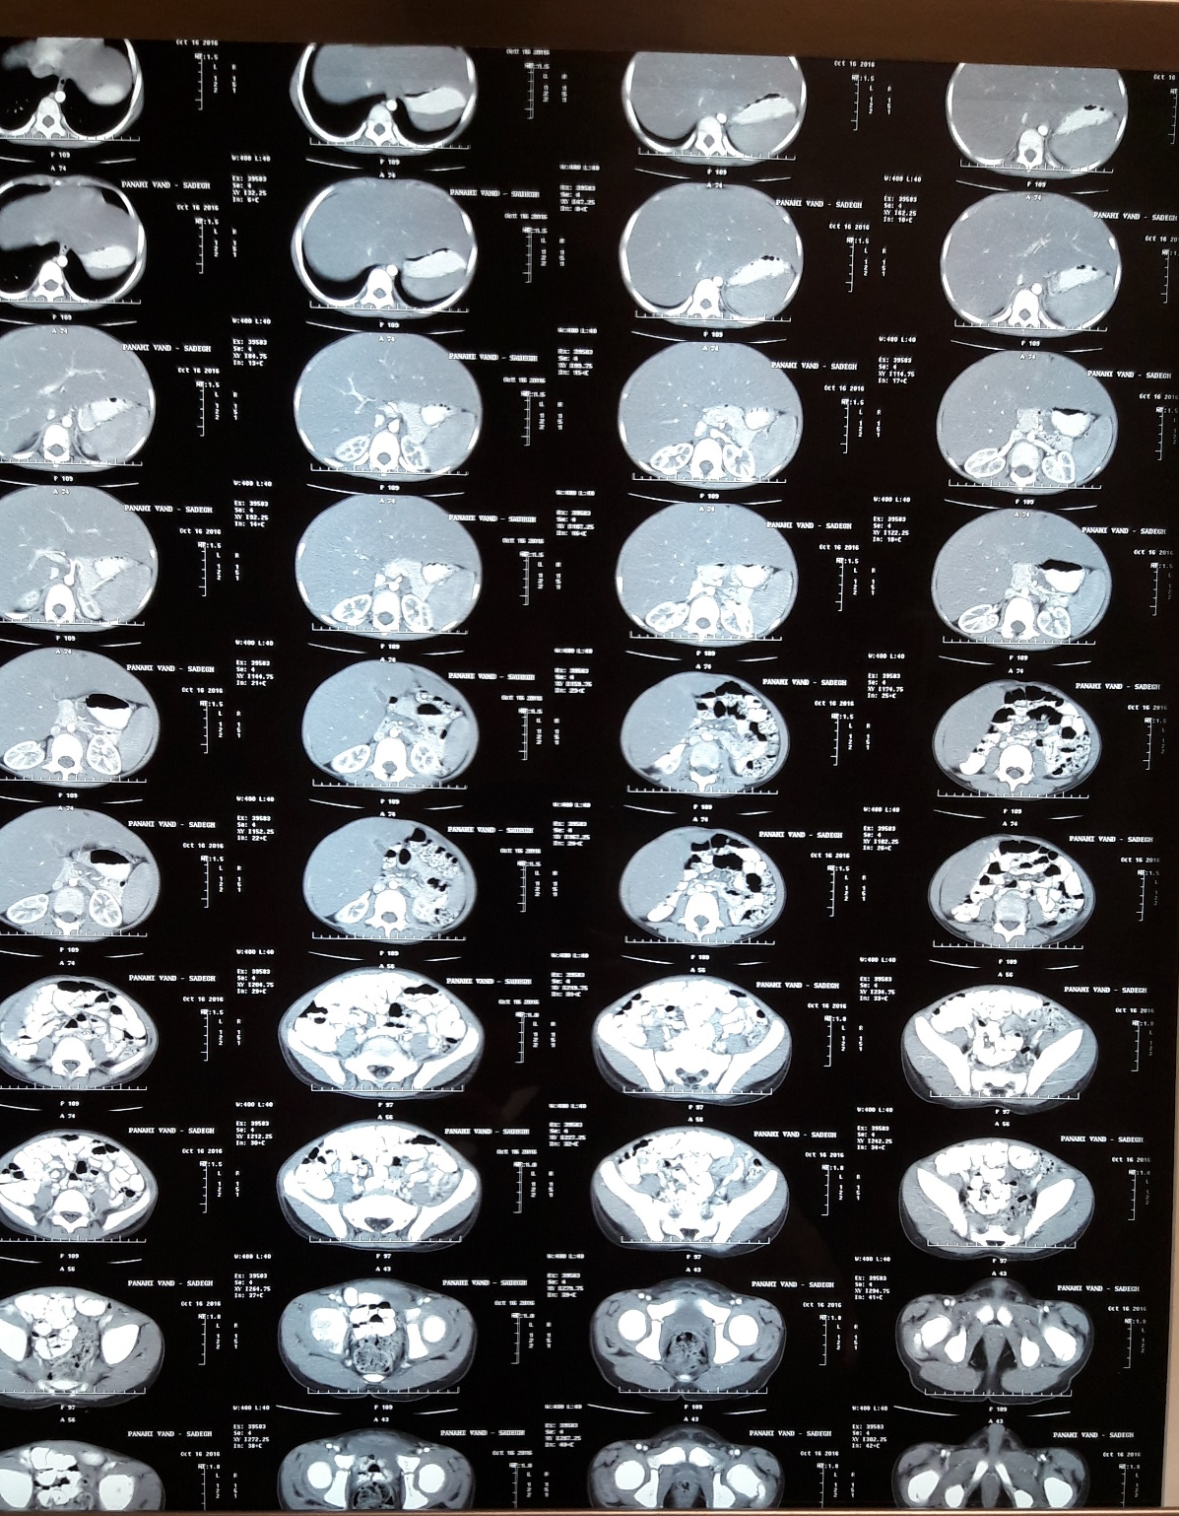

Slide 11
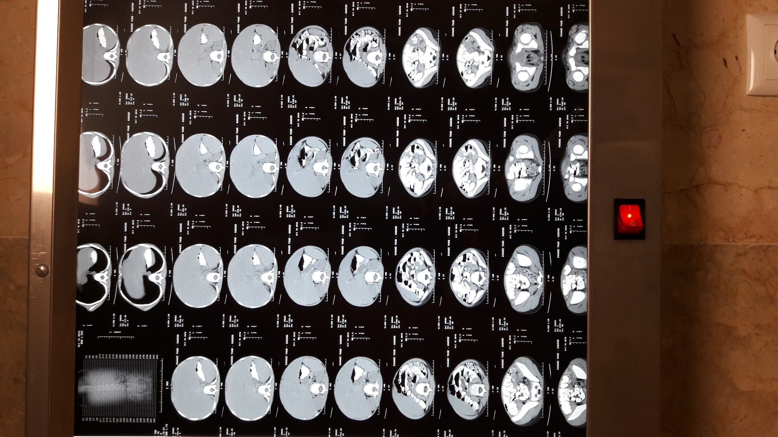

Slide 13
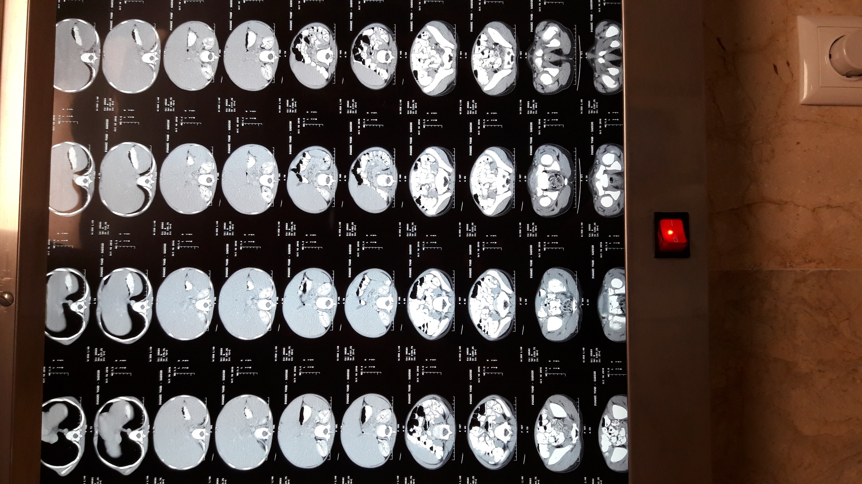

Slide 14
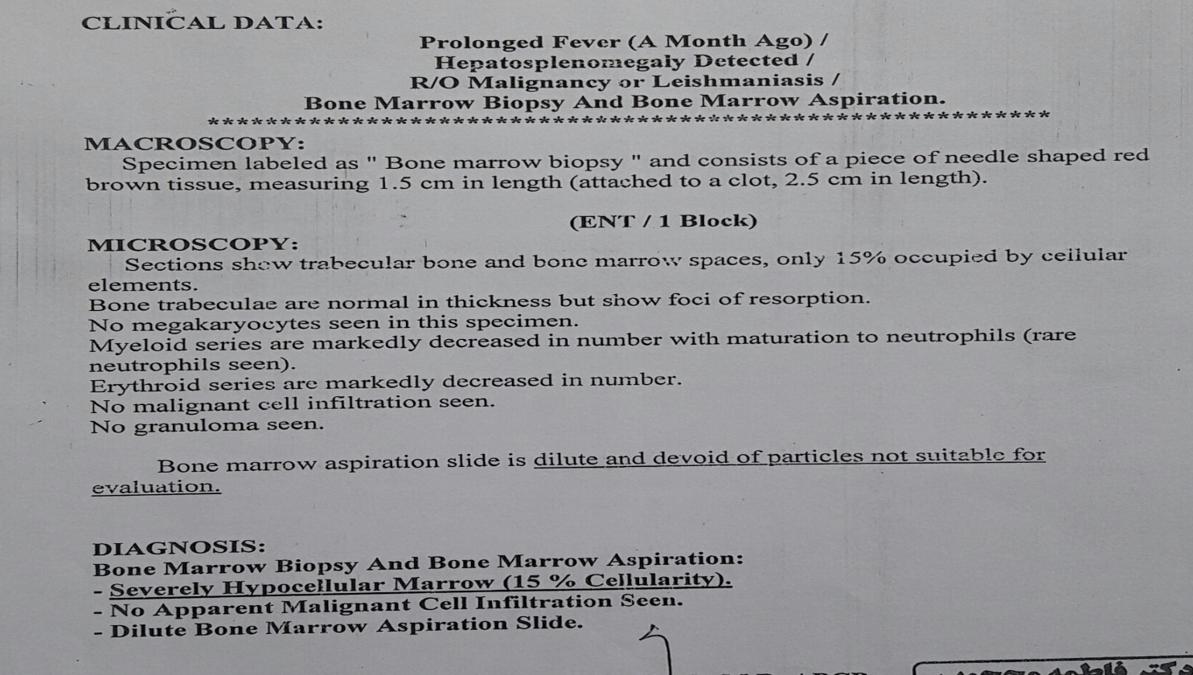
1st BMA & BMB

Slide 15
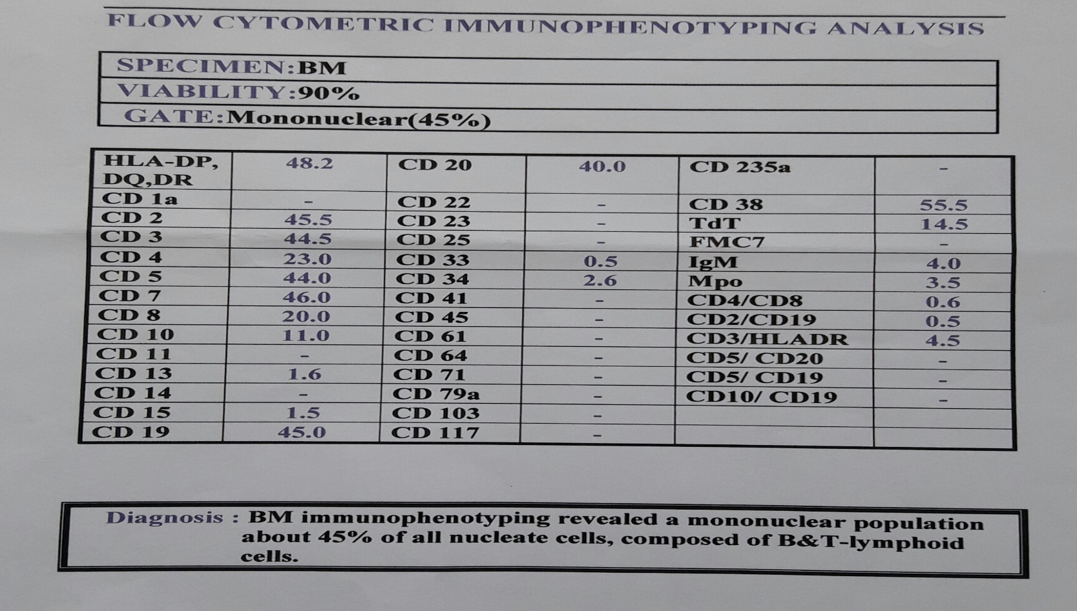
Immunophenotyping

Slide 16
CSF

Slide 17
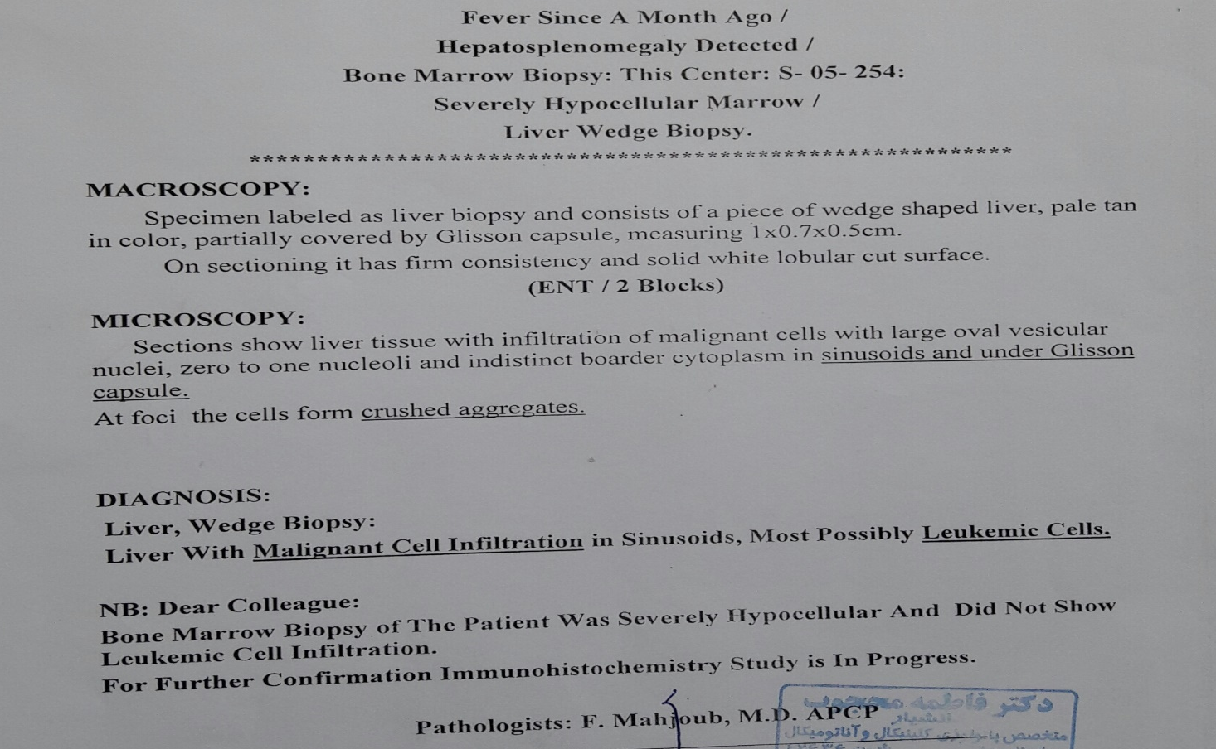
Liver biopsy

Slide 18
Liver biopsy

Slide 19
Whole body bone scan

Slide 20
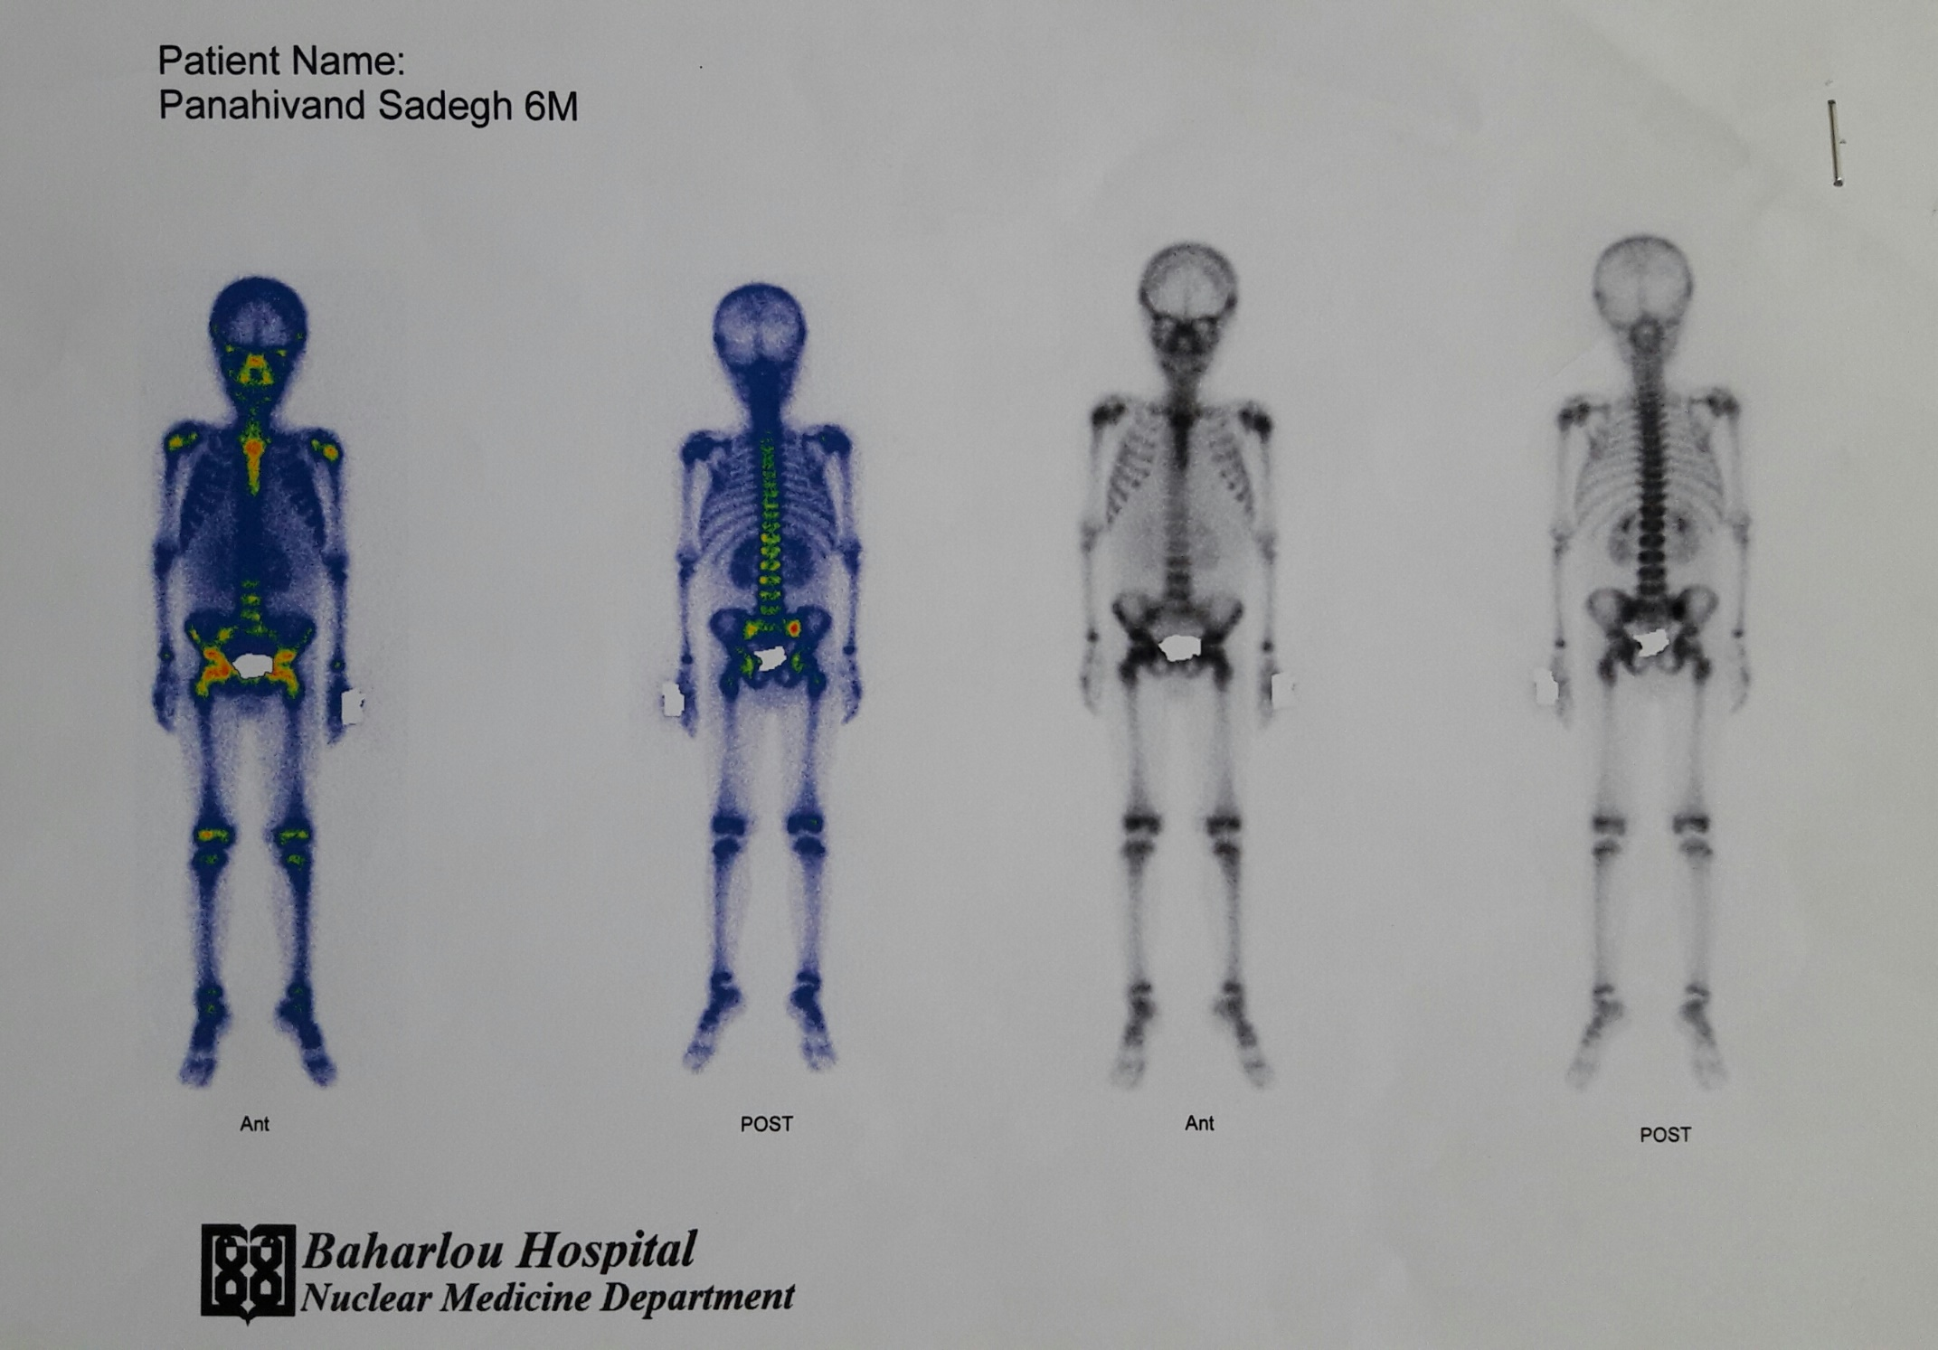

Slide 21
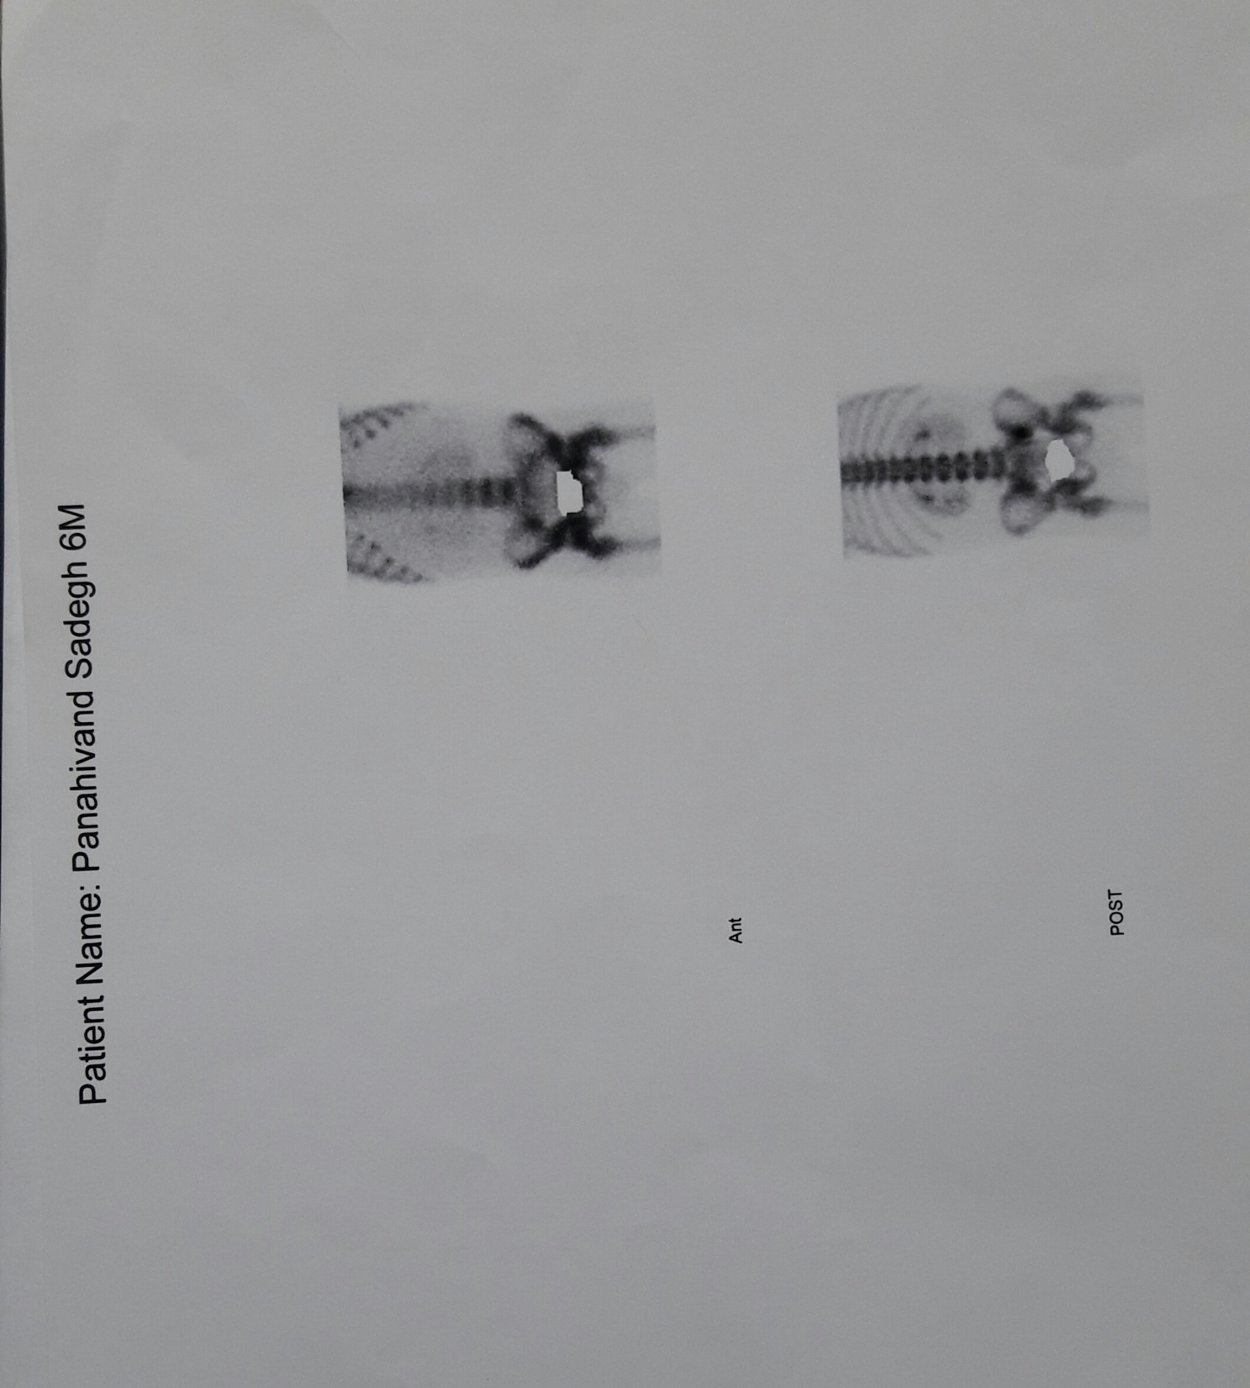

Slide 22
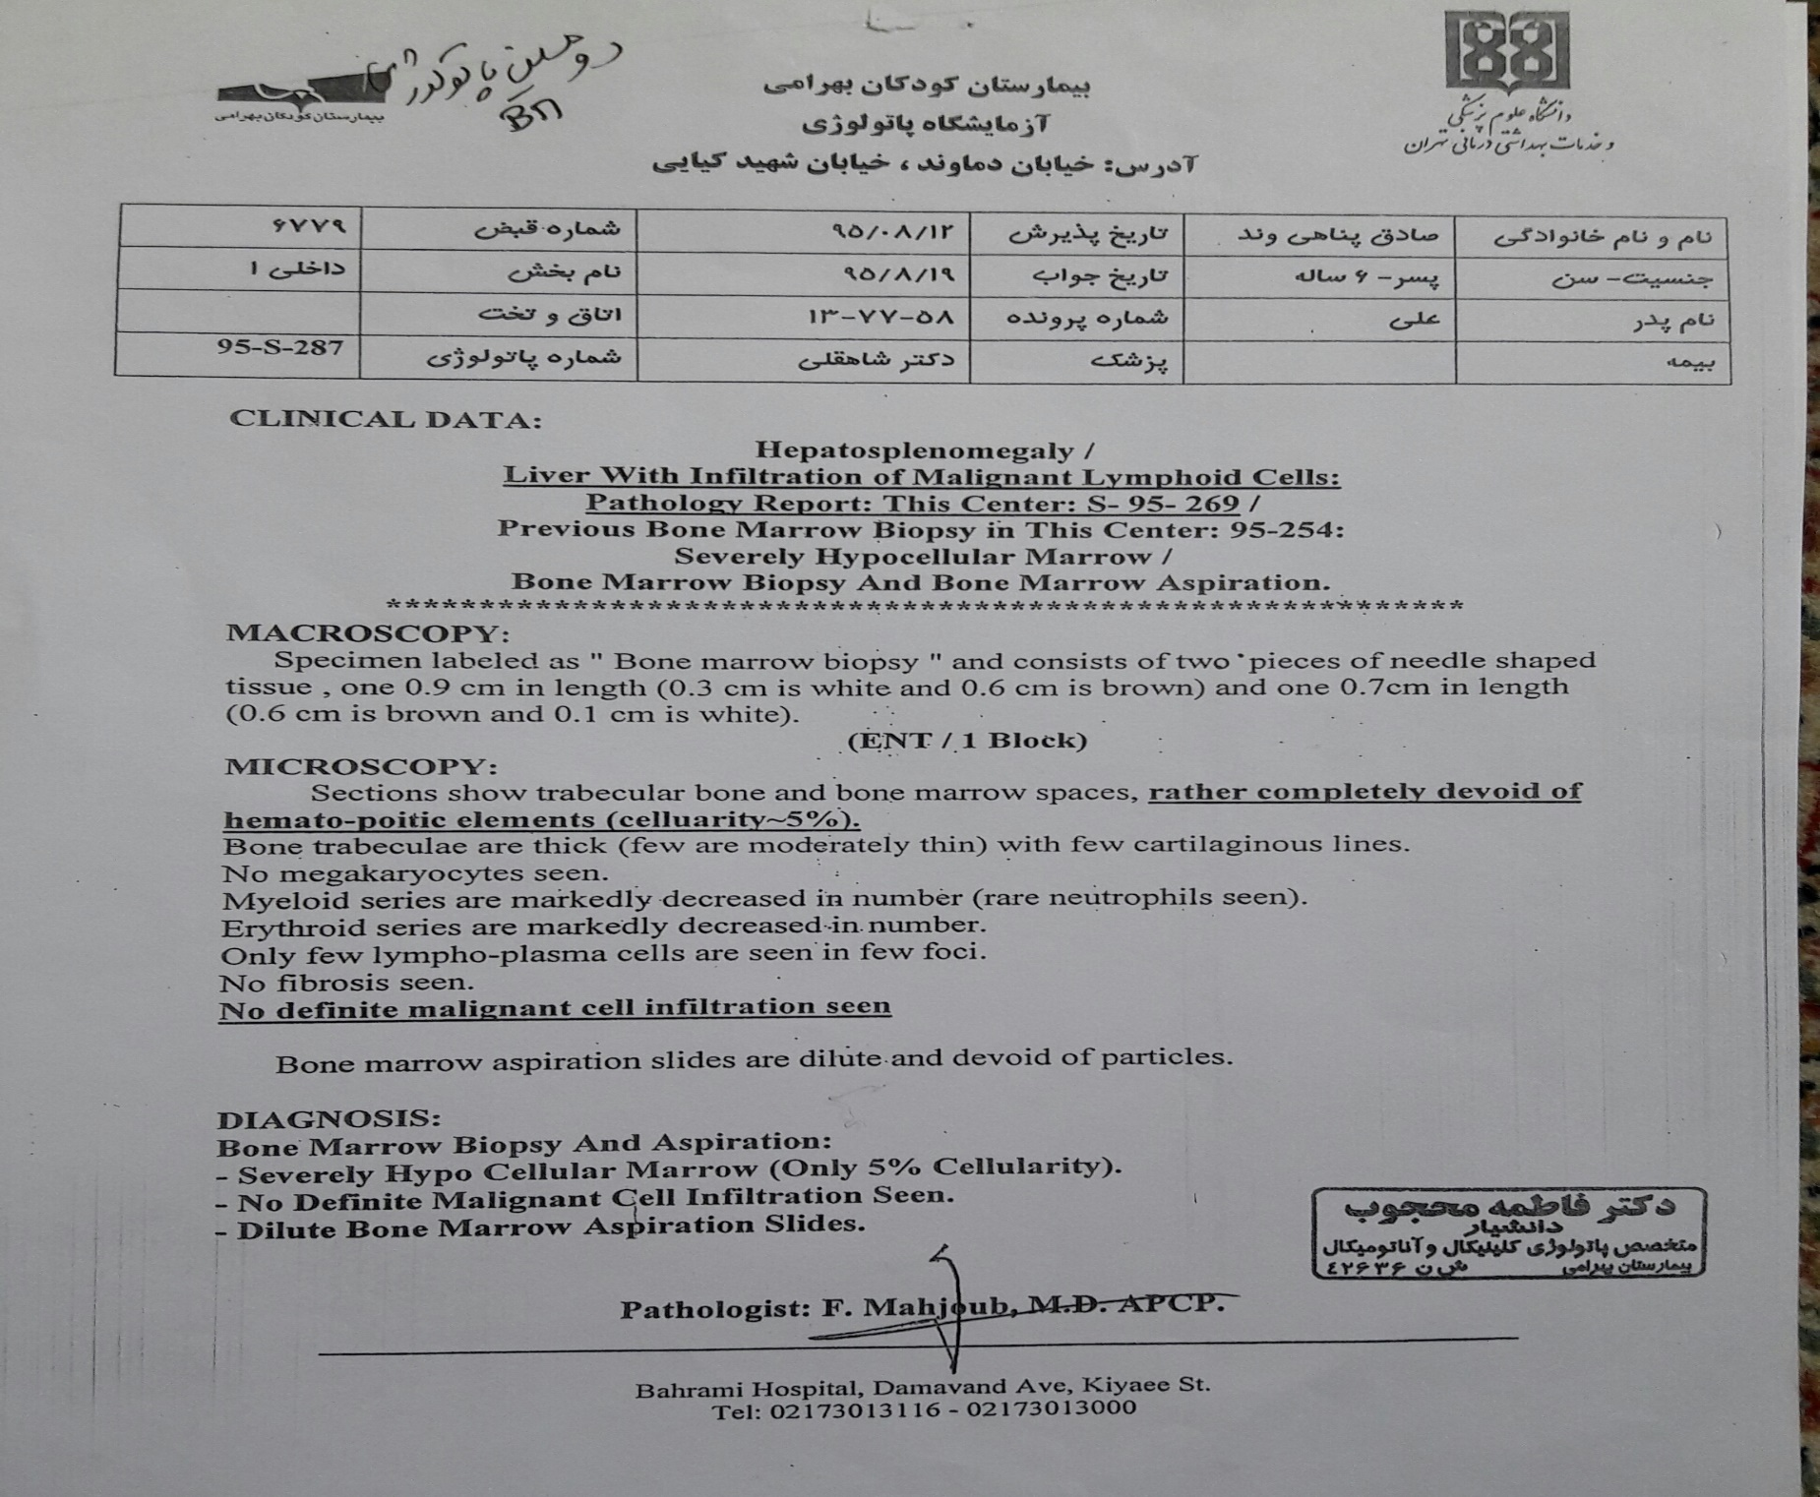
2nd BMA&BMB

Slide 23
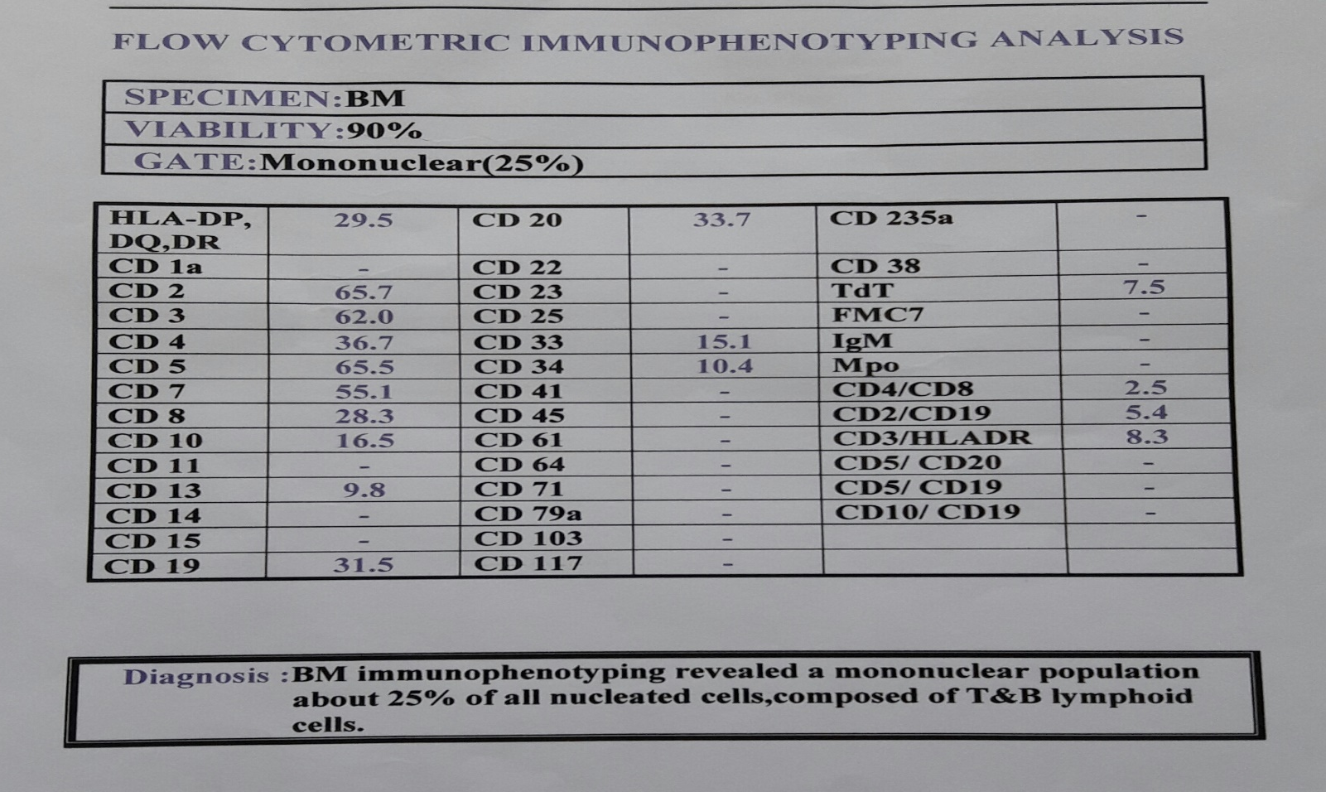
Flow cytometric immunophenotyping

Slide 24
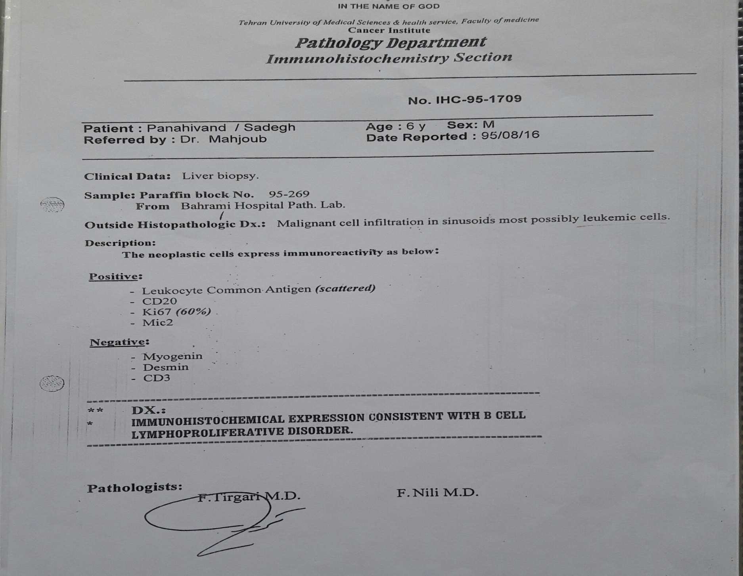
IHC (1)

Slide 25
IHC (1)

Slide 26
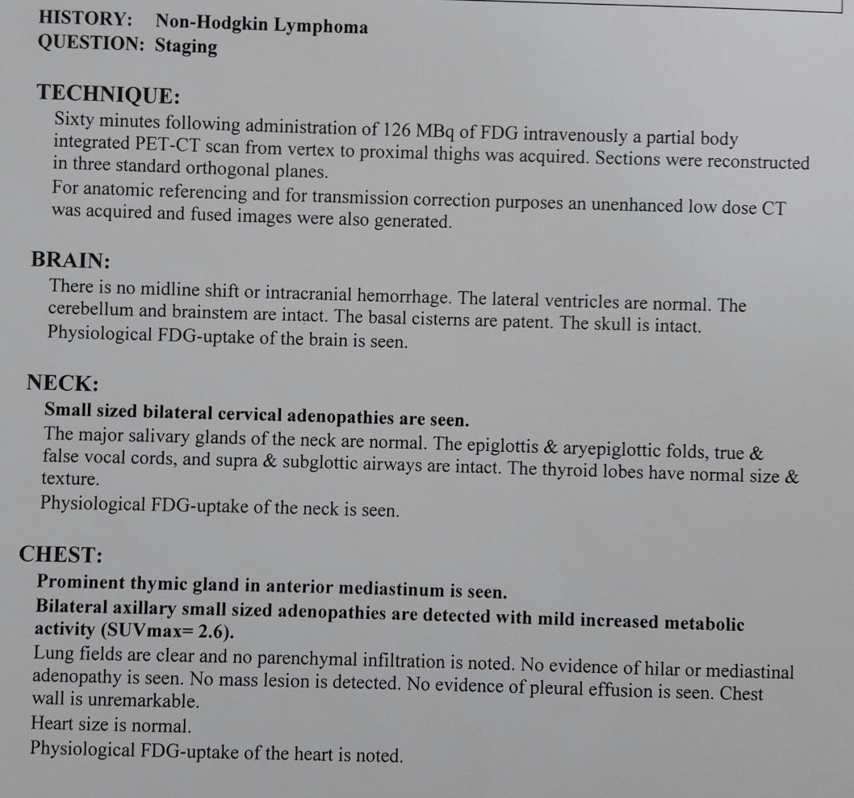
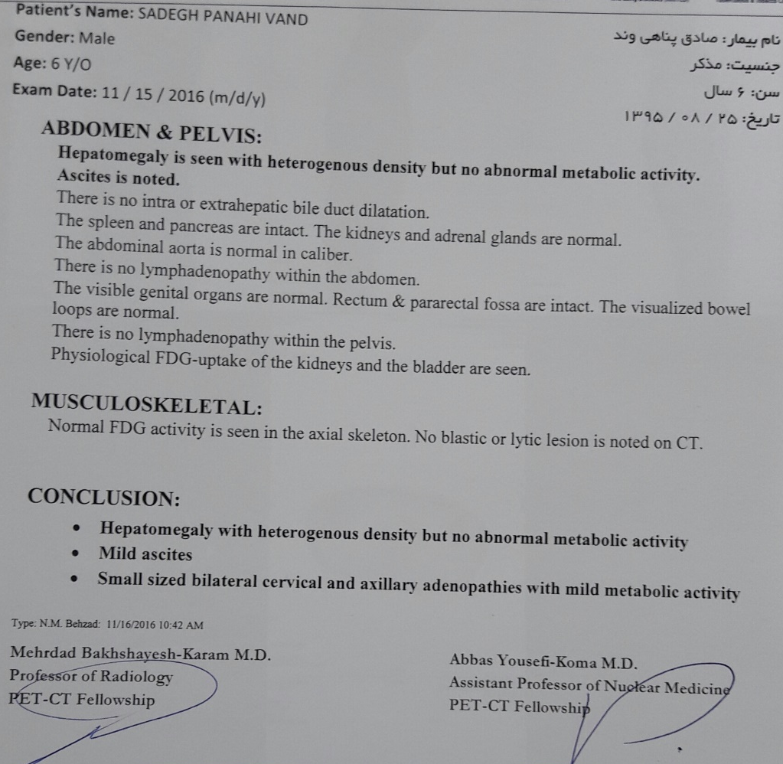
PET Scan

Slide 27
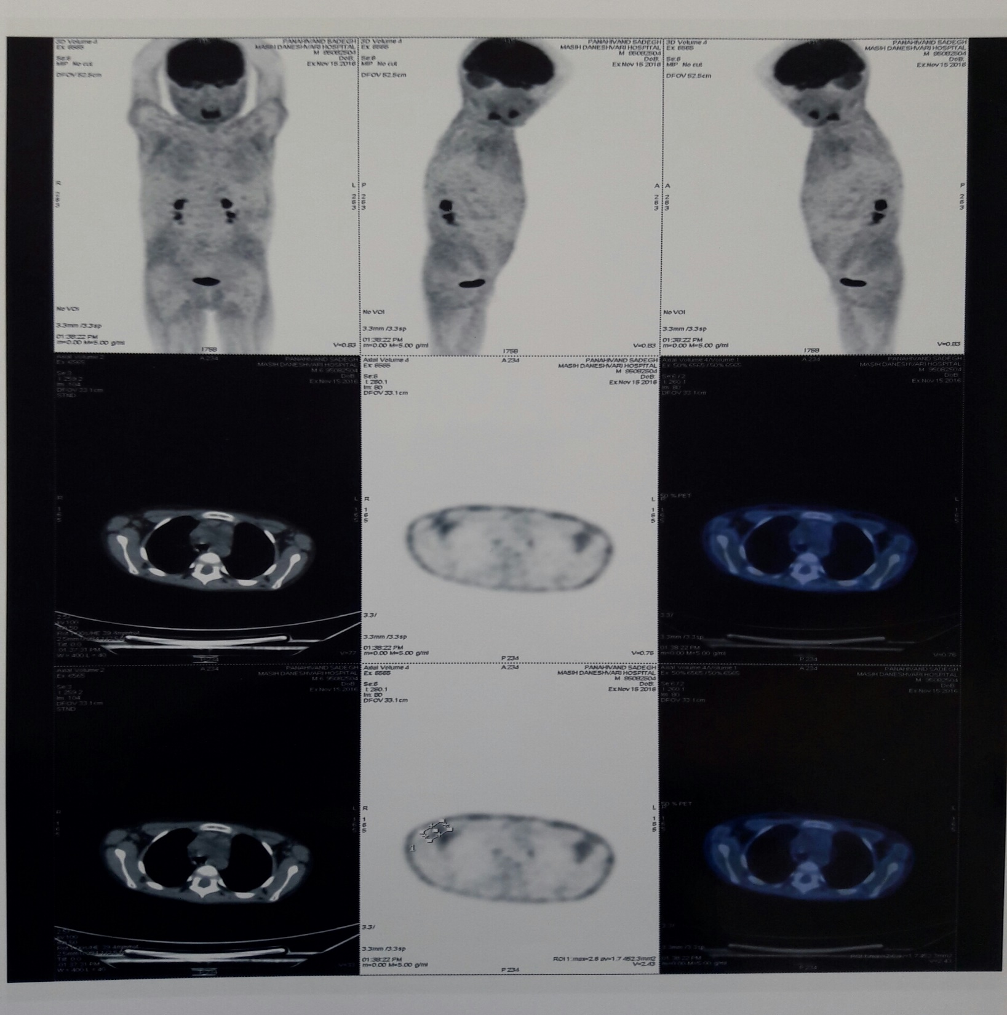

Slide 28
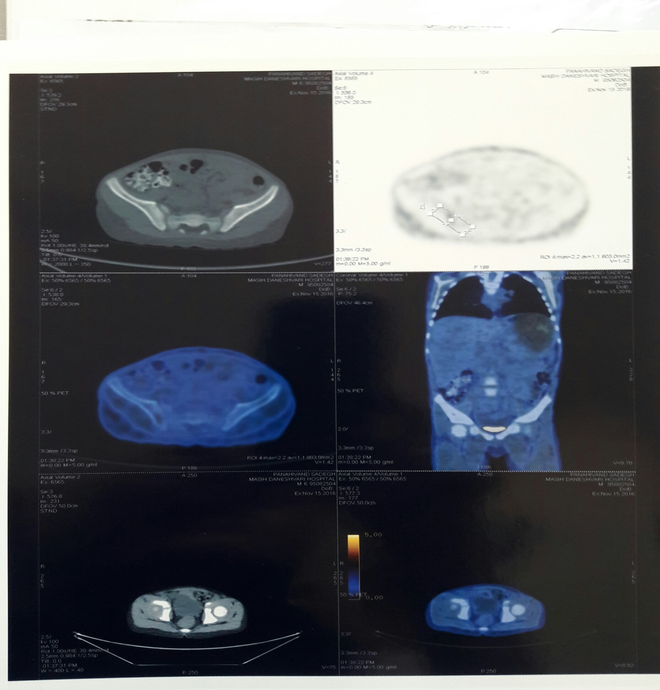

Slide 29
Based on all findings and diagnosis of Burkitt's lymphoma, LMB protocol was selected for this patient and he received induction and re-induction phase of this protocol and he re-evaluated.

Slide 30
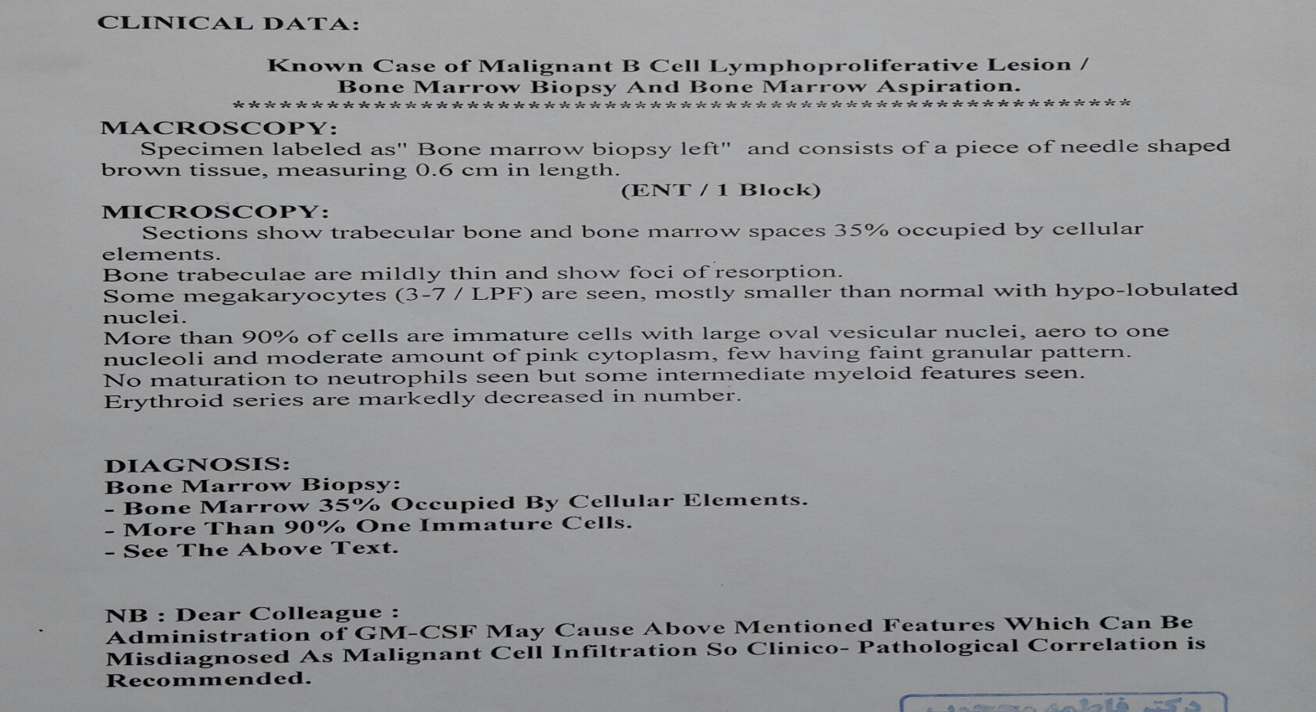
3th BMA&BMB

Slide 31
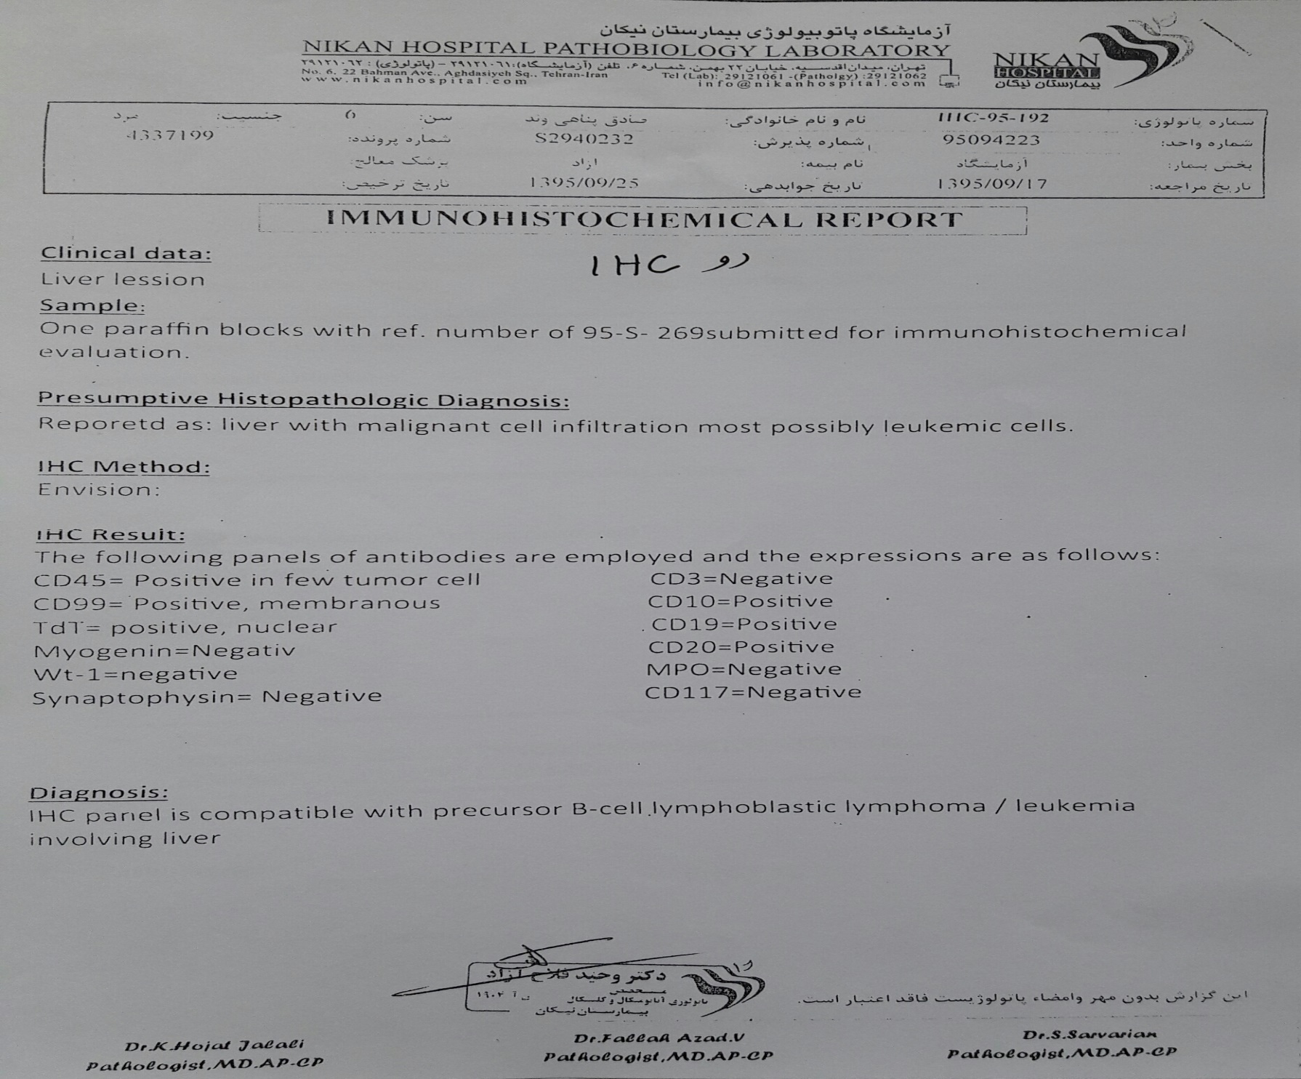
IHC revision (2)

Slide 32
According to second report of liver biopsy IHC (TDT: positive, CD 10: positive) and diagnosis of precursor B-cell lymphoblastic lymphoma/ leukemia (BLBL), we changed the protocol of chemotherapy from LMB to BFM .
Abd. & pelvic CT scan was repeated two months after BFM high risk lymphoma- leukemia protocol.

Slide 33
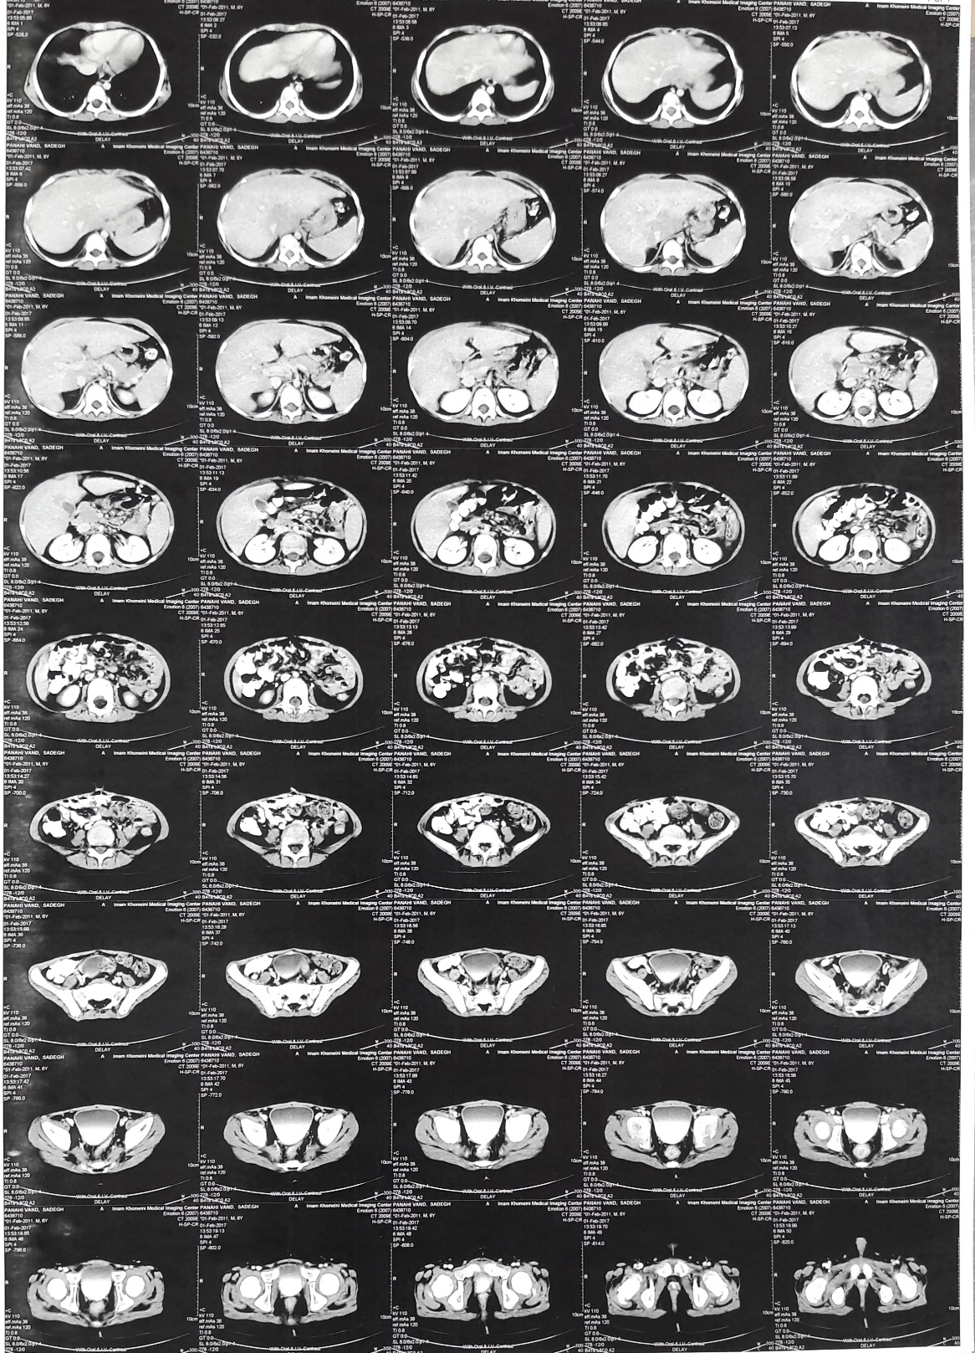
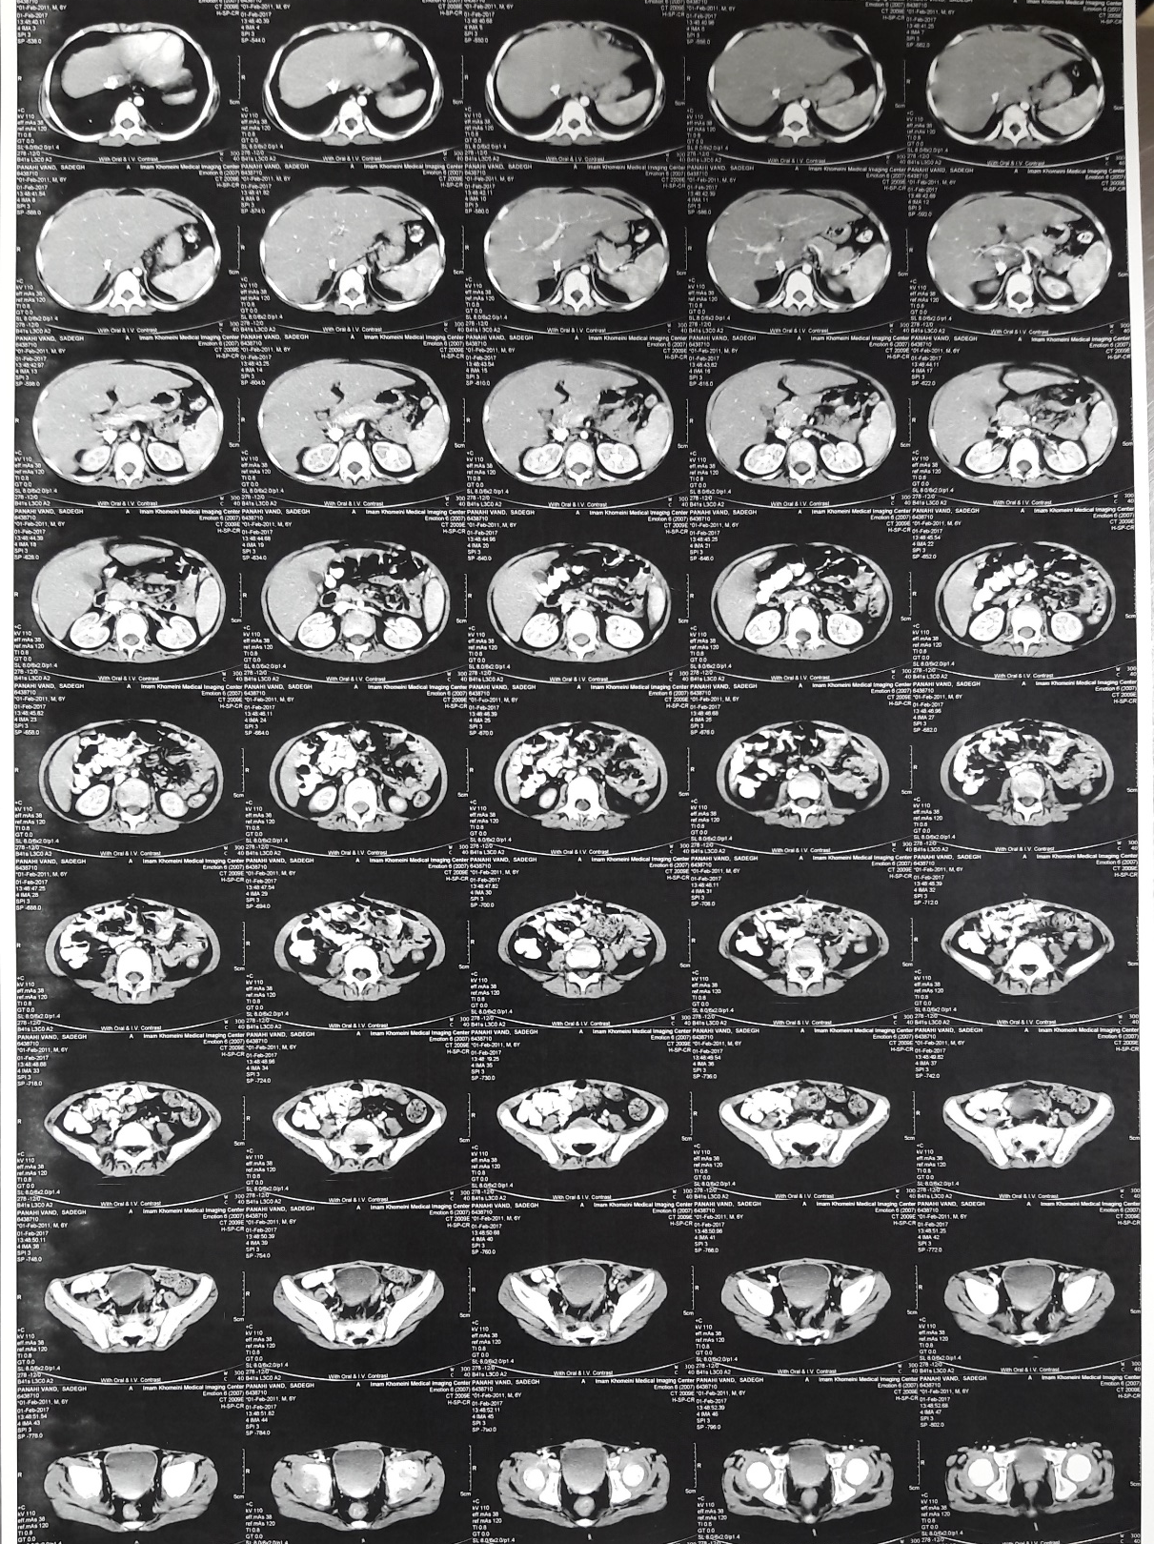

Slide 34
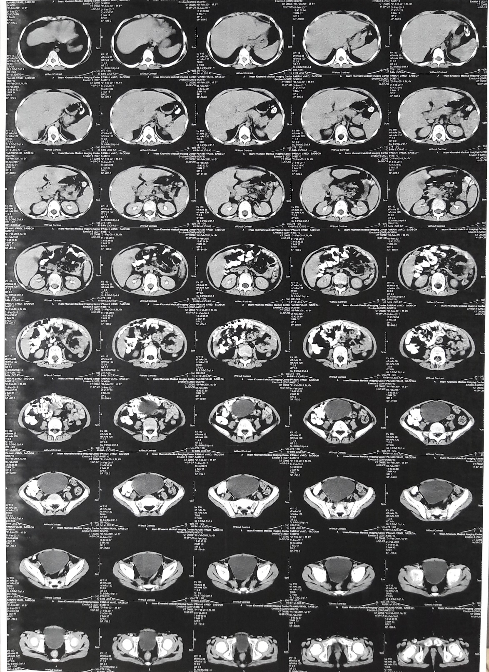

Slide 35
Stable disease after induction I,II
No change in liver and spleen size
Persistant porta hepatic node

