Slide 1
IMAGING IN NHL

Slide 2
In the pediatric age groups NHL encompasses high-grade tumors that usually are diffuse in nature.
Pediatric NHLs are divided more evenly between B-cell and T-cell neoplasms as opposed to adults where the majority of tumors are of B-cell origin.

Slide 3
Incidence of subtypes of non-Hodgkin lymphoma in the pediatric population :
Burkitt lymphoma :40%
Diffuse large B-cell lymphoma :20%
Anaplastic large cell lymphoma :10%
Lymphoblastic lymphoma :30%

Slide 5
Advances in cross-sectional imaging and the availability of positron emission tomography (PET) and PET-CT have had a major impact on imaging and management of pediatric patients.

Slide 6
IMAGING WORK-UP
Imaging studies in lymphomas are related to emergency imaging and to studies for staging the extent of disease.

Slide 7
EMERGENCY IMAGING
Chest film and chest CT are necessary for evaluation of thoracic emergencies (SVC syndrome or air way compromise) .
CT of the abdomen and pelvis is necessary to evaluate abdominal emergencies (obstruction of the kidneys, biliary tree, or gastrointestinal tract).
Before performing intravenous contrast studies, urinary function tests must be obtained.
Abnormal renal function may be secondary to tumor lysis syndrome.
Symptoms related to cord compression must be urgently evaluated. MR imaging should be performed for central nervous system (CNS) emergencies.

Slide 8
T-cell lymphoblastic NHL presented with shortness of breath and facial swelling

Slide 9
Initial Staging by Imaging
lymphomas should include a chest radiograph and CT of the chest, abdomen, and pelvis.
CT of the neck is performed when there are symptoms and signs referable to the neck.
When evaluating superificial lymph nodes, color Doppler US may be helpful in differentiating reactive from malignant lymphadenopathy.
FDG PET-CT is shown to alter staging in up to one third of pediatric patients who have lymphomas

Slide 10
In staging FDG-PET and PET/CT results in adult NHL cannot be extrapolated to pediatric NHL, as the disease biology, prognostic factors, staging system, treatment, and outcome are different between the groups.
There is a paucity of data on the use of PET/CT in pediatric NHL, as the few available studies have predominantly used FDG-PET .

Slide 11
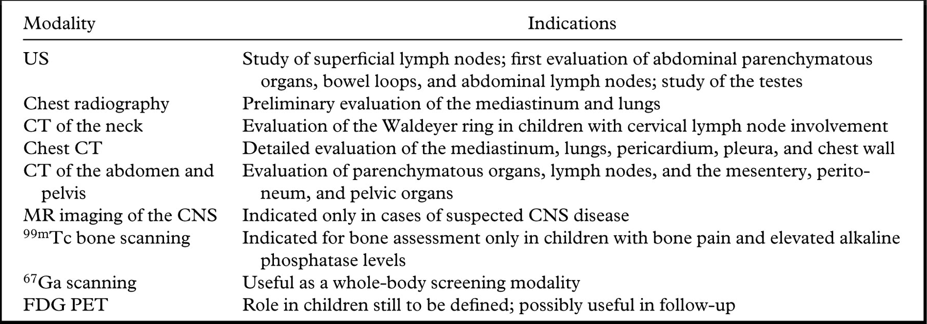

Slide 12
Sequence of Imaging
CT of chest ,abdomen and pelvis should be performed before institution of chemotherapy and obtained after surgery and before chemotherapy begins.
Burkitt tumors have such a fast doubling rate that residual tumor may grow significantly between the time of surgery and the beginning of chemotherapy.
Follow-up CT scans should be performed on a routine basis in conjunction with gallium or PET scans.
They should be performed after a single cycle of chemotherapy to assess response to treatment and then at suitable intervals to detect new disease.

Slide 13
Routine use of FDG PET is unnecessary in staging NHLs in children.
PET-CT has become extremely important in the follow-up and prognosis of pediatric lymphoma. Early PET responsive disease is associated with a excellent prognosis and is used to modify therapy. Likewise, persistent FDG uptake after front-line chemotherapy in patients who have lymphoma is associated with relapse.
In both HD and NHLs, a residual mass at CT or MR imaging may suggest persisting disease. FDG PET may be used in children to differentiate active residual disease from nonpathologic tissue.

Slide 14
Research has not yet fully established PET/CT in the evalaution of pediatric lymphomas.
PET/CT early in treatment can predict early and late treatment response.
PET/CT early in treatment may be able to allow for response-adapted therapy.
• PET/CT early in and/or at the end of treatment may stratify patients to less invasive therapy

Slide 15
Because of concerns about radiation risk to oncology patients, particularly those who are children, with repeat imaging examinations, the role of MRI is likely to increase.
The multiplanar capability and superb soft-tissue contrast resolution of MR imaging make it an excellent modality for assessing both nodal and extranodal disease in the neck region. MR imaging is also valuable for assessing lower cervical nodes near the clavicles, where beam-hardening artifacts at CT often obscure the complex anatomy .
MR imaging is extremely sensitive for bone marrow infiltration and CNS and spinal involvement.

Slide 17
Nonmalignant FDG activity includes reactive nodes, inflammatory lung disease, and infection.
Radiation pneumonitis also may be PET positive
Brown adipose tissue is metabolically active in children, decreasing with age. Sites of FDG avidity include the neck, around the coronary arteries, the perinephric space, and the para-aortic and intercostal regions.
Transient FDG avidity can be observed in the spine, pelvis, long bones, and spleen of patients treated with growth factor support and in patients recovering from an infection or inflammatory process .

Slide 18
False-positive findings :
Salivary glands and lymphoid tissue in the head and neck
• Thyroid
• Brown adipose tissue
• Thymus, especially in children
• Lactating breast
• Skeletal and smooth muscle (more marked with hyperinsulinemia)
• Gastrointestinal (e.g., esophagus, stomach, bowel)
• Urinary tract structures (containing excreted FDG)
• Female genital tract (e.g., uterus during menses, corpus luteum cyst)

Slide 19
False-negative findings:
• Small size (< 2 x resolution of the system)
• Tumor necrosis
• Recent chemotherapy or radiotherapy
• Recent high-dose steroid therapy
• Hyperglycemia and hyperinsulinemia
• Some low-grade tumors (e.g., sarcoma, lymphoma, brain tumor)
• Tumors with large mucinous components .
Some skeletal metastases, especially osteoblastic or sclerotic tumors
• Some osteosarcomas

Slide 20
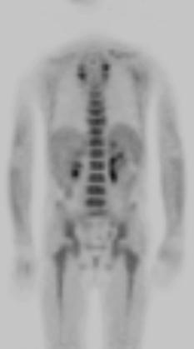
Diffuse increased FDG uptake in the spine represents post–GCSF treatment effects.
Physiologic activity in brown fat

Slide 23
Burkitt lymphoma is the most frequent subtype of non-Hodgkin's lymphoma in childhood and accounts for approximately 34% of these cases.
Burkitt lymphoma is the most rapidly growing tumor in children, with a doubling time of approximately 24 hours, so prompt recognition and initiation of therapy are essential.
Pediatric patients typically present with Burkitt lymphoma with extranodal involvement, specifically occurring in the abdomen approximately 31% of the time .
Weight loss, fever, and other systemic features present more often with disseminated disease but are less commonly seen than in other types of non-Hodgkin's lymphoma in childhood.

Slide 24
Imaging
Burkitt lymphoma primarily affects the ileocecal region in children younger than 16 years old.
The terminal ileum is the most commonly reported location of Burkitt lymphoma in children, likely because of the high concentration of lymph tissue in that region of the bowel .
Tumor does not elicit a desmoplastic response, bowel obstruction is most often caused by intussusception.
Imaging findings on CT include a focal mass and diffuse thickening of the bowel wall

Slide 25
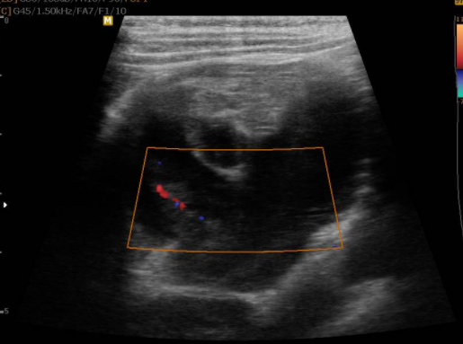
7 y/o girl with intermittent abdominal pain from last month with exacerbation from last day girl with intermittent abdominal pain from last month with exacerbation from last day

Slide 26
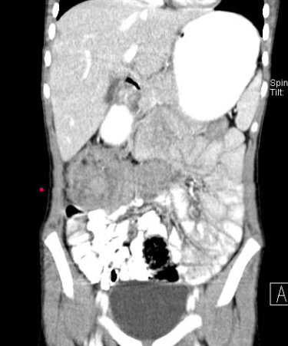

Slide 27
Extensive infiltration of small bowel with bowel wall thickening and aneurysmal dilatation of small bowel loops

Slide 28
Enlarged, diffusely infiltrated spleen with extensive retroperitoneal adenopathy ,BL

Slide 29
Tumor infiltration of the pancreas and peripancreatic area

Slide 30
Multiple bilateral low-attenuation lesions in both kidneys.

Slide 31
Diffuse Large B-Cell Lymphoma
Most patients present with disseminated disease.
single or multiple masses in nodal and extranodal sites.
Patients who have DLBCL who present with disease localized to the mediastinum may be difficult to distinguish from HL
The gastrointestinal tract is the most common extranodal site of involvement .
Liver, spleen, and renal involvement occur. Mesenteric and retroperitoneal adenopathy also are seen.
In patients who present with gastrointestinal manifestations, distinction from BL may not be possible.
Peripheral adenopathy and bone involvement make DLBCL the more likely diagnosis .

Slide 33
DLBCL

Slide 34
Numerous sites of nodal disease in the mediastinum, abdomen, and pelvis. FDG uptake in liver, spleen, and axial and appendicular skeleton,DLBCL

Slide 35
Lymphoblastic Lymphoma
Anterior mediastinal and/or bulky cervical/supraclavicular adenopathy is characteristic of LBL.
Up to 70% of patients have a mediastinal mass, which may cause dyspnea, stridor, head and neck swelling, and superior vena cava syndrome .
Malignant pericardial effusion and pleural effusion can result from invasion.
Painless adenopathy in the head and neck, axilla, and inguinal regions may occur.
Hepatosplenomegaly may be present but renal involvement is more common.
Dissemination to CNS, bone marrow, or gonads may be present at diagnosis.
CNS involvement is common. CNS prophylaxis is given to all patients, even if CNS disease is not detectable at presentation.

Slide 36
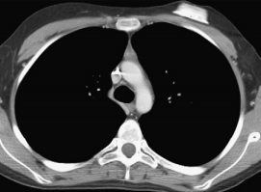
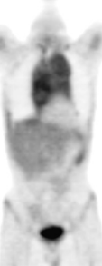
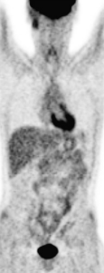
anterior mediastinal mass displacing the carina and bilateral pleural effusions. PET demonstrates FDG uptake in the anterior mediastinal mass. Imaging after 5 months of therapy demonstrates resolution of the mediastinal mass on CT and PET with no evidence of FDG avid disease.

Slide 37
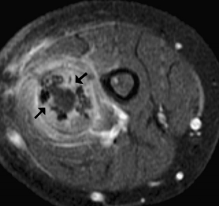
permeative changes and periosteal reaction . T1 axial postcontrast MR image demonstrates cortical destruction (black arrow) and enhancing soft tissue mass

Slide 38
Anaplastic Large Cell Lymphoma
The majority of patients present with disseminated disease.
90% present with peripheral adenopathy, an important clinical feature.
Mediastinal masses are common .
Retroperitoneal adenopathy also is seen.
The most common sites of extranodal disease include skin, soft tissues, bone, and lung.
Masses in the soft tissues and muscles are common.
Skin nodules may be single or multiple and may be ulcerated.
Lung disease may be manifest as nodules or as infiltrate.
Malignant effusions may be present.
Bone involvement is common and the lesions may simulate primary bone tumors.
Rarely, there is involvement of the pancreas, kidneys, liver, or gastrointestinal tract. CNS and bone marrow involvement are uncommon.

Slide 39
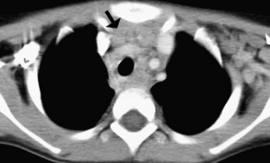
bilateral cervical lymphadenopathy, left greater than right . CT of the upper thorax shows extensive mediastinal and left axillary adenopathy.

Slide 40
THANK YOU

Slide 41
Central Nervous System
Primary involvement of the CNS by lymphoma occurs almost exclusively with NHLs and is uncommon in children.
It may manifest as cranial nerve palsy or spinal cord compression.
Unlike in adults, primary cerebral lymphomas manifesting as discrete masses or infiltrations involving the corpus callosum are very rare in the pediatric age group .
Meningeal infiltration can also be seen .
Subarachnoid nodules, diffuse leptomeningeal carcinomatosis, or both can be seen on postcontrast MR images .
Intramedullary spinal cord involvement by either HD or NHL is rare and is usually a manifestation of widespread disease

Slide 42
