Slide 2
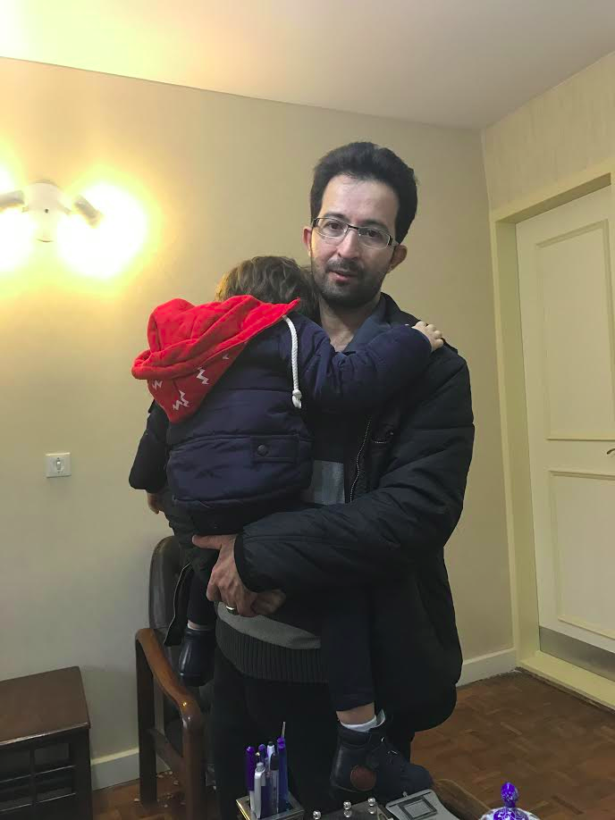

Slide 3
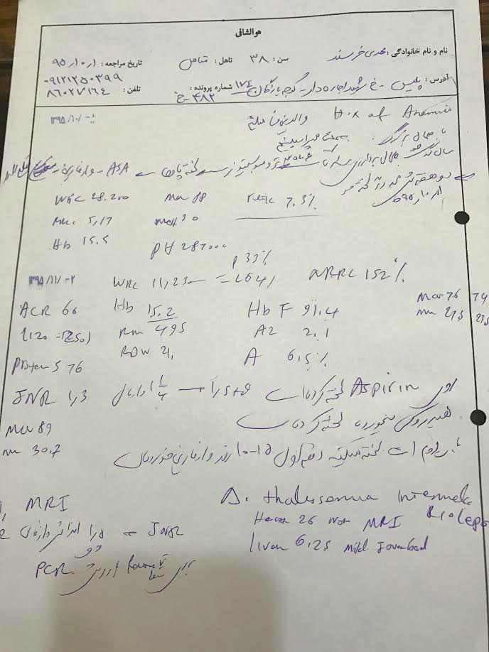

Slide 4
Treatment option?
Transfusion
Hydroxy urea
Aspirin
Warfarin
Warfarin and Aspirin

Slide 6
Complications of thalassemia intermedia
Extramedulary hematopoiesis
Chronic anemia and heart complications
Leg ulcer
Iron overload
Pulmonary hypertension
hypersplenism
Thromboembolic event

Slide 7
pathophisiology
Ineffective erythropoiesis
Chronic anemia and hypoxia
Increased iron absorbtion and iron overload

Slide 8
Thalassemia trait and arterial thromboembolic events: a systematic review and a meta-analysis of the literature. Dentali F¹, Romualdi E, Ageno W, Cappellini MD, Mannucci PM
CONCLUSIONS:
β-Thalassemia trait may act as a protective factor against the development of arterial cardiovascular and cerebrovascular disease in male subjects. Larger prospective studies are necessary to confirm these preliminary findings and to further investigate the mechanisms underlying this protective effect.
© 2011 International Society on Thrombosis and Haemostasis.

Slide 9
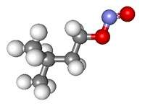
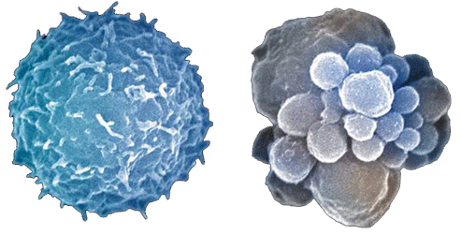
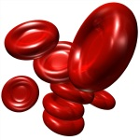
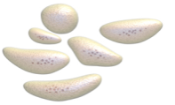
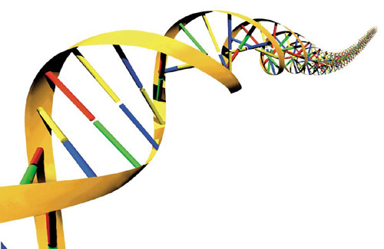
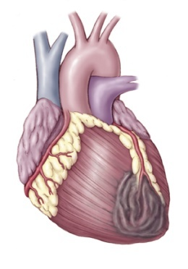
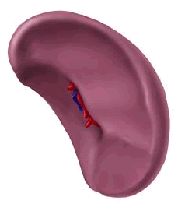
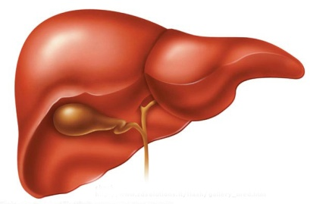
Nitric oxide
Hallmark of haemolysis
↓ levels leading to vasoconstriction
RBCs
Formation of reactive oxygen species
Expression of negatively charged phospholipids
Enhanced cohesiveness and aggregability
Peripheral
blood elements
Expression of endothelial adhesion molecules and tissue factor on endothelial cells (ELAM-1, ICAM-1, vWF, VCAM-1)
Formation of microparticles
Hypercoagulability
Platelets
Increased platelet aggregation
Increased expression of activation markers
Presence of platelet morphologic abnormalities
Hypercoagulability
Thrombophilia
No role for prothrombotic mutations
Decreased levels of antithrombin III, protein C, and protein S
Anti-phospholipid antibodies
Other factors
Cardiac dysfunction
Hepatic dysfunction
Endocrine dysfunction
Splenectomy
High platelet counts and hyperactivity
High levels of negatively charged RBCs
Cappellini MD, et al. Ann N Y Acad Sci 2010;1202:231-6.
Notes:
Splenectomy: can contritbute to increase susceptibility to thrombosis and it is linked to high PLT counts and aggregation following splenectomy, and(or to increased number of damaged RBCs.
Thrombophilia: does not have a role, even if decreased levels of ATIII, protein C and S, and high levels of anti-phosholpid antibodies have been documented, the exact nature of these antibodies and their relation to coexistent hepatitis C virus is still under investigation.

Slide 10
Thromb Haemost. 2006 Oct;96(4):488-91.
Prevalence of thromboembolic events among 8,860 patients with thalassaemia major and intermedia in the Mediterranean area and Iran.
Taher A¹, Isma'eel H, Mehio G, Bignamini D, Kattamis A, Rachmilewitz EA, Cappellini MD.
Author information
Abstract
Beta-thalassaemia is a congenital haemolytic anaemia characterized by partial (intermedia, TI) or complete (major, TM) deficiency in the production of beta-globin chains. The primary aim of this study was to determine the prevalence of thromboembolic events in patients with beta-thalassaemia. To achieve this, a multiple choice questionnaire was sent to 56 tertiary referral centres in eight countries (Lebanon, Italy, Israel, Greece, Egypt, Jordan, Saudi Arabia and Iran), requesting specific information on patients who had experienced a thromboembolic event. The study demonstrated that thromboembolic events occurred in a clinically relevant proportion (1.65%) of 8,860 thalassaemia patients (TI - 24.7% or TM - 75.3%) from the Mediterranean and Iran. Thromboembolism occurred 4.38 times more frequently in TI than TM (p < 0.001), with more venous events occurring in TI and more arterial events occurring in TM. Thrombosis in thalassaemia was also more common in females, splenectomized patients and those with profound anaemia (haemoglobin <9 g/dl). Due to the increased risk of thromboembolic events, the rationale for splenectomy should perhaps be re-assessed and the role of transfusion therapy for the prophylaxis of thrombosis, among other complications, be evaluated prospectively

Slide 12
Thromboembolic events
Patients (N = 8,860)
6,670 with TM
2,190 with TI
146 (1.65%) thrombotic events
61 (0.9%) with TM
85 (3.9%) with TI
Type of event
Risk factors for developing thrombosis in TI were
age (> 20 years)
previous thrombotic event
family history
splenectomy
Thromboembolic events (%)
DVT = deep vein thrombosis; PE = pulmonary embolism; PVT = portal vein thrombosis; STP = superficial thrombophlebitis.
Taher A, et al. Thromb Haemost. 2006;96:488-91.
Notes:
12
Thromboembolic events in a large cohort of β-thalassaemia patients
The largest clinical study to date analyzed data from 8.860 pts (6.670 TM, 2190 TI). The authors demonstrated that TEE occurred 4.38 times more frequently in TI than TM with more venous events occurring in TI and more arterial events occurring in TM.
Moreover, patients with TI who developed a TEE were more splencetomized, non-transfused, and had a hemoglobin level below 9 g/dL, which may justify a higher thrombotic drive as abonomrla RBCs are expected to remian longer in the circulation.
The study describe age beyind 20 years, splenectomy, family history of TEE and previuos TEE as the main risk factors dor develping thrombosis in the study group.
12

Slide 13
Risk factors for thrombosis in β-TI
Splenectomy, age above
35 years, and a serum ferritin level >1000 μg/L are associated with a
higher risk for thrombosis¹
Iron chelation
Hydroxyurea
Transfusion
Splenectomy
SF ≥ 1,000 μg/L
Hb ≥ 9 g/dL
Female
Age > 35 years
¹Musallam KM, Taher AT. Hemoglobin 2011;35:503–510

Slide 14
The OPTIMAL CARE study splenectomized patients
Complication | Parameter | RR | 95% CI | p value
EMH | Splenectomy | 0.44 | 0.26–0.73 | 0.001
 | Transfusion | 0.06 | 0.03–0.09 | < 0.001
 | Hydroxyurea | 0.52 | 0.30–0.91 | 0.022
Pulmonary hypertension | Age > 35 years | 2.59 | 1.08–6.19 | 0.032
 | Splenectomy | 4.11 | 1.99–8.47 | < 0.001
 | Transfusion | 0.33 | 0.18–0.58 | < 0.001
 | Hydroxyurea | 0.42 | 0.20–0.90 | 0.025
 | Iron chelation | 0.53 | 0.29–0.95 | 0.032
Heart failure | Transfusion | 0.06 | 0.02–0.17 | < 0.001
Thrombosis | Age > 35 years | 2.60 | 1.39–4.87 | 0.003
 | Hb ≥ 9 g/dL | 0.41 | 0.23–0.71 | 0.001
 | Serum ferritin ≥ 1,000 µg/L | 1.86 | 1.09–3.16 | 0.023
 | Splenectomy | 6.59 | 3.09–14.05 | < 0.001
 | Transfusion | 0.28 | 0.16–0.48 | < 0.001
Cholelithiasis | Age > 35 years | 2.76 | 1.56–4.87 | < 0.001
 | Female | 1.96 | 1.18–3.25 | 0.010
 | Splenectomy | 5.19 | 2.72–9.90 | < 0.001
 | Transfusion | 0.36 | 0.21–0.62 | < 0.001
 | Iron chelation | 0.30 | 0.18–0.51 | < 0.001
Abnormal liver function | Serum ferritin ≥ 1,000 µg/L | 1.74 | 1.00–3.02 | 0.049
Taher AT, Musallam KM, Karimi M, et al. Blood. 2010;115:1886-92.

Slide 15
The role of prevention
Blood transfusion
Iron chelation therapy
Fetal Hb inducer(hydroxyurea)
Anticoagulant or antiplatelet therapy
Delay splenectomy

