Slide 1
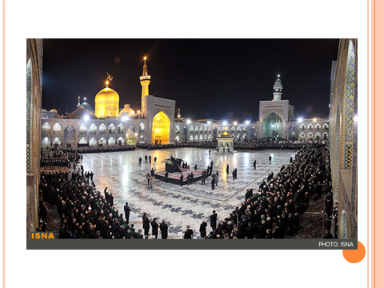

Slide 2
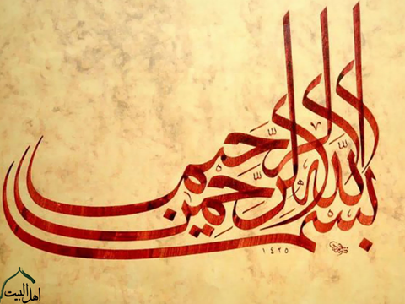

Slide 3
Dr Ghssemi Ali Associate Professor of Pediatric Hematologist & Oncologist & stem cell transplantation

Slide 4
BMT in Montasrieh Hospital,MUMS NO Patients:73 Allogenic:54= %75 Autologous=18=%25

Slide 5
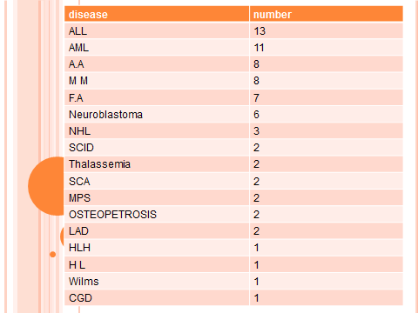

Slide 6
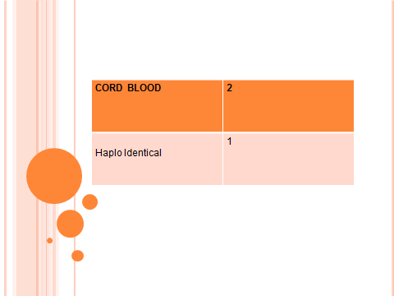

Slide 7
3 Months old girl prolong fever .1month .post vaccination CBC: thrombocytopenia Hepatosplenomegaly

Slide 8
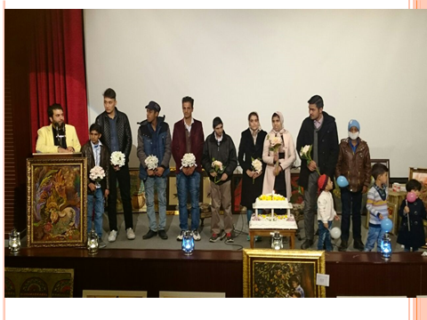

Slide 9
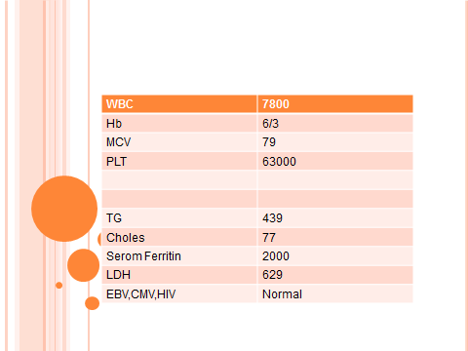

Slide 10
History of death in previous baby BMA x2 = normal Acid fast staining was normal Treatment with HLH protocole

Slide 11
Father, mother and other sibling didn’t match in HLA Extended family search performed

Slide 12
Donor: male 40 years old Father's uncle Mother's uncle Date of BMT= 7/7/1394 BG= A+ Recipient = Girl 7month BG=O+

Slide 13
Stem cell phresis=200ml TNC=26 x 10⁸/kg MNC = 22.1 x 10⁸/kg Infusion MNC= 8 x 10⁸/kg

Slide 14
Conditioning regime FLU 5 day ATG 4 day Melphalan 2 day

Slide 15
Recovery Neut +11 WBC= 1100, Neut=66% PLT= 45000 +11 Discharge= +14 duration = 25

Slide 18
آخرین CBC 96/6/7 WBC=11000 Hb=12/1 Plt=235000

