Slide 1
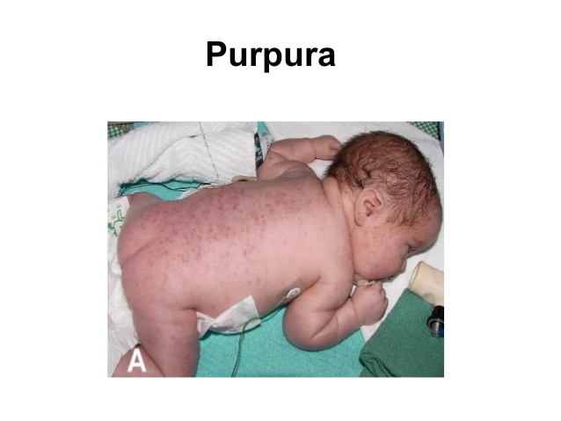
Case presentation 1
5 hours full term newborn P1G1 baby with purpur and cephalhematoma
Otherwise normal platelet of mother :normal
Your aproach?

Slide 2
Case presentation 1
WBC 18000
Hb 18gr/dl platelet 11000 PT 15 PTT 55
What is your diagnosis?
Management?

Slide 3
Case 1
Apnea and seizure has happened before transfusion of platelet and IVIG
Intubation and respiratory care
Control of seizures
IVIG 1gr/kg
Random platelet on day 1 and 2
Methyl prednisolon 1mg/8 houres
Improvement after 3 days
Platelet raising to 25000 ,50000, 110000 and discharged

Slide 4
Case 1

Slide 5
Neonatal alloimmune thrombocytopenia
What is your planning for subsequent pregnancy?

Slide 6
Case 2
35 days old baby with a purpura
No fever no hx of uri or other illness
Feeding good
Physical exam: petechia ,purpura
Well nourished ,no hepatosplenomegaly, reflexes good
What blood tests should be done?

Slide 7
Case 2
Hb :10.5 gr/dl
WBC: 6700, poly 30% lymph 60%
Platelet 16000 - 4000
PT 13 PTT 44

Slide 8
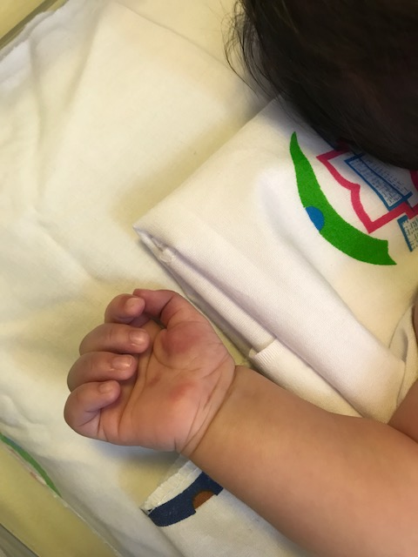
case2

Slide 9
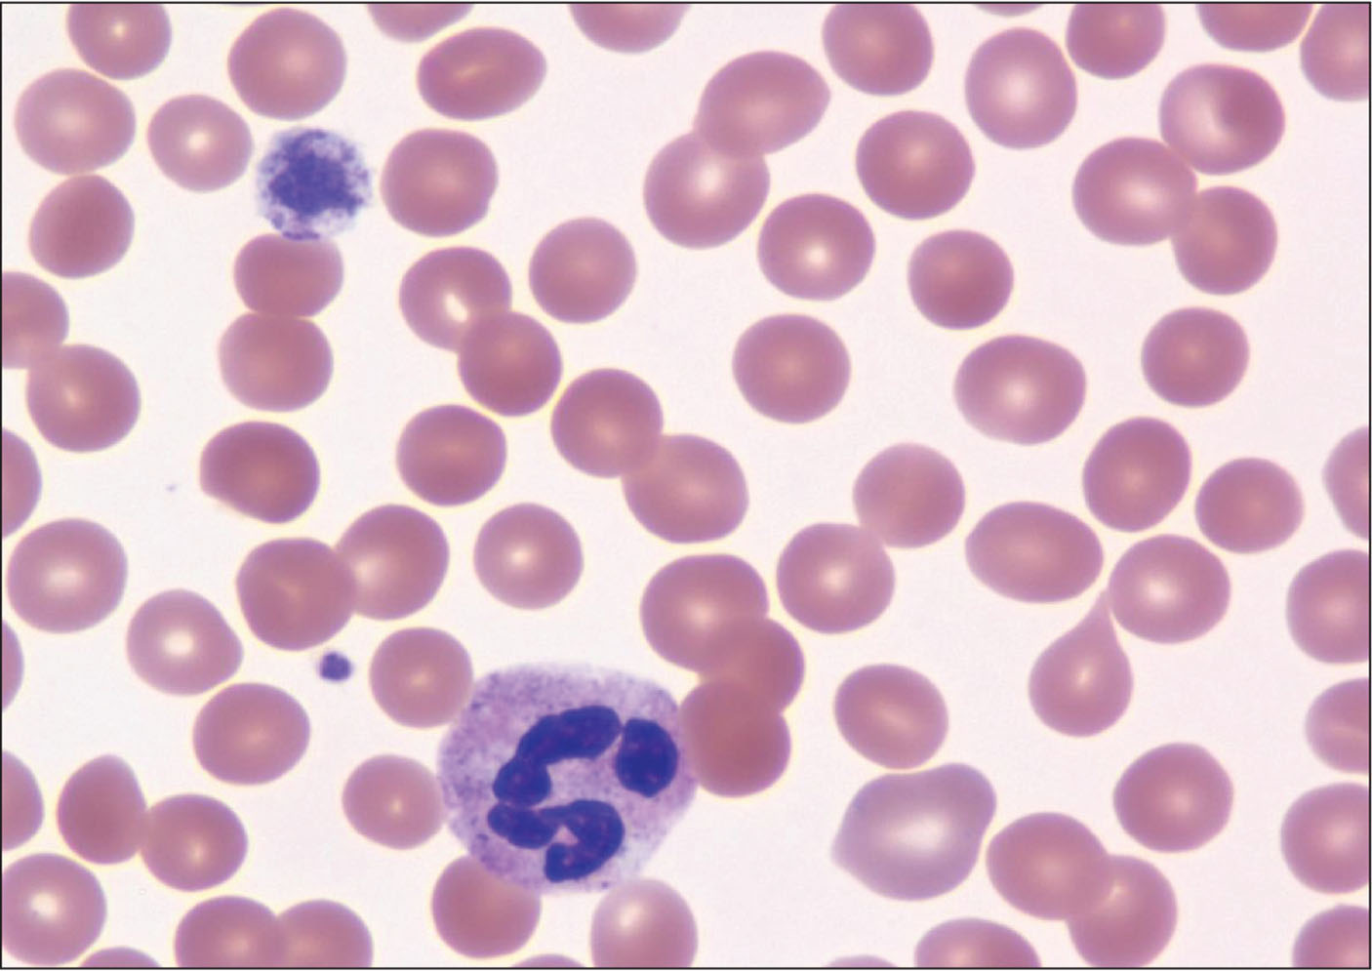
Case 2 Peripheral smear

Slide 10
Case 2 ITP
Management?
IVIG
Prednison
Platelet?

Slide 11
Case 3
A full term baby from mother with ITP by c/s
Apgar 9/10
Pregnancy and delivery without complication
Mother received prednisolone one week before delivery, platelet raised from 40000 to 70000
How is your approach to this baby?

Slide 12
Case 3
Platelet count? Cord blood,24h,48h
CNS ultrasonography?
NICU care?
Correlation between platelet count of mother and baby?

Slide 13
Case 3
cord Platelet count: 50000
day 1:55000
Day 2: 38000
What is your suggestion?
Continue observation in the hospital
IVIG and prednisolone
Discharge and follow up

Slide 14
Case Study 4

Slide 15
Clinical presentation
4 day old boy with refer to emergency unit due to cyanosis, feeding difficulty , abnormal movement, tachypnea, abnormal tone of crying and lethargy.

Slide 16
Ph/E
Typical facial features include a bulbous-tipped nose, micrognathia, and malar flattening.
Heart murmur and CHF with cardiogenic shock
Cleft palate

Slide 17
Emergency treatment
Prostglandin infusion
Echocardiography
Tetralogy of Fallot With Pulmonary Atresia

Slide 18
procedure
After Cardiac catheterization severe bleeding occurred.

Slide 19
Lab test
Ca:6.5
Plt:35000/mm3
PT:13/s
PTT:33/s
Other test:normal

Slide 20
PBS

Slide 21
Platelet function test: No response to Ristocetin Response to collagen ,ADP

Slide 22
Flow-cytometry: absence CD41a,CD 61

Slide 23
Bernard Soulier Syndrome with velocardiofacial syndrome

