Slide 1




Applications of Cord Blood (Stem Cell) Banking
Amir Ali Hamidieh
Director, Pediatric Stem Cell Transplant Program, Children's Medical Center, Tehran University of Medical Sciences
Seyed Mostafa Monzavi
MD & PhD Candidate, Department of Applied Cell Sciences, Tehran University of Medical Sciences

Slide 2

HSCT & Umbilical Cord Blood
Hematopoietic stem cell transplantation (HSCT) refers to infusion of (HSCs) to:
  Reconstitute the hematopoietic system of patients with a wide variety of malignant and non-malignant disorders (over 70 disorders)
  Allow delivery of supra-lethal doses of chemotherapy (transplant given as rescue)
  Correct congenital defects in bone marrow (replaces defective marrow)
  Donor cells may directly attack cancer cells (anti-cancer effect/graft versus tumor, graft versus leukemia)
Umbilical cord blood (CB), the remaining blood in the vein of the umbilical cord at the time of birth, is a clinically useful source of HSCT (an alternative to HLA-matched related or unrelated donors).

Slide 3
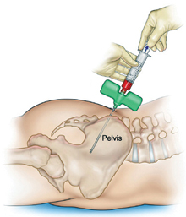
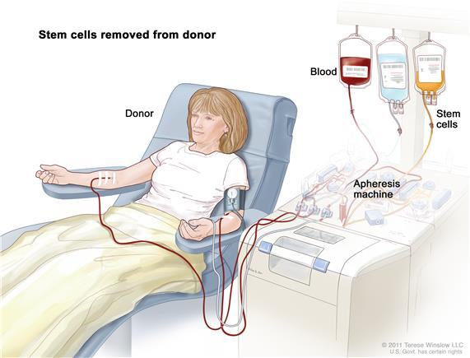
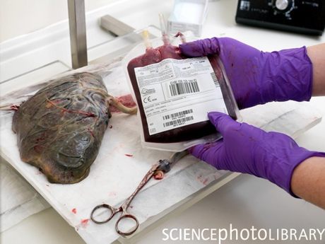
Graft Types & Stem Cell Sources
Graft Types:
Autologous (using patient's own HSCs)
Syngeneic (from twin)
Allogeneic (related or unrelated donor)
  Sibling
  Other relative
  Unrelated Donor (AUD)
Bone Marrow
(BMSC)
Peripheral Blood (PBSC)
Umbilical Cord Blood
Collection of HSCs from peripheral circulation after mobilization
Placental blood directly drained into bag
Direct aspiration under anesthesia

Slide 4
When to Consider a CB as a Source for HSCT
For the majority of HSCT indications, best option is allogeneic HSCT from a matched sibling.
For patients who do not have a matched related or a unrelated donor or when there is not enough time to line up a donor, there are two rapidly available alternative stem cell donor sources:
  A haploidentical family member
  A stored CB

Slide 5
Advantages & Disadvantages of CB-HSCT
Advantages:
  For allogeneic transplants; HLA mismatch is better tolerated (even with haploidentical donors)
  Reduced incidence and severity of GvHD
  Available more readily than marrow or PBSC unrelated donors (off-the-shelf product)
  Lower viral infections
Disadvantages:
  Unknown donor background
  Lower number of CD34⁺
  Frozen (not a fresh) product
  Slow hematopoietic recovery & delayed immune reconstitution
  High cost for storage
  One-time availability

Slide 6
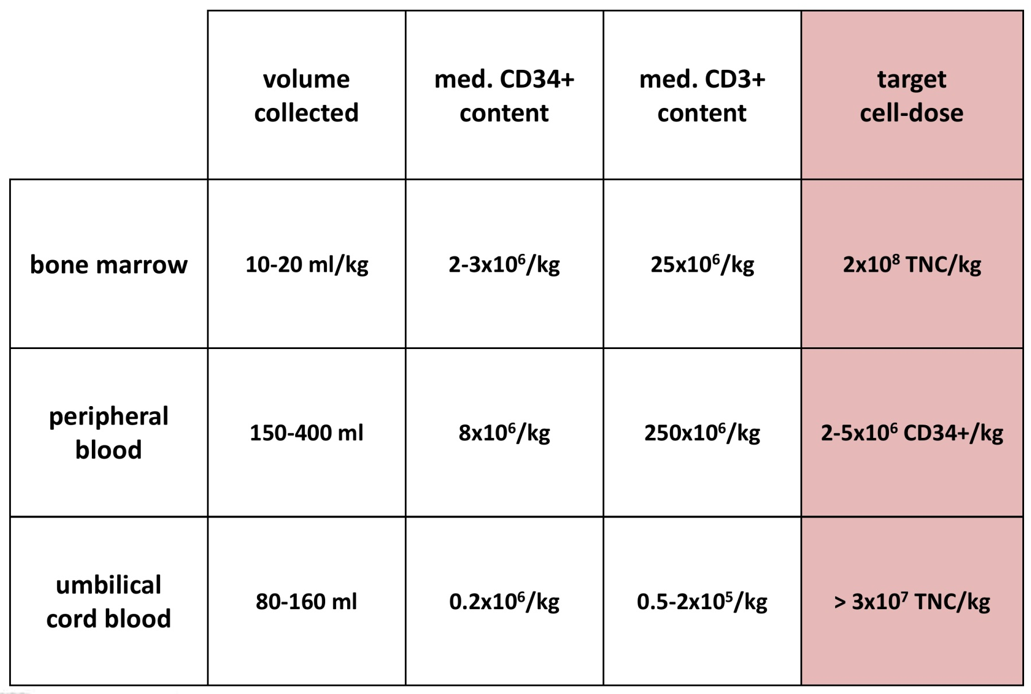
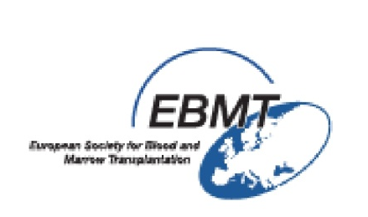
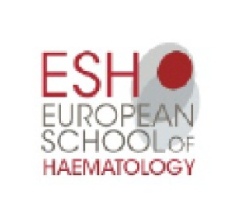
Comparison of HPCs in Different Sources

Slide 7
Umbilical Cord Blood Collection
Collection at term (> 37 weeks gestational age)
Umbilical vein puncture of placenta, after NVD or caesarean section
Collection by gravity using a bag system containing Anticoagulant Citrate Dextrose (ACD) OR Citrate Phosphate Dextrose (CPD) solution
Since cell dose is the main limitation of UCB use, it is important to optimize:
  Donor selection
  Collection method
Placenta
Umbilical Cord
Cord Blood Unit

Slide 8
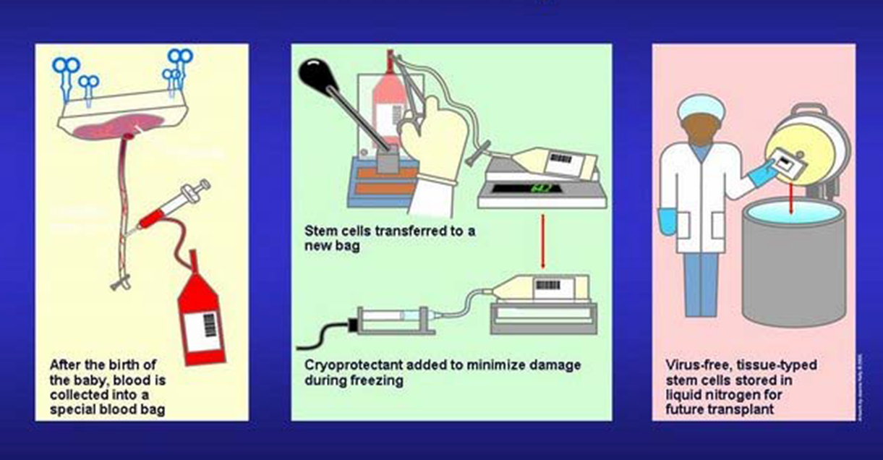
Umbilical Cord Blood Collection

Slide 9
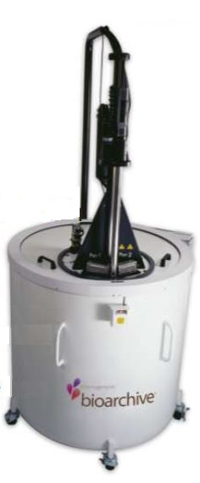
HSC Storage
Storage in liquid nitrogen at a temperature of:
  -156^{oC} (vapor phase)
  -196^{oC} (liquid phase)
Container should be temperature-monitored every 24h to avoid transient warming during storage.
No use by date:
  BM autologous SCT after 21 years of cryopreservation
  Holter J et al. Transplantation. 2011;91:e54-5.
  Recovery of functional UCB progenitor after 20 years
  Roura S1 et al. Stem Cell Res Ther. 2015;6:123.

Slide 10
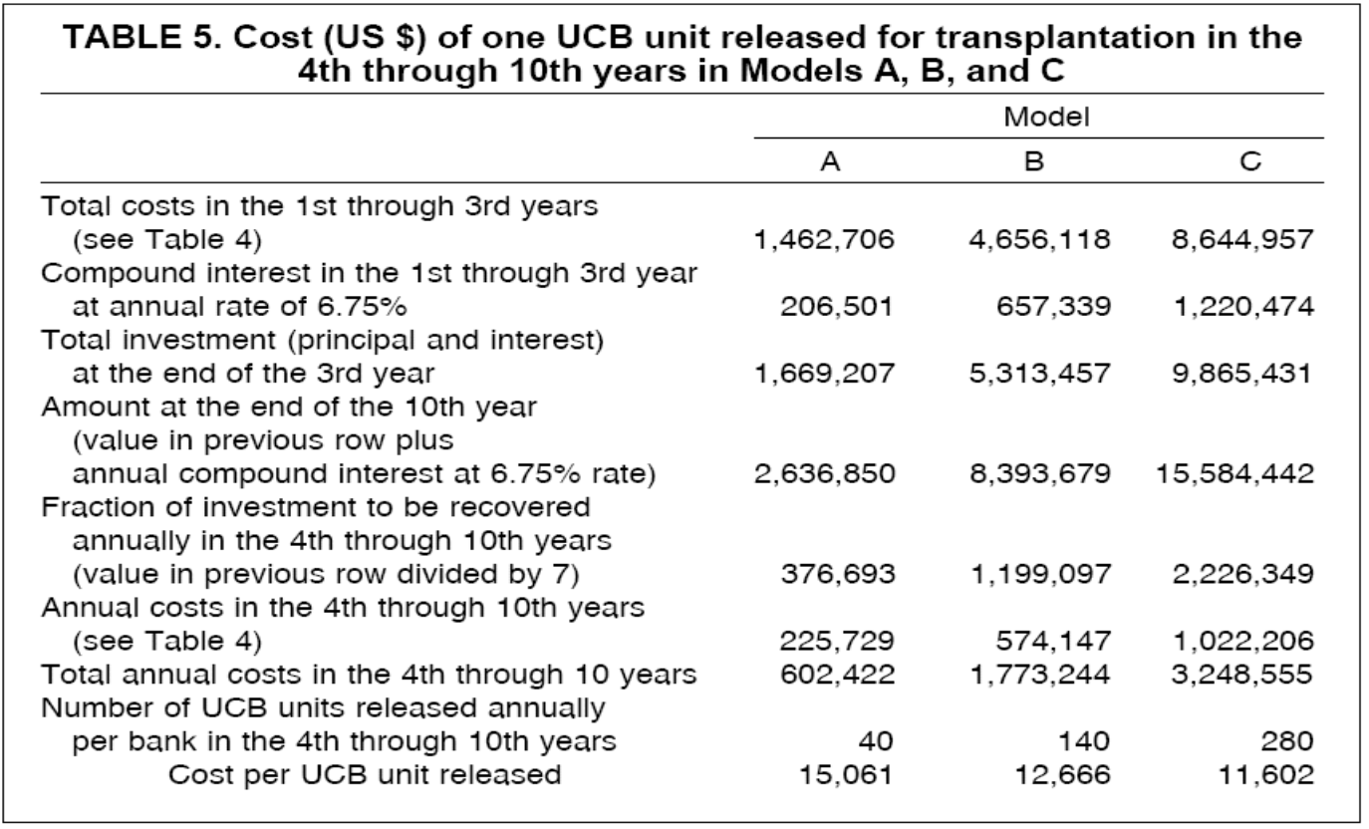
UCB Unit Procurement and Storage Costs
The average fee per released UCB unit is around 15,000 $ to 25,000 $ in the US and Europe.
It is less than 10,000 $ in Iran.
Petrini C. Umbilical cord blood banking: from personal donation to international public registries to global bioeconomy. J Blood Med. 2014;5:87-97.

Slide 11
HSC Storage Complications
In the case of allogeneic transplants, fresh HSC are preferred in order to avoid cell loss that might occur during the freezing and thawing process.
Loss of integrity may occur
  During shipment (1/3)
  At the time of thaw (2/3)
Incidence of bag breakage: 1-5%
Occurrence of breaks depends upon
  Bag material and manufacturer
  Attention paid to handling

Slide 12
UCB Banking and Transplantation Milestones
Broxmeyer et al:
Potential application
of UCB HSCs for transplantation
Rubinstein:
First UCB bank established in New York
1974 1988 1989 1993 1994
Knudtzon et el:
First evidence of the presence of primitive and committed HSCs
Gluckman et al:
First sibling UCB transplant for an FA patient
Wagner et al:
First unrelated UCBT in a child with leukemia

Slide 13
Global HSCT Numbers
Over the past 50 years, more than 1 million HCTs (53% auto, 47% allo) have been recorded across the globe.
Gratwohl A, et al. One million haemopoietic stem-cell transplants: a retrospective observational study. Lancet Haematol. 2015;2:e91-100.
Notes:
13

Slide 14
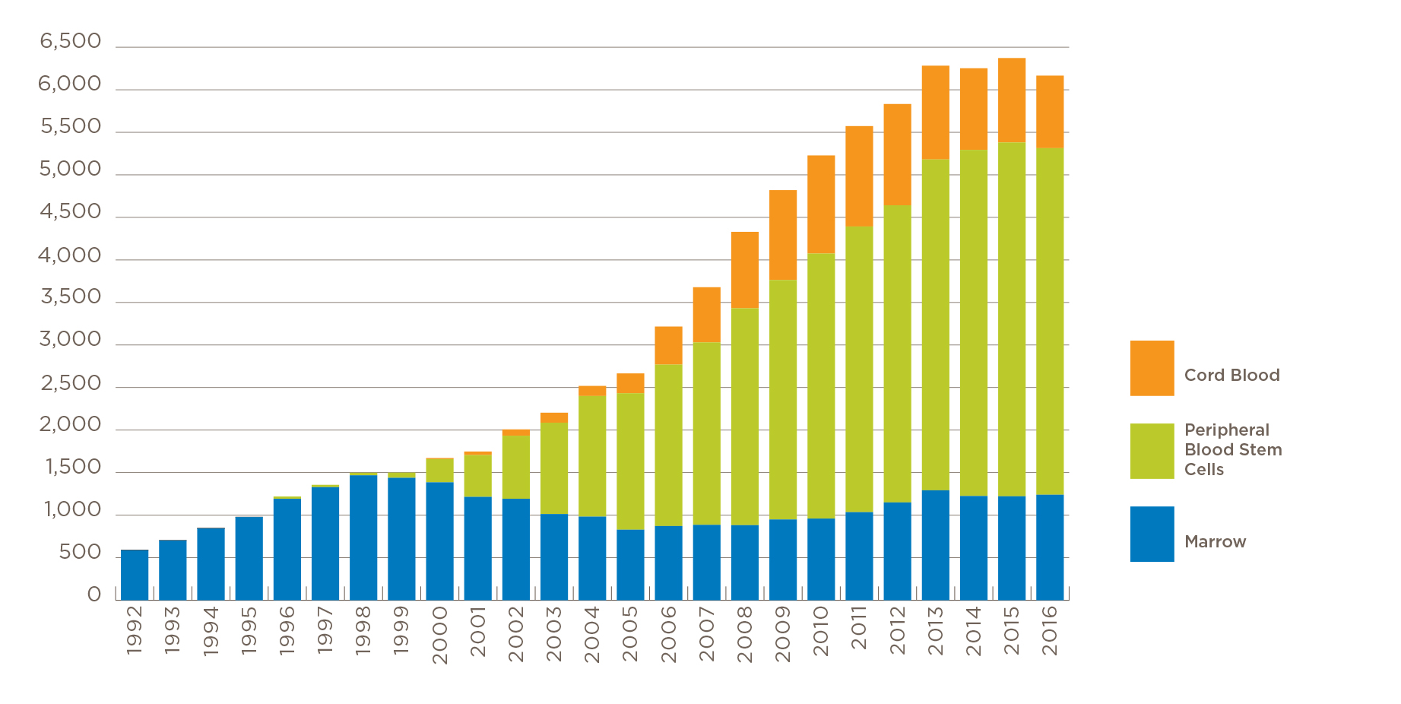

Stem Cell Sources for Allogeneic HSCT, USA (1992-2016)

Slide 15
Stem Cell Sources for Allogeneic HSCT, EBMT (1988-2009)
Stem Cell Products provided for unrelated transplantation
18,000
16,000
14,000
12,000
Number of donations
10,000
8,000
6,000
4,000
2,000
0
1988
1989
1990
1991
1992
1993
1994
1995
1996
1997
1998
1999
2000
2001
2002
2003
2004
2005
2006
2007
2008
2009
2010
2011
2012
2013
2014
2015
Year
BM donations
PBSC donations
Cord Blood Units

Slide 16

Private vs. Public (Availability)
There are two banking options for storing umbilical cord blood:
Private (family)
Public
Cord blood stored in private banks are used for either autologous or allogeneic transplants for the infant donor or related family members but private cord blood banks are not searchable or available to the public.
Till now, more than 1,000,000 cord blood units are stored in over 130 private cord blood banks, worldwide, and over 600,000 units in more than 100 quality controlled public cord blood banks.
Butler MG, Menitove JE. Umbilical cord blood banking: an update. J Assist Reprod Genet. 2011;28:669-76.

Slide 17
Private vs. Public (Applicability)
Both private and public banks can store cord blood units for a period of around 20 years.
From the private CB banks' point of view, there are too few documented cases of children receiving their own banked CB for HSCT, because physicians are reluctant to use autologous CB:
  The stem cells present in autologous CB carry the same genetic information as the recipient and so cannot be used to treat genetic diseases.
  There are potentials for presence of pre-leukemic and leukemic cells in the stored CB of children who later develop childhood leukemia.
  The graft-versus-leukemia effect in which the donor's immune system acts against residual recipient malignant cells cannot occur in autologous HSCT.
Young-Ho Lee. Is cord blood worth saving for public or private banking? Blood Res. 2015; 50:3-4.

Slide 18
Cord Blood HSCT
 | Autologous CB | Targeted CB | Unrelated CB
Definition | Donor = Recipient (Private) | HLA-id sibling; born after recipient (Private) | Collected from unknown recipient (Public)
Advantages | Availability Sufficient cells? No rejection/GvHD No viral transmission | Availability Sufficient cells? Little rejection/GvHD No viral transmission | Availability Sufficient cells? Reduced GvHD No or reduced Viral transmission
Disadvantages | Genetic disease Costs | Genetic disease? | Costs Matching problems
N 2010 in Europe N 2011 | 3 1 | 52 47 | 789 771

Slide 19
Private vs. Public (Statistics)
More than 25,000 cord blood transplantations have been performed worldwide since the first cord blood transplantation in 1989.
Estimates of the proportion of autologous CB transplants performed range widely:
  American Academy of Pediatrics suggests that it is more like 1 in 200,000. There have been over 450,000 CB units stored in the United States private CB banks.
  In South Korea, just 4 CBs among the roughly 300,000 units in private banks were released for autologous HSCT up to the end of 2014.
  Study by the Italian Stem Cell Donors Association noted that the probability that any of the neonates whose UCBs are stored in private banks for autologous use may one day need a transplant of hematopoietic stem cells is effectively between 1:75,000 and 1:100,000.
According to available reports, in Iran, 4 out of near 100,000 UCB units stored privately are successfully used for HSCT (All targeted CBs).
Petrini C. J Blood Med. 2014;5:87-97.

Slide 20
Summary of Private CB Banking Disadvantages
Lower number of hematopoietic cells compared to BM or PB donations (Public & Private)
Slow hematopoietic recovery & delayed immune reconstitution (Public & Private)
High cost for storage (Public & Private)
One-time availability (Public & Private)
Chance for bag breakage (Public & Private)
Fresh HSCs are preferred for HSCT (Public & Private)
Loss of viability of cells for long time storage (Public & Private)
CB HSCT success rate: 40-50% at best (Public & Private)
In general 90% of the banked UCB units fail to meet the very strict criteria for clinical use (Public & Private)
The incidence of refractory genetic disease and malignancies treatable by HSCT is about 1 per 300,000 people (0.0003 %) (Private)
Sun J, et al. Transfusion. 2010;50:1980-7.
Gratwohl A, et al. JAMA. 2010;303:1617-24.

Slide 21
International Restrictions
For all the mentioned reasons:
Both the American Academy of Pediatrics and the Society of Obstetricians and Gynecologists of Canada discourage this practice while encouraging the storing in public banks.
In an opinion issued March 15, 2011, the Italo-French Commission for the Proper Use of Umbilical Cord Blood stated that the collection and storage of UCB from healthy newborns for “preventive” purposes, for possible future autologous use, as practiced by private organizations on a fee-paying commercial basis, is in contrast to “the general public interest and, in particular, the interests of patients with oncohaematological, genetic haematological, immunological or dysmetabolic diseases that can be cured in the majority of cases with allogeneic transplants of haematopoietic stem cells and not with autologous cells, and who thus need a vast pool of altruistic donations from which to draw HLA-matched donors”.
As a result; Italy, Belgium and France have banned private banking of cord blood.
NetCord, the International Foundation of Leading Cord Blood Banks, discourages autologous UCB banking since 2008.

Slide 22

NetCord Statement
NetCord "Position Statement on Cord Blood for Autologous Use": “Since the therapeutic benefit of allogeneic cord blood transplantation has been convincingly demonstrated, NetCord primarily promotes banking for allogeneic stem cell transplantation.
Banking for autologous purposes may be considered if such storage is part of a program whose primary mission is the use of cord blood units for allogeneic stem cell transplantation.”
NetCord Position statement on cord blood for autologous use. NetCord Newsletter. 2008 Jan 2

Slide 23

Decrease in CB Use and Potential Solutions
The utilization of cord blood as a source of stem cells for transplantation has decreased in recent years.
Strategies aimed to enhance speed of engraftment and ongoing clinical trials are investigating ways to make CBT more widely available:
  Improving hematopoietic engraftment by ex vivo expansion, co-infusion of CB with mesenchymal cells, …
  Generation of third-party immune cells (CB units are good source of NK cells for adoptive transfer to prevent or treat relapsed leukemia

Slide 24
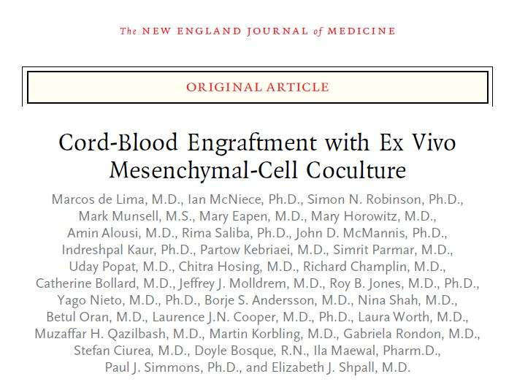
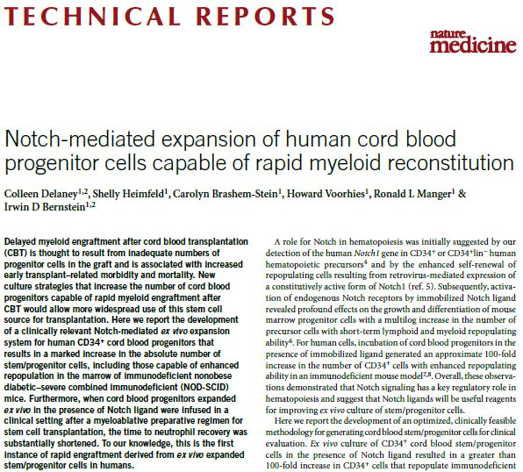
Cord Blood Expansion

Slide 25
Cord Blood Stem Cells & Tissue for Clinical Trials
Cord tissue is the tissue of the umbilical cord that contains blood vessels supported by a tissue called Wharton’s jelly that happens to be a rich source of mesenchymal stem cells.
The mesenchymal stem cells are multipotent in nature, having the ability to proliferate and differentiate into muscle, cartilage, bone, and fat cells.
Cord tissue is known to work specifically towards spinal and brain injuries.
Clinical trials are currently underway for diseases such as multiple sclerosis, cartilage repair, stroke, brain damage, liver cirrhosis, traumatic optic neuropathy, muscular dystrophy, and many such others.
Cord tissue stem cells have the important characteristic of multipotency, making them capable to treat a vast number of diseases in comparison to those that cord blood alone can treat.

Slide 26
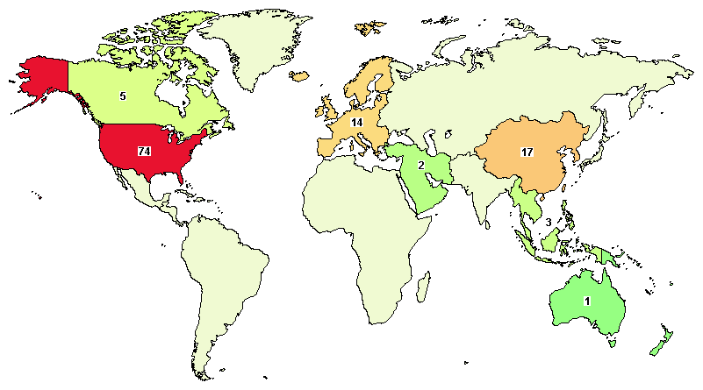
clinicaltrials.gov
Keyword: Umbilical Cord Stem Cells
Total Number of Studies: 217
Up to: 12th September 2017

Slide 27
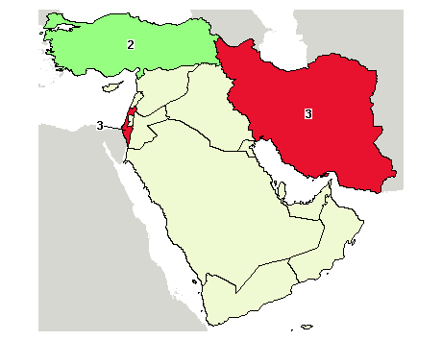
clinicaltrials.gov
Keyword: Umbilical Cord Stem Cells
Total Number of Studies: 8
Up to: 12th September 2017

Slide 28

Thank you for your Patience & Attention
Any Question?
Playing music of life
(An Iranian 8-year-old CB Transplanted FA child)

