Slide 1


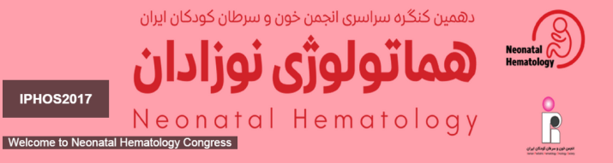
Platelet Function disorders in Neonate
Mohammad Faranoush,MD
Professor of pediatric Hematology Oncology
Iran University of Medical Sciences
Rasool Akram Medical Complex

Slide 2
Disclosures
No conflict of interest

Slide 3
Introduction
Platelets play a crucial role in hemostasis.
Platelet dysfunction due to congenital and acquired etiologies is one of the most common causes of bleeding encountered in clinical practice.
Bleeding manifestations are characterized by mucocutaneous bleeding

Slide 4
Platelet function
Platelets from neonatal CB:
    Less responsive than adult platelets to agonists such as :
      ADP
      Epinephrine
      Collagen
      Thrombin
      Thromboxane analogs (eg, U46619)

Slide 5
Platelet Function
Flow - cytometric platelet activation:
    Decreased expression of surface activation markers in neonatal platelets stimulated with thrombin, ADP, and epinephrine.

Slide 6
Platelet Function Disorders
Inherited platelet function disorders, bleeding is usually present since childhood but may be variable and exacerbated by conditions that stress hemostasis.

Slide 7
Platelet Function Disorders
Acquired
History of medication
Diagnosis of severe infection
Presence of cataracts or hearing defects in MYH-9 disorders
Occulocutaneous albinism in patients with Hermansky-Pudlak syndrome
Hyperextensible joints in Ehlers-Danlos syndrome

Slide 8
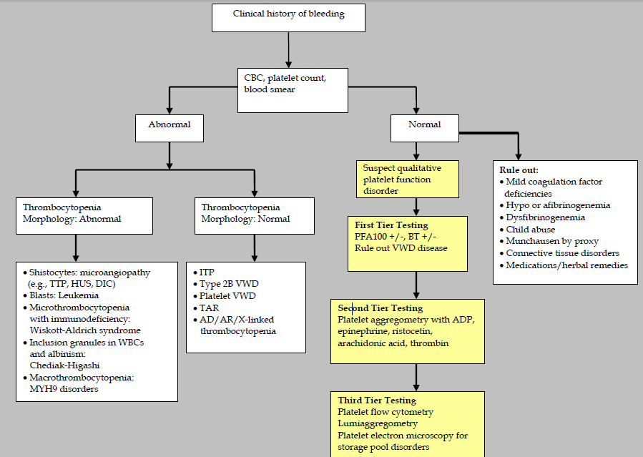

Slide 9
Morphological abnormalities
Platelet satellitism
Gray platelet syndrome
Giant platelets
Schistocytes

Slide 10
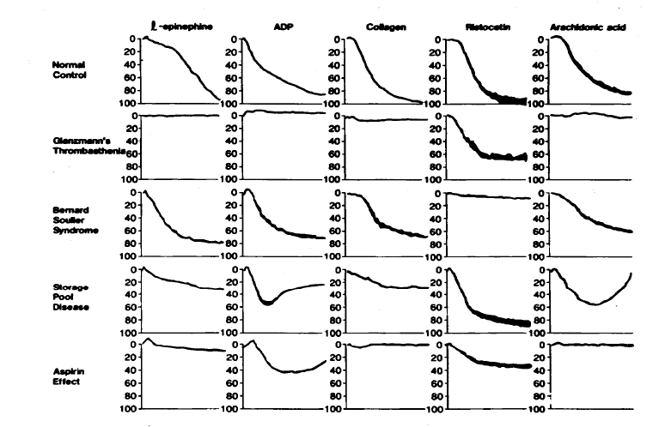
Platelet aggregation studies

Slide 11
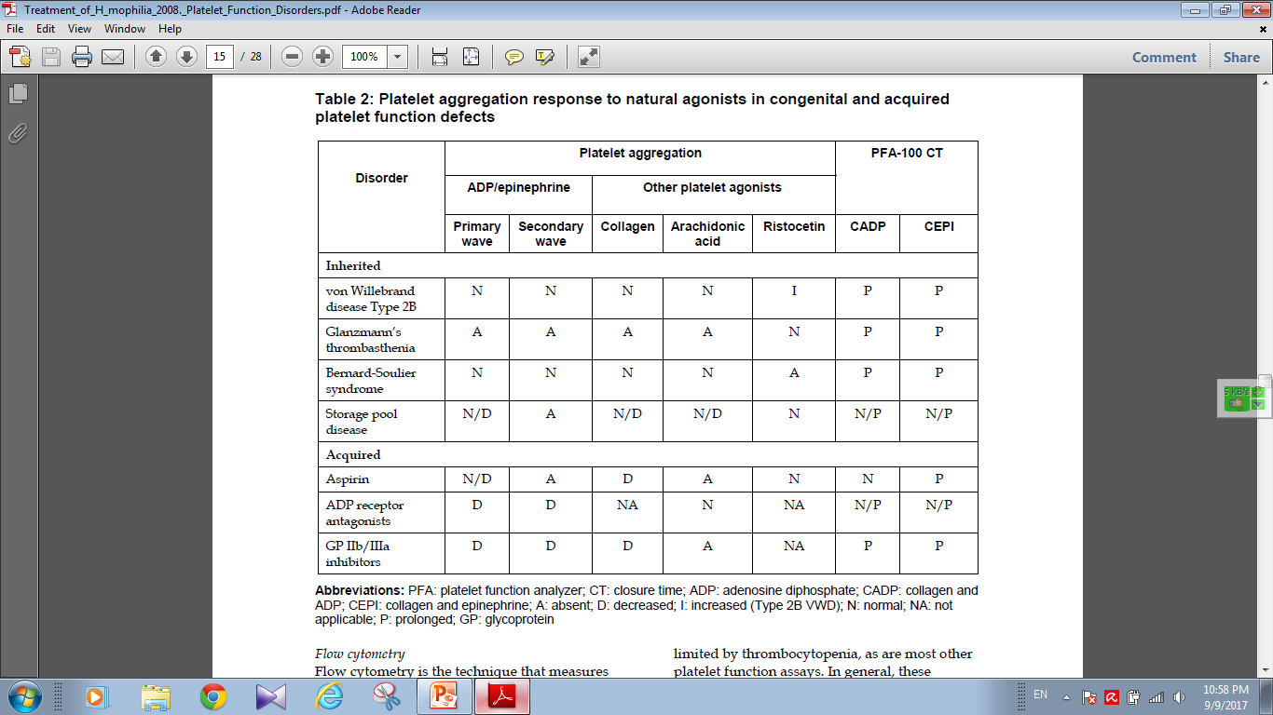

Slide 12
Flow-cytometry
CD41
CD42
CD61

Slide 13
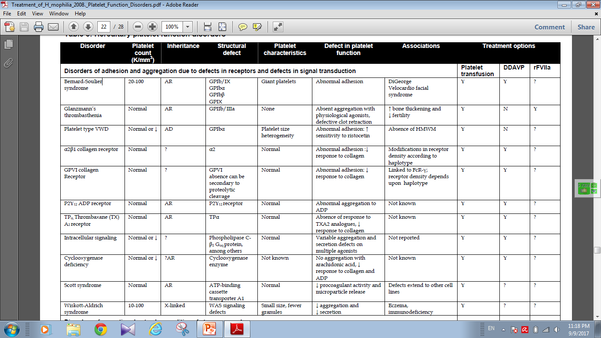

Slide 14
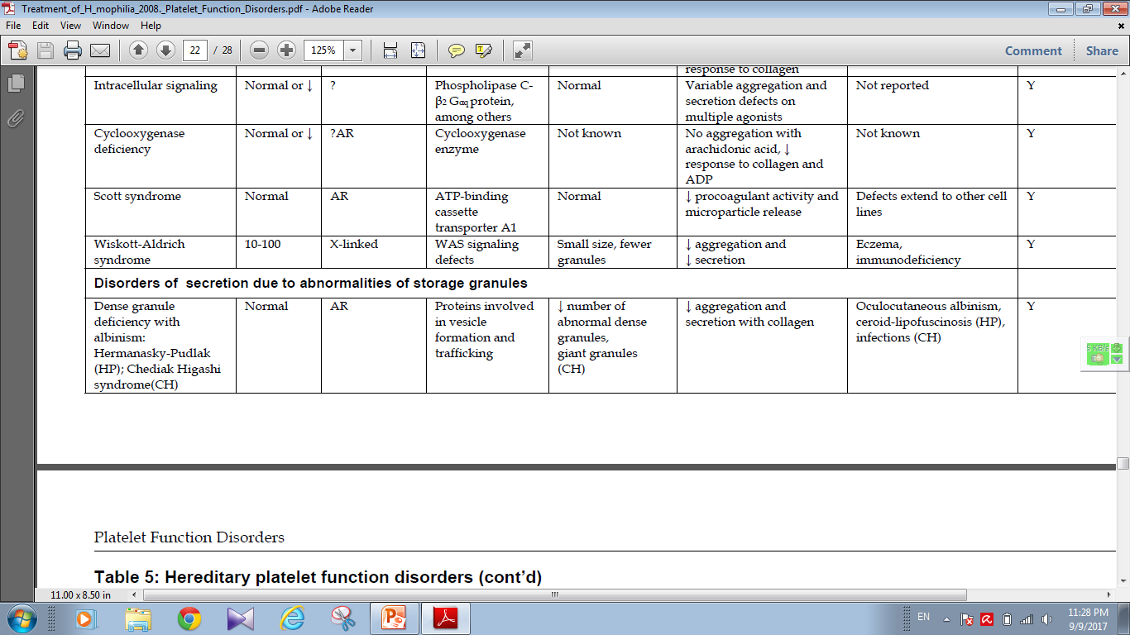

Slide 15
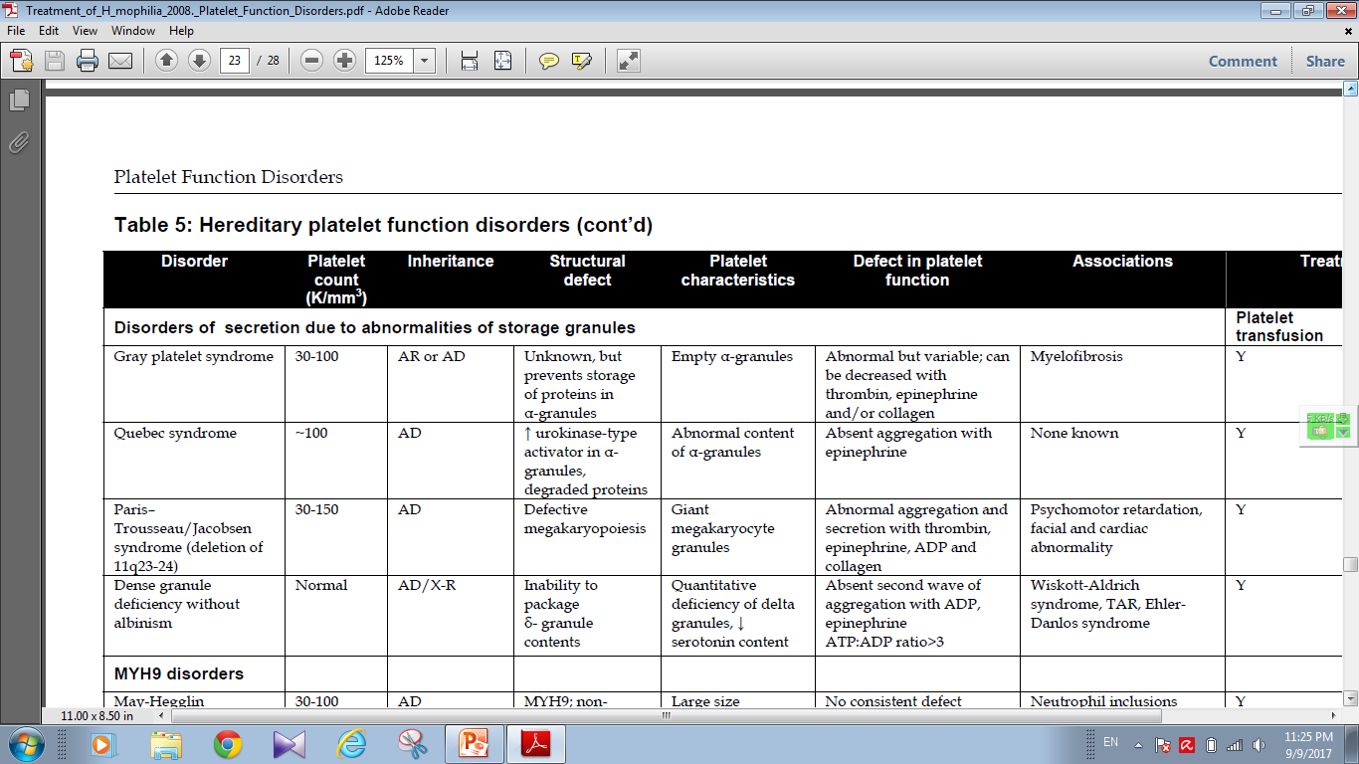

Slide 16
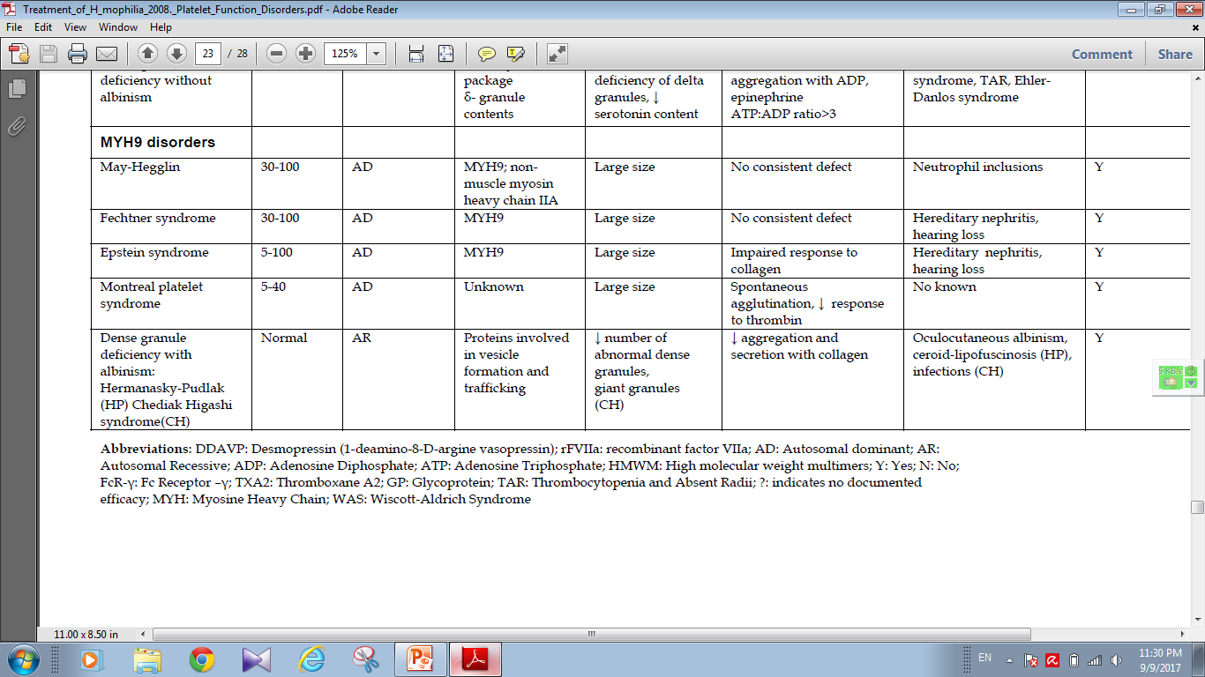

Slide 17
Glanzmann’s Thrombasthenia
Eduard Glanzmann (1887-1959), Swiss pediatrician
Reported a case of a bleeding disorder starting immediately after birth
W. E. Glanzmann:Hereditäre hämorrhägische Thrombasthenie. Ein Beitrag zur Pathologie der Blutplättchen.
Jahrbuch für Kinderheilkunde, 1918; 88: 1-42, 113-141.

Slide 18
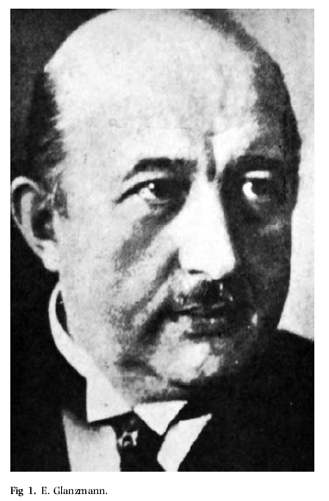

Slide 19
Glanzmann’s
IIbIIIa most abundant platelet surface receptor (80,000 per platelet)
IIbIIIa complex is a Ca++ dependent heterodimer
Genes for both subunits are found on Chromosome 17
Disease is caused by mutations (substitution, insertion, deletion, splicing abnormalities) in genes encoding for IIb or IIIa resulting in qualitative or quantitative abnormalities of the proteins

Slide 20
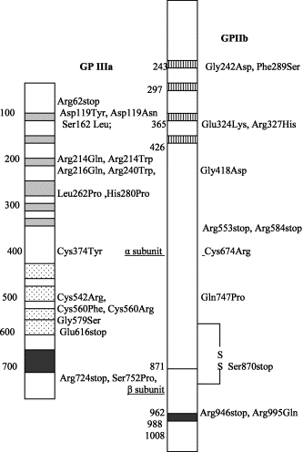

Slide 21
Fundamental defect of thrombasthenic patients is the inability of the platelets to aggregate
Other problems: platelets do not spread normally on the subendothelial matrix (due to lack of IIbIIIa – vWF/fibronectin interaction)
Also, alpha granule fibrinogen is decreased to absent

Slide 22
AR inheritance
Patients present with wide spectrum of disease
Like thrombocytopenic bleeding: skin, mucous membrane (petichiae, echymoses), recurrent epistaxis, GI hemorrhage, menorrhagia, and immediate bleeding after trauma/surgery
ICH, joint, muscle bleeding uncommon

Slide 23
Glanzmann’s patients are stratified into three groups based on complex expression:
  Type I less than 5 percent GPIIbIIIa, absent alpha granule fibrinogen
    Usually as a result of IIb gene mutation
  Type II <20 percent, fibrinogen present
  Type III >50 percent; “variant” thrombasthenia; qualitative disorder

Slide 24
Diagnosis
Platelet count and morphology are normal
Bleeding time prolonged
The hallmark of the disease is severely reduced or absent platelet aggregation in response to multiple agonists ie ADP, thrombin, or collagen (except Ristocetin)
Flow cytometry: decreased mAb expression of CD41 (GPIIb) and CD61 (GPIIIa)

Slide 25
Platelet Aggregation Studies
Platelet-rich plasma (PRP) is prepared from citrated whole blood by centrifugation
Inactive platelets impart a characteristic turbidity to PRP
When platelets aggregate after injection of an agonist, the turbidity falls, and light transmission through the sample increases proportionally
The change in light transmission can be recorded on an aggregometer

Slide 26
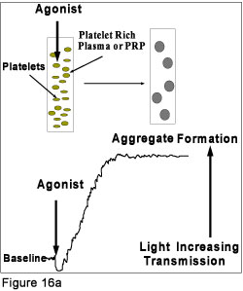

Slide 27
Agonists
Different concentrations of each agonist are used
ADP: biphasic pattern:
    First wave: low concentration, reversible
    Second wave: high concentration, irreversible

Slide 28
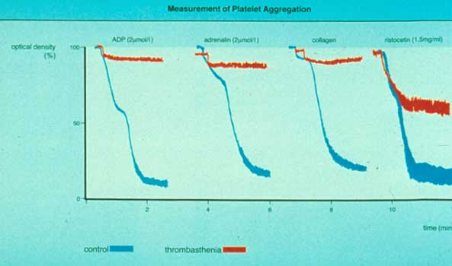

Slide 29
Other agonists
Epinephrine: triphasic (resting platelets, primary aggregation, secondary aggregation)

Slide 30
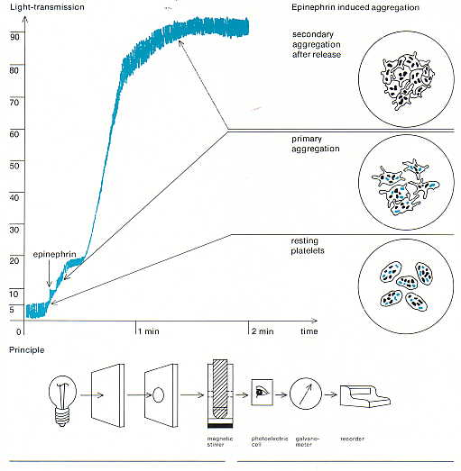

Slide 31
Other agonists
Collagen, arachidonic acid, Calcium ionophore, PAF are potent agonists and induce a single wave of irreversible aggregation
Ristocetin (antibiotic): aggregation can be reproduced with metabolically inert, formalin-fixed platelets
    Defective risto-induced aggregation is characteristic of Bernard-Soulier

Slide 32
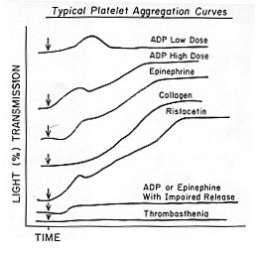

Slide 33
Problems with platelet aggregation studies
Numerous variables affect aggregation:
    Anticoagulant (sodium citrate best)
    Plt count in PRP
    Plt size distribution
    Time of day
    Temporal relation to meals and physical activity

Slide 34
Bernard-Soulier Syndrome
First described in 1948 by Jean Bernard and Jean-Pierre Soulier; French hematologists
    Bernard J, Soulier JP: Sur une nouvelle variete de dystrophie thrombocytaire hemarroagipare congenitale. Sem Hop Paris 24:3217, 1948
AR; characterized by moderate to severe thrombocytopenia, giant platelets, and perfuse/spontaneous bleeding
Basis for the disease is deficiency or dysfunction of the GP Ib-V-IX complex

Slide 35
Bernard-Soulier Syndrome
Decreased GP Ib-V-IX leads to decreased platelet adhesion to the subendothelium via decreased binding of vWF
Approximately 20,000 copies of GP Ib-V-IX per platelet
GP 1b: heterodimer with an alpha and beta subunit
The gene for GP Ib alpha is located on chromosome 17; GP Ib beta: chromosome 22; GPIX and V: chromosome 3
Most mutations are missense or frameshifts resulting in premature stop codons
Most mutations involve GP Ib expression (rare GP IX mutations have been described; no mutations in GP V)

Slide 36
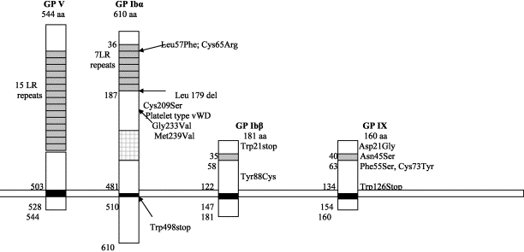

Slide 37
Diagnosis
Prolonged bleeding time, thrombocytopenia (plt<20 K), peripheral smear shows large platelets (mean diameter >3.5 microns)

Slide 38
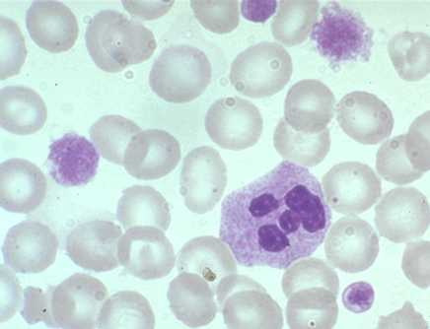

Slide 39
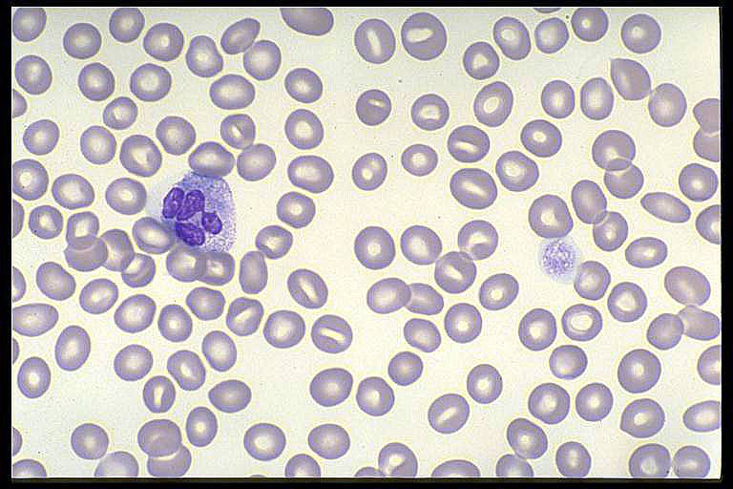

Slide 40
Diagnosis
Platelet aggregation studies show normal aggregation in response to all agonists except Ristocetin (opposite pattern than thrombasthenia)
Flow cytometry: decreased expression of mAbs to CD 42b (GPIb), CD42a(GPIX), CD42d(GPV)

Slide 41
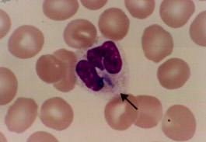
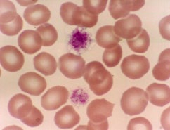

Slide 42
May-Hegglin anomaly: AD; giant platelets, thrombocytopenia, Dohle-like inclusions (larger, more angular)
Neutrophils are functional; only 40% of patients may have bleeding diathesis

Slide 43
MYH9-RD
Formerly May-Hegglinanomaly, Sebastian Syndrome, Epstein syndrome, Fechtnersyndrome
Mutations in non-muscle myosin heavy chain 9
Mutations in head of MYH9 may have more severe phenotype than mutations in tail
Platelet count generally 60-90K with variability in this
Large platelets on smear (may be counted as RBC)

Slide 44
PBS

Slide 45
MYH9-RD
Mild to no bleeding diathesis
No clear genotype-phenotype correlation and all patients are at risk for:
    Renal disease (nephropathy)
    Cataracts
    Hearing loss
    Mutation analysis available on a clinical basis

Slide 46
MYH9-RD
Generally do not need treatment as risk of bleeding is pretty low
For particularly at risk procedures would consider platelets on hold for bleeding (?T&A)
Some patients with very low platelet counts and bleeding: anti-fibrinolytics, platelet transfusions
Some patients can have severe bleeding!!!

Slide 47
MYH9-RD: Genotype/Phenotype
Generally more severe phenotype
More likely hematologic only

Slide 48
Wiskott-Aldrich
X-linked, genetic defect in WASp (protein responsible for actin cytoskeleton formation in hematopoetic cells)
characterized by thrombocytopenia (with platelet storage pool defect), eczema,and recurrent infections

Slide 49
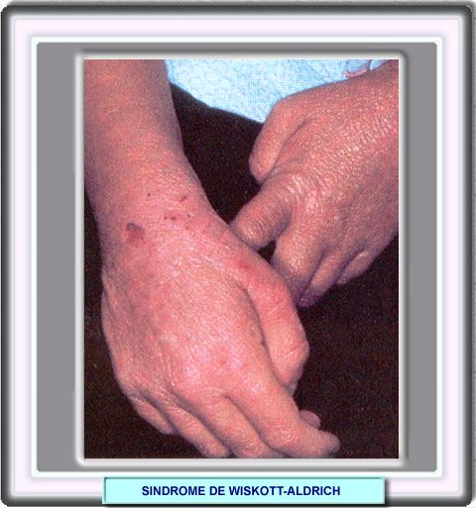
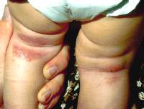
WASP

Slide 50
Hermansky-Pudlak
Described in 1959 by Hermansky and Pudlak
AR, tyrosinase-positive oculocutaneous albinism, ceroid-like deposition in lysosomes of the RES and marrow
Highest prevalence in Puerto Rico
May be associated with pulmonary fibrosis, IBD, and recurrent infections
quantitative deficiency of dense granules leading to mild-moderate bleeding diathesis

Slide 51
Hermansky-Pudlack Syndrome
Microdeletion of HPS6 on one chromosome and variant on other chromosome
Absent dense granules on platelet EM
Normal platelet function on LTA and abnormal serotonin release and uptake as well as abnormal ATP:ADP ratio
Occulocutaneous albinism, nystagmus, some variants are associated with pulmonary fibrosis and Crohn’s like GI illness
Bleeding varies but dense granule deficiency

Slide 52



Hermansky-Pudlak

Slide 53
Chediak-Higashi
described by Beguez Cesar in 1943, Steinbrinck in 1948, Chédiak in 1952, and Higashi in 1954
AR; abnormal microtubule formation and giant lysozomal granules are present in phagocytes and melanocytes
No degranulation/chemotaxis = recurrent bacterial infections
Partial oculocutaneous albinism
Dense-body granules decreased/absent

Slide 54
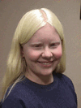
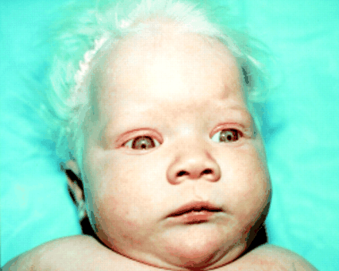
Chediak -Higashi

Slide 55
CHS

Slide 56
Thrombocytopenia with absent radius (TAR)
First described in 1951
AR, characterized by absent radii, thrombocytopenia (with storage pool defect), and other abnormalities of the skeletal, GI, cardiovascular system
Etiology unclear
Hemorrhage is the major cause of mortality
PX is good if survive the two years

Slide 57
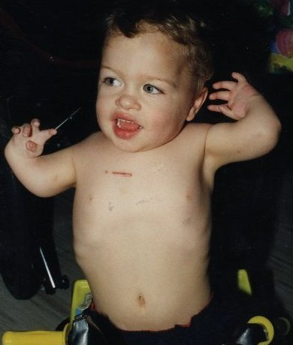
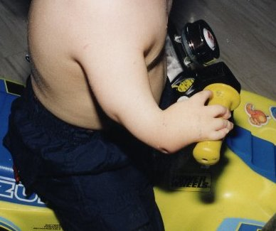
TAR

Slide 58
Diagnosis
Platelet aggregation studies may show diminished response to low concentration collagen
ADP and epinephrine show diminished second wave response
Ristocetin shows normal aggregation
EM: lack of dense bodies
Increased ATP:ADP ratio within platelets

Slide 59
Alpha granule deficiency
Alpha storage pool deficiency, Gray Platelet Syndrome
First described by Raccuglia in 1971
Normal platelets contain approximately 50 granules (PF4, beta-thromboglobulin, PDGF, fibrinogen, vWF, Factor V, fibronectin)
Patients lack granules, present with lifelong, mild to moderate mucocutaneous bleeding

Slide 60
Diagnosis
Prolonged bleeding time, mild thrombocytopenia
Agranular, large “gray” platelets on peripheral smear
Aggregation studies: decreased to absent response to collagen

Slide 61
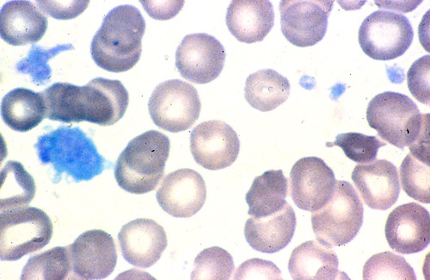

Slide 62
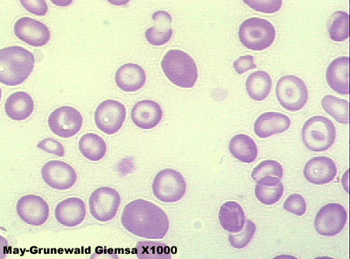

Slide 63
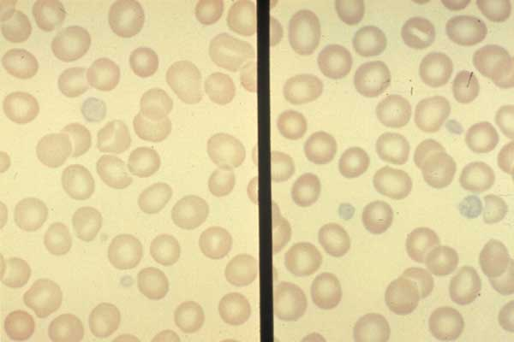

Slide 64
Acquired
DIC
Cardiopulmonary bypass
Hypothermia
Liver dysfunction
Uremia

Slide 65
Management
Prevention and local care
Avoidance of medications such as Aspirin and nonsteroidal analgesics is critical
Antifibrinolytic agents
Desmopressin
Platelet transfusion
rFVIIa
Splenectomy
Other option

Slide 66
Summary
Morphology and role of the platelet in primary hemostasis
Adhesion: GP1b-V-IX; Bernard-Soulier; aggregates with everything but Ristocetin
Activation (Secretion): dense body deficiency (associated syndromes), alpha granule deficiency
Aggregation: GPIIb-IIIa; Glanzmann’s; no aggregation except for Ristocetin

Slide 67
Take home points
Inherited disorders and acquired disorders can occur in combination or look like each other
While each individual platelet disorder may be relatively rare, in aggregate, they are not at all uncommon
Be on the look out for platelet disorders in you patients with bleeding, thrombocytopenia or combination

Slide 68


