Slide 1
In the name of god

Slide 2
Infantile leukemia
k.goudarzipour,pediatric congenital hematologic disorders research center ,shahid beheshti university of medical science,Tehran,Iran

Slide 3
Case report
The patient is 7 months with cc of lethargy and poor feeding,CBC is shown below:
WBC:180.000,P:10,Blast:90
RBC:3.3
Hb:10.8
HCT:32
MCV:78
PLT:130.000

Slide 4
BMA:increase CD15,19,20 and full blast
DX:ALL,MLL negative
RX:Inter fant 2006 but 6 days cytosar
Folow up:after 2 years of end of treatment the patient is in remission.

Slide 5
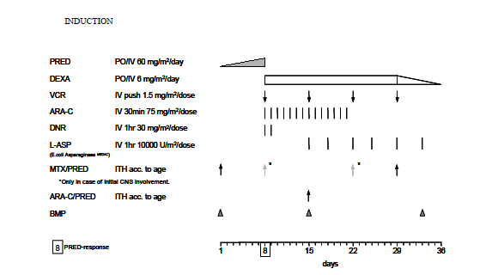
Induction phase interfant

Slide 6
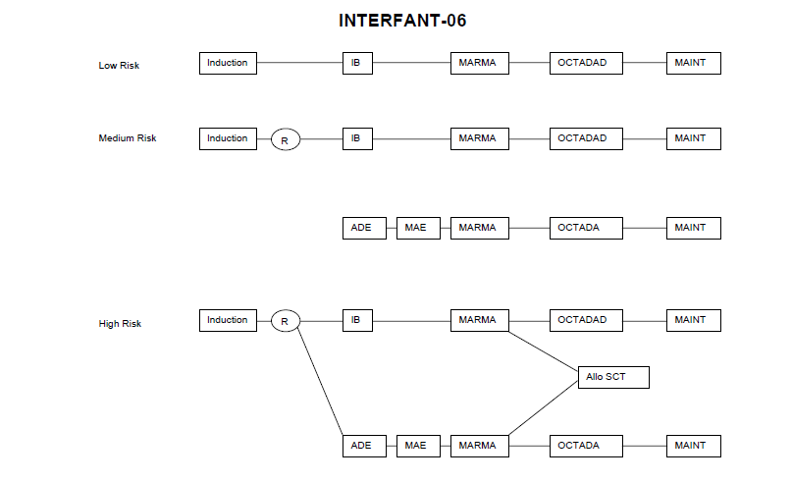

Slide 7
We had alot of morbidity and mortality with 14 days cytosar.
6 case were died after 14 days cytosar.
2case are still alive with dose adjustment

Slide 8
The Oncologist 1999;4:225-240
annual incidence of ALL (20 per million) is almost twice the rate of AML (10.6 per million).
While 2.5% to 5% of pediatric ALL occurs in infants, AML in infants comprises 6% to 14% of pediatric AML

Slide 9
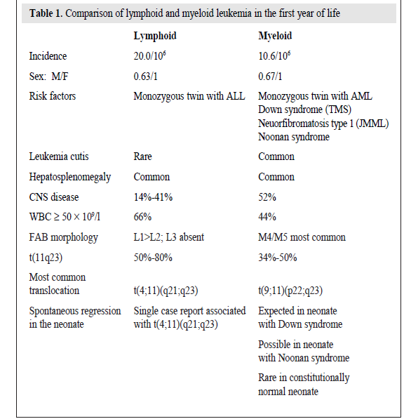
The Oncologist 1999;4:225-240

Slide 10
Risk group interfant-2006

Slide 11
HEMATOLOGY-2013

Slide 12
Hematology Am Soc Hematol Educ Program. Author manuscript; available in PMC 2016 January 27.

Slide 13
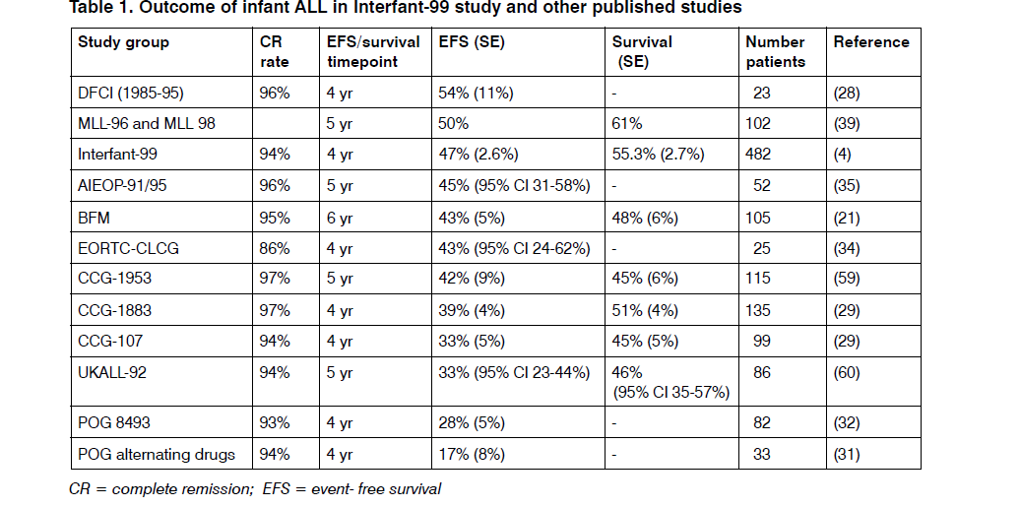
SIOP

Slide 14
RX
AML same as other children but ALL is different.

Slide 16
Hsct OR NOT SCT

Slide 17
Infant ALL with MLL rearrangements-ash2011
Results of 3 large cohort study failed to show an advantage of transplant over chemotherapy.
Transplant in very high risk group infantile ALL(age below than 6 months,WBC more than 300,000 ,poor response to glucocorticoid)is benefical.
FLT3 is more important in this group .

Slide 18
Biology of blood and marrow transplant-2014
26 infants who were submitted to a SCT for acute leukemia. There were 15 cases of acute myeloid leukemia and 10 cases of acute lymphoid leukemia. One patient had a bilineal leukemia.
With a median follow-up of 67 months, the 5-year overall survival and disease-free survival were 64% and 63%

Slide 19
coNclusion
Decrease dose of cytosar
HSCT or not HSCT?

Slide 20
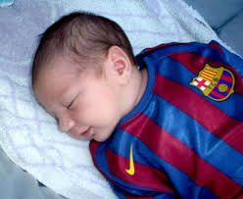
Thank you

