Slide 1
Rare Interesting case
Rare case Presentation
Pediatric Blastic Plasmacytoid Dendritic Cell Neoplasm
BPDCN
BibiShahin Shamsian, MD
31/1/96

Slide 2
Case Presentation
10 years old boy
Right lower limb mass -Calf mass, since several months ago, No pain, No other findings
PE: R calf mass about 6-7 cm, firm, no pain
Biopsy report : BPDCN,Blastic Plasmacytoid Dendritic Cell Neoplasm
Evaluation CBC, Bio, Nl
BMA& and CD flow Cytometry : No diagnostic finding
BMB:Nl
CT : Chest , abdo and R Leg mass Chest and abdo CT: Nl
CT of R leg; mass lesion resectable
Bone survey: ?
Bone scan:?/
Mass Resection 8x5cm : in Pars Hospital: Dr Sam Sami
Pathology in Pars hospital : DD lymphoblastic lymphoma and BPDCN recommendation study B& T cell monoclonality and gene rearrangement
Second review and IHC : BPDCN

Slide 3
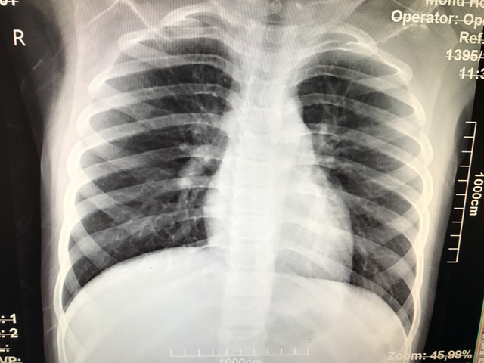
CXR

Slide 4
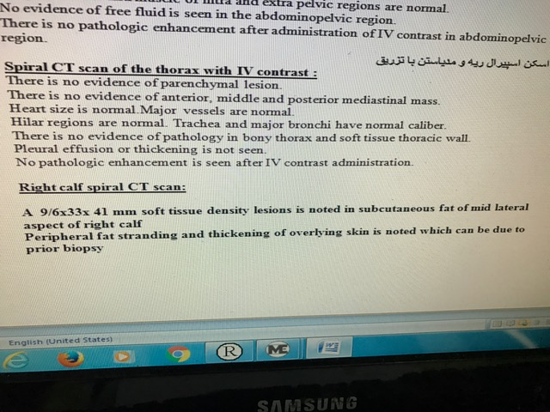
Chest CT and Leg CT

Slide 5
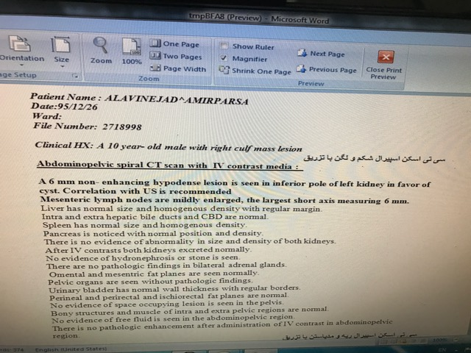
Abdomen CT

Slide 6
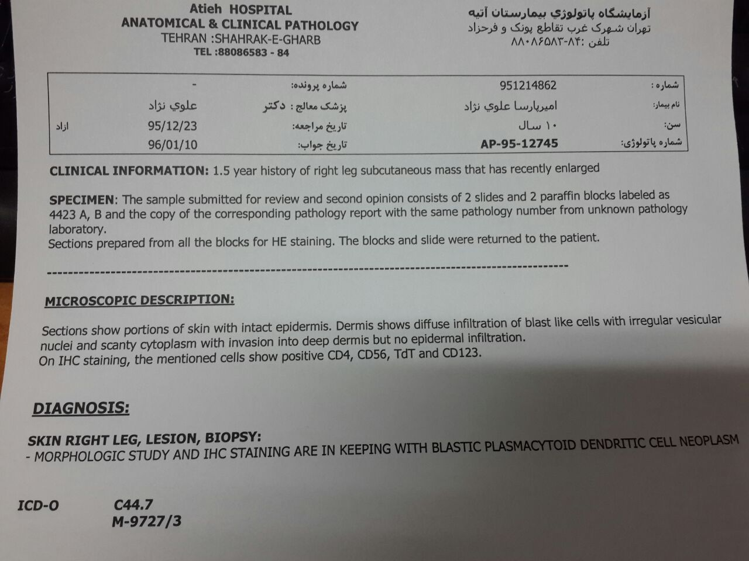
Pathology Report 1 :12/95

Slide 7
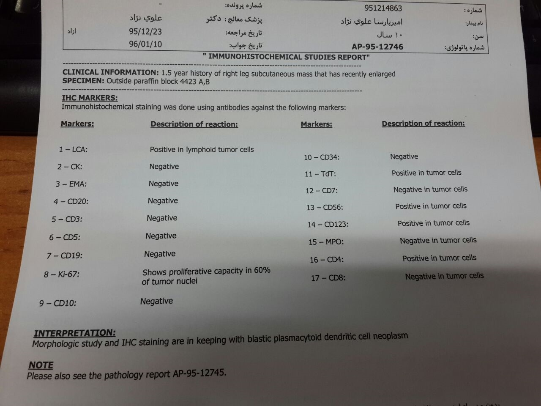
IHC Report 1 : 23/12/95

Slide 8
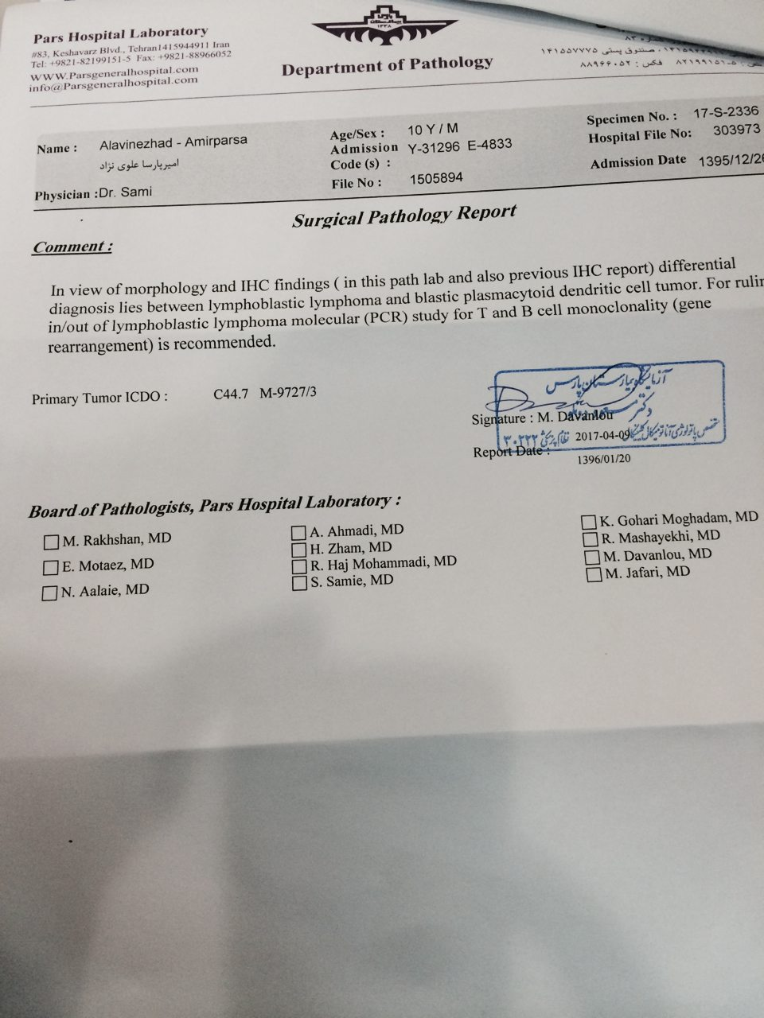
Pathology Report 2, pars Hospital

Slide 9
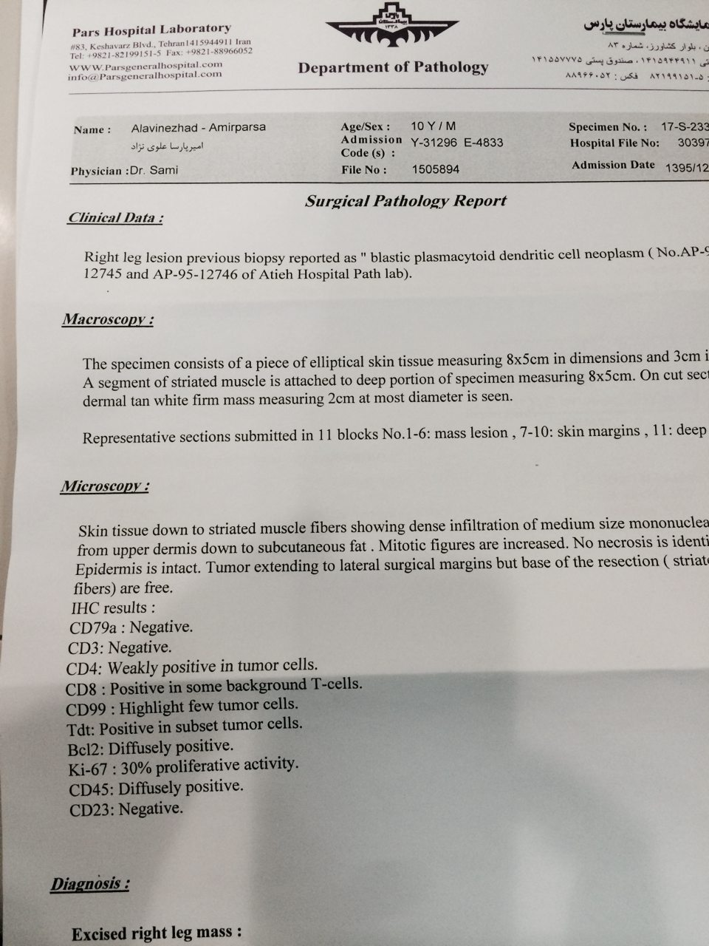
Pathology report 2 ,Resection mass 8x5 cm : Pars Hospital

Slide 10
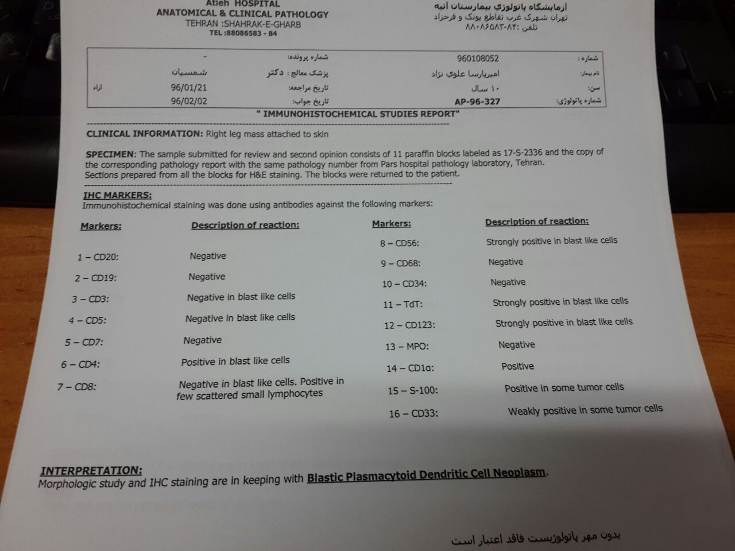
IHC report 2 Dr Kosari : 21/1/96

Slide 11
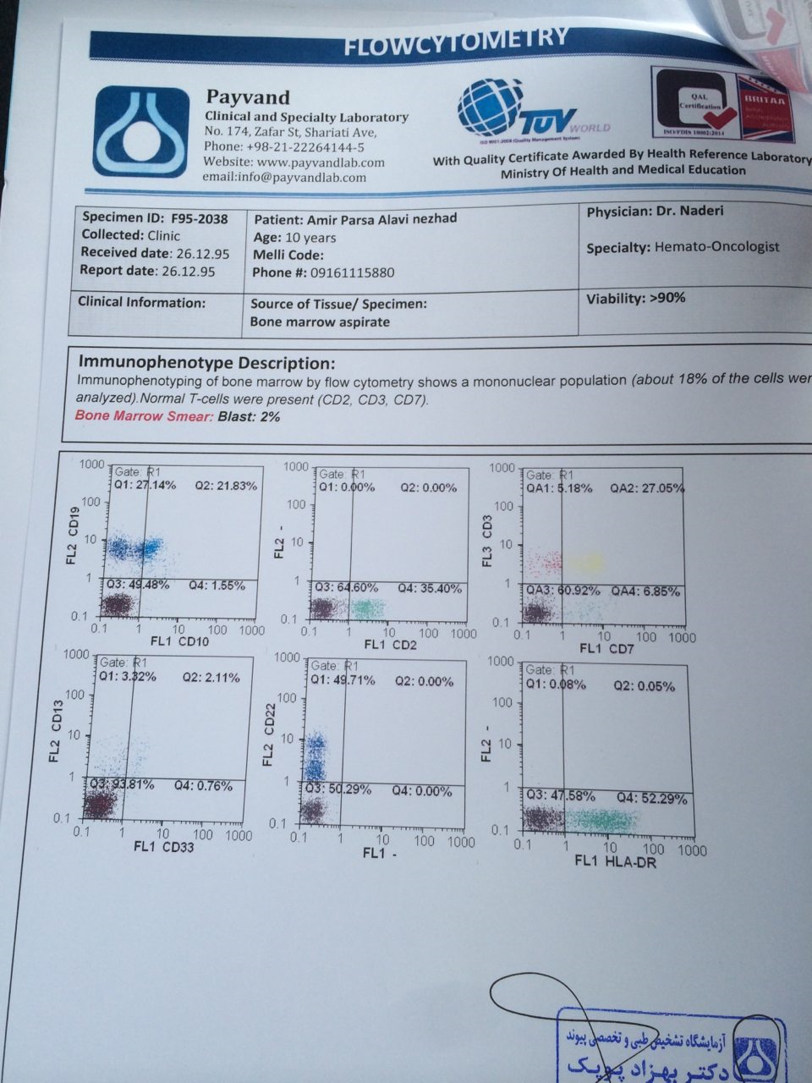
CD flowcytometry , BMA, payvand Lab

Slide 12
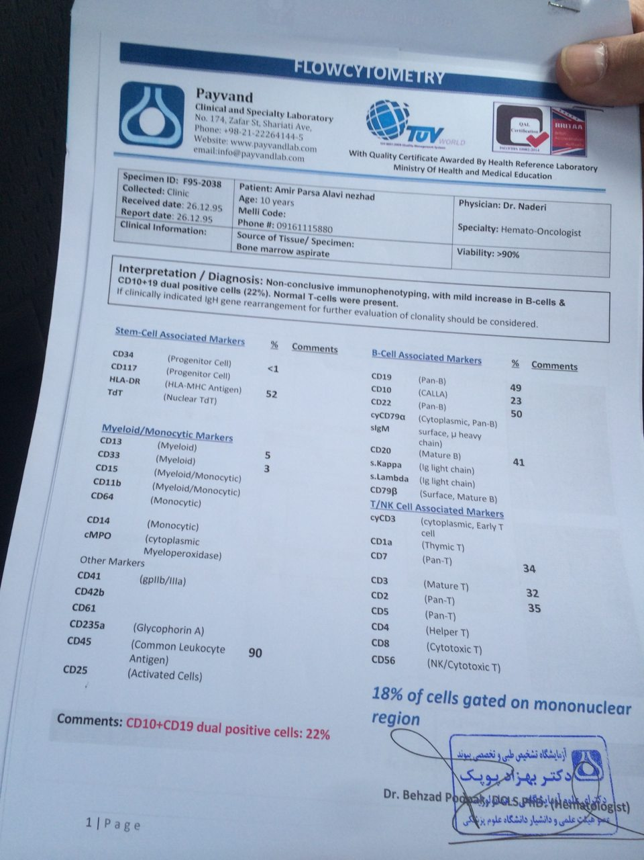
CD flowcytometry ,BMA, payvand Lab

Slide 13
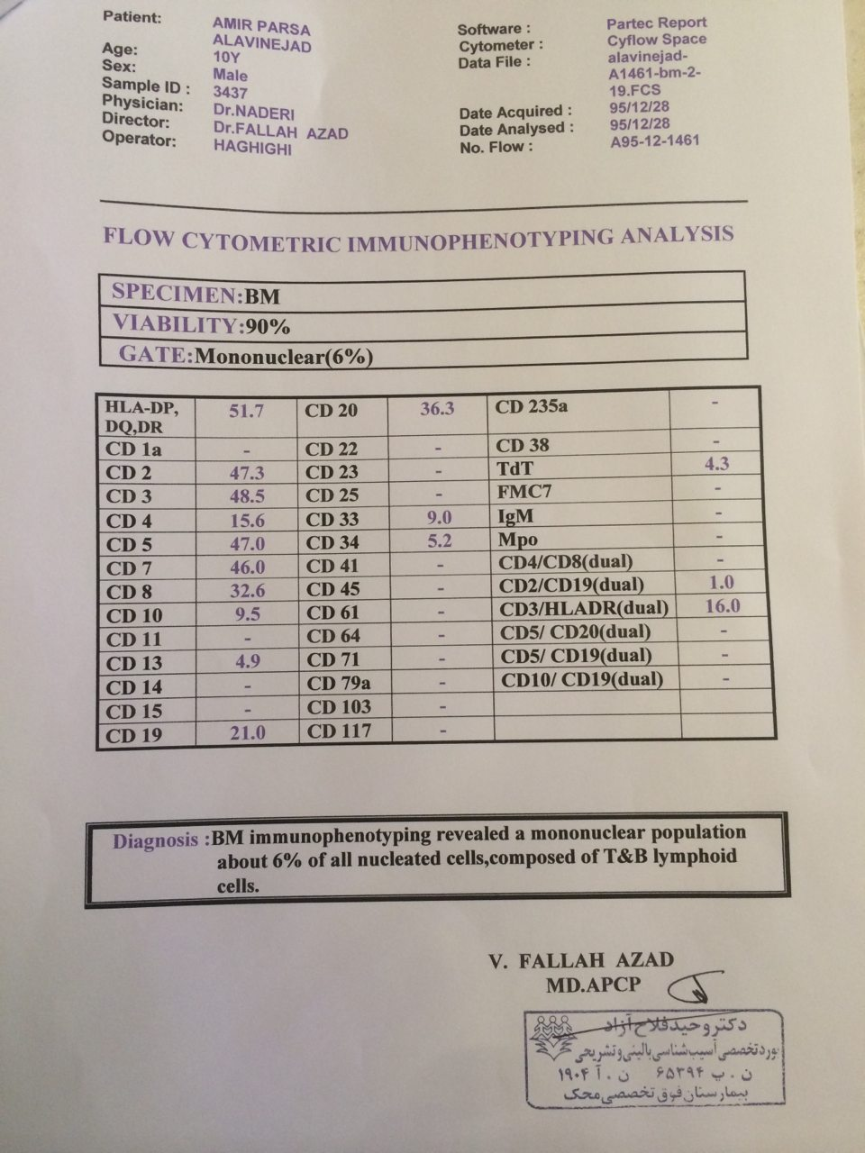
BMA- CDF :Mahak Hospital

Slide 14
Case Consult , Dr Naveen Pemmaraju, MD Anderson cancer Center , USA
Thank you so much for reaching out to me
Yes, BPDCN does indeed occur in pediatric patients, just as in your patient
Here in US, I am leading , with Dr Konopleva , a Clinical trial : with SL-401 for patients with BPDCN: however the protocol currently only allows for age 18 and higher.
So my first choice would be to recommend compassionate use administration of this promising agent for patients with BPDCN;However it must be given here in America
The sponsor is very helpful, I have given compassionate use now and we have given to several pediatriac patients
Can the patient travel here to US?
Best, Naveen

Slide 15
Naveen Pemmaraju, MD .
Houston, Texas The University of Texas MD Anderson .Cancer Center
Clinical Advances in Hematology & Oncology Volume 14, Issue 4 April 2016
So Rare
Incidence: ? 1% of all hematologic malignancies, and fewer than 1% of primary cutaneous lymphomas
Male predominance; approximately 75% to 90%
BPDCN also tends to be a disease of older patients, with a median age at onset of anywhere from 60 to 70 years and older , But in Female and pediatric
Experience in children with this disease is very limited

Slide 16
Naveen Pemmaraju, MD .
Houston, Texas The University of Texas MD Anderson .Cancer Center
Clinical Advances in Hematology & Oncology Volume 14, Issue 4 April 2016
USA. Haematologica 2010
Multiple organs, Bone marrow and blood ,lymph nodes and the skin
Approximately 85% of BPDCN :cutaneous involvement at presentation, with about half the cases confined to skin at the time of initial staging,
Although leukemic variants lacking cutaneous involvement have also been documented based on rigorous immunophenotypic profiling.
Often presents as leukemia or evolves into acute leukemia
24% of the pediatric cases lacked cutaneous involvement at presentation,

Slide 17
Presentation / BPDCN
Vast majority of patients—70% or more—already have or acquire skin lesions, purplish discoloration
leukemic presentation, which means low blood cell counts and the presence of blasts in the bone marrow, such as are seen in acute myeloid leukemia (AML) and acute lymphocytic leukemia (ALL)
Lymph nodes, spleen, liver, or central nervous system, or they have Extramedullary involvement

Slide 18
Blastic plasmacytoid dendritic cell neoplasm - BPDCN
Blastic natural killer cell lymphoma and CD4+/CD56+ hematodermic (or hematopoietic ) neoplasm
Origin:The precise developmental pathway of plasmacytoid dendritic cells is somewhat controversial, but current evidence favors derivation from a common macrophage and dendritic cell precursor
WHO : Standardized the term blastic plasmacytoid dendritic cell neoplasm in 2008, listing it under “acute myeloid leukemia and related precursor neoplasms.”

Slide 19
How is BPDCN diagnosed
Clinical and pathologic technologies morphology
IHC and flow cytometry, the cells are positive for the classic triad of BPDCN: CD4, CD56, and CD123 ,T-cell leukemia/ lymphoma 1 (TCL1)
CD123, the interleukin-3 receptor α chain, which is strongly expressed in BPDCN
ASH -2013 ;Somatic loss-of-function mutations in the splicing factor ZRSR2 in patients with BPDCN, Xp22 (frameshift, nonsense, or splice site mutations) all 10 ,male
Chromosomal karyotype, flow cytometry, and molecular features -AML, ALL, and cutaneous T-cell lymphoma.

Slide 20
IHC Markers/ BPDCN
Other markers
T-cell leukemia/lymphoma 1 (TCL1)
Blood dendritic cell antigen-2 (CD303/BDCA-2)
CD2-associated protein (CD2AP).
CD56 expression may be nonspecific

Slide 21
Out come / BPDCN
Outcome:poor Most patients survive for only 10 to 14 months after diagnosis, despite receiving various chemotherapeutic regimens
Outcomes were poor regardless of the patient’s age and regardless of a skin-only or a bone marrow presentation

Slide 22
How is BPDCN treated?
No uniform, consensus, worldwide standard of care treatment for BPDCN
Chemotherapy regimens designed for AML or ALL.
Another approach is to treat the disease like nonHodgkin lymphoma (CHOP)
Multiple agent, intensive chemotherapy ;remissions
Relapse tends to occur quickly.
Patients die either of active disease in the setting of relapse or of infections or multiple-organ failure very quickly after relapse.

Slide 23
How is BPDCN treated?
2014 ;Single cycle of therapy with diphtheria toxin DT388-IL3, which is now known as SL-401produced an objective response in 7 /9 patients.
Of these, 5 ;complete remissions , 2 ; partial remissions, with a median duration of response of 5 months (range, 1-20+ months)
Side effect ; capillary leak syndrome
lorvotuzumab mertansine, targets CD56
Allogeneic or, interestingly, Autologous transplant can improve median survival to 2 to 4 years.
11 patients with BPDCN who underwent Autol ;overall survival rate of 82% - 4 years
Among all children with BPDCN who underwent SCT, the overall survival was 67% (4 of 6 cases) 2010

Slide 24
Blastic plasmacytoid dendritic cell neoplasm in children: diagnostic features and clinical implications
Cleveland, OH, USA. haematologica | 2010; 95(11) .Armin G. Jegalian
Retrospective study :9 cases of BPDCN in patients under the age of 18 years
We also identified 20 well-documented additional pediatric cases in the literature.
Results
OS rate among the 25 patients with available followup, all having received chemotherapy, was 72% (follow-up ranging from 9 months to 13 years, with a median of 30 months).
The EFS rate was 64%.
9 patients were alive 5 years after the original diagnosis, although only 3 of them had undergone HSCT – 1 in first complete remission and 2 in second remission.

Slide 25
Blastic plasmacytoid dendritic cell neoplasm in children: diagnostic features and clinical implications
Cleveland, OH, USA. haematologica | 2010; 95(11) .Armin G. Jegalian
Results
Of the 7 patients who lacked cutaneous disease at presentation, 100% survived, including five who were alive more than 5 years after diagnosis, although only two had undergone stem cell transplantation.
Among the 18 patients who presented with cutaneous disease and for whom follow-up data were available, only 11 survived (61%).
Detailed immunophenotypic characterization and clinical features of all cases are presented.
Unexpectedly, ¾ cases of BPDCN tested showed focal positivity for S-100.
S-100 was negative in 28 cases of acute myeloid leukemia evaluated for this marker

Slide 26
Blastic plasmacytoid dendritic cell neoplasm in children: diagnostic features and clinical implications
Cleveland, OH, USA. haematologica | 2010; 95(11) .Armin G. Jegalian
It is important to note that CD123, CD4, and CD56 positivity, the most commonly used BPDCN immunophenotypic profile, is not specific and that these markers can be expressed in both acute myeloid leukemia and ALL
A variety of regimens have been employed in the treatment of BPDCNALL-type therapies have been most commonly utilized and are associated with the best-reported results.
All patients who received acute myeloid leukemia-type therapy died (n = 3).
Patients who received non-Hodgkin’s lymphoma-type therapy appeared to have a favorable response
however, the number of patients treated with this approach was small

Slide 27
Blastic plasmacytoid dendritic cell neoplasm in children: diagnostic features and clinical implications
Cleveland, OH, USA. haematologica | 2010; 95(11) .Armin G. Jegalian
Conclusion
BPDCN in children are clinically less aggressive.
Treatment with high-risk acute lymphoblastic leukemia-type chemotherapy appears to be effective,
Stem cell transplantation may be reserved for children who relapse and achieve a second remission.
Outcomes were more favorable in cases that lacked cutaneous disease at presentation, although a comparison of cutaneous and non-cutaneous cases might be confounded by differences in treatment regimens.
Focal expression of S-100 may be seen in concert with other markers of plasmacytoid dendritic cells.

Slide 28
Case presentation
2-year-old girl ; fever and cough for 2 days.
PB :marked leukocytosis (WBC, 75000/mL) with 76% blasts.Blasts were medium to large size with scant agranular paleblue cytoplasm.The nuclei were irregular, folded, or ﬂowerlike. Some had a prominent nucleolus.
CSF :87% blasts
LDH ;3759 IU/L.
lymphadenopathy without skin lesion or hepatosplenomegaly..

Slide 29
Case presentation
Fow cytometry, ; positive for CD4, CD7, CD36, CD38, dim CD45, CD123, and HLA-DR
Negative for tested lineage markers CD2, CD3 (surface and cytoplasmic), CD5, CD14, CD19, CD20, CD33, CD34, CD41, CD56, CD64, CD117, TdT, and myeloperoxidase
By immunohistochemistry, IHC the blasts were positive for T-cell leukemia 1
Karyotyping was complex: 47, X, der(X)t(X;8)(q24;q24.1), add(5)(p13), 26, del(6)(q13q27), 18, der(8), t(X;8), add(8)(q24.1)32, del(9)(q12q31), del(9)(q13q22), der(10;13)(q10;q10), add(12)(p13), 214, 13mar[20].

Slide 30
Case presentation
FISH was positive for single-copy deletion of the ETV6 gene
Fish: Negative for MLL gene rearrangement, BCR/ABL1, andETV6/RUNX1 translocation.
patient was diagnosed with blastic plasmacytoid dendritic cell neoplasm ,
complete remission by bone marrow biopsy 4 weeks after initial high-risk acute lymphoblastic leukemia therapy.
This case has the following unique features: young age, negative CD56, acute leukemia without skin lesion, and involvement of the central nervous system.

Slide 31
Thank You

