Slide 2
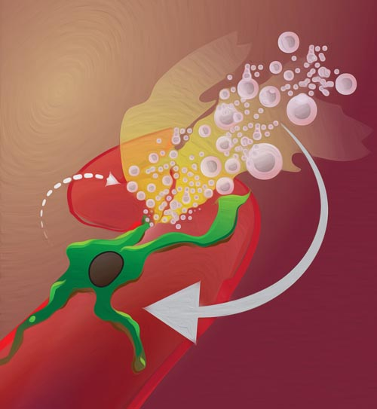
Hemophagocytic Lympho Histiocytosis

Slide 3
Case presentation
11 yr old boy with CC:
Fever & Headache since 2 wks ago

Slide 4
Physical findings
Pallor
Huge hepatosplenomegaly

Slide 5
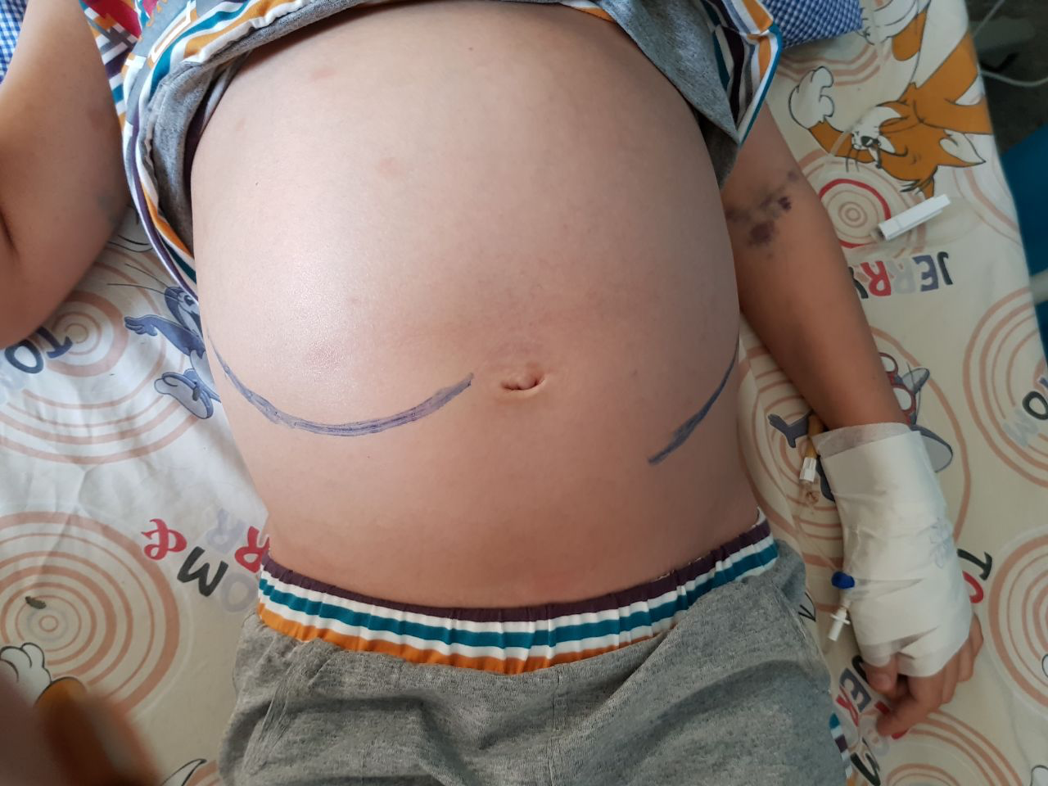

Slide 6
Lab findings
Pancytopenia
Hyperferretinemia
Abnormal lipid profile
Hyofibrinogenemia
Hemophagocytosis in BM
Normal Cranial MRI
Lp traumatic

Slide 7
l
Lab Data
Flow cytometry
Reversed CD4/CD8

Slide 8
Differential Diagnosis
Leukemia/ lymphoma
Rhomatologic disorder (MAS)
Infection (EBV, kalazar)
Familial HLH
XLP 1
Hypogammaglobunemia

Slide 9
Diagnosis

Slide 10
Differential Diagnosis
Leukemia/ lymphoma
Rhomatologic disorder (MAS)
Infection (EBV, kalazar)
Familial HLH
XLP 1
Hypogammaglobunemia

Slide 11
Immunology
IgG
IgM

Slide 12
Virology
EBV PCR Load 750
EBNA Negative
CMV PCR Negative
HIV Ab Negative
HBV Negative

Slide 13
Kalazar
BM Negative
Serology Negative

Slide 14
Rheumatology panel
Negative RF
Negative Anti DNA

Slide 15
Genetic
Not ready

Slide 16
Supportive therapy
Irradiated blood products
Broad spectrum AB
IV IG
PCP and fungal prophylaxia

Slide 17
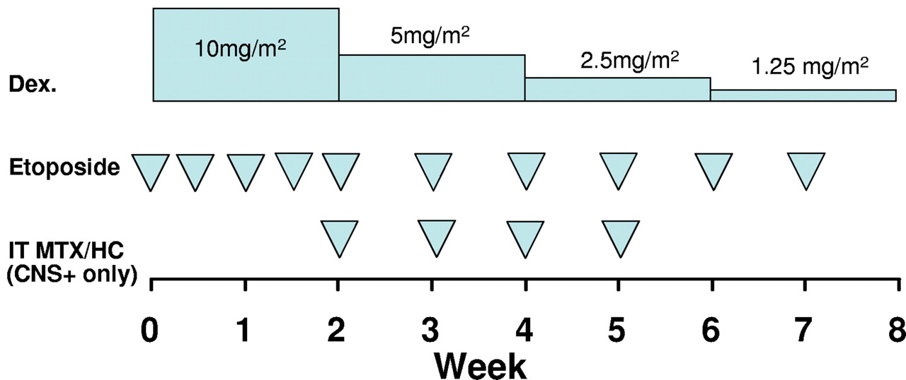
Protocol 94

Slide 18
After 3wks
Initial Clinical response , no lab response
Worsening of symptoms after 2 wks
Rise of hepatic enzymes
Rise of ferretin
Severe neutropenia
No change in liver and spleen size
Worsening of headache

Slide 19
Switch to HLH 2004 Protocol
Systemic Therapy | Dexamethasone | Etoposide | Cyclosporine
Week 1 | 10 mg/m² daily | 150 mg/m² IV biw | 3 mg/kg bid
Week 2 | 10 mg/m² daily | 150 mg/m² IV biw | To Trough 200 μg/L
Week 3 | 5 mg/m² daily | 150 mg/m² IV qwk | To Trough 200 μg/L
Week 4 | 5 mg/m² daily | 150 mg/m² IV qwk | To Trough 200 μg/L
Week 5 | 2.5 mg/m² daily | 150 mg/m² IV qwk | To Trough 200 μg/L
Week 6 | 2.5 mg/m² daily | 150 mg/m² IV qwk | To Trough 200 μg/L
Week 7 | 1.25 mg/m² daily | 150 mg/m² IV qwk | To Trough 200 μg/L
Week 8 | Taper and d/c | 150 mg/m² IV qwk | To Trough 200 μg/L

Slide 20
Modified therapy
Methyl prednisolon pulse 30 mg/kg X 3 days Then prednisone 2 mg /kg daily
Vp-16 150/m² wkly
Cyclosporine 3 mg / kg ( trough level 200 μg/L)
IVIg 10 gr wkly

Slide 21
Response
Initial Clinical condition improved (well being )
Normalized hepatic enzymes
Ferretin 28000→ 15000
Blood count recovery (PLT, poly , Hb)
Normalized fibrinogen level
EBV PCR Negative
CMV PCR Negative
Cranial MRI Normal
Normal CSF
Latest Flow cytometry : CD56 + , CytoplasmicCD3 +, Reverse CD4/CD8
B Cell CD markers decreased
Very high triglyceride and cholestrol ≈ 500
No change in liver and spleen size

Slide 23
HLH

Slide 25
HLH Definition HLH is not a single disease, but rather a hyperinflammatory syndrome
Excessive uncontrolled activation and proliferation of T cells and macrophages
Hyperinflammation
Cytokine storm

Slide 27
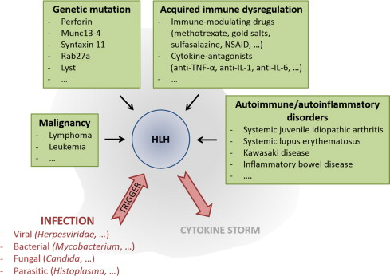

Slide 28
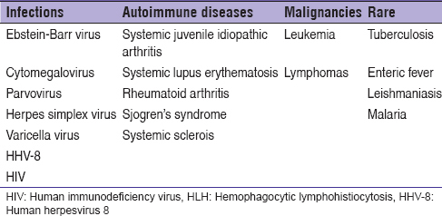
Secondary HLH

Slide 29
Primary HLH
Familial
XLP
XIAP
Immune deficiency

Slide 30
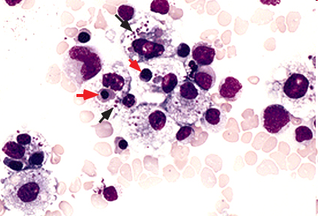
Pathophysiology
Genetic mechanisms for primary HLH known
Mechanism of acquired HLH unknown
From Uptodate.com
Notes:
Bone marrow from a child with hemophagocytic syndrome, secondary to Epstein-Barr virus infection. Reactive histiocytes show phagocytosis of nucleated red blood cells (red arrows) and platelets (black arrows). Wright-Giemsa stain

Slide 31
Pathophysiology Primary HLH

Slide 32
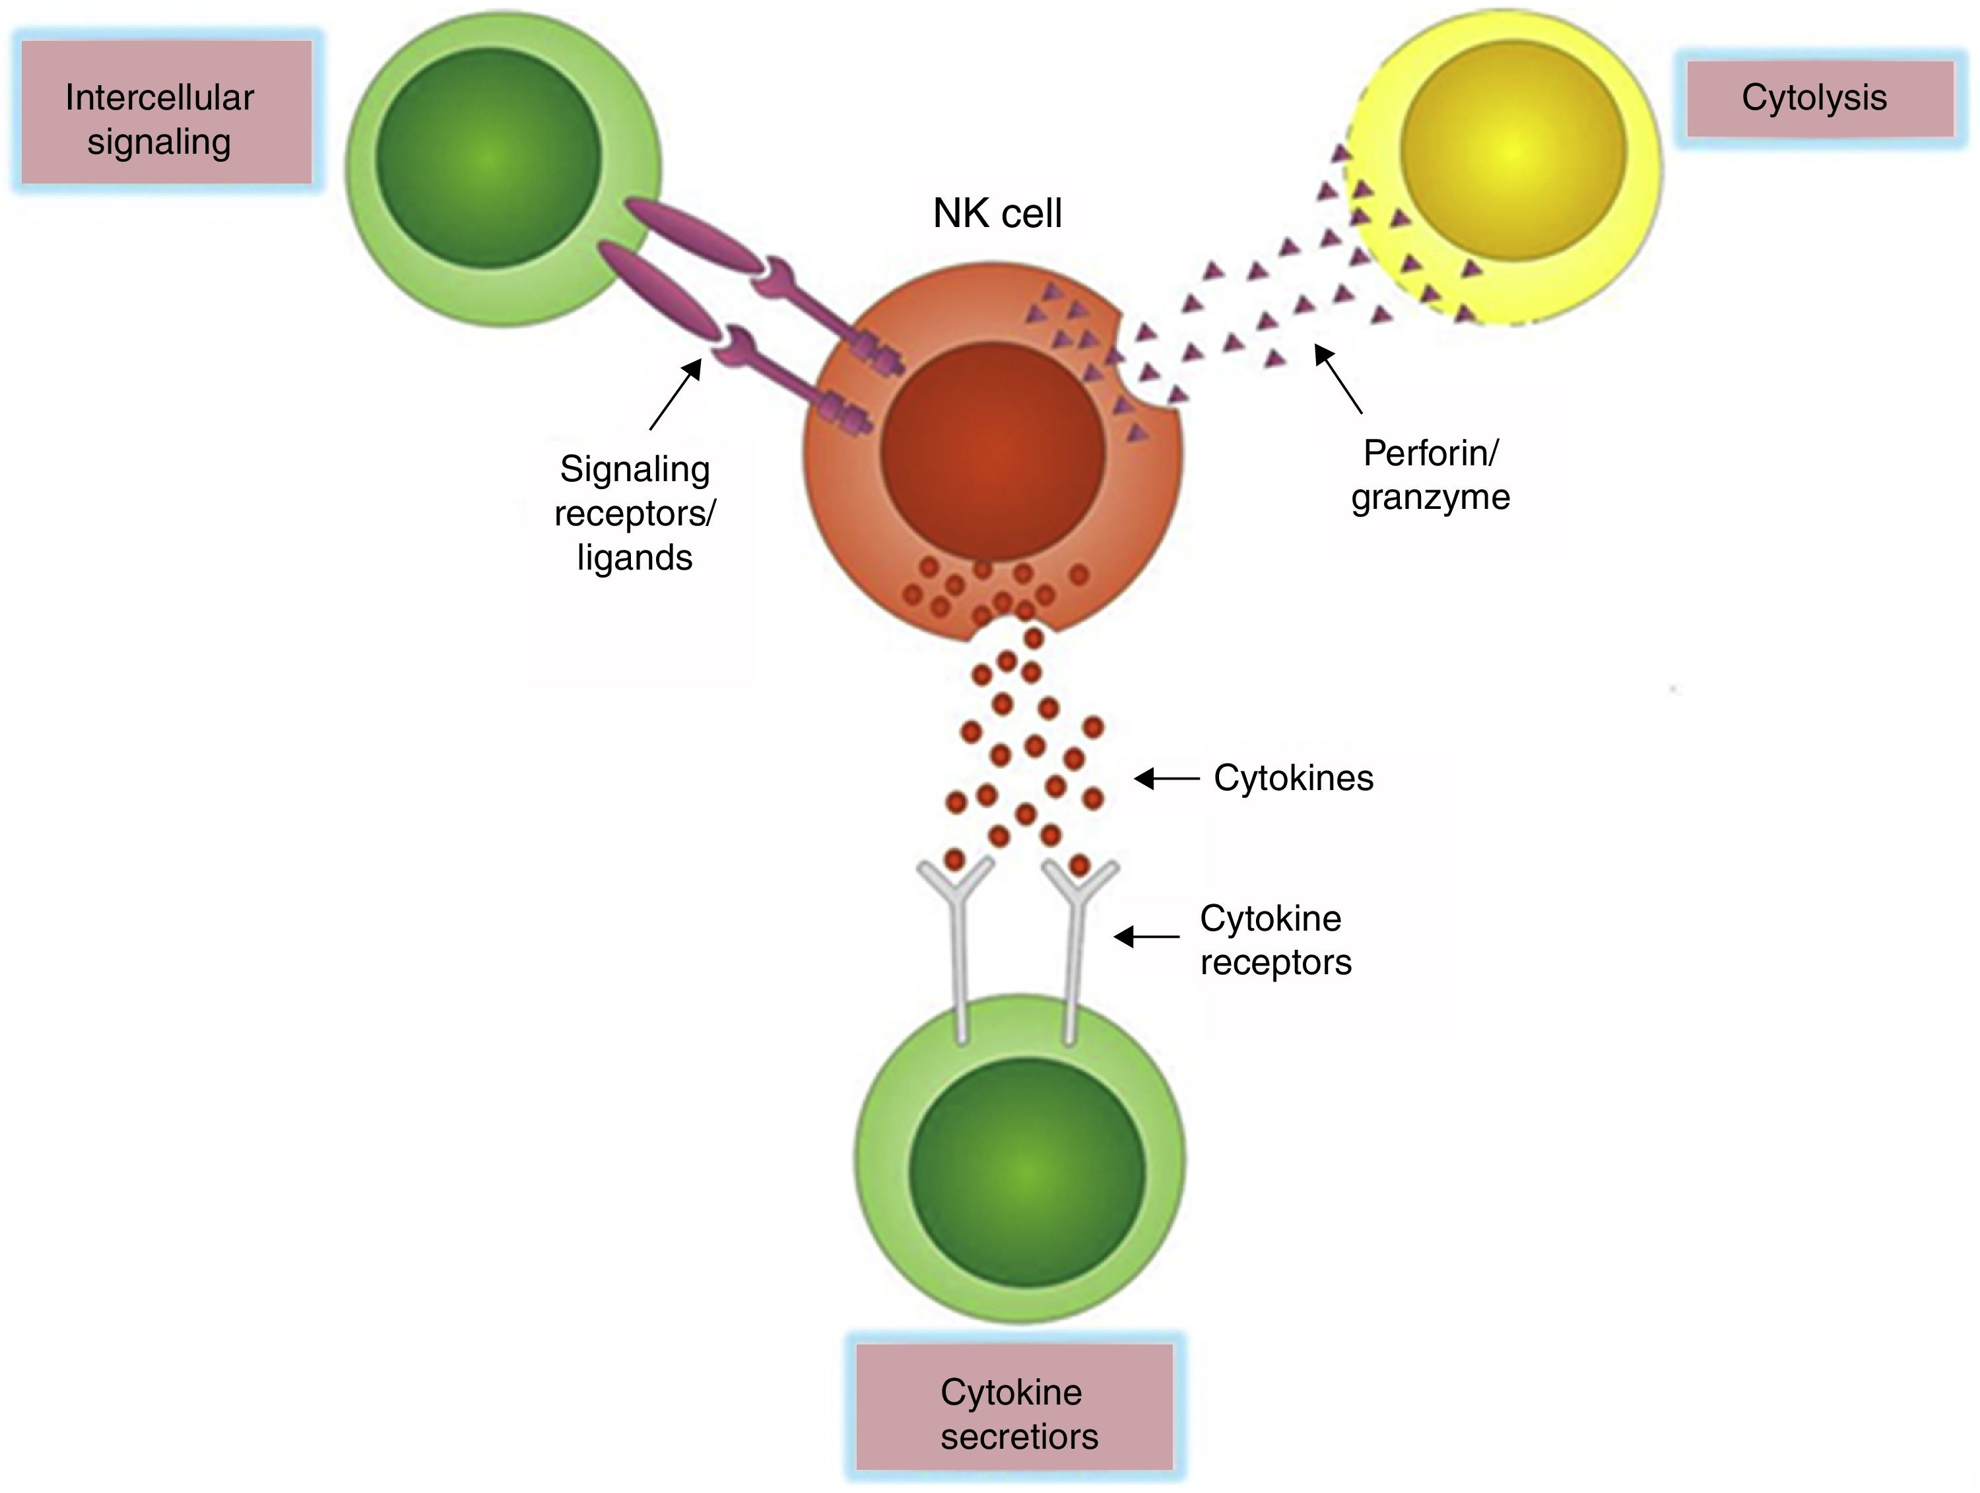
NK cells mediate their functions through at least three mechanisms: releasing perforin/granzyme for cytolysis, delivering intercellular signaling through receptor–ligand crosslinking, and secreting cytokine

Slide 34
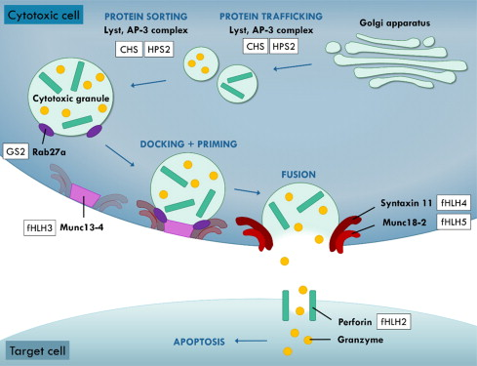

Slide 35
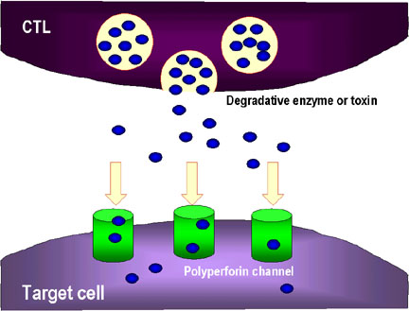

Slide 36
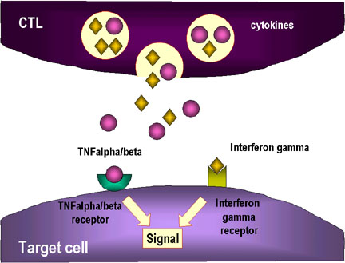

Slide 37
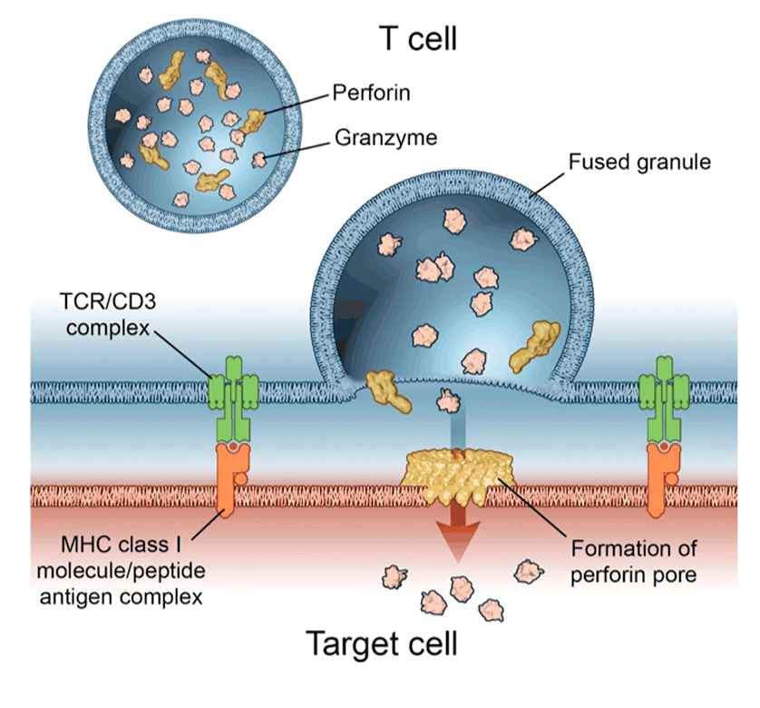

Slide 38
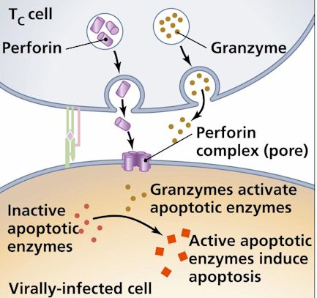

Slide 40
Cytokine Storm
Spectrum of Cytokine-Induced Disease
Systemic Inflammatory Response Syndrome
Macrophage activation syndrome
Genetic HLH
SIRS
Normal response to infxn
Acquired HLH
Severe sepsis

Slide 41
Cytokins Storm
Fever | IL1, IL6
Pancytopenia | TNF α, IFN γ
Ferretin⬆ | Activated macrophage
fibrinogene⬇ | Macrophages plasminogen activator IL-1B activation of plasminogen DIC from elevated IFN-g, TNF-a
HyperTG - | TNF-a inhibition of lipoprotein lipase
soluble CD25 (CNS,Liver) | Activated lymphocytes
CD163 (hemophagocytosis) | Proliferation of macrophages

Slide 42
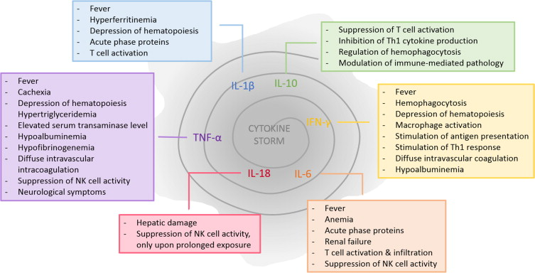

Slide 44
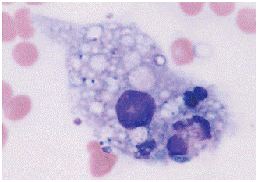

Slide 45
Causes of HLH
Perforin deficiency
Helminthic infections
Munc 13-4 deficiency
Fungal infections
Syntaxin 11 deficiency
Bacterial infections
HLH
Munc 18-2 deficiency
Viral infections
Unknown gene mutations
Medications
Immune deficiencies
Autoimmune diseases
Malignancy

Slide 46
Immune deficiency
Griscelli Syndrome (GS2)
Chediak- Higashi (CHS)
Hermansky Pudlk (HPS)

Slide 47
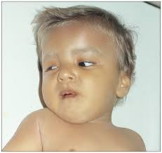
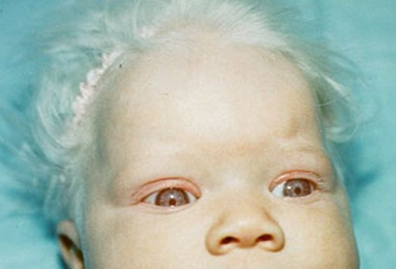
ا
Cytotoxic degranulation defect
griscelli syndrome
RAB 27
Chediak –Higashi Syndrome
LYST AP3
Hermansky Pudlak

Slide 48
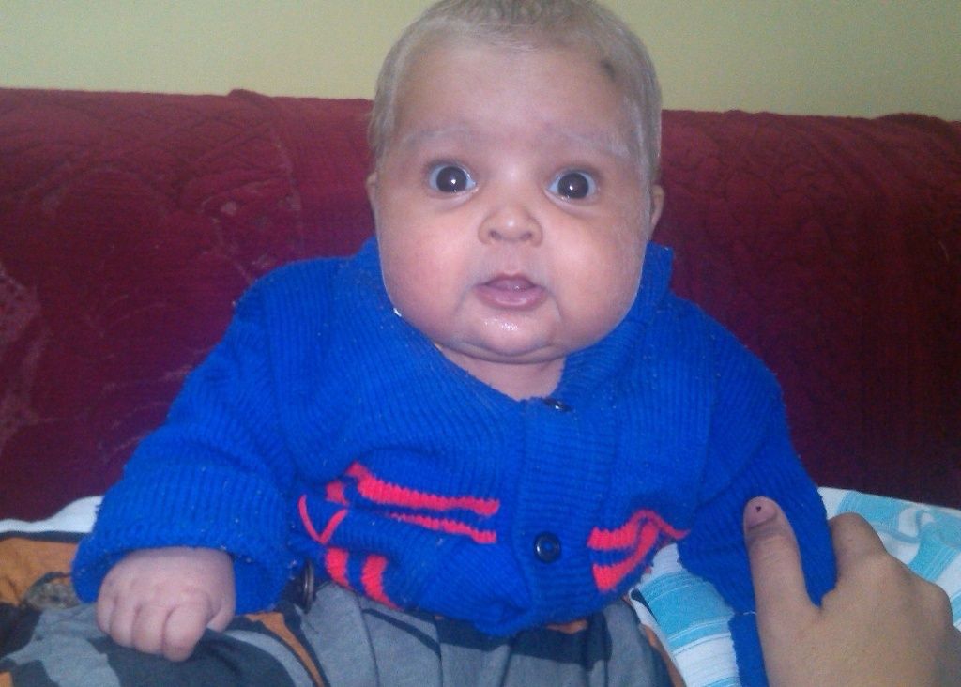
griscelli syndrome

Slide 49
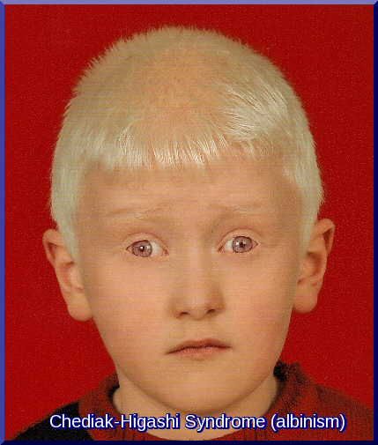
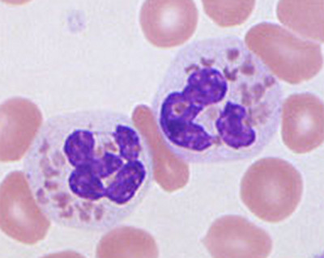
Chediak –Higashi Syndrome

Slide 50
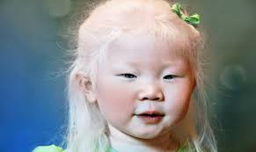
Hermansky Pudlak

Slide 51
X -Linked Lymphoproliferative Disorders
XLP
XIAP

Slide 52
XLP
X-linked lymphoproliferative disorder—characterized by hypogammaglobulinemia or lymphoproliferation
Caused by mutations in SLAM-associated protein (SAP) or X-linked inhibitor of apoptosis (XIAP)
Epstein-Barr virus infection results in fulminant and fatal mononucleosis
HLH is almost always associated with EBV infection
SAP deficiency results in a partial cytotoxic defect; no observable cytotoxic defect in XIAP deficiency

Slide 53
^{XLP}
In XLP, 60–70% of patients have mutations in the gene SAP (SLAM-associated protein), also termed SH2-DIA (SH2-domain containing gene 1A) or DSHP.
This gene, located at Xq25, regulates a protein involved in signal transduction in T and NK cells. In T cells, the protein binds to the Signaling Lymphocyte Activation Molecule (SLAM, known as CDw150) and in NK cells it binds to 2B4, an NK- cell-activating receptor.

Slide 54
Causes of HLH
Perforin deficiency
Helminthic infections
Munc 13-4 deficiency
Fungal infections
Syntaxin 11 deficiency
Bacterial infections
HLH
Munc 18-2 deficiency
Viral infections
Unknown gene mutations
Medications
Immune deficiencies
Autoimmune diseases
Malignancy

Slide 55
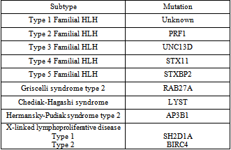

Slide 56
Diagnosis

Slide 57
Timely Diagnosis
Timely diagnosis is critical to start therapy before damage by hypercytokinemia becomes irreversible.
There is no single feature that is specific for HLH.

Slide 58
Possibility of HLH
Triad of:
Prolonged fever,
Hepatosplenomegaly,
Cytopenias
should arouse suspicion of the possibility of HLH.

Slide 59
Primary HLH vs. Secondary HLH
Severity of disease and the identification of an
infectious agent do not discriminate between genetic and acquired forms of HLH.
Age is helpful to some extent: a minority of children 1 year of age will have acquired HLH, but older age does not reliably exclude genetic HLH.

Slide 60
Diagnostic criteria for HLH
1. Familial disease/known genetic defect or
2. Clinical and laboratory criteria (5/8 criteria should be fulfilled)
Fever
Splenomegaly
Cytopenia 2 cell lines
Hemoglobin 90 g/L (below 4 weeks of age, 100 g/L)
Platelets 100 109/L
Neutrophils 1 109/L
Hypertriglyceridemia and/or hypofibrinogenemia
Fasting triglycerides 3 mmol/L
Fibrinogen 1.5 g/L
Ferritin 500 g/L*
sCD 25 2400 U/mL
Decreased or absent NK cell activity
Hemophagocytosis in BM, CSF, or lymph nodes

Slide 61
Diagnostic criteria for HLH
1. Familial disease/known genetic defect or
2. Clinical and laboratory criteria (5/8 criteria should be fulfilled)
Fever
Splenomegaly
Cytopenia 2 cell lines
Hemoglobin 90 g/L (below 4 weeks of age, 100 g/L)
Platelets 100 109/L
Neutrophils 1 109/L
Hypertriglyceridemia and/or hypofibrinogenemia
Fasting triglycerides 3 mmol/L
Fibrinogen 1.5 g/L
Ferritin 500 g/L*
sCD 25 2400 U/mL
Decreased or absent NK cell activity
Hemophagocytosis in BM, CSF, or lymph nodes

Slide 62
Supportive Evidence
Cerebral symptoms with moderate pleocytosis and/or elevated protein,
Elevated transaminases, bilirubin, and lactate dehydrogenase.
A higher cutoff for ferritin values of 3000 g/L or 10 000 g/L to be more helpful.

Slide 63
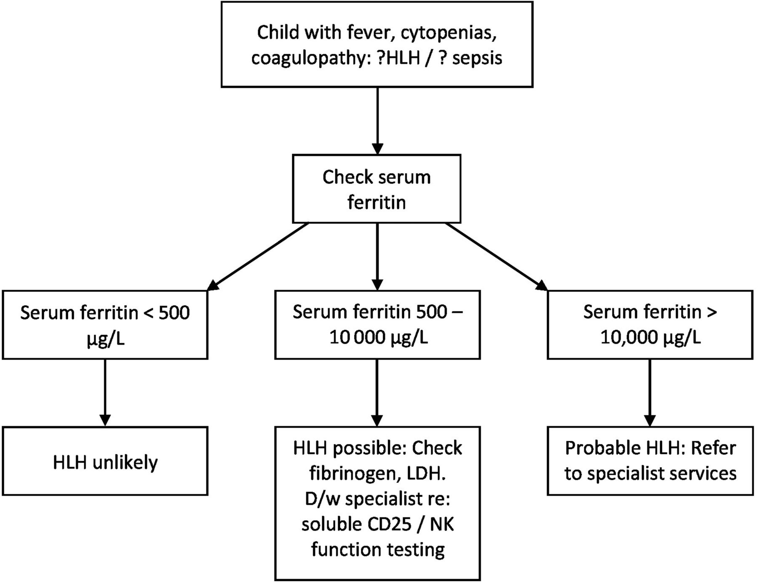

Slide 64
Primary HLH Screening
FHL2 Perforin expression
FHL3-5, CD107a
CHS, GS2
XLP1(male) SAP protein expression
XIAP (male) XIAP Protein expression

Slide 65
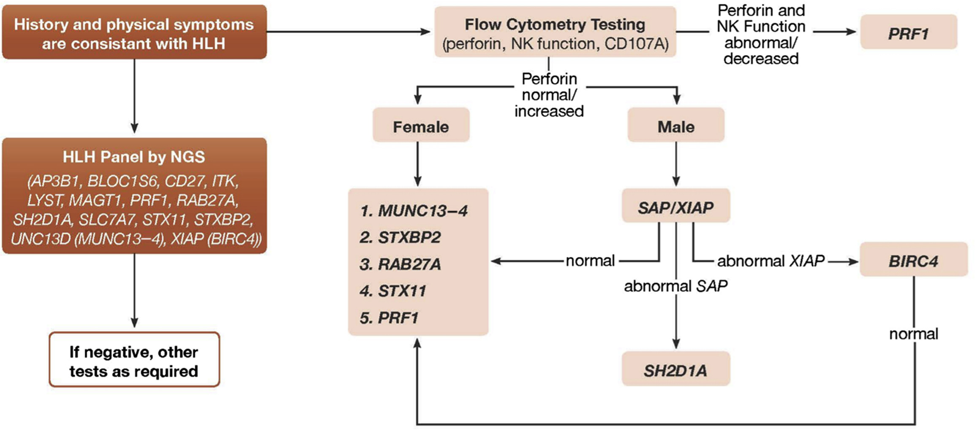
Fever+ Cytopenia+Hepatosplenomegaly + Hyperferritinemia

Slide 66
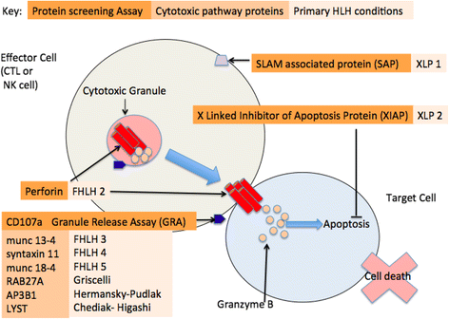
hlh final presentation anjoman 2

Slide 67
Genetics and HLA testing
A genetic analysis is not practical in all cases in developing countries.
However, it is mandatory in children with :
CNS involvement,
relapsing/refractory disease,
disease with significant multiorgan involvement
children born to consanguineous parents/ with positive family history.

Slide 69
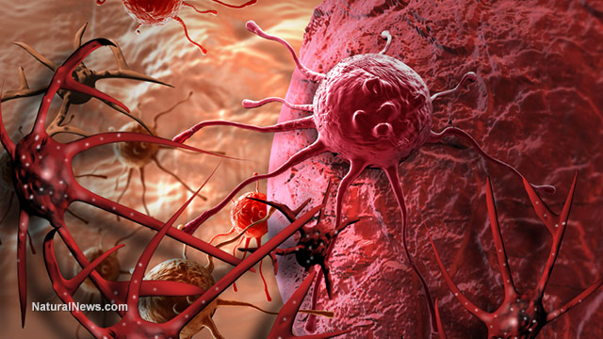
Immunology & HLH

Slide 70
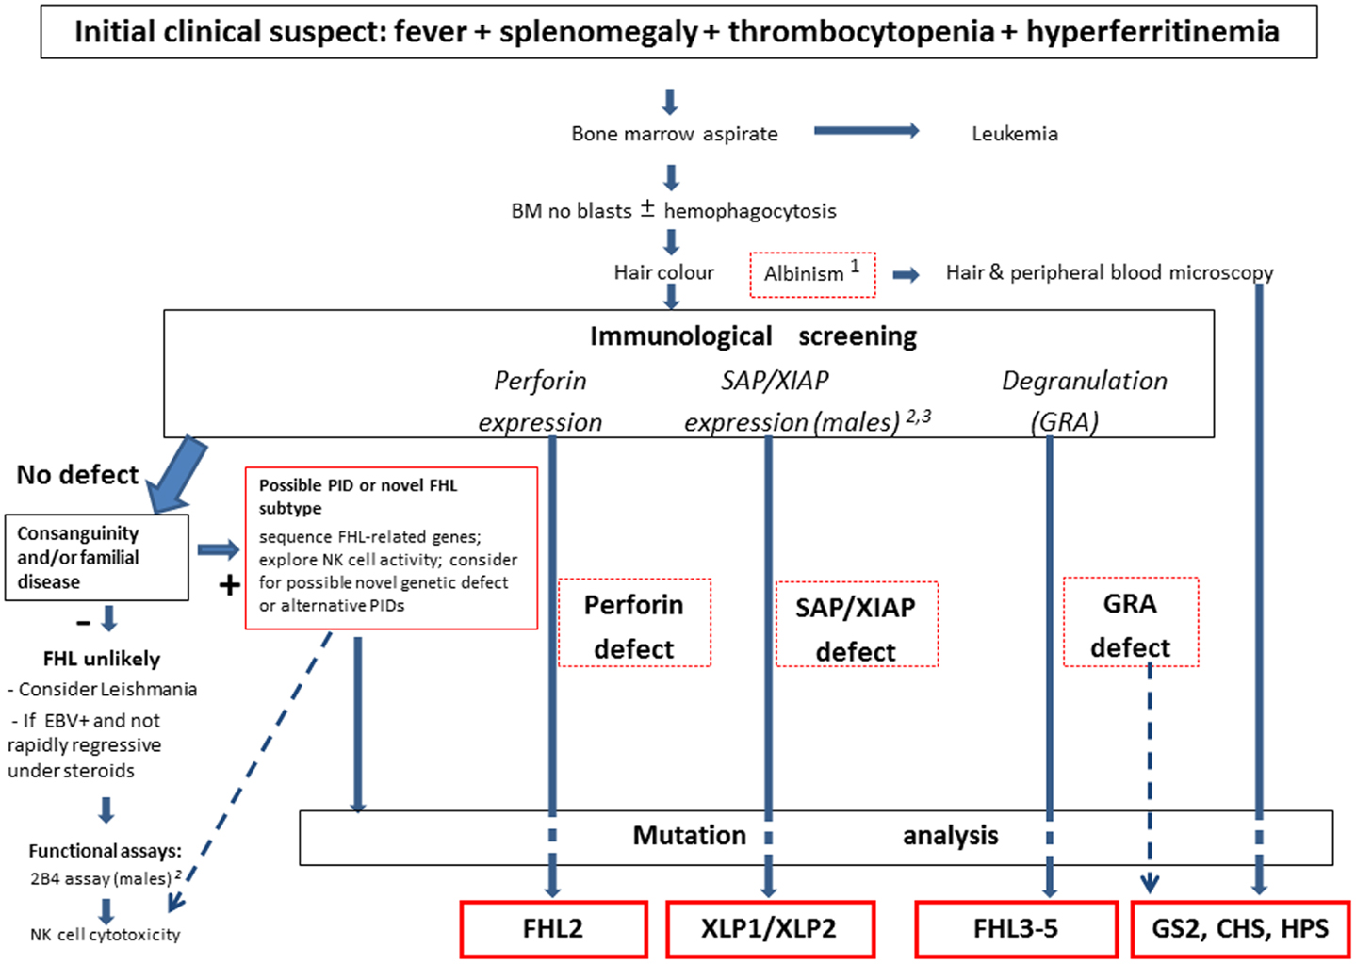

Slide 71
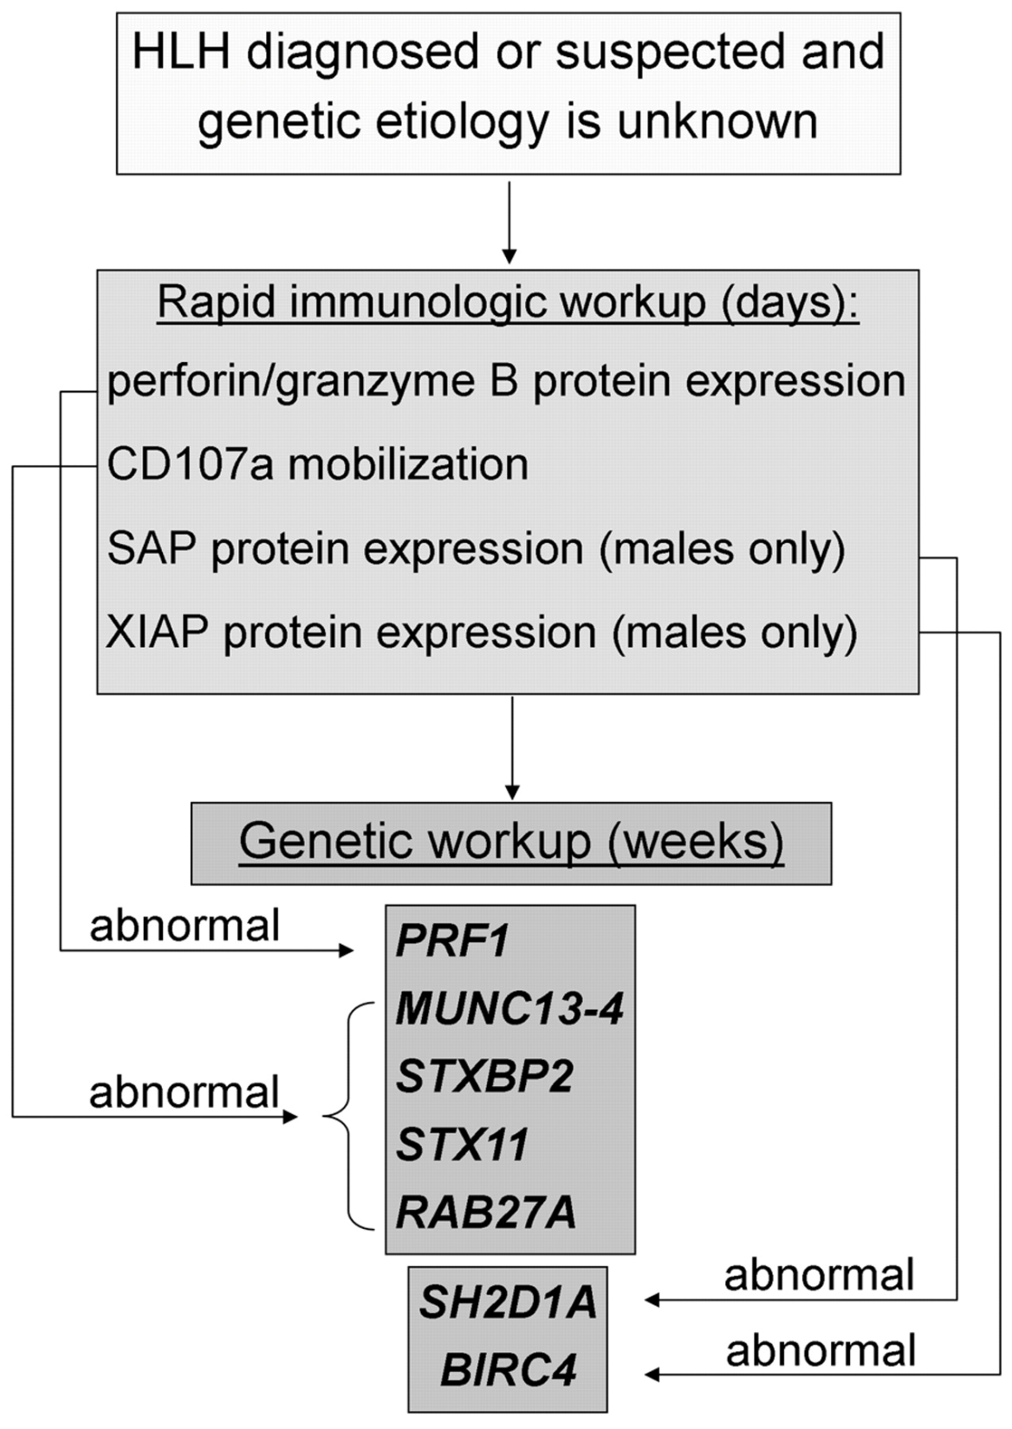

Slide 72
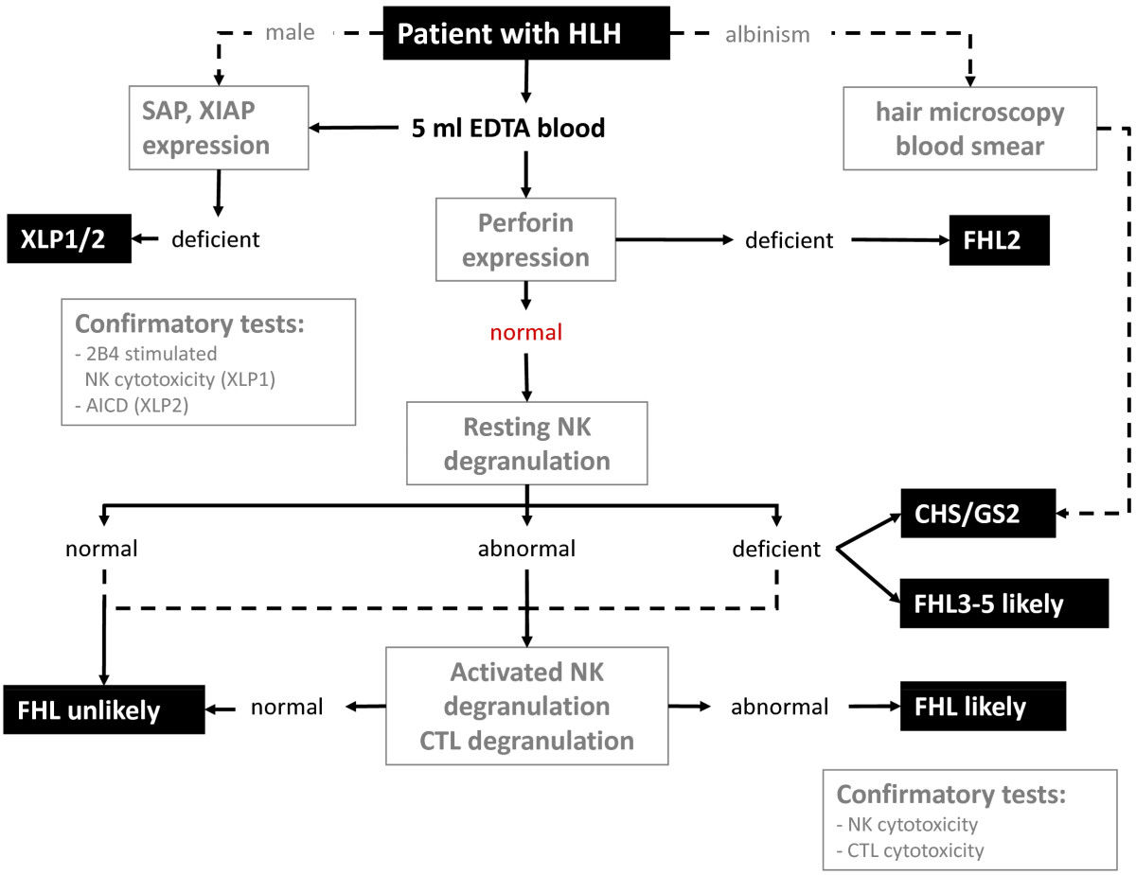

Slide 73
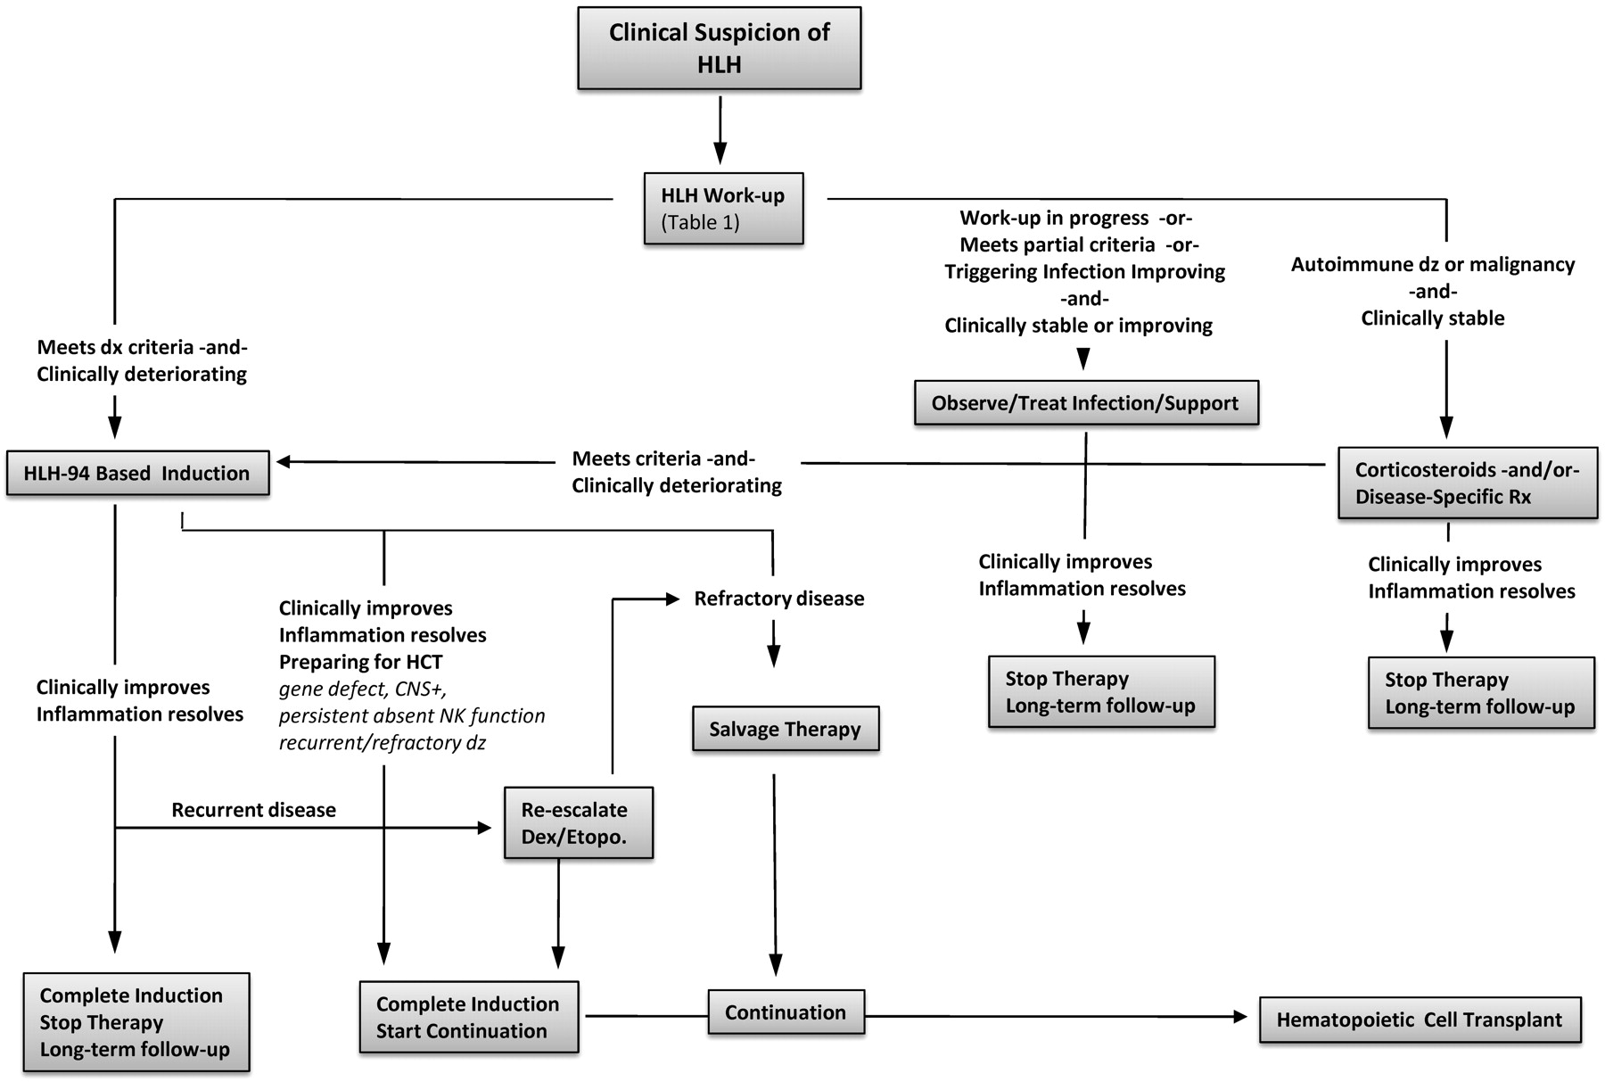
Treatment strategy for HLH. An algorithm for HLH treatment strategies in various clinical contexts.
Michael B. Jordan et al. Blood 2011;118:4041-4052
©2011 by American Society of Hematology
Notes:
Treatment strategy for HLH. An algorithm for HLH treatment strategies in various clinical contexts.

Slide 74
Once these functional tests suggest a genetic basis for HLH, molecular analysis should follow, including for parents and siblings.

Slide 75
Protocol 94

Slide 76
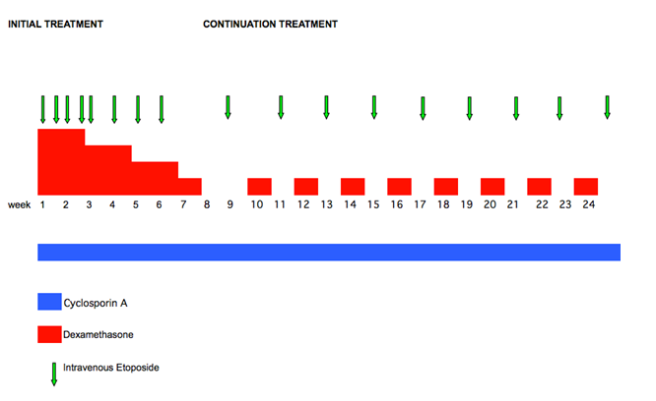
Protocol 2004

Slide 77
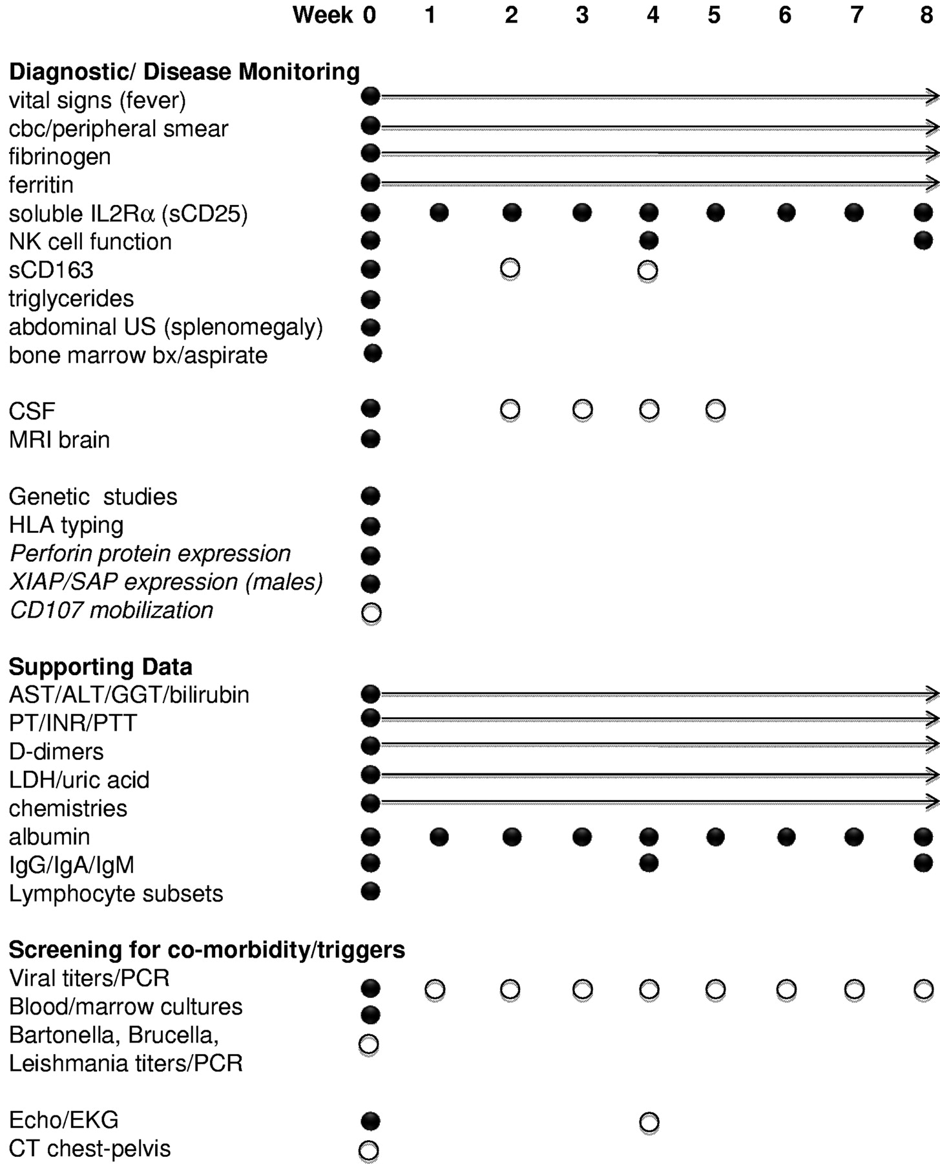
HLH diagnostic and induction surveillance strategy.
Michael B. Jordan et al. Blood 2011;118:4041-4052
©2011 by American Society of Hematology
Notes:
HLH diagnostic and induction surveillance strategy. A complete diagnostic evaluation, thorough search for underlying triggers (including infection or malignancy), and assessment of relevant immune studies are indicated in patients suspected to have HLH. In addition, ongoing reevaluation of inflammatory markers is essential to gauge the response to therapy. ● represents recommended studies; and ○, recommended studies with sufficient clinical suspicion. Arrows indicate recommendations for initial daily labs with decreasing frequency to one study per week as values normalize. Italicized studies are those that may facilitate diagnosis but are not directly part of current diagnostic criteria. CT or abdominal ultrasound may also facilitate diagnosis by documenting splenomegaly. sCD25 and sCD163 are useful markers of inflammation that may be more reliable measures of HLH disease activity than ferritin in some patients. CD107 mobilization may corroborate NK functional studies and quickly indicate a relevant degranulation defect. Careful monitoring of infection status is appropriate when persistent viral (or other infection) is found. Initial viral PCRs should assess EBV, CMV, adenovirus, and other relevant viruses. CSF studies are important to determine CNS involvement of HLH, although MRI may be substituted initially in coagulopathic patients. Pan-CT may be helpful in cases where there is concern for abscess or underlying malignancy. EKG/echocardiogram establish baseline organ function and screen for coronary artery vasculopathy in patients with overlapping symptoms of Kawasaki disease. We also recommend initiating HLA testing at the time of diagnosis to avoid delays in identifying donors for HCT.

Slide 78
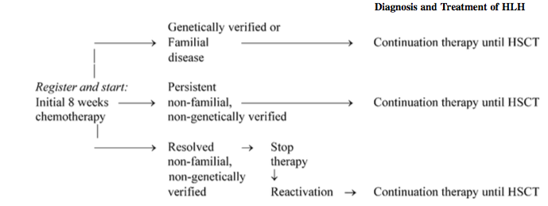

Slide 79
QUESTIONS
Defenition of refractory HLH
Plasmapheresis indication
Salvage therapy
Protocol 2004 vs 94
BMT in HLH
EBV load in HLH
Genetic in HLH

