Slide 1
In the name of God
Chronic ITP
Debates & Dilemmas
Professor H.Abolghasemi
F.Malek

Slide 2
Outlines
Chronic ITP new concepts
Chronic ITP Treatment options
Splenectomy versus Rituximab therapy
The impact of combination therapy
Necessities of BMA in anticipation of Splenectomy
Novel Drugs in treatment of ITP should it be the Dawn of a new era?
How far should be go for the treatment of chronic ITP?

Slide 3
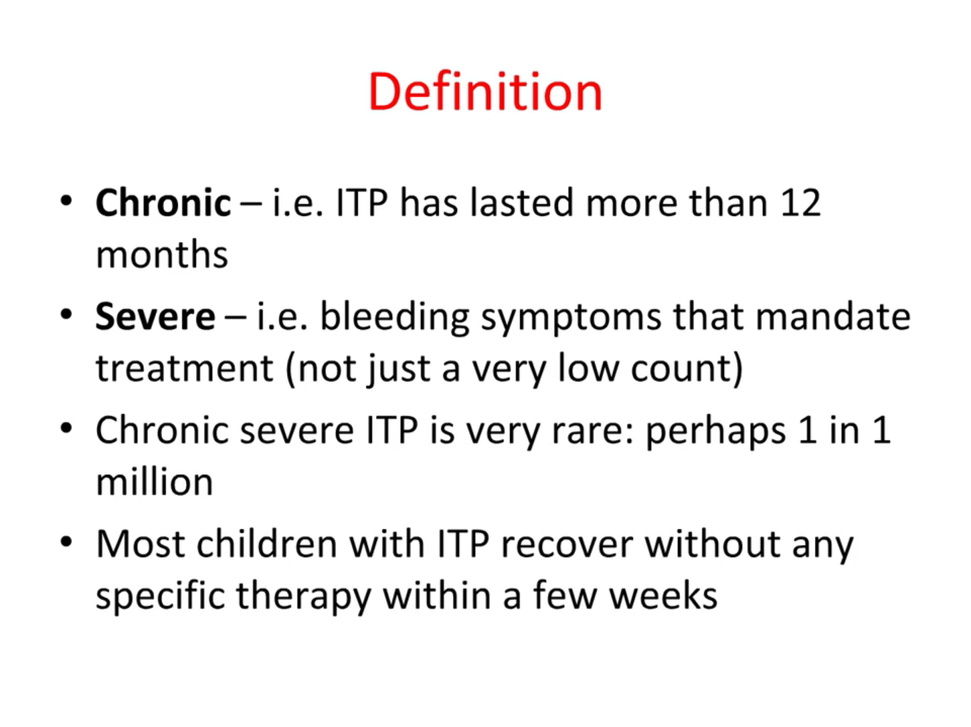

Slide 4
What is refractory ITP?
An International Working Group (IWG) defined refractory ITP as disease that does not respond to or relapses after splenectomy and that requires treatment to reduce the risk of clinically significant bleeding.
It may not be applicable to children; In these patients, avoidance of splenectomy may be desirable or even necessary.
Indeed, the IWG acknowledged that it was unable to achieve consensus on the definition of refractory disease in children .
Adam Cuker and Cindy E. Neunert. How I treat refractory immune thrombocytopenia . , BLOOD, 22 SEPTEMBER 2016 x VOLUME 128

Slide 5
Pathophysiology of chronic ITP
The pathophysiology of chronic ITP is heterogeneous and complex.
In chronic ITP, platelet membrane glycoproteins (GPs), become antigenic and stimulate the immune system to produce autoantibodies.
The platelet-directed autoantibodies are more commonly directed against platelet GP IIb-IIIa and/or GPIb-IX
In addition to the antibody-mediated destructive process, a perturbation in T-cell homeostasis also plays a role in the pathogenesis of chronic ITP.
Spotlight on romiplostim in the treatment of children with chronic immune thrombocytopenia: design, development, and potential place in therapy Drug Design, Development and Therapy 2017:11

Slide 6
Pathophysiology of chronic ITP
Platelet production is also suboptimal in chronic ITP patients. Megakaryocytes express GPIIb-IIIa and GPIb-IX, which are targets for autoantibodies.
These autoantibodies inhibit megakaryocyte growth as documented by morphologically abnormal megakaryopoiesis and the ability of ITP plasma to inhibit megakaryopoiesis
The suboptimal platelet production in ITP that is mediated by the presence of autoantibodies directed against platelet antigens provides support for the use of TPO mimetic agents in the treatment of children with chronic ITP
Spotlight on romiplostim in the treatment of children with chronic immune thrombocytopenia: design, development, and potential place in therapy Drug Design, Development and Therapy 2017:11

Slide 7
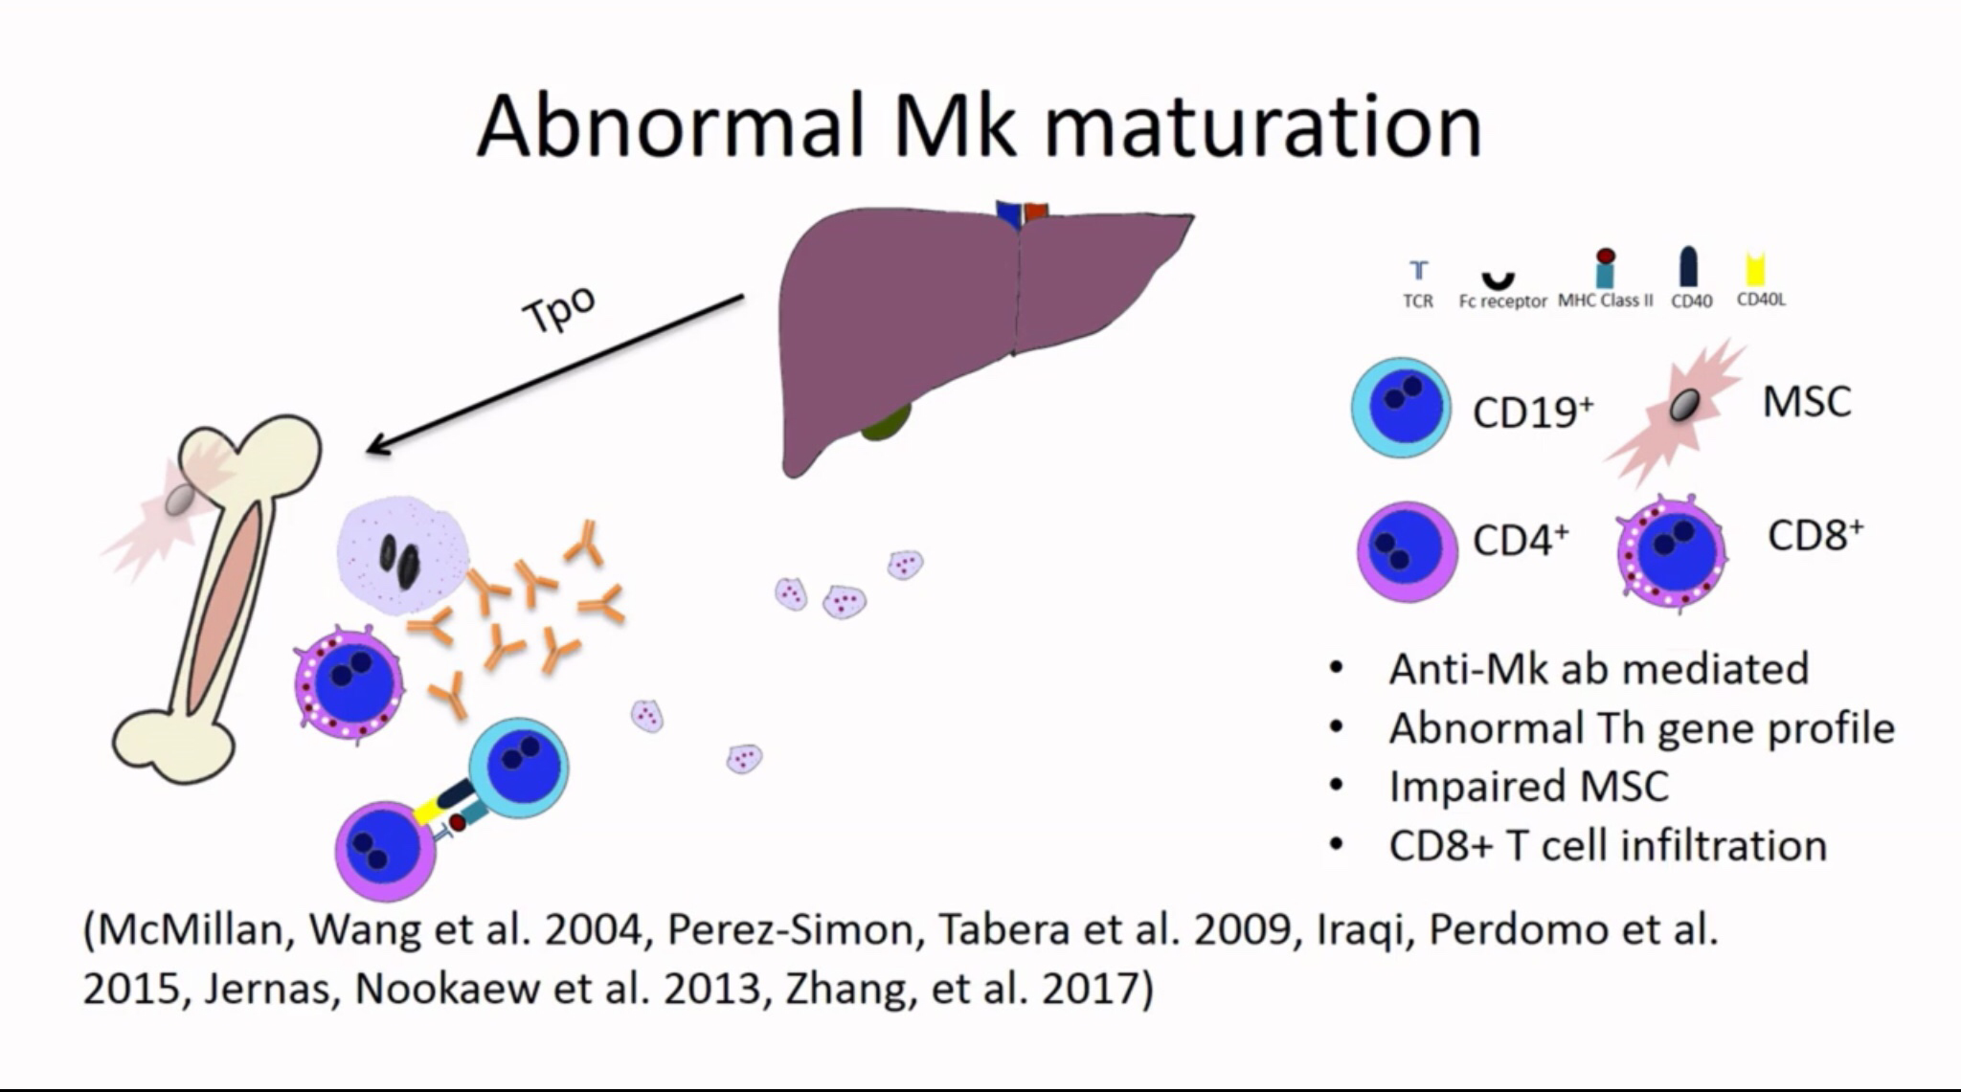

Slide 8
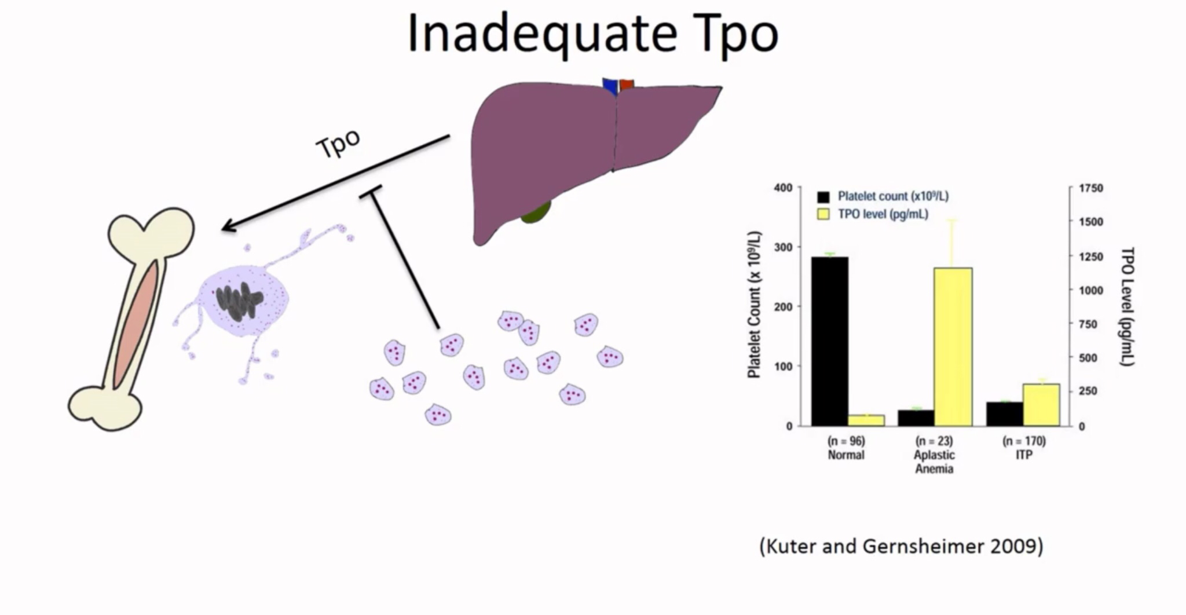

Slide 9
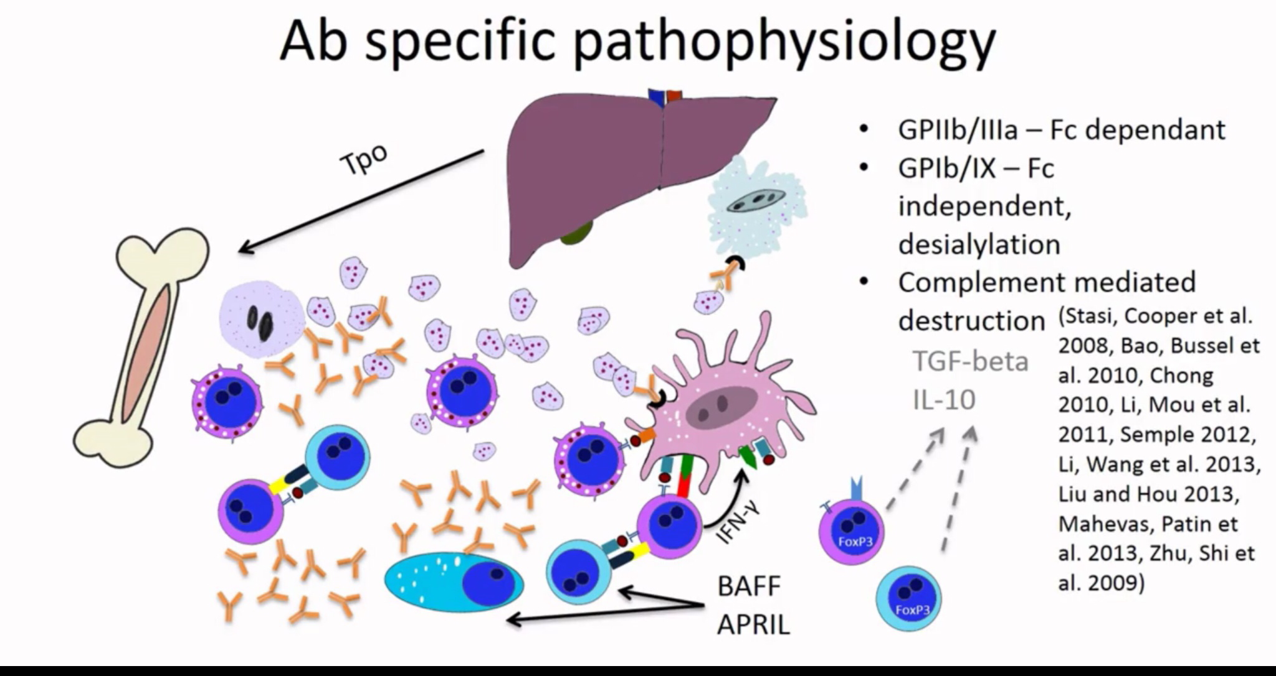

Slide 10
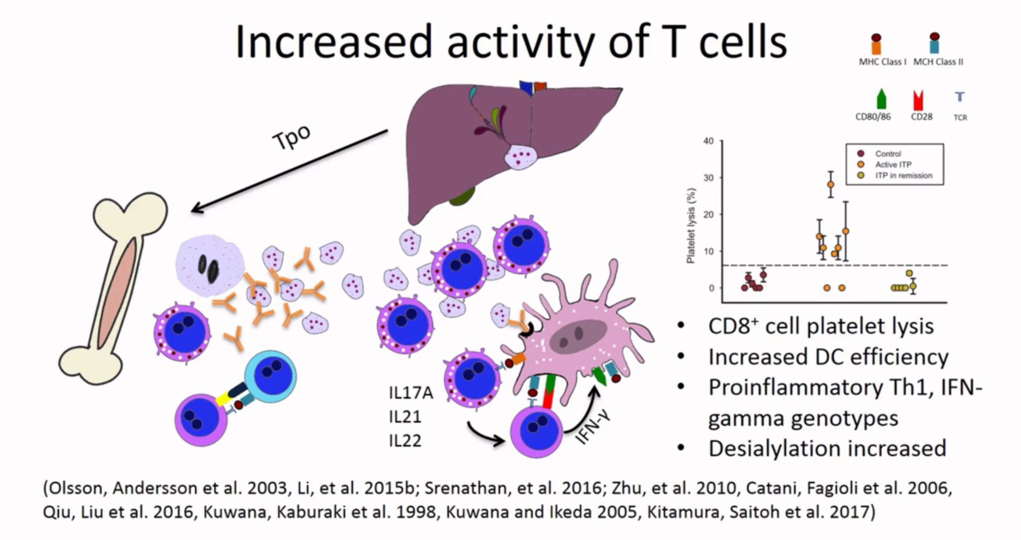

Slide 11
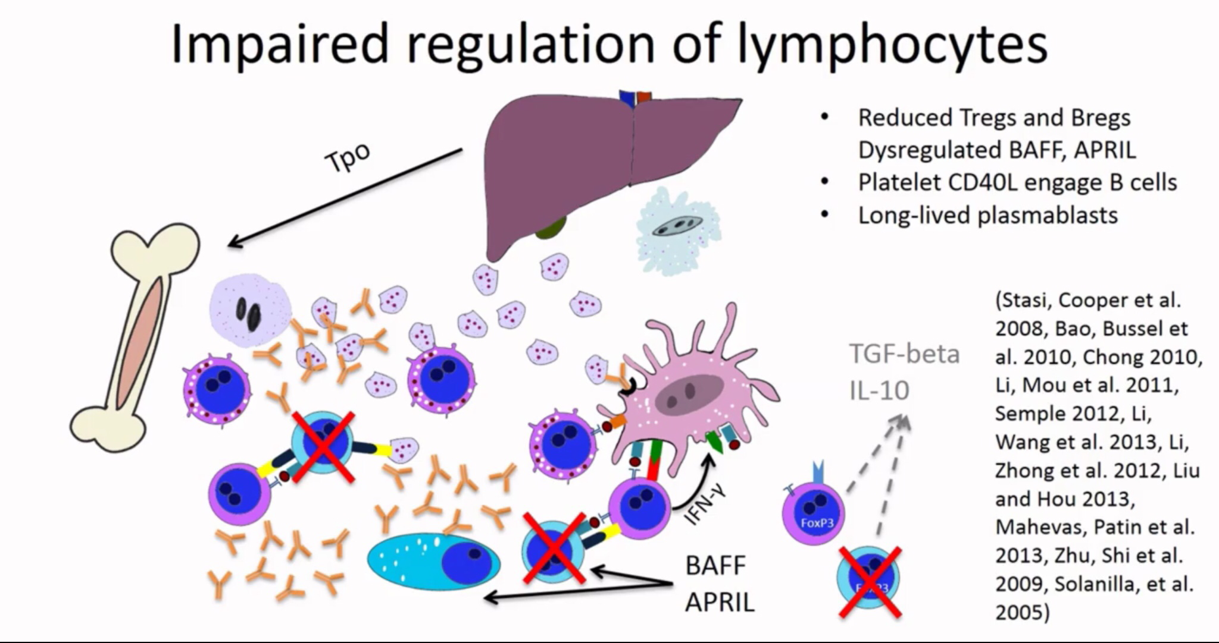

Slide 12
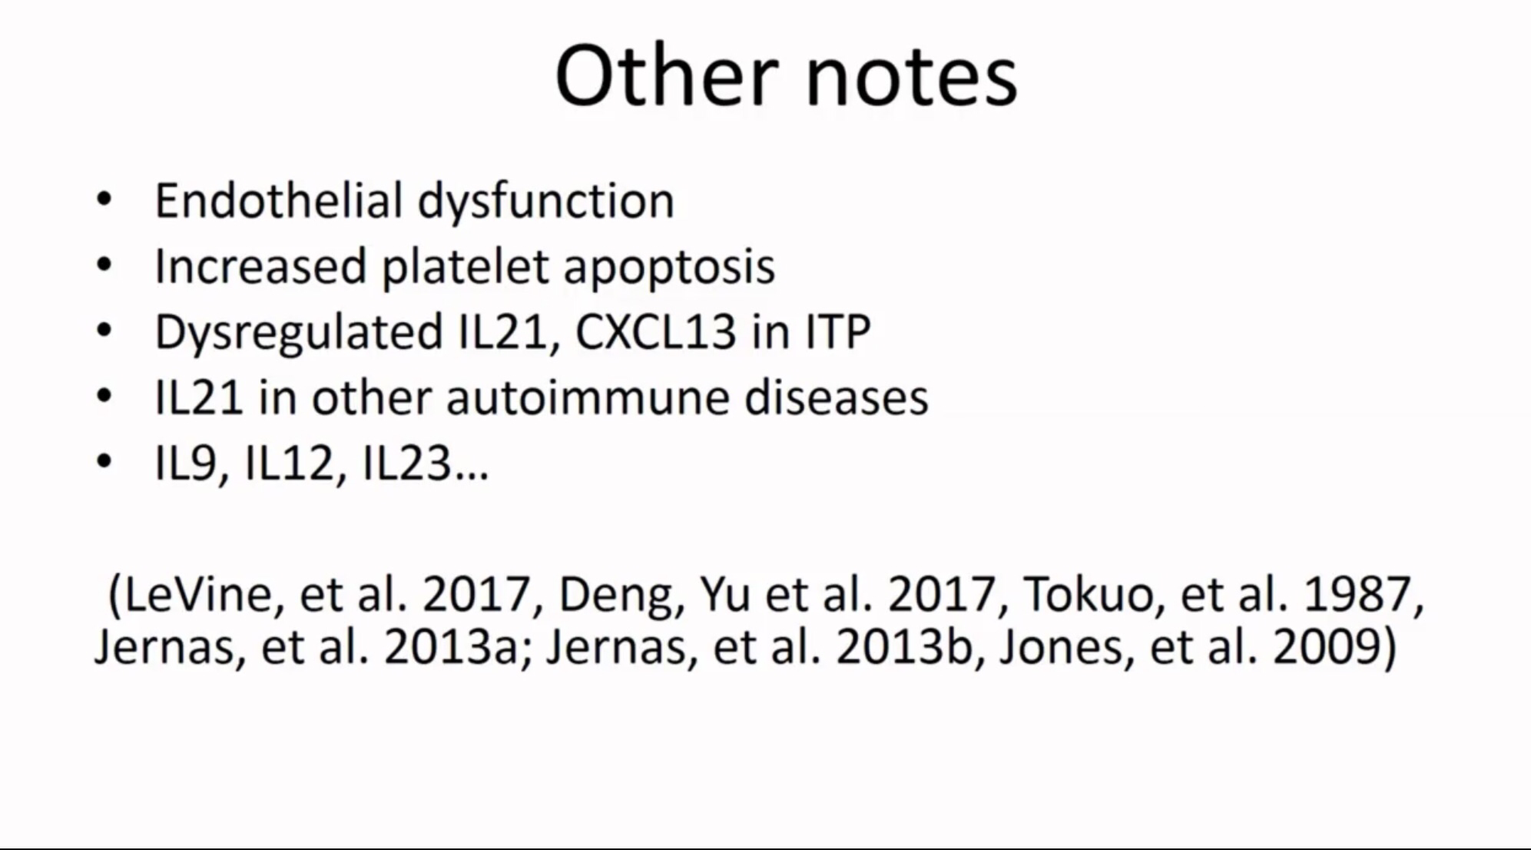

Slide 13
Outlines
Chronic ITP new concepts
Chronic ITP Treatment options
The impact of combination therapy
Splenectomy versus Rituximab therapy
Necessities of BMA in anticipation of Splenectomy
Novel Drugs in treatment of ITP should it be the Dawn of a new era?
How far should be go for the treatment of chronic ITP?

Slide 15
High-Dose Corticosteroids
Dexamethasone (28–40 mg/m2/day) has been used in pediatric patients with chronic refractory ITP, obtaining response rates greater than 80%, with and a mean duration of the response of 26 months
Psychiatric adverse effects, such as insomnia and aggressive behavior, are frequent and this makes dexamethasone only a second-line therapeutic alternative.

Slide 16
Rituximab
This anti-CD20 antibody, used in other autoimmune diseases and B-cell lymphoma, has been used in chronic refractory ITP often showing response rates greater than 60%.
Study by Bennett et al. revealed that only 31% of patients responded
However, follow-up studies have shown that sustained response is uncommon and safety profile is unclear.

Slide 17
Danazol
There are only a few studies about its use in pediatric patients, showing a good effectiveness without significant adverse reactions.
Unfortunately, danazol can accelerate bone growth, and this limits its applicability in prepuberal patients

Slide 18
Use of Immunosuppressors
There are a few studies investigating the role of immunosuppressive agents, single or in combination, in patients with refractory ITP, and experience in childhood is not enough strong to give specific recommendations
Azathioprine, used in several autoimmune pediatric diseases, is still an option particularly in chronic ITP and when splenectomy is contraindicated or has been ineffective
In pediatric age, cyclosporine is used in several conditions while its applicability in ITP is not completely defined.

Slide 19
Splenectomy
Several studies reported a response in almost 85% of patients after splenectomy, with a 20–25% of relapses during the following years .
Many works investigated the role of potential predictors of response to splenectomy in children and adults and suggested that female sex, younger age, response to steroids, and higher platelet count could be positive prognostic determinants, although the role of response to steroids is not univocally accepted .

Slide 20
Thrombopoietin Receptor Agonists (TPO-RAs)
Reported adverse effects consist in an increased risk of hepatic damage and cataract.
Recently, avatrombopag, a new drug with an eltrombopag-like mechanism of action, was included in clinical trials for adults, showing response rate similar to other TPO-RAs in absence of severe adverse effects
In summary, TPO-RAs seem to be safe end effective also in childhood-onset refractory ITP

Slide 21
Thrombopoietin Receptor Agonists (TPO-RAs)
Romiplostim acts on TPO-binding subunit of the receptor and is administered subcutaneously weekly . It is not yet approved for childhood-onset ITP, although in several studies it showed a 50–80% response rate, without severe adverse effects
Eltrombopag acts binding the transmembrane domain of TPO receptor and is administered orally daily . It showed response rates greater than 60% in two randomized trials, associated with a good tolerability so in 2015 FDA has approved it for the use in childhood-onset disease.

Slide 22
Outlines
Chronic ITP new concepts
Chronic ITP Treatment options
Splenectomy versus Rituximab therapy
The impact of combination therapy
Necessities of BMA in anticipation of Splenectomy
Novel Drugs in treatment of ITP should it be the Dawn of a new era?
How far should be go for the treatment of chronic ITP?

Slide 23
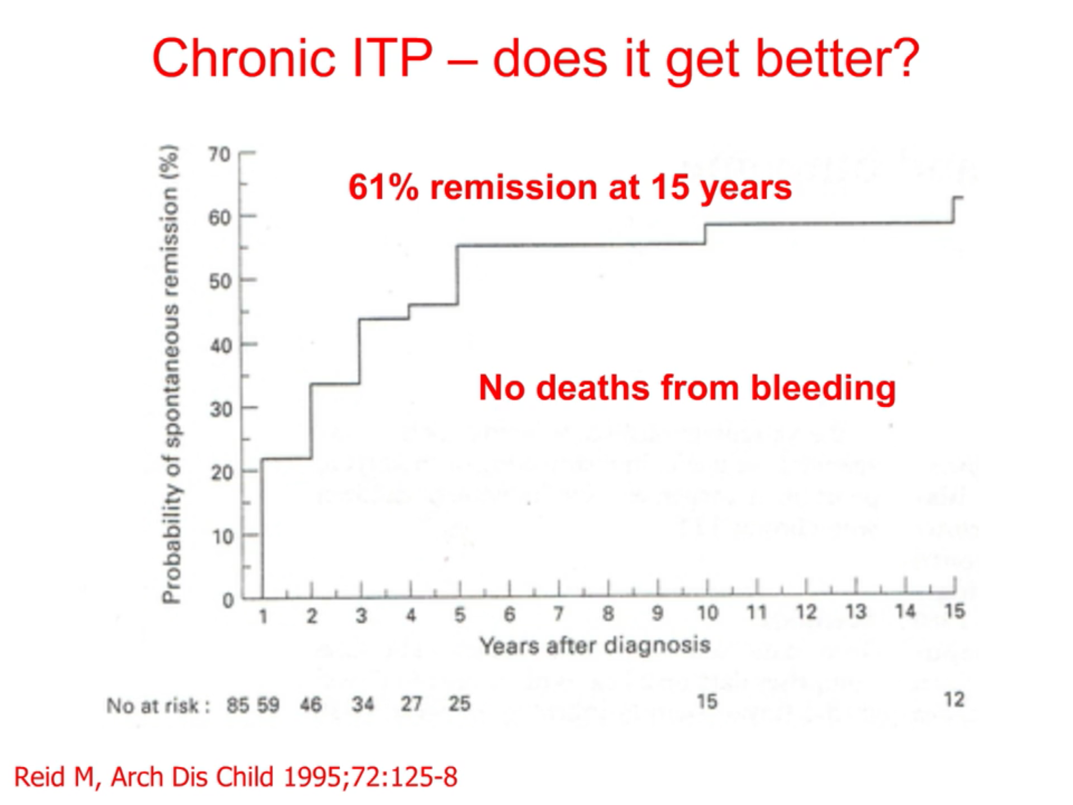

Slide 24
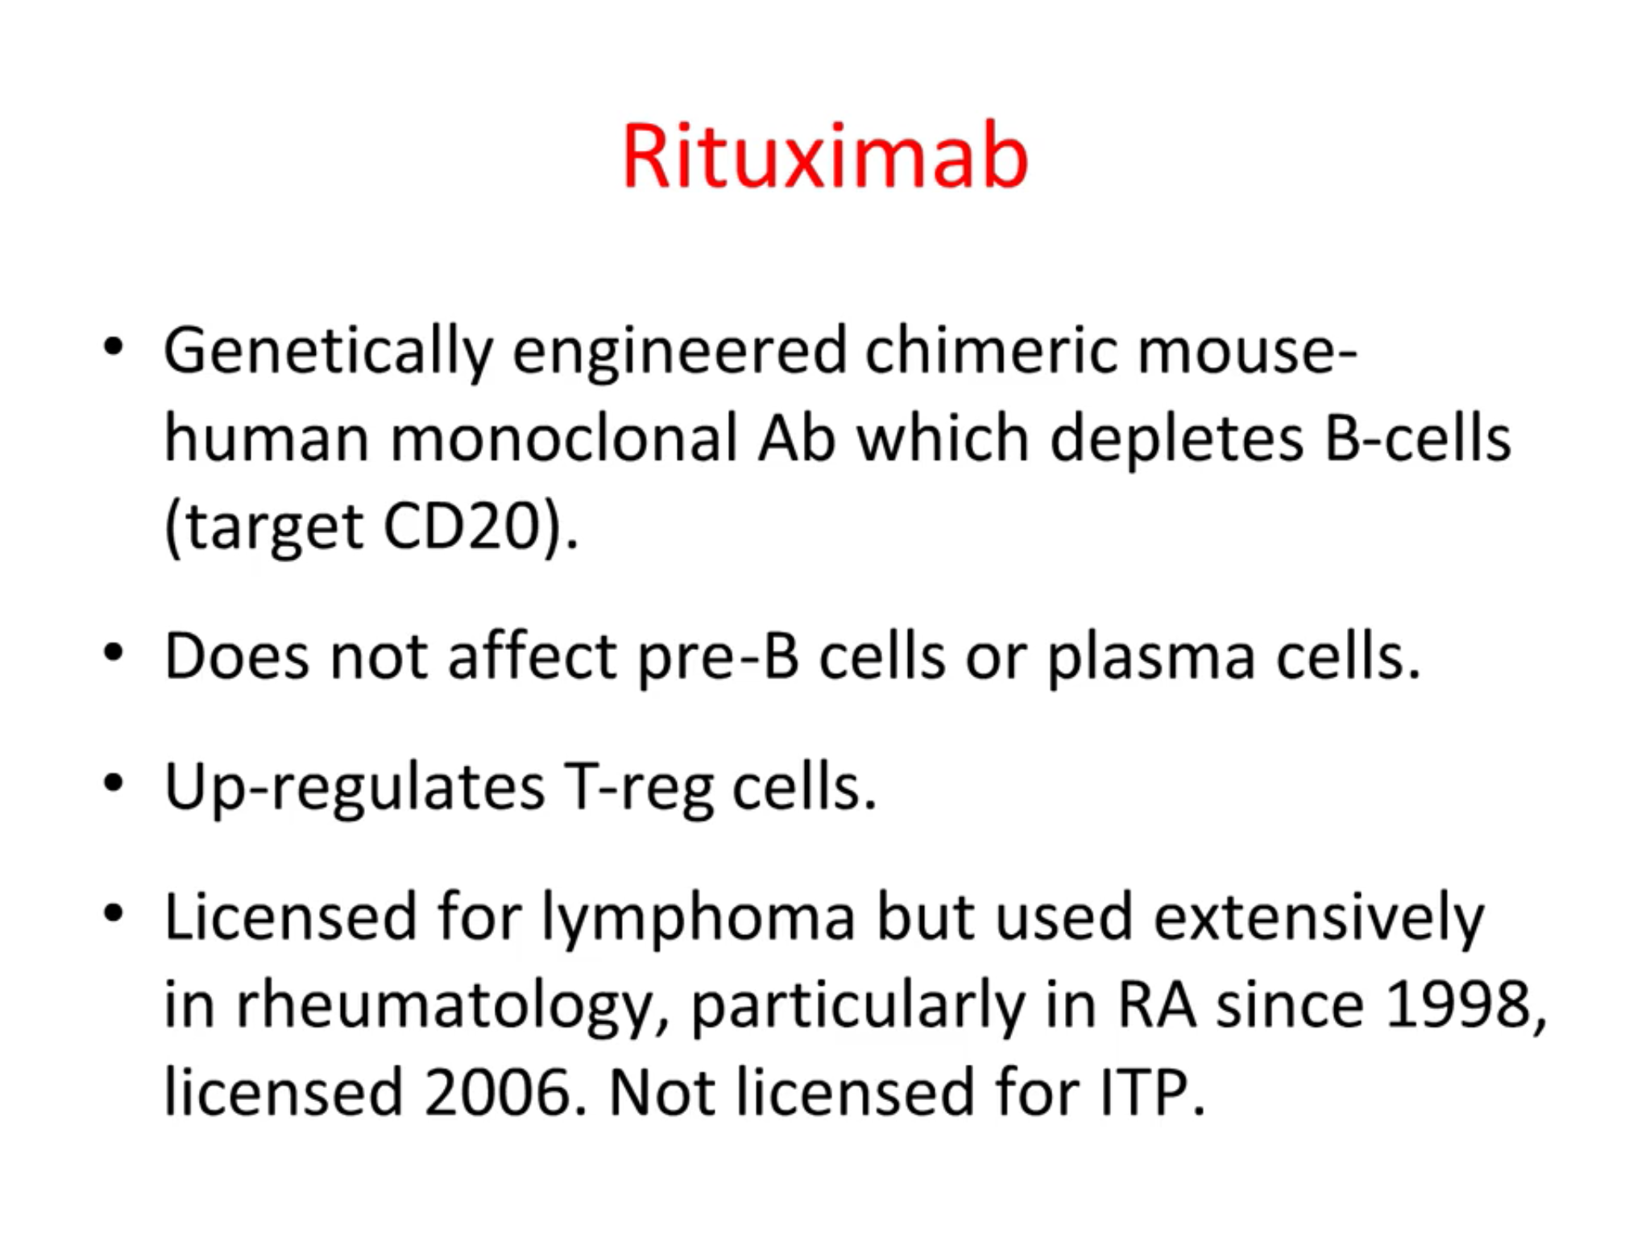

Slide 26
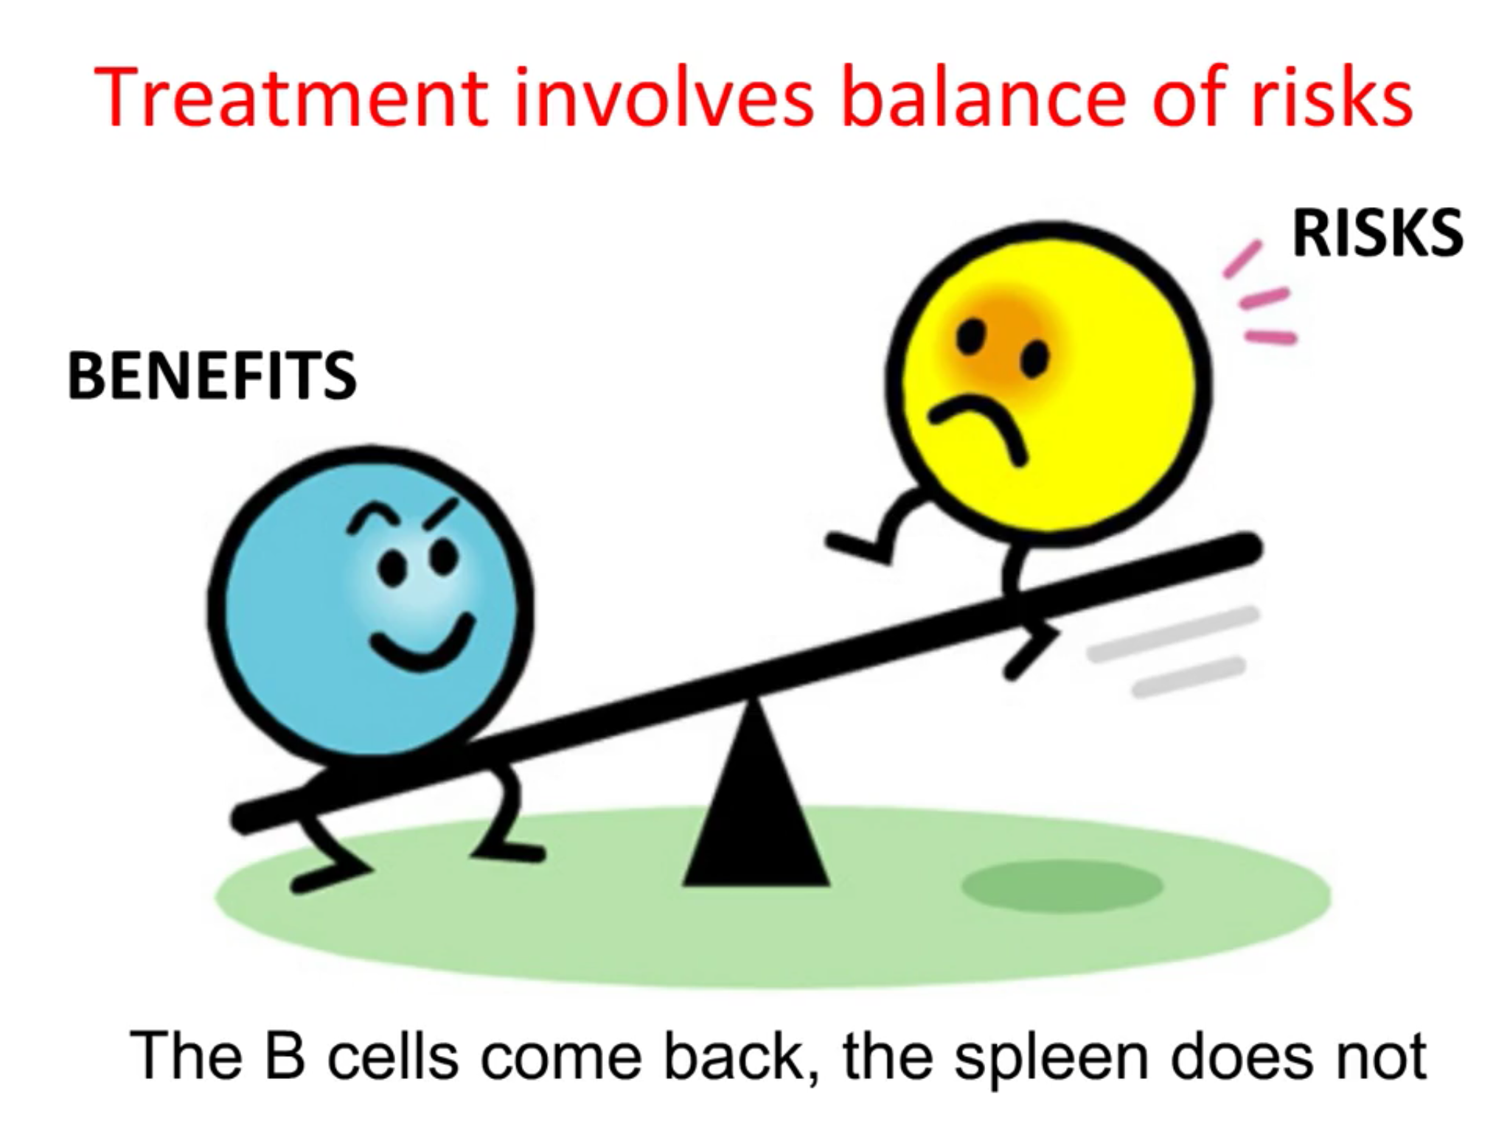

Slide 27
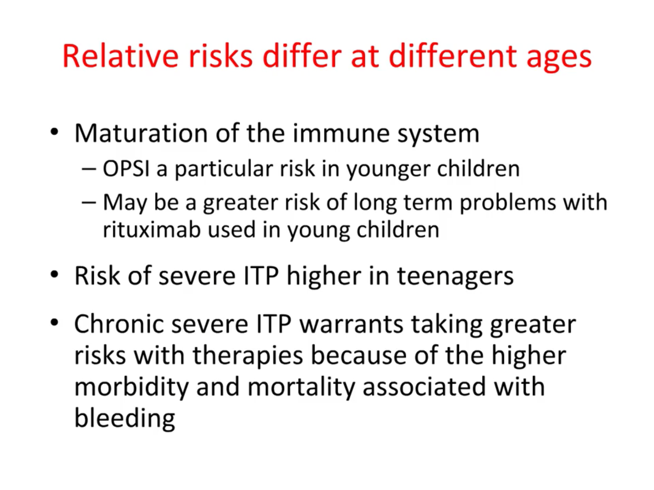

Slide 28
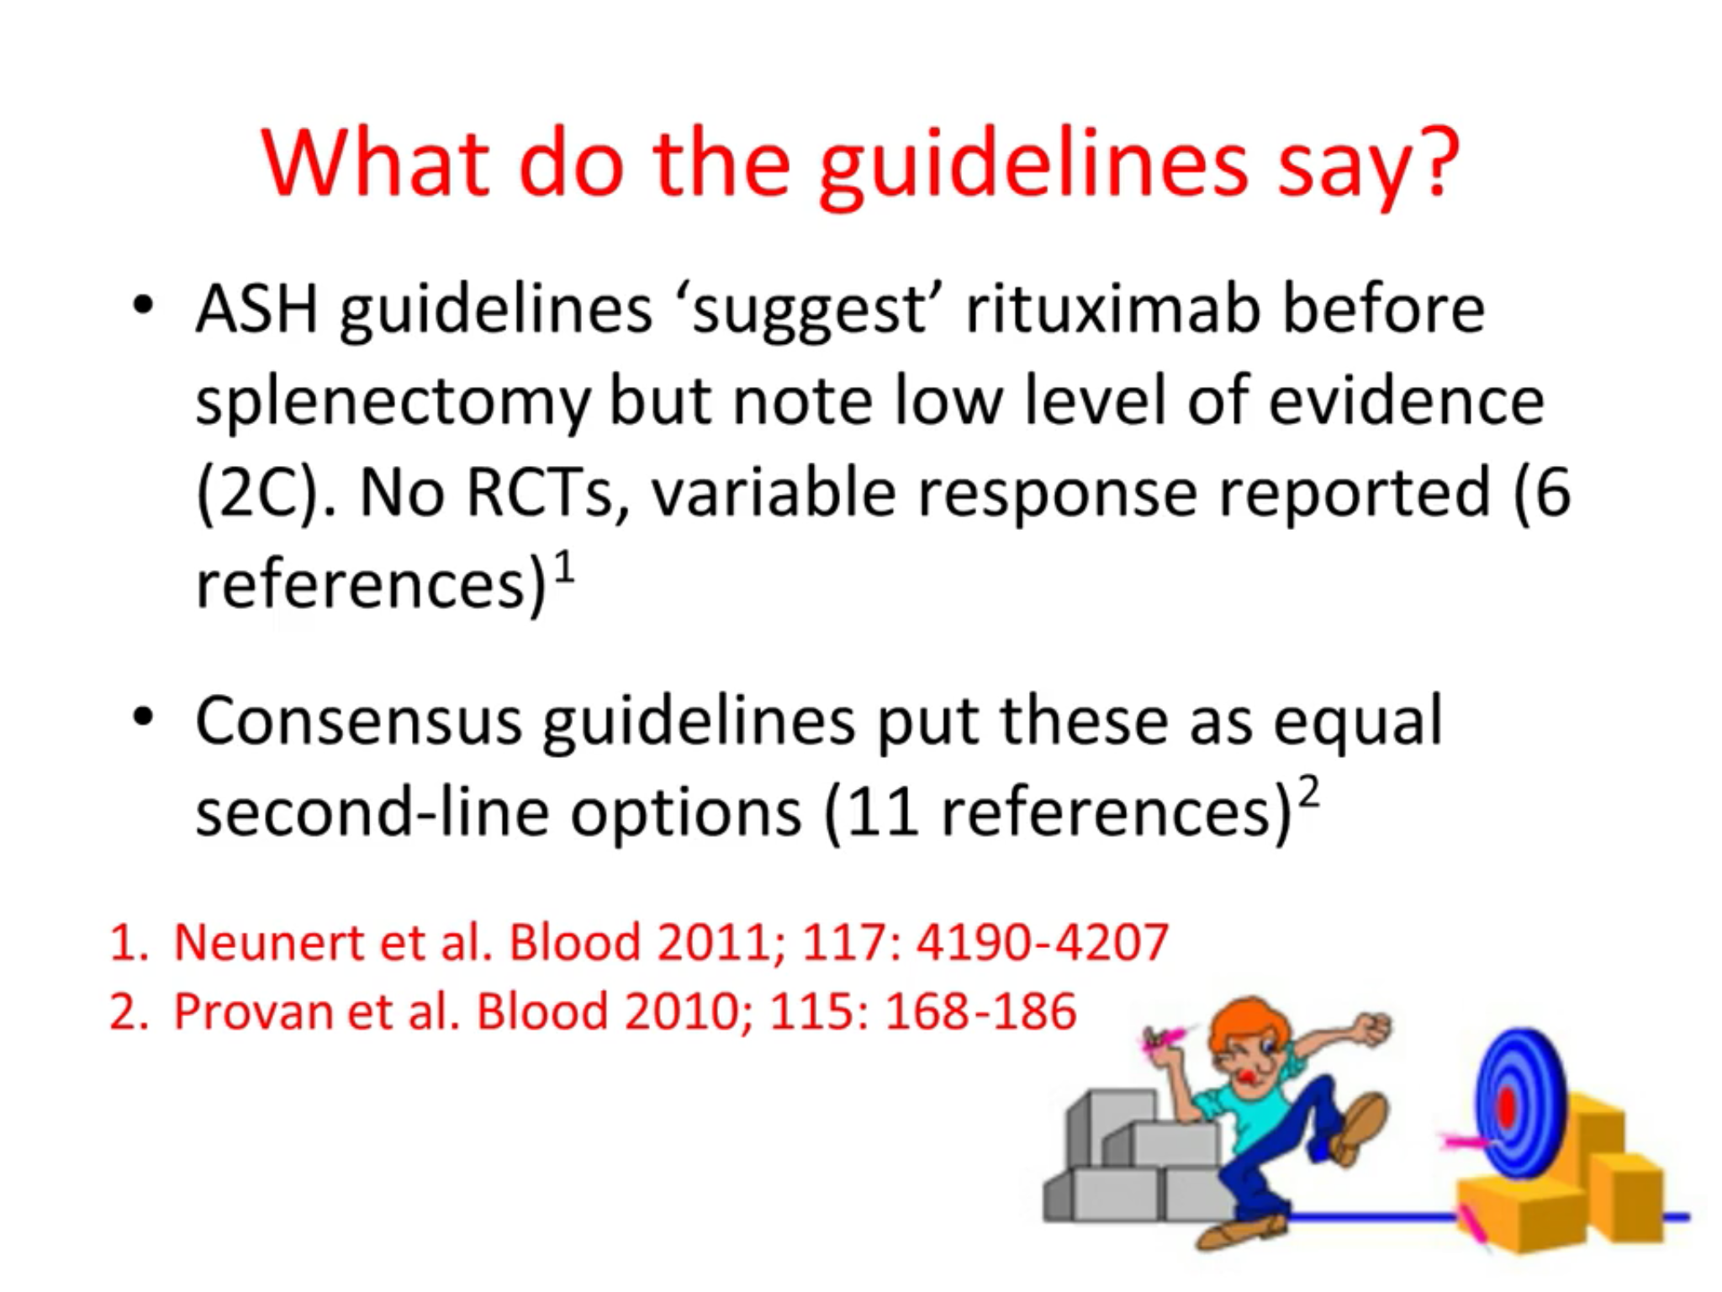

Slide 29
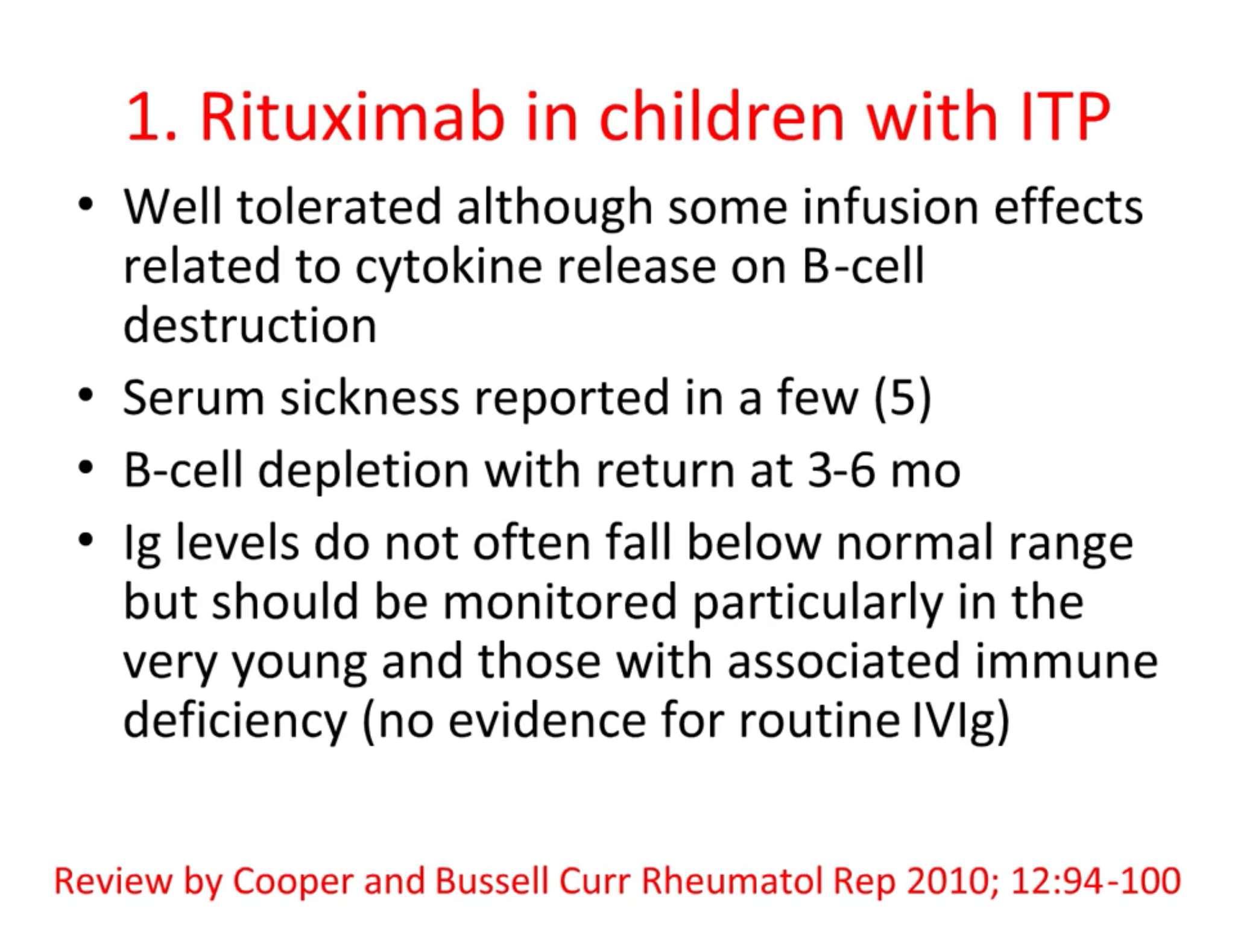

Slide 30
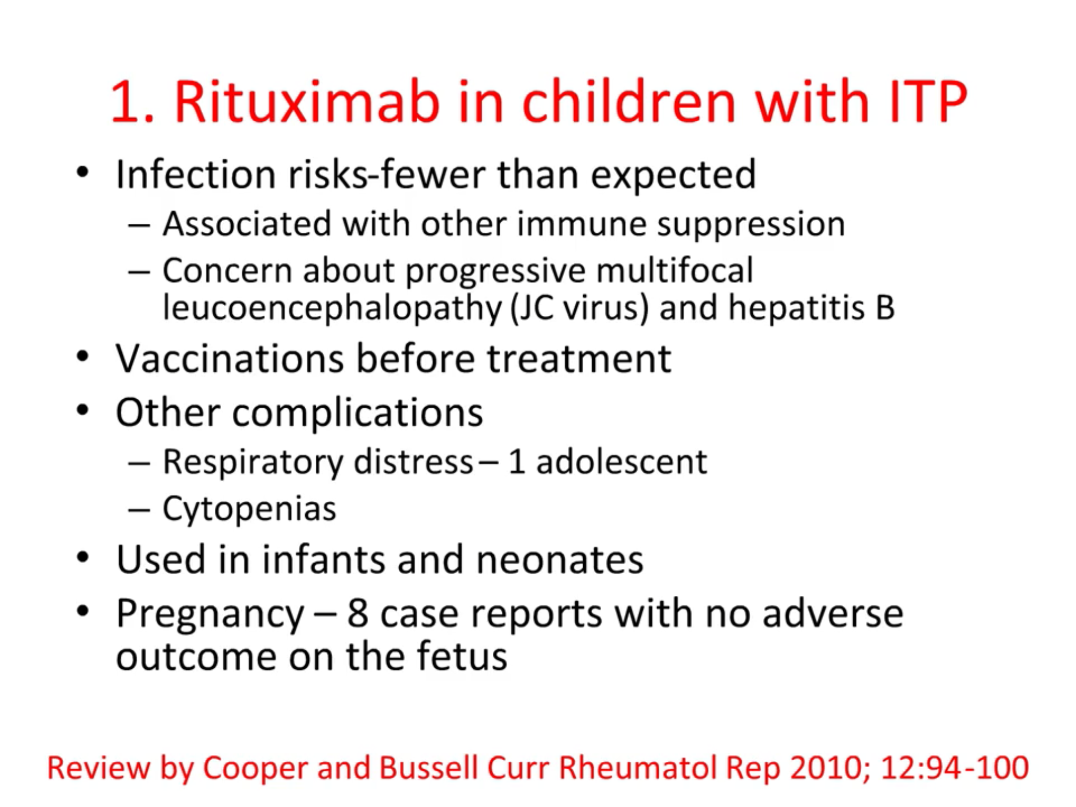

Slide 32
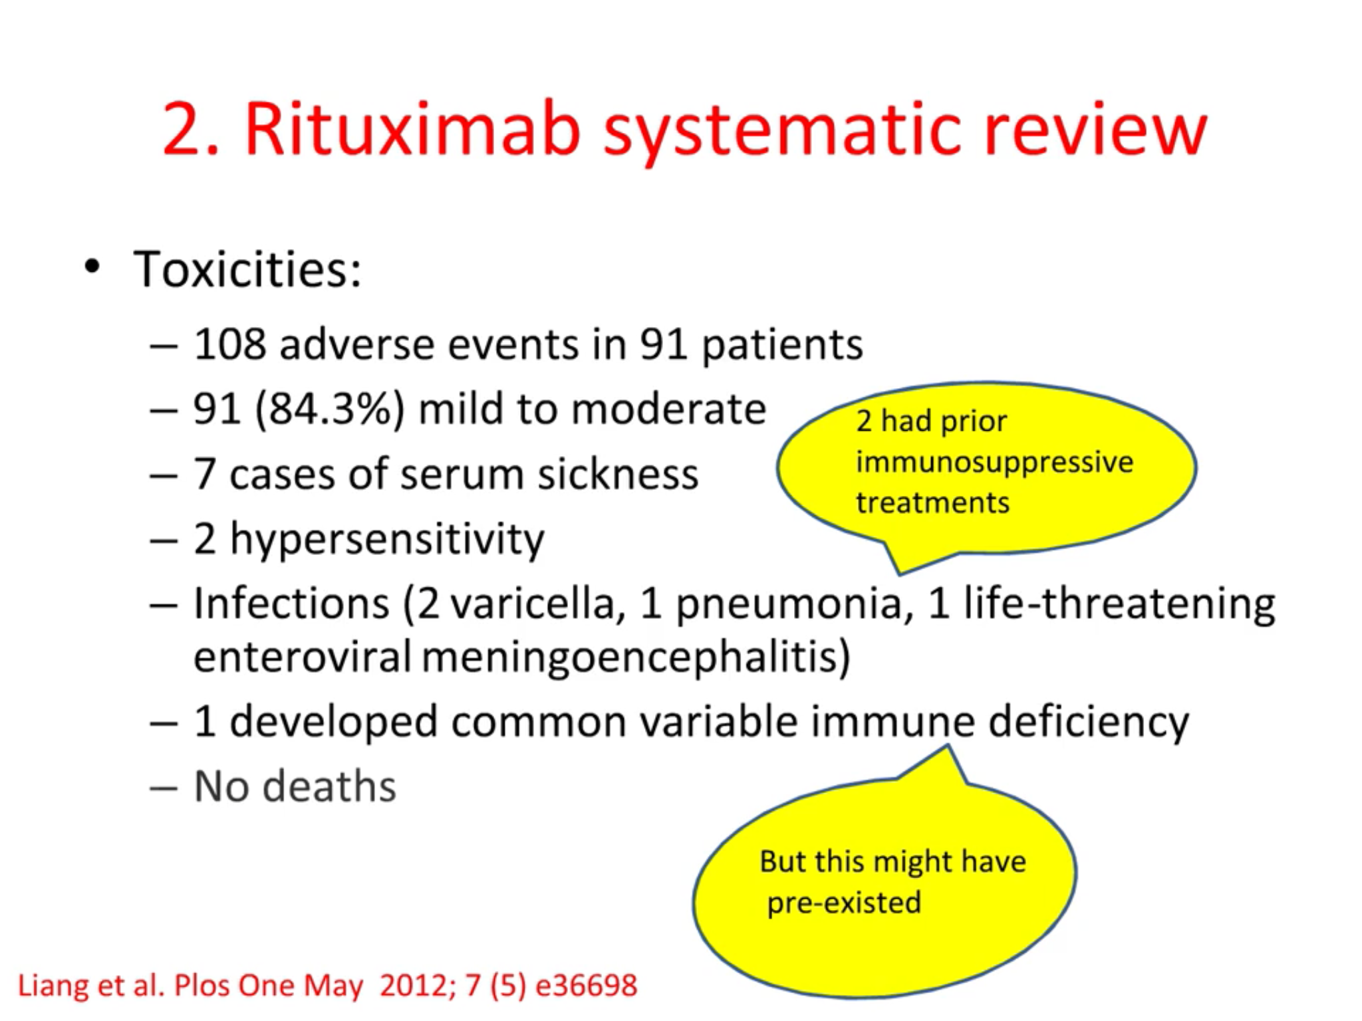

Slide 33
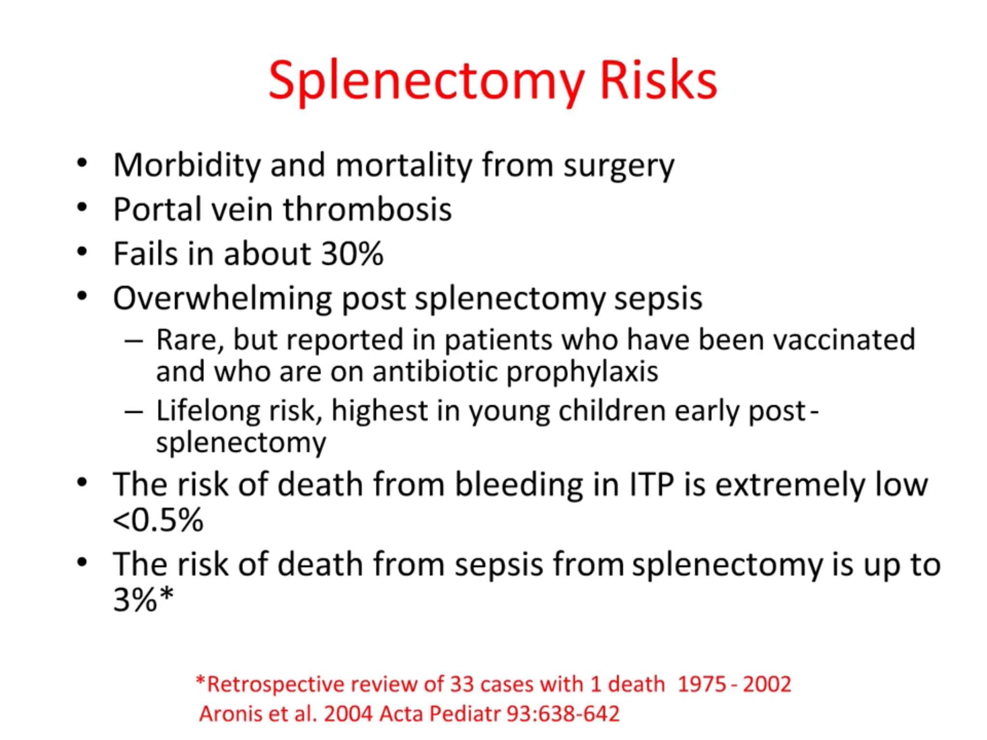

Slide 34
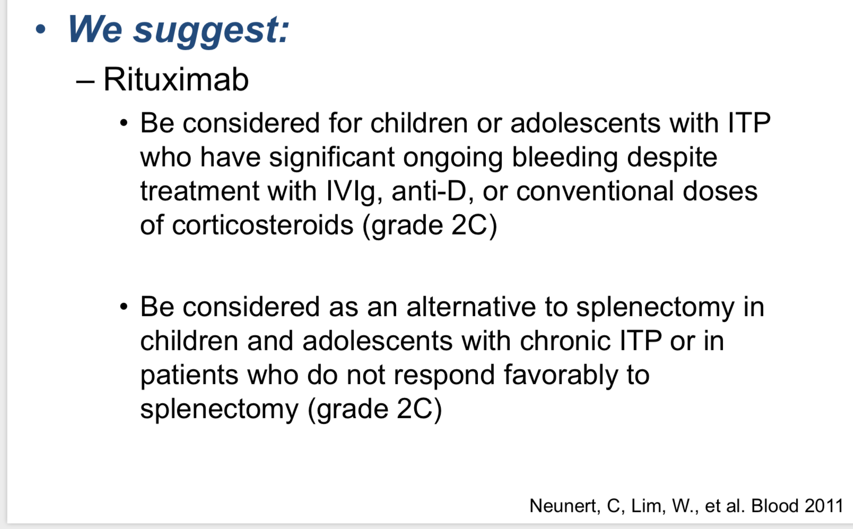

Slide 35
Berrueco R, Dapena JL, Sebastián E, Sastre A. Controversias en el tratamiento de la trombocitopenia inmune pediátrica. Ann Pediatr. 2018;89:189.
The use of rituximab as a second-line treatment is even more controversial in paediatric patients. Before TPO-RAs, several publications already recommended splenectomy in patients with refractory ITP
Furthermore, although the use of rituximab was proposed as an alternative to splenectomy in children with chronic or refractory ITP, authors emphasised its potential adverse effects-serum sickness, increased risk of viral infection, hepatitis B virus reactivation or secondary hypogammaglobulinemia

Slide 36
Outlines
Chronic ITP new concepts
Chronic ITP Treatment options
Splenectomy versus Rituximab therapy
The impact of combination therapy
Necessities of BMA in anticipation of Splenectomy
Novel Drugs in treatment of ITP should it be the Dawn of a new era?
How far should be go for the treatment of chronic ITP?

Slide 37
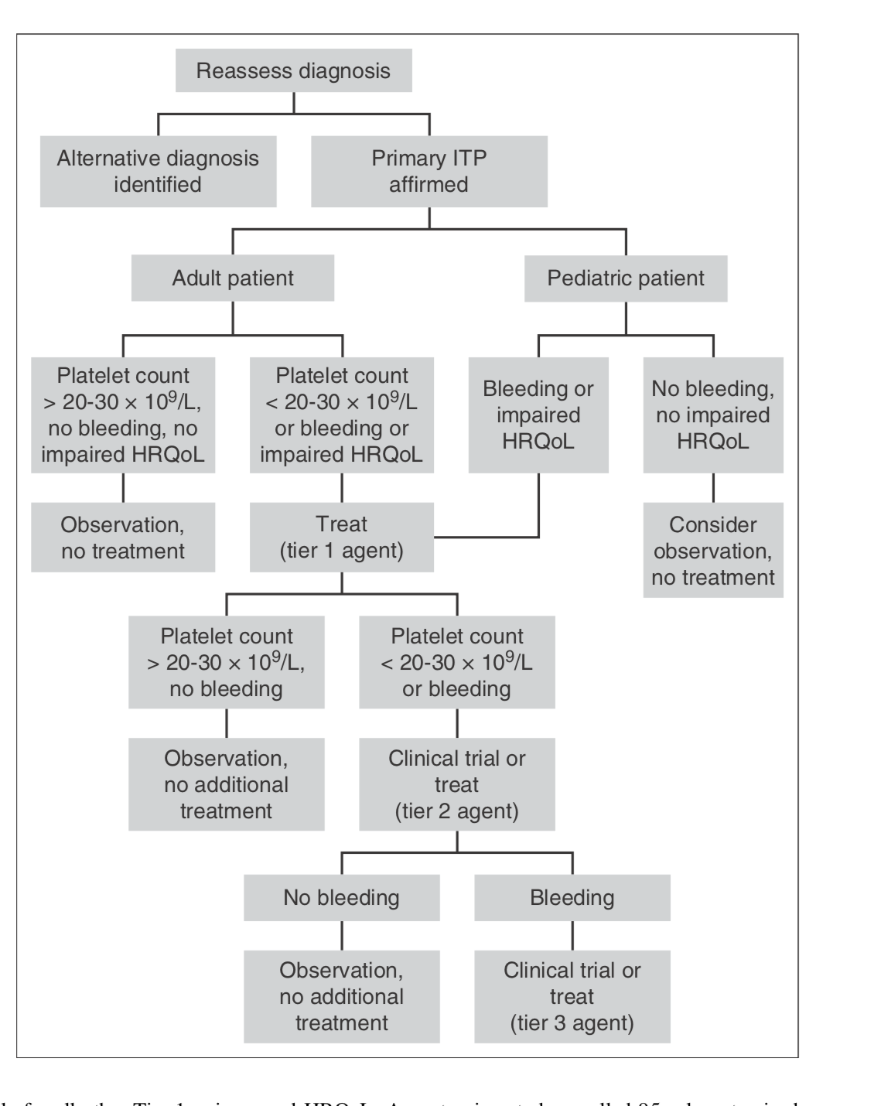
Approach to the patient with refractory ITP
Adam Cuker and Cindy E. Neunert. How I treat refractory immune thrombocytopenia . , BLOOD, 22 SEPTEMBER 2016 x VOLUME 128,

Slide 38
How I treat refractory immune thrombocytopenia
If a patient is unable to maintain a hemostatic platelet count with single-agent therapy using the options in Tier 1, we encourage participation in a clinical trial.
If a suitable clinical trial is not available, we proceed to Tier 2 agents. We frequently prescribe Tier 2 agents not as monotherapy but in combination with a Tier 1 or another Tier 2 drug
We prefer to combine drugs with different mechanisms of action, which allows for potential synergy between agents.
For example, we often use a TRA to boost platelet production in combination with a drug that interferes with platelet clearance (eg, low-dose prednisone or danazol) or autoantibody production (eg, azathioprine or mycophenolate mofetil
Adam Cuker and Cindy E. Neunert. How I treat refractory immune thrombocytopenia . , BLOOD, 22 SEPTEMBER 2016 x VOLUME 128, NUMBER 12

Slide 39
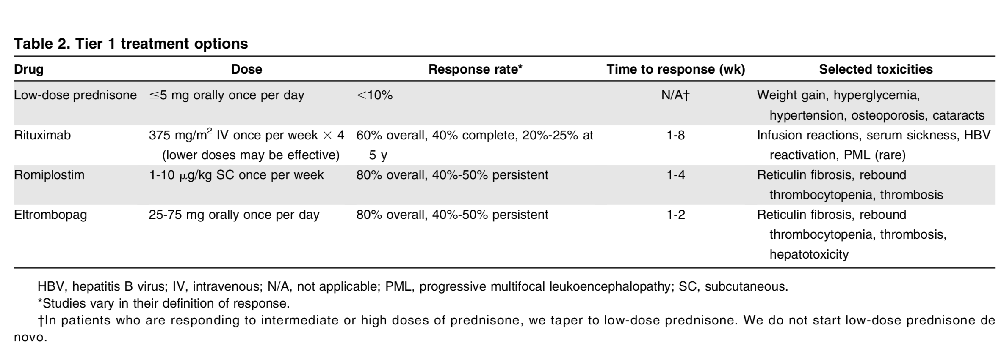
Adam Cuker and Cindy E. Neunert. How I treat refractory immune thrombocytopenia . , BLOOD, 22 SEPTEMBER 2016 x VOLUME 128,

Slide 40
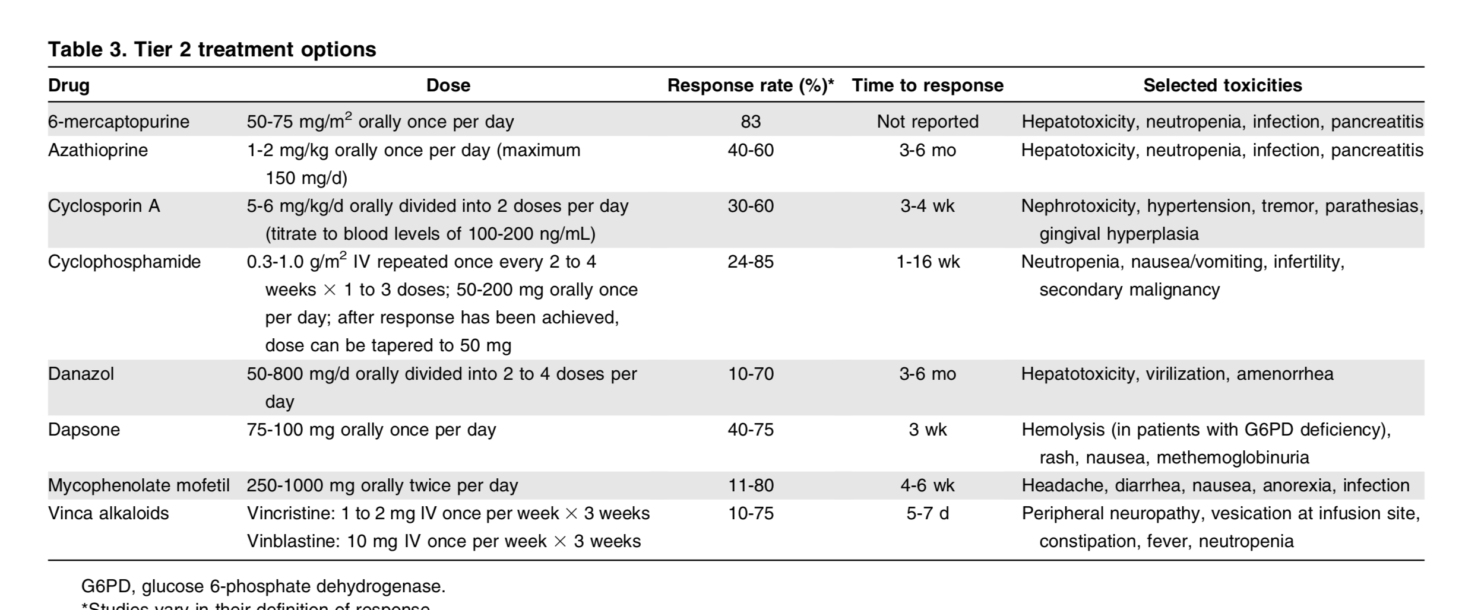
Adam Cuker and Cindy E. Neunert. How I treat refractory immune thrombocytopenia . , BLOOD, 22 SEPTEMBER 2016 x VOLUME 128,

Slide 41
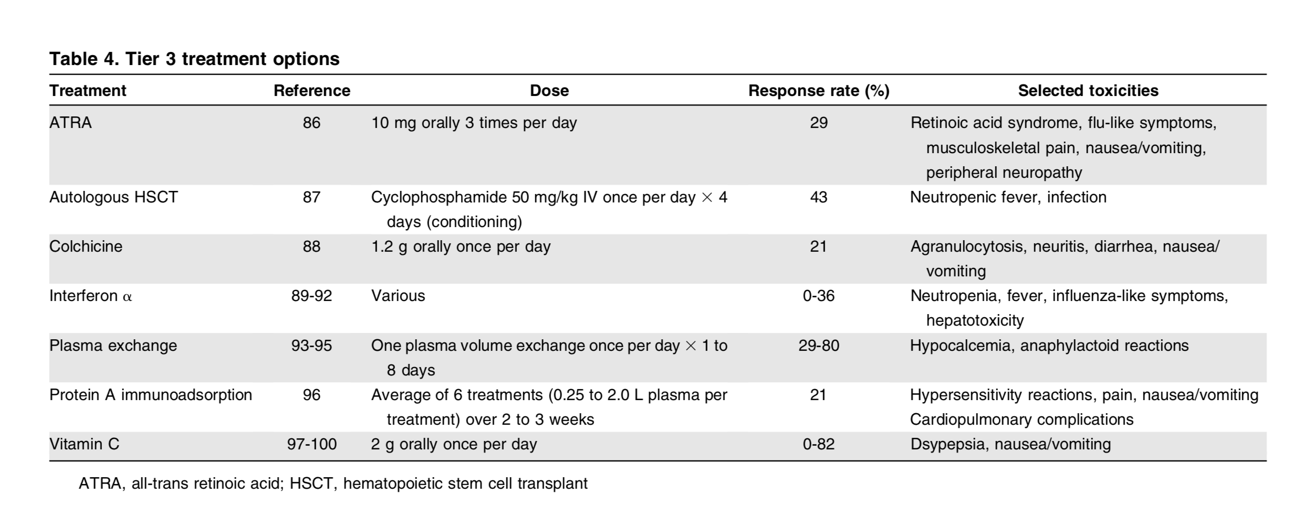
Adam Cuker and Cindy E. Neunert. How I treat refractory immune thrombocytopenia . , BLOOD, 22 SEPTEMBER 2016 x VOLUME 128,

Slide 42
Second-generation thrombopoietin agonists
Romiplostim has undergone limited evaluation in the treatment of chronic ITP in children .
Pasquet et al reported on 10 children treated with romiplostim for a median of 9 months.
One patient achieved a complete response and four patients achieved a partial response. A complete response was defined as a platelet count .100,000/μL and the absence of bleeding.
A partial response was defined as a platelet count between 30 and 100,000/μL and at least doubling of the baseline count along with the absence of bleeding.
Drug Design, Development and Therapy 2017:11 1055–1063

Slide 43
New Therapeutic Targets
There are ongoing trials about other classes of drugs for ITP, currently limited to application in adulthood.
New potential targets are represented by interaction between T-cells and antigen-presenting cells (anti-CD40L antibodies)
platelet phagocytosis [SYK inhibitors and interference with FcR binding on macrophages
activation of B-cells (anti-CD52 or alemtuzumab)
T-cells [anti-IL-2R or daclizumab and TH1 expansion (anti-CD16)

Slide 44
Outlines
Chronic ITP new concepts
Chronic ITP Treatment options
Splenectomy versus Rituximab therapy
The impact of combination therapy
Splenectomy versus Rituximab therapy
Necessities of BMA in anticipation of Splenectomy
Novel Drugs in treatment of ITP should it be the Dawn of a new era?
How far should be go for the treatment of chronic ITP?

Slide 45
Outlines
Chronic ITP new concepts
The impact of combination therapy
Splenectomy versus Rituximab therapy
Necessities of BMA in anticipation of Splenectomy
Novel Drugs in treatment of ITP should it be the Dawn of a new era?
How far should be go for the treatment of chronic ITP?

Slide 46
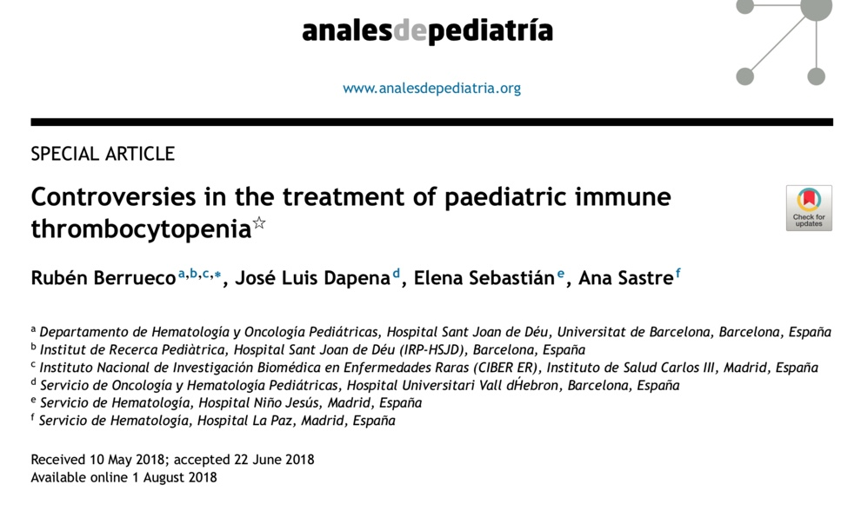

Slide 47
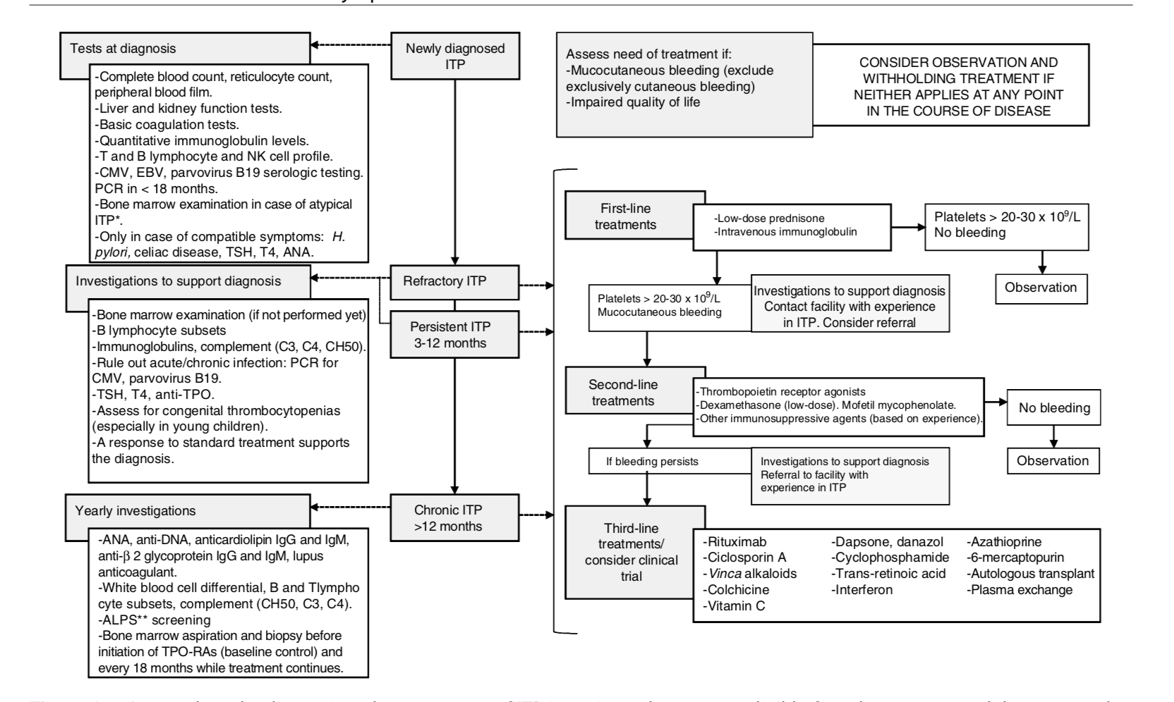

Slide 48
Which approach is most appropriate for management of persistent and refractory ITP in children?
When it comes to paediatric patients with ITP,the most important step prior to initiating treatment is to assess whether it is justified by haemorrhagic manifestations.
Thus, treatment should be reserved for patients with active bleeding (excluding exclusively cutaneous bleeding). On the other hand, prevention of bleeding in asymptomatic patients would only be justified in the case of surgical intervention or if the clinician in charge believes that there is a high risk of bleeding associated to the physical activity of the child.
Other factors, such as the circumstances of the family or the quality of life of the patient may also be taken into account in treatment planning, always balancing the risks and benefits of treatment

Slide 49
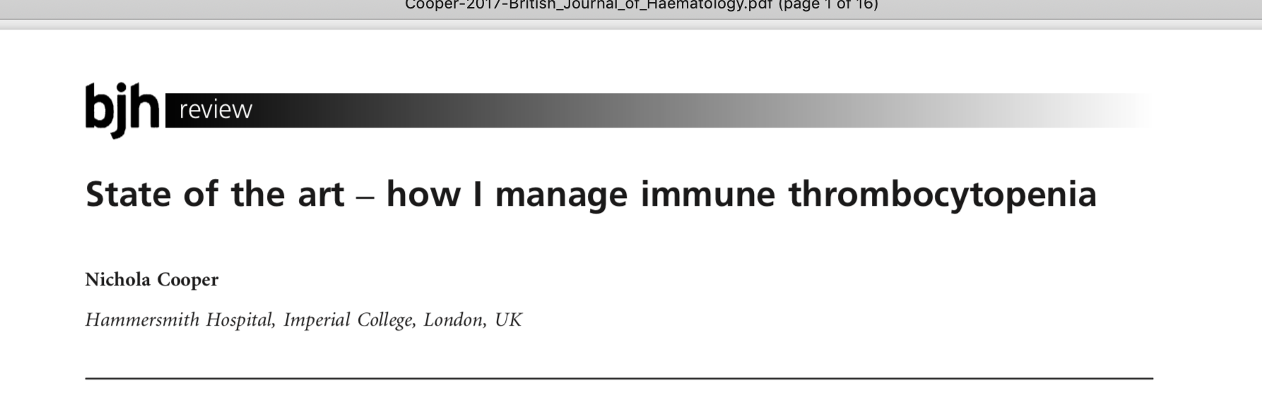

Slide 50
Is a bone marrow examination necessary in ITP?.
The test should include evaluation of cellularity, megakaryocyte abnormalities, B and T cell clonality, and karyotype to look for other causes of thrombocytopenia.
This may be particularly relevant at both younger and older ages. I recommend bone marrow examination in: patients with atypical features,
abnormalities on blood film or any other full blood count (FBC) abnormalities
presence of lymphadenopathy/ splenomegaly;
patients who do not respond appropriately to IVIG and steroids.
before using TPO-RAs and in most patients with persis tent ITP.
British Journal of Haematology, 2017, 177, 39–54

Slide 51
Outlines
Chronic ITP new concepts
The impact of combination therapy
Splenectomy versus Rituximab therapy
Necessities of BMA in anticipation of Splenectomy
Novel Drugs in treatment of ITP should it be the Dawn of a new era?
How far should be go for the treatment of chronic ITP?

Slide 52
New Therapeutic Targets
There are ongoing trials about other classes of drugs for ITP, currently limited to application in adulthood.
New potential targets are represented by interaction between T-cells and antigen-presenting cells (anti-CD40L antibodies)
platelet phagocytosis [SYK inhibitors and interference with FcR binding on macrophages
activation of B-cells (anti-CD52 or alemtuzumab)
T-cells [anti-IL-2R or daclizumab and TH1 expansion (anti-CD16)

Slide 54
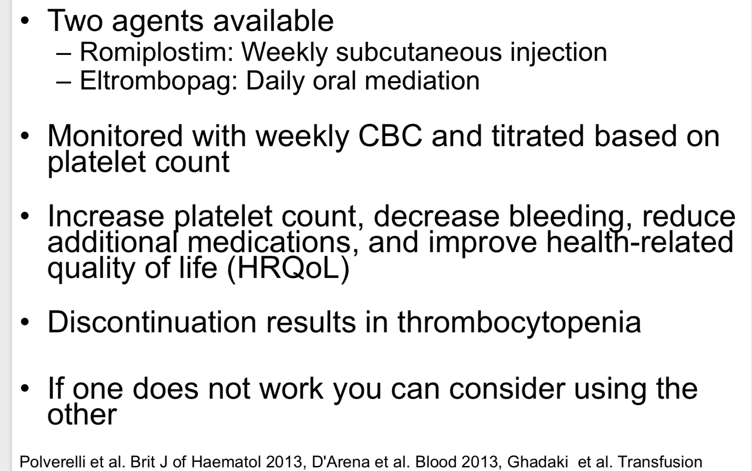

Slide 55
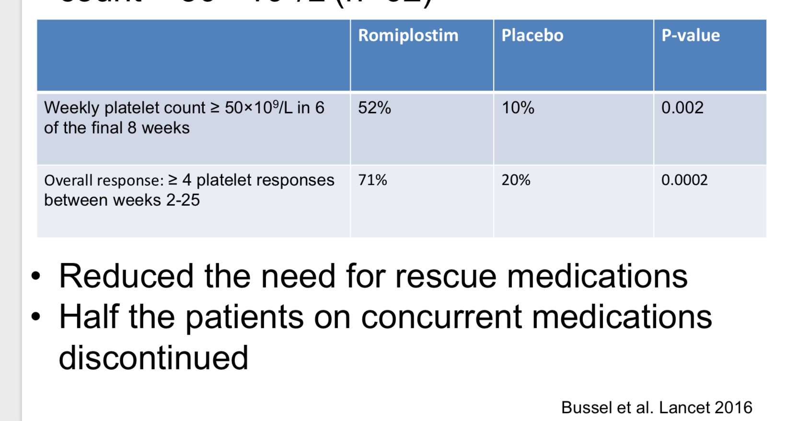

Slide 56
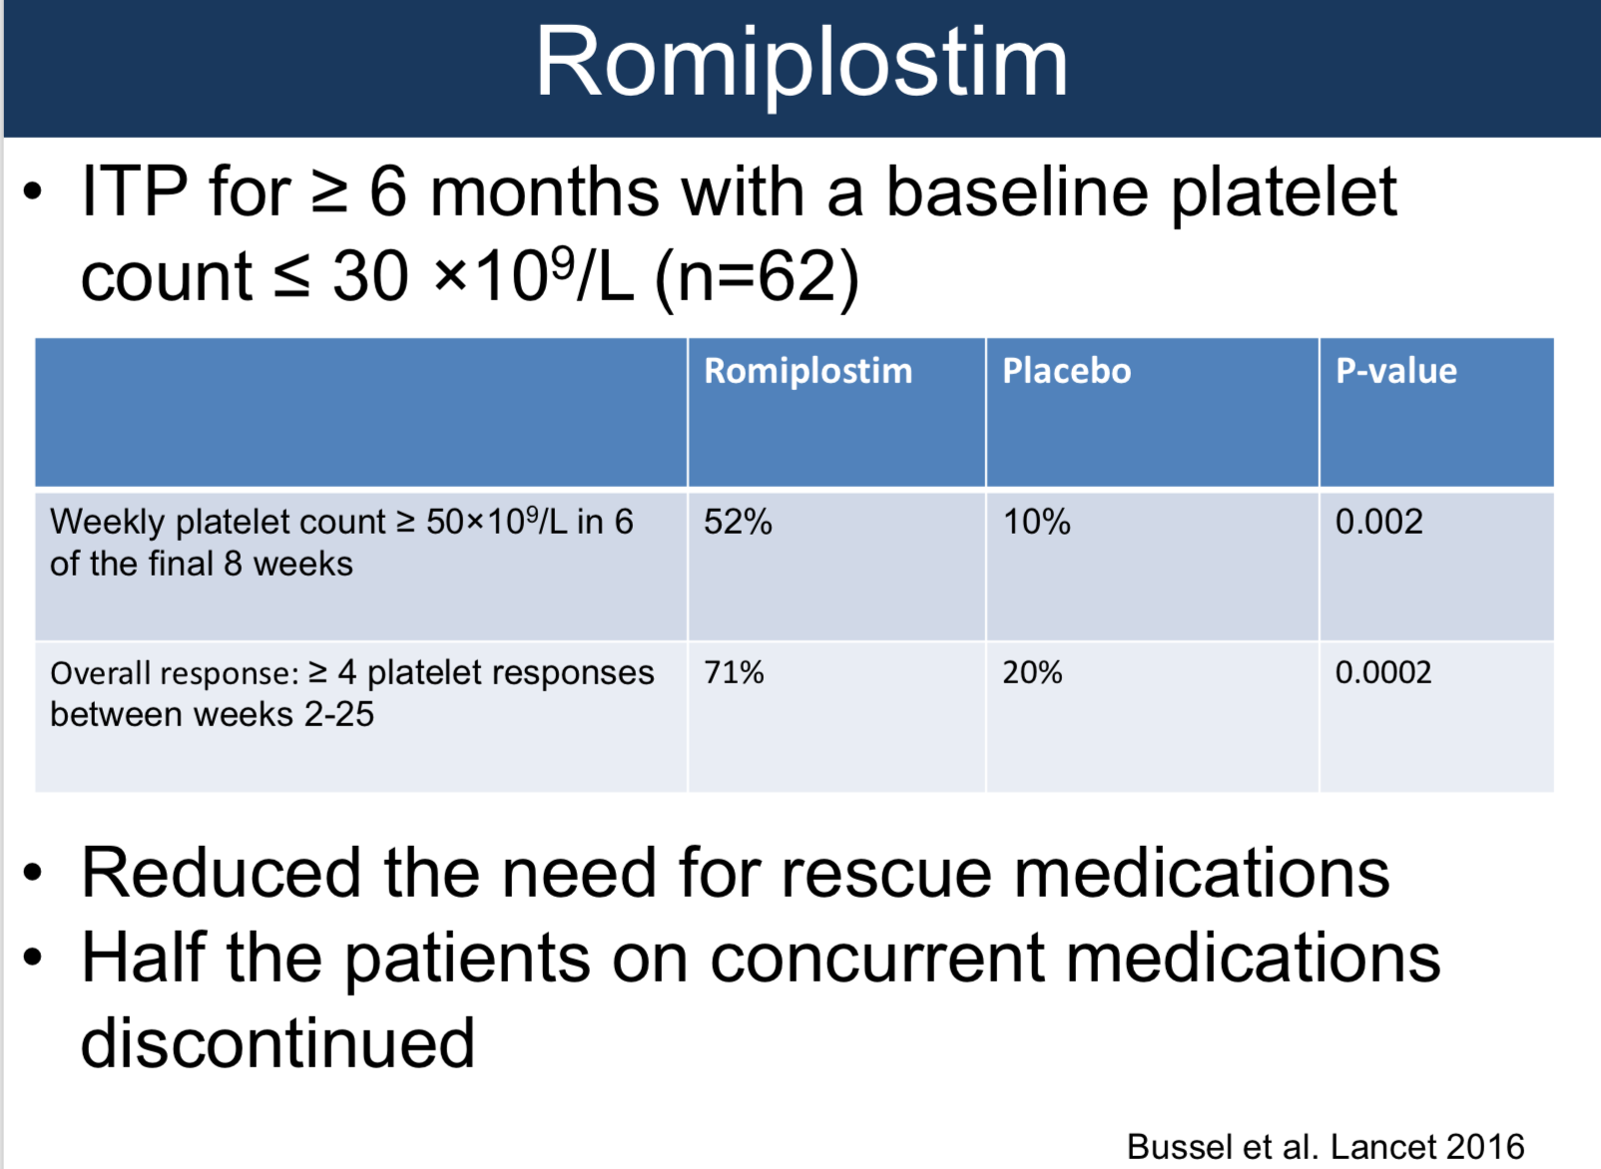
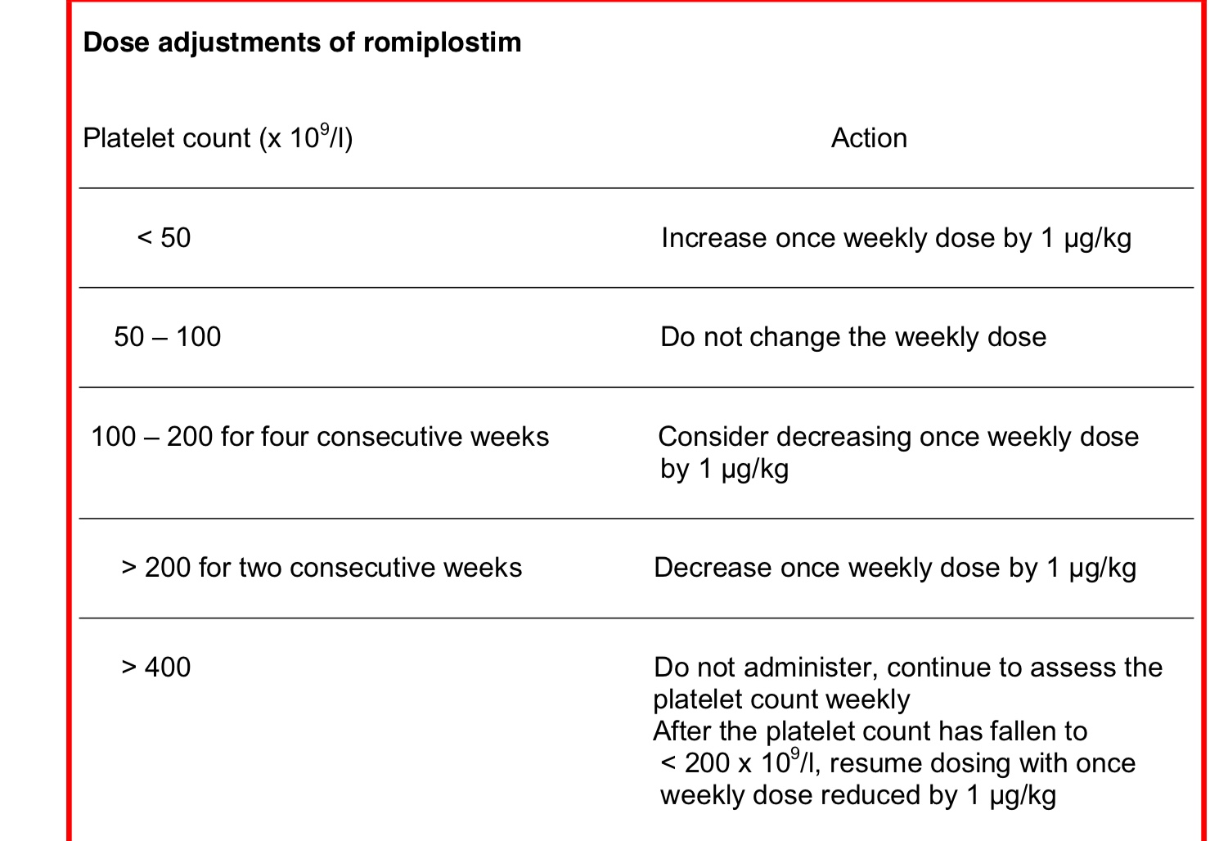

Slide 57
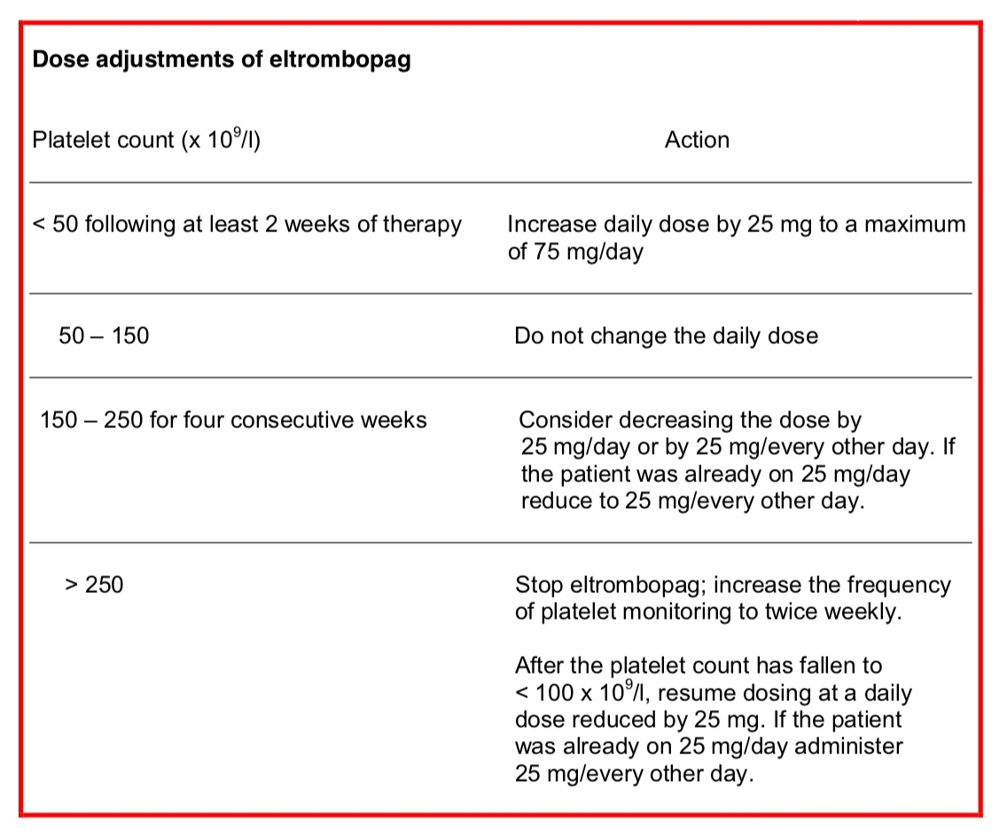
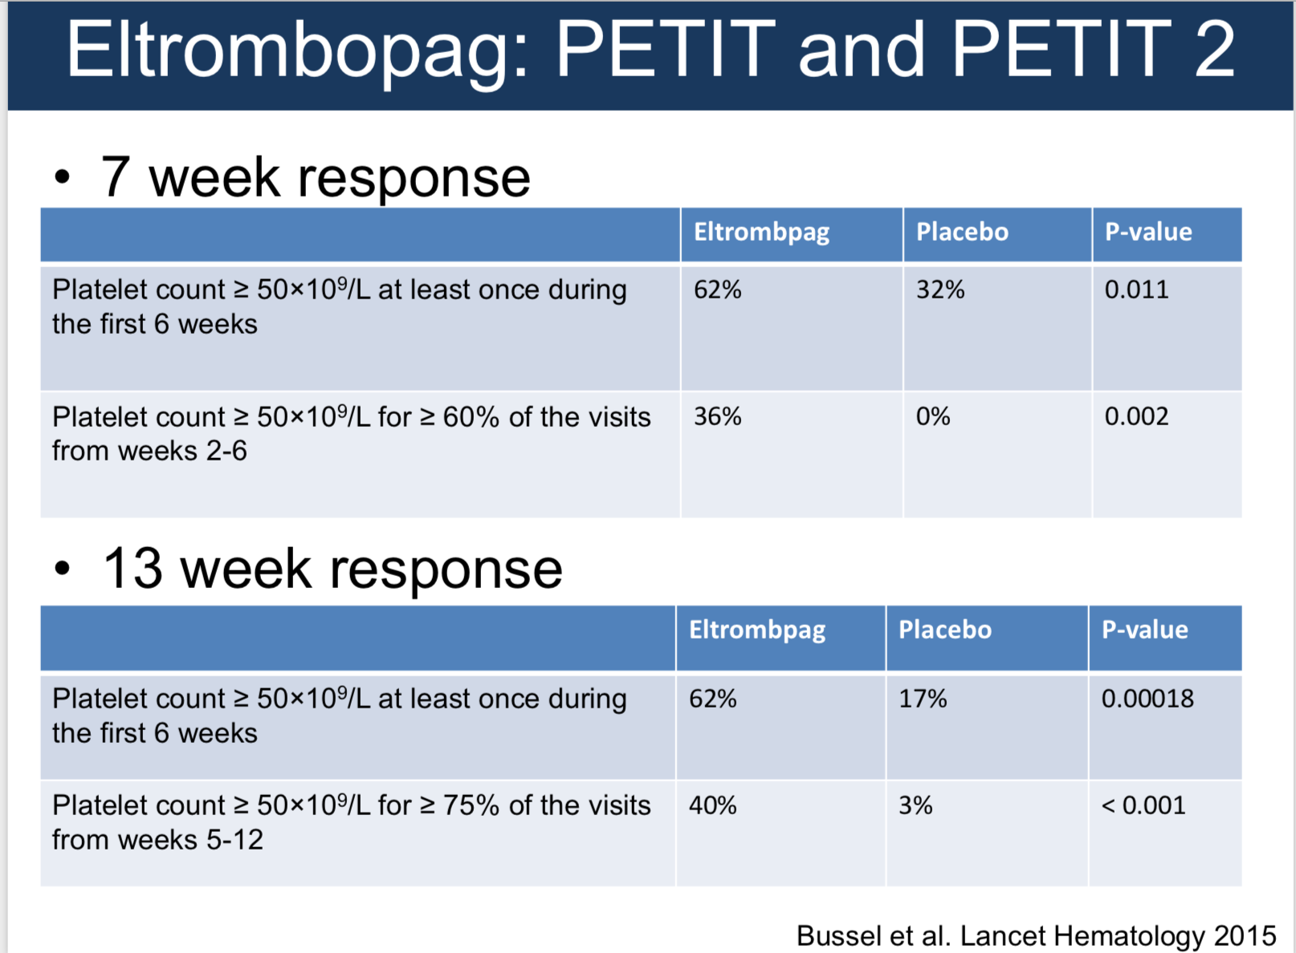

Slide 58
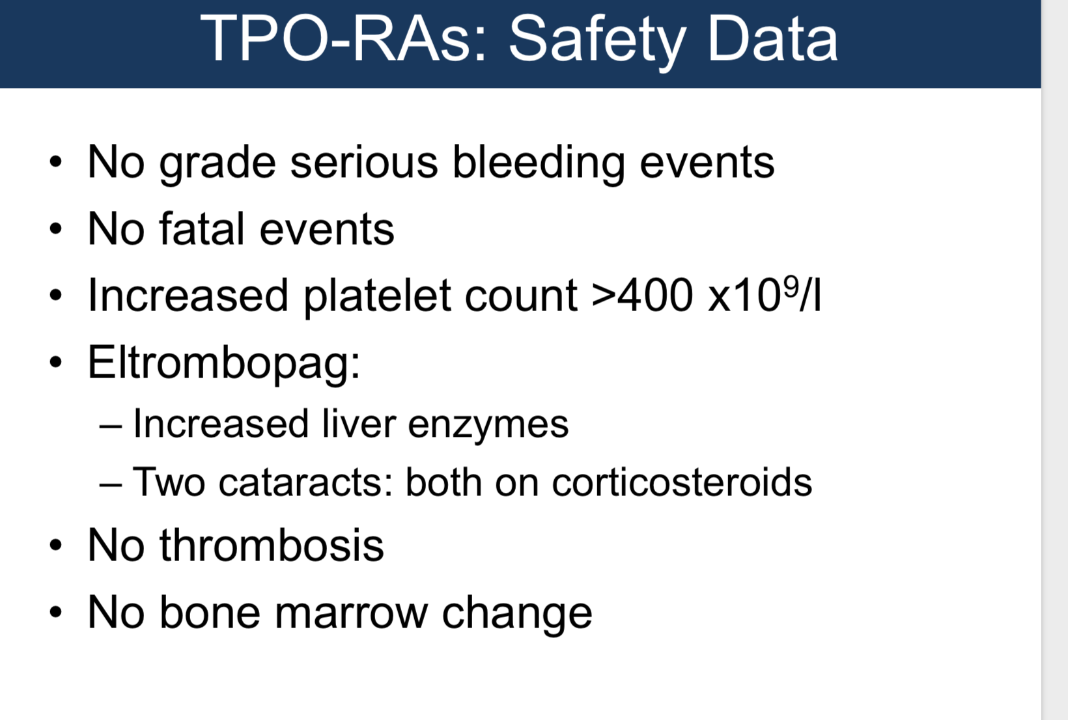

Slide 59
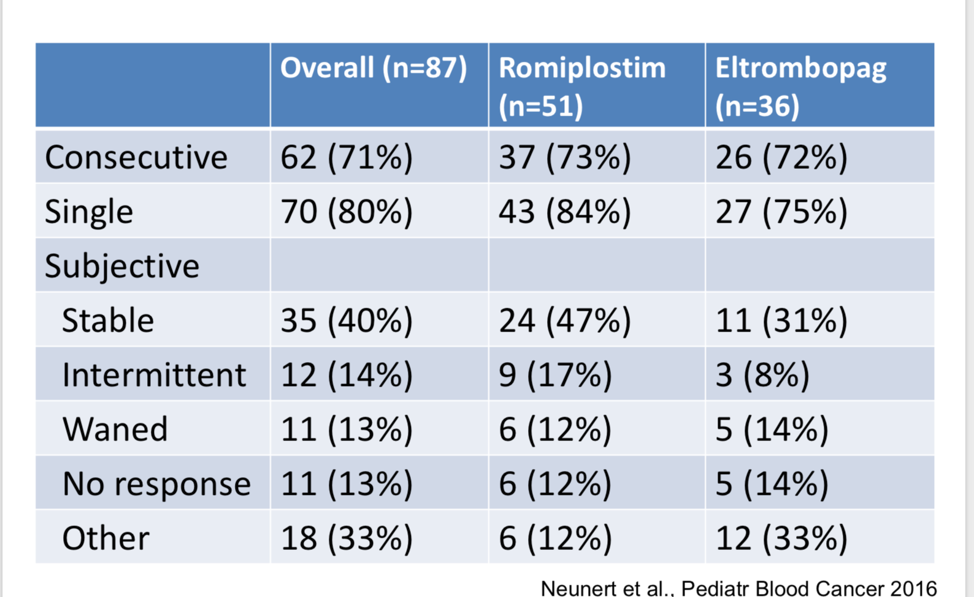

Slide 60
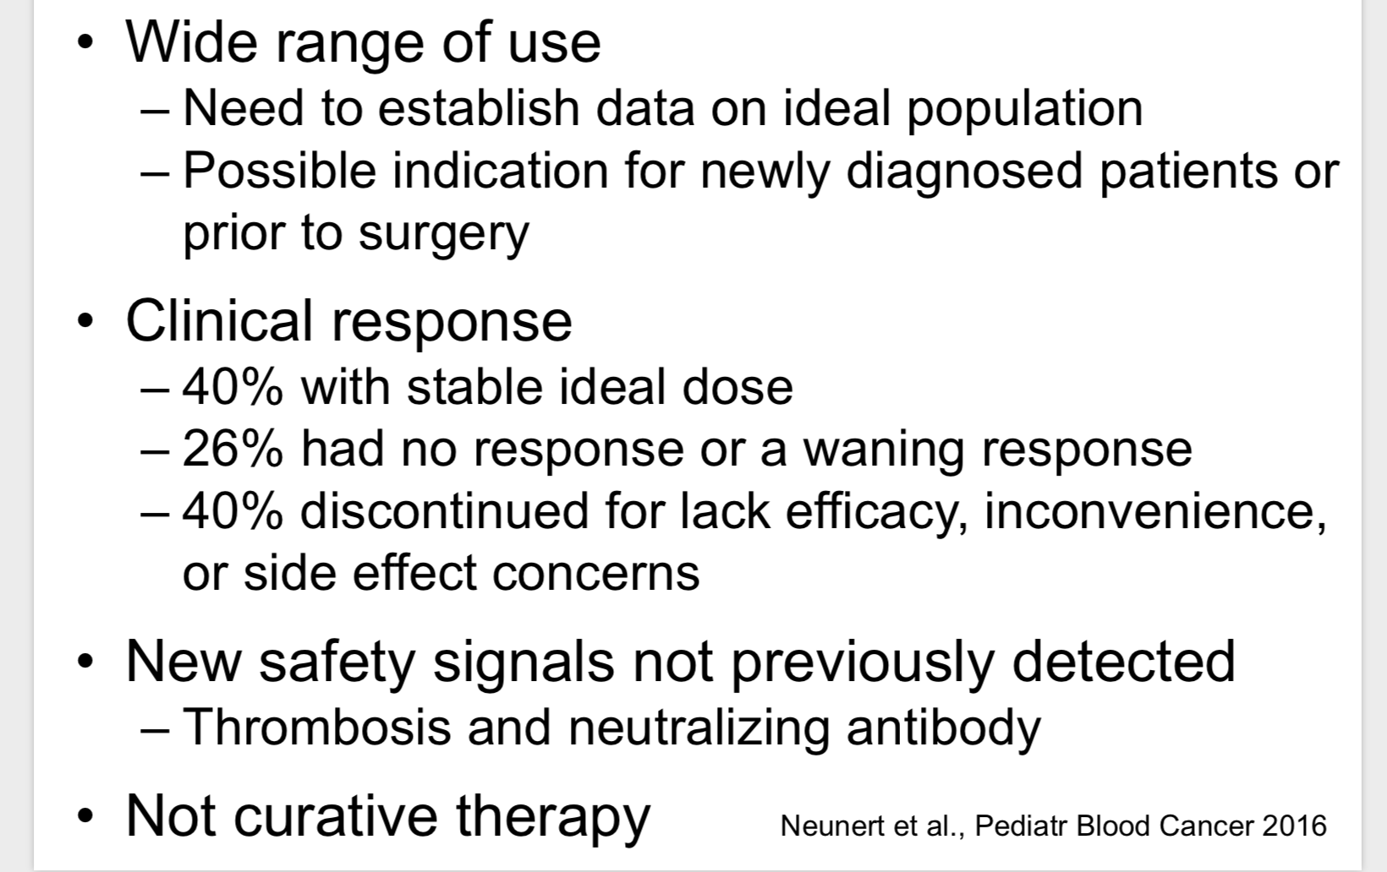

Slide 61
Outlines
Chronic ITP new concepts
The impact of combination therapy
Splenectomy versus Rituximab therapy
Necessities of BMA in anticipation of Splenectomy
Novel Drugs in treatment of ITP should it be the Dawn of a new era?
How far should be go for the treatment of chronic ITP?

Slide 62
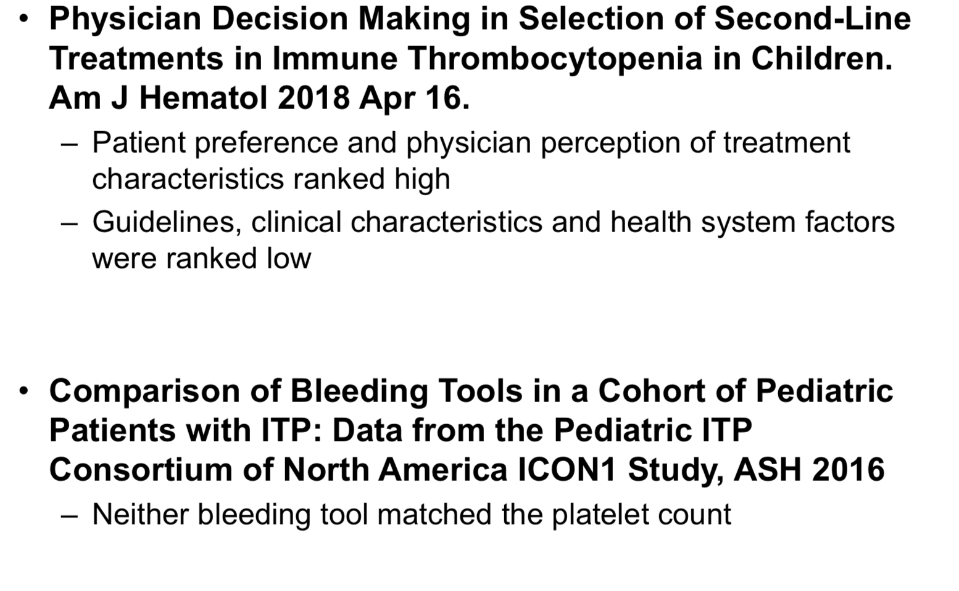

Slide 63
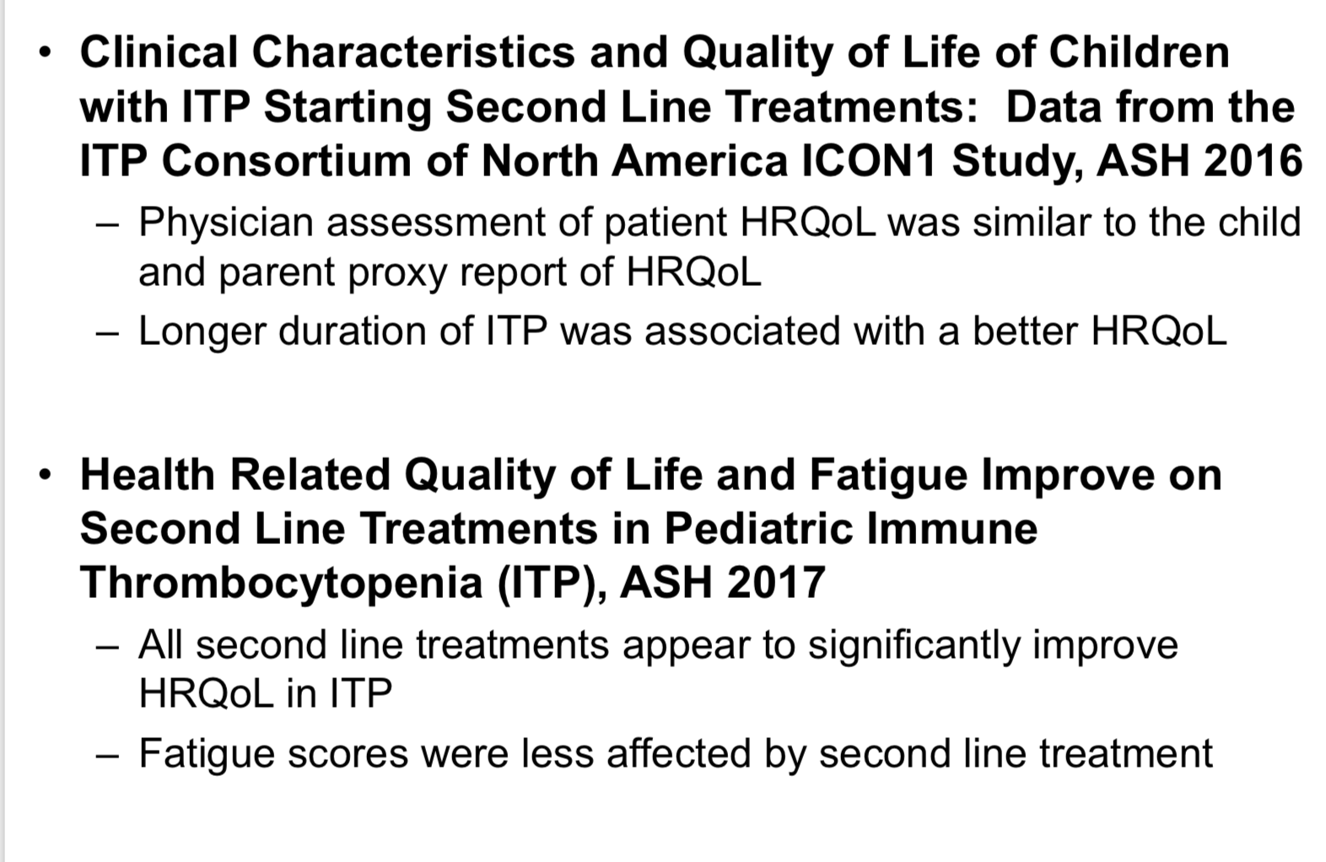

Slide 64
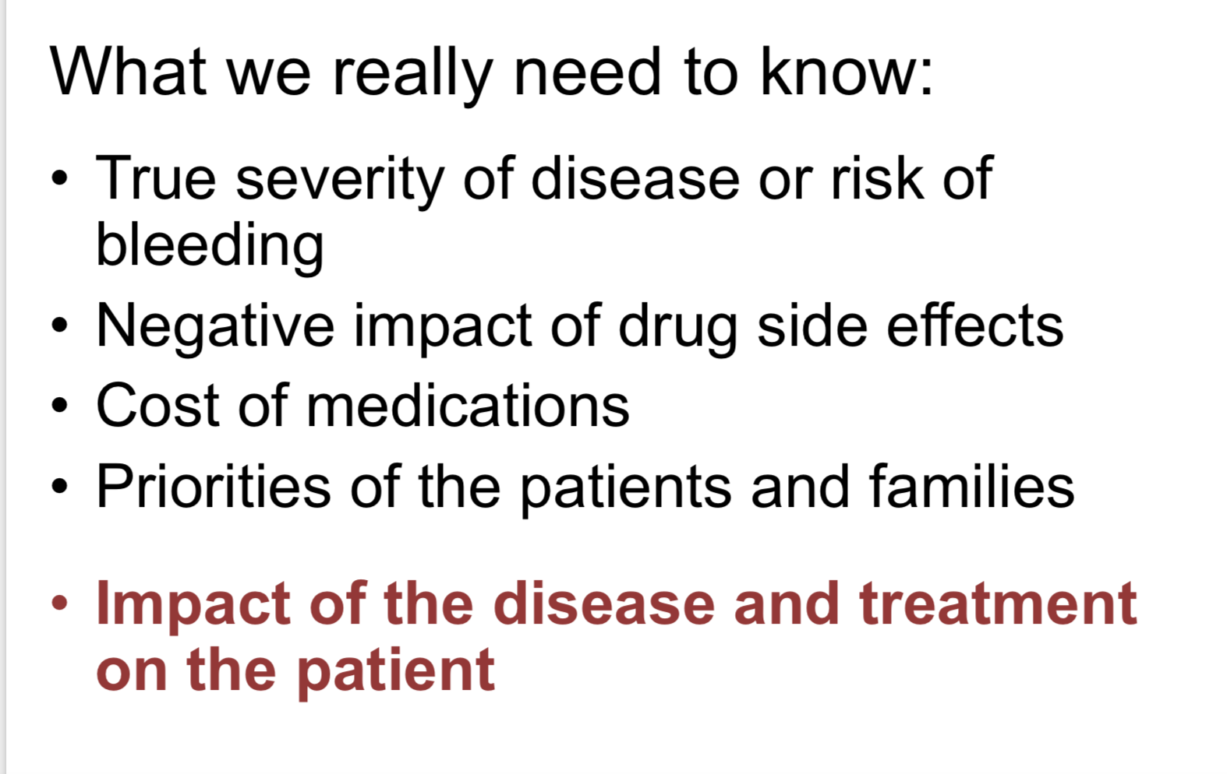

Slide 65
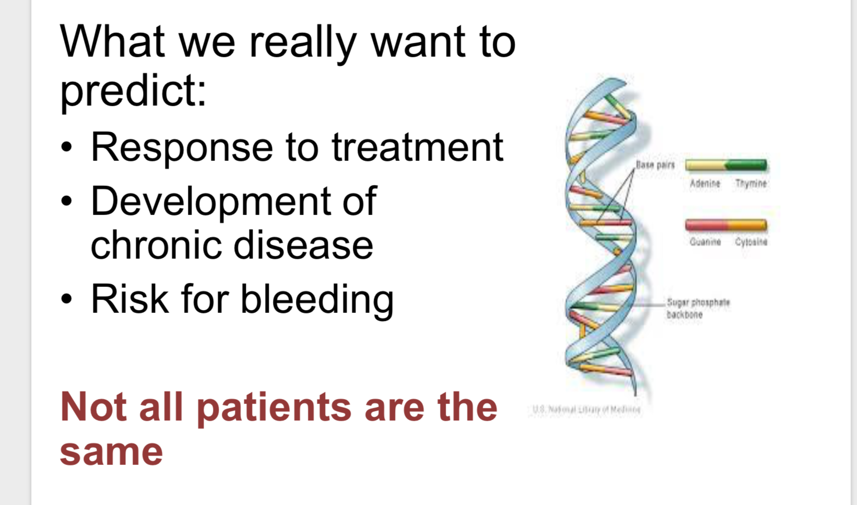

Slide 66
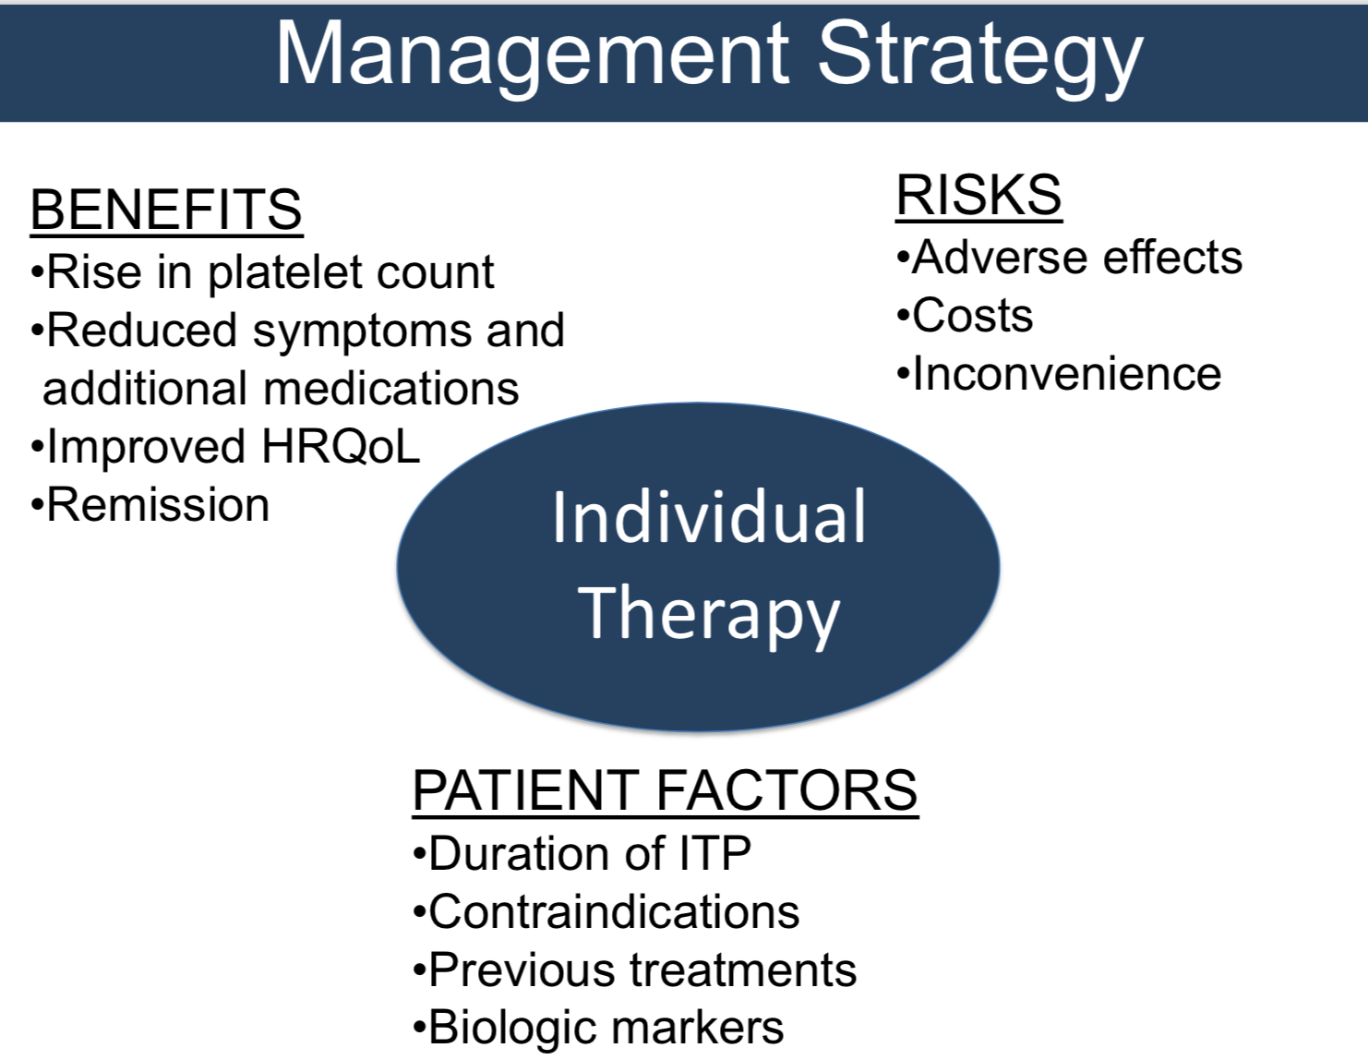

Slide 67
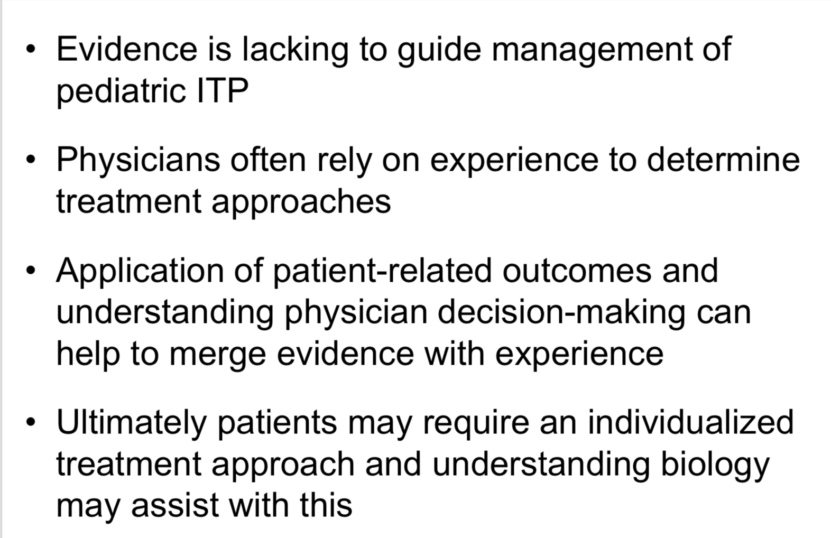
Conclusion

