Slide 1
Superior vena cava thrombosis in sickle cell trait patient Case study
Dr Babak Abdolkarimi

Slide 2
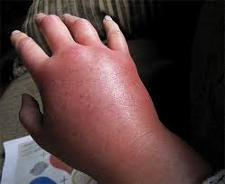
Case presentation:
A case of 19 years old sickle cell carrier male that presented with bilateral upper extremities swelling after exercising at the gym.
Initial Blood TESTS: D-dimer of 2.72 ng/ml(+)
sickling test: +
Upper extremities Doppler ultrasound : no evidence of deep venous thrombosis (DVT)
Chest CT scans : SVC thrombosis involving the right subclavian vein and extending to the right basilic vein.

Slide 3
Patient evaluations:Normal results
Factor V Leiden mutation (PCR) Prothrombin mutation
ANA Anti-thrombin assay
Protein C Fibrinogen
HIV test anti-Ds DNA (ELISA)
Janus Kinase (JAK2) mutation.

Slide 4
Patient management:
Systemic anti-coagulation therapy : LMWH(5 d) +Warfarin
RESULT: good recovery without needing an endovascular treatment
repeat CT scan :residual thrombus in the right basilic vein.
follow up: day 9 after hospitalization

Slide 5
After lost follow-up:
SCT is not a benign disease phenotype, exercise-related sudden death and thrombosis are possible, lethal complications in SCT carriers.
SVC thrombosis (SVCT) was believed to be secondary to sickle cell trait in the absence of malignancy and thrombophilia underlying causes.

Slide 6
Clinical questions:
Dose he need for:
1. thrombophilia panel(acquired OR heriditary) evaluations?
2. anticoagulant agent administration?
3. exchange transfusion administration?

Slide 7
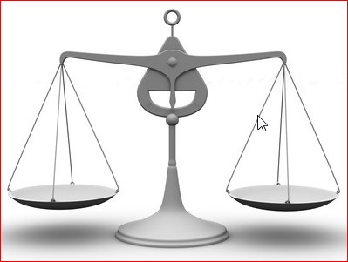
Perfusion defect in SCD:

Slide 9
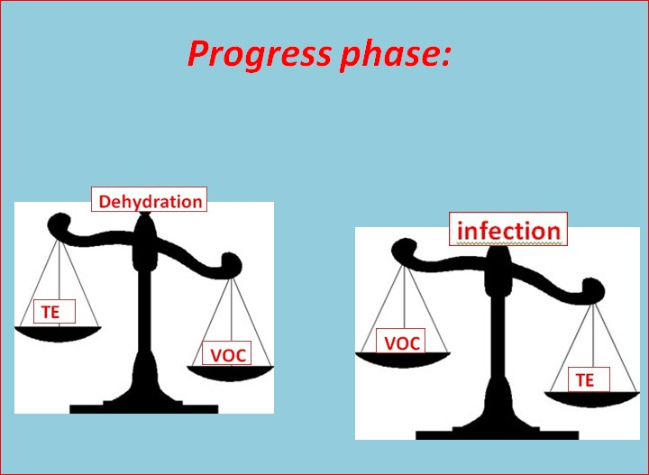
Progress phase:

Slide 10
Key Questions:
Reversible or irreversible event?
(rev) Veno-occlusive crisis(VOC)---→infarct
(rev) Thrombosis----------------------→infarct
(irev) Infarction
Main(vital) organ or accessory organ involvement?
Brain(cortex/sinuses)
Heart
Lung
Liver
Spleen
Limbs(vein/bone)
Thrombotic or non-thrombotic event?
Throbosis
VOC

Slide 11
Management options :
Hydration
Exchange transfusion
Anticoagulant drug
Hydroxiurea

Slide 12
Thrombotic perfusion defect in liver(vital organ)
Without infarction :
AntiCOA(long term)+Hydroxiurea
Portal thrombosis--→LMWH(UFH)+Warfarin
Hepatic artery thrombosis--→ASA(anti-plt)

Slide 13
Thrombotic perfusion defect in liver(vital organ)
With infarction :
Exchange transfusion+AntiCOA(long term)+Hydration+Hydroxiurea
Portal thrombosis--→LMWH(UFH)+Warfarin
Hepatic artery thrombosis--→ASA(anti-plt)

Slide 14
Non-Thrombotic perfusion defect(voc) in liver(vital organ)
With infarction:
Exchange transfusion+Hydration+Hydroxiurea
Without infarction:
Hydration+Hydroxiurea

Slide 15
Thrombotic perfusion defect in accsesory organ(limb)→
AntiCOA(short term)+Hydration+Hydroxiurea
vein thrombosis--→LMWH(UFH)+Warfarin
arterial thrombosis--→ASA(anti-plt)
Non-Thrombotic perfusion defect( VOC) in accsesory organ(bone)→
Hydration+Hydroxiurea

