Slide 1
Vascular Access for Therapeutic Apheresis: A review of literature
Najib Khalife, MD
Medical Affairs, Terumo BCT, Belgium

Slide 2
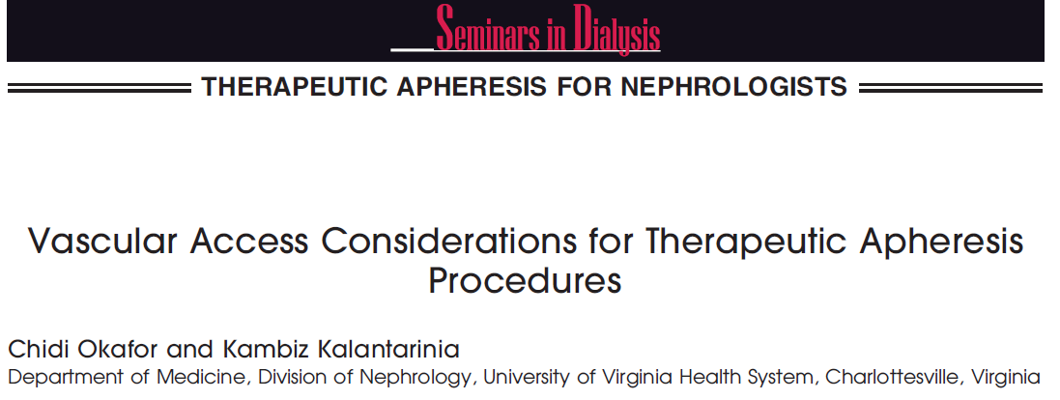
Introduction
Vascular access is an essential requirement for any Therapeutic Apheresis procedure
Therepautic Apheresis treatments require a stable and functioning vascular access with minimal complications. The choice of access is dependent on the duration for which the apheresis procedure is indicated⁽¹⁾
Initial use of the antecubital veins is sufficient
If required over a prolonged period of time, it is common practice to abandon the ante-cubital veins and establish other means of vascular access⁽²⁾
The apheresis operator needs to have a strong grasp of the principles of underlying vascular access, and knowledge of the vascular access options at their disposal
Okafor C, Kalantarinia ; Vascular access considerations for therapeutic apheresis procedures. Seminars Dialysis, 2012; 25:140-4
Noseworthy JH, Shumak KH, Vandervoort MK; Long Term use of antecubital veins for plasma exchange. The Canadian Cooperative Multiple Sclerosis Study group; Transfusion;1989; 29:610-13

Slide 3
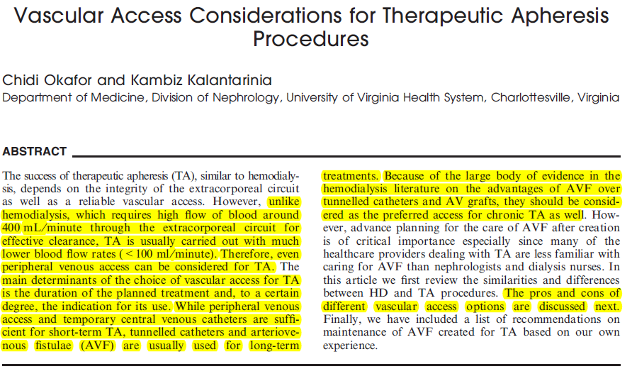
Haemodialysis procedures require a much higher blood flow rate (around 300ml/min) compared to Therapeutic apheresis procedures (50-100ml/min) ⁽¹⁾
Gauge of needle smaller than those required in haemodialysis and can be of particular importance for smaller patients & paediatrics ⁽¹⁾
Haemodialysis patients as a group tend to have more comorbidities ⁽¹⁾
(1) Okafor C, Kalantarinia ; Vascular access considerations for therapeutic apheresis procedures. Seminars Dialysis, 2012; 25:140-4

Slide 4
Common Vascular Access Options
Peripheral Access: The most commonly used veins for Therapeutic Apheresis procedures are the antecubital veins ⁽³⁾
Central Venous Access: Non-Tunneled or Tunneled⁽³⁾
AVF of AVG: Connecting a native artery to a vein most often in the upper extremity⁽⁵⁾
U/S guided deep veinous access: Deep brachial cannulation offers an alternative of obtaining IV access ⁽⁴⁾
Venous Access ports: The port has been a welcome alternative for some chronic apheresis procedures ⁽⁶⁾
(3)Kalantari K; The choice of vascular access for therapeutic apheresis; Journal of Clinical Apheresis; 2012,27:153-9
(4)Wang R, Snoey E, Frazee B; Ultrasound-Guided Deep Brachial and Basilic Vein Cannulation in the Emergency Department; Western Journal of Emergency care with Population Health; 2005, 6(2)38
(5)Spergel LM, Ravani P, Roy-Chaudhury P, Besarab A; Autogenous arteriovenous fistula options; Journal of Nephrology; 2007; 20: 288-298
(6)Barbetakis N, Asteriou C, Kleontas A, Tsilikas C. Totally implantable central venous access ports. Analysis of 700 cases. Journal of Surgical Oncology; 2011; 104:654-656

Slide 5
*Noseworthy J. H. The Canadian Cooperative Multiple Sclerosis Study Group. Transfusion 1989; 29:610 - 613
Long – term use of Antecubital veins for TPE
Patients n= 294
Weekly TPE for up to 20 weeks
Total TPE sessions = 1207
Result:
79.3 % of all TPE procedure required no interventions related to vascular access
5.4 % procedures were terminated prematurely due to inadequate vascular access
Conclusion:
Our experience suggests that it is possible to use only upper limb veins for venous
access in the majority of ambulatory patients requiring long – term plasma exchange.

Slide 6
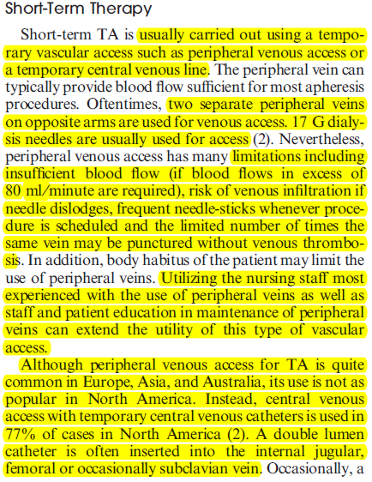
Short term Therapy
Carried out using a temporary vascular access such as peripheral venous access or a temporary central venous line ⁽¹⁾
Treatment usually days to weeks
Long term Therapy
In certain situations, apheresis is required for months or even years
Creation of a permanent vascular access becomes more favorable in these situations ⁽¹⁾
1.Okafor C, Kalantarinia ; Vascular access considerations for therapeutic apheresis procedures. Seminars Dialysis, 2012; 25:140-4

Slide 8
Kalantari (2012), suggested that several factors should be considered to determine which type of vascular access should be used⁽³⁾
Indication, duration and availability of suitable peripheral veins. Consider large peripheral veins as the first choice for VA
Non-tunneled catheters for relatively short-term (5-7) treatments
Ports and tunneled catheters should be considered because of lower rates of infections
AVG and AVF would be the preferred options if TA is being considered for several years
(3) Kalantari K; The choice of vascular access for therapeutic apheresis; Journal of Clinical Apheresis; 2012,27:153-9

Slide 9
AV Fistula in Therapeutic Apheresis
AVF should only be considered for those who require treatment for years or in some cases life-long
Although the evidence on the advantages of AVF over other forms of long term VA is based on the studies conducted in the HD population, it would be reasonable to consider this native option as the preferred option for TA patients over CVC or AV grafts⁽³⁾
Kalantari (2012) suggested that care should be undertaken by the appropriately trained nursing staff, patient education and regular vascular surgeon input & assessment⁽³⁾
(3) Kalantari K; The choice of vascular access for therapeutic apheresis; Journal of Clinical Apheresis; 2012,27:153-9

Slide 10
Ultrasound guided deep veins cannulation
Pros
Cons
Solution to compromised venous access
Can be used immediately after insertion
Adequate blood flow rates
Short term solution
Risk of infection
Effect on quality of life / mobility
Maintenance / heparin packing and dressing
Risk of venous stenosis
Risk of pneunothorax

Slide 11
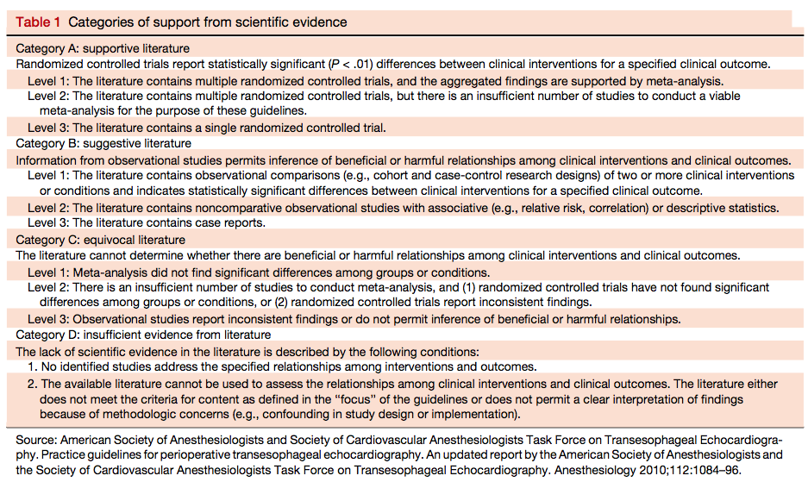
Ultrasound guided deep veins cannulation
Recommendations of the American Society of Echocardiography and the Society of
Cardiovascular Anesthesiologists (8)(Troianos et al;2011) included:
Use real-time ultrasound during IJ cannulation to reduce the incidence of complications
Use of real-time ultrasound for the cannulation of the IJ and FV in paediatric patients
Obese and coagulopathic patients should have ultrasound screening of the SC vein before attempted cannulation to identify vessel location and patency
Understand the limitations of the ultrasound-guided technique

Slide 12
Ports
Conventional Ports:
Have cylindrical geometry with square corners at the base and septum and an exit stem placed perpendicularly to the chamber. This design results in dead spaces behind the needle and in corners
Vortex Ports:
Have elliptical geometry with no internal corners and the exit placed tangentially to the chamber. Dead space is virtually eliminated regardless of needle position or orientation

Slide 13
Vortex Ports vs conventional ports
PROS
CONS
Decrease risk of infection
Minimal effect on patients self
esteem/quality of life/mobility
Fewer blood flow problems
Supports adequate blood flow rates for phototherapy
Rated for over 1000 punctures
Risk of infection
Risk of thrombosis
Requires surgery
Discomfort with needle insertion
Maintenance required
Decreased patency without strict heparin protocol
Not supported by manufacturer for apheresis use

Slide 14
Types of vascular access
Peripheral access: Brachial / Antecubital
Ultrasound guided deep veins access
Femoral catheter
Jugular access
Subclavian catheter
Arteriovenous fistula or graft
Ports

Slide 16
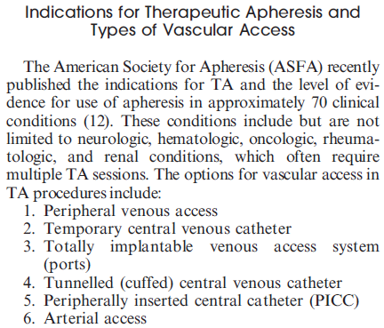

Slide 17
Purpose: Evaluate placement of an 8-F catheter in the basilic vein of children for PBSC collection.
Catheter was placed with imaging-guided percutaneous technique in 15 children for collection of autologous PBSC.
Due to low CD34 positive cell yield per kg in two of the larger patients (77 and 56 kg), they decide to increase the size and length of the apheresis catheter. 8-F catheter in the right arm was exchanged for a 12.5-F 32-cm-long silicone catheter. There were no complications related to the 15 original placement procedures and the two subsequent catheter revisions.
A total of 46 sessions of apheresis were necessary for PBSC collection. The mean sustained maximum flow rate was 60 mL/min . There were a total of 54 catheter days. No signs or symptoms of arm or neck swelling were reported, and there was no decrease in catheter function to suggest clot formation or decreased venous inflow.
The flow rates achieved with peripherally placed apheresis catheters compared favorably with rates for those placed surgically from internal jugular or subclavian sites.
Our experience with the 8-F central catheter placed from a peripheral approach suggests that it can be successfully and safely used in patients older than 8 years who weigh at least 30 kg
There were no immediate or long term complications. This is a low morbidity procedure requiring minimal sedation that results in successful collection of peripheral blood stem cells and allows flow rates comparable to those with surgically placed central catheters.

Slide 18
The choice of VA for TA depends partly on the indication, the anticipated duration of treatment, and availability of suitable peripheral veins.
If large peripheral veins are available, they should be considered as the first choice for VA.
Other options for vascular access (VA) include central venous catheters (temporary or tunneled), totally implantable ports, and arteriovenous fistulae (AVF) or grafts (AVG).
Nontunneled catheters should be considered as the choice of VA for relatively short-term (5-7) treatments mainly in the inpatient settings.
For long-term treatments, ports and tunneled catheters should be considered because of lower rates of infections compared to nontunneled catheters.
If TA is being considered for several years, AVG and AVF would be the preferred options of VA. Studies in HemoDialysis (HD) population indicate far better outcomes with the use of AVF as compared to AVG.
if AVF is considered for TA, special preparations should be considered in advance. Specific considerations, slightly different than those recommended for HD, are required for the care of AVF for chronic TA. These changes are required mainly because of the differences in the frequency of TA when compared with HD treatments, blood flows required for these procedures and the physicians in charge of patient care.

Slide 20
Inpatient costs, mortality and 30-day re-admission in patients with central-line-associated bloodstream infections. Stevens et al., Clin Microbiol Infect 2014; 20: O318–O324
Previous reports suggest central-line associated bloodstream infection (CLABSI) associated with increased costs and mortality.
No studies have assessed both total and variable costs, and data on outcomes outside of the intensive-care unit (ICU) is rare.
This paper describes the excess in-hospital mortality and costs attributable to CLABSI in both ICU and non-ICU patients.
Retrospective cohort and cost-of-illness reported (from a hospital perspective) of 398 patients in a tertiary-care academic hospital over 3 years (Jan 08 – Dec 10). All CLABSI patients and a simple random sample drawn from a list of all central lines inserted during the timeframe were included.
Patients with CLABSI (both ICU and non-ICU) costs were c. $32k higher on average than for patients without CLABSI (Costs adjusted to 2010 US $ date).
Once data was controlled for severity of illness and other healthcare-associated infections, CLABSI was associated with a 2.27-fold increased risk of mortality.
Other healthcare-associated infections were also significantly associated with greater costs and mortality. (N.B. Highlighting the fact that if you have a central/femoral line inserted you invariably have overnight hospital stays. Peripheral venous access will reduce this).
Overall, CLABSI was associated with significantly higher adjusted in-hospital mortality and total and variable costs than those for patients without CLABSI.

Slide 21
Guidelines for Performing Ultrasound Guided Vascular Cannulation: Recommendations of the American Society of Echocardiography and the Society of Cardiovascular Anesthesiologists. Troianos et al., J Am Soc Echocardiogr 2011;24:1291-318
Review of recommended use of ultrasound for the placement of all central venous catheters – to improve patient care
Recommendations are made for ultrasound-guided central venous access of the internal jugular (IJ) vein, subclavian (SC) vein, and femoral vein (FV) on the basis of the strength of the scientific evidence present in the literature.
The role of ultrasound for vascular cannulation of paediatric patients is discussed specifically
The use of ultrasound to facilitate arterial cannulation and peripheral venous access is also discussed.
Recommendations are made for training, including the role of simulation.

Slide 22
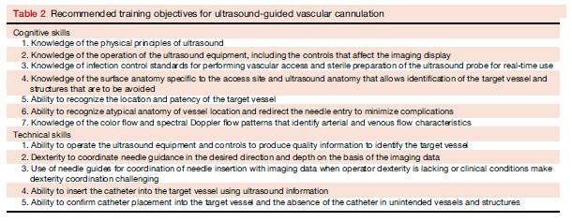
Troianos et al., J Am Soc Echocardiogr 2011;24:1291-318 continued
Recommendations:
Use real-time ultrasound during IJ cannulation whenever possible to improve cannulation success and reduce the incidence of complications associated with the insertion of large-bore catheters.
Use of real-time ultrasound for the cannulation of the IJ and FV in paediatric patients.
Obese and coagulopathic patients should have ultrasound screening of the SC vein before attempted cannulation to identify vessel location and patency.
If real-time ultrasound is not used as the initial technique for SC vein cannulation, it should be used as a rescue device.
Understand the limitations of the ultrasound-guided technique.

Slide 23
Complications of Central Venous Catheterization – Kusminsky., J Am Coll Surg Vol. 204, No. 4, 2007
Complications associated with CVC use important
Efforts to minimize and prevent their occurrence should be a routine element of quality improvement programs.
Emphasis is placed on the growing body of information that supports the use of UAI as a superior technique to decrease adverse events (from a clinical and practical point of view).
CVC complications are best classified as secondary to insertion, indwelling, and extraction practices.
Femoral catheterization has a higher incidence of mechanical complications than SCV or IJV access.
Associated with severe injury if an inadvertent femoral artery puncture is too high and is followed by anticoagulation.
IJV and SCV catheterization carry similar risks of mechanical complications, although IJV insertion has been reported to have a higher incidence of mechanical complications than SCV in elective and emergency situations
UAI of CVCs supporting its adoption continues to expand.
There is now abundant evidence to establish UAI as the safest method to prevent or decrease overall and specific complications of insertion.
Reports of the advantages of ultrasonography over the anatomic landmark method support the findings of risk reduction & improved cannulation success for all access sites in adults and children & in different settings.
Notes:
Abbreviations and Acronyms
CVC central venous catheter
FV femoral vein
IJV internal jugular vein
SCV subclavian vein
UAI ultrasonography-assisted insertion

Slide 24
Summary of peripheral access
Pros
Decreased risk of infection
Minimally invasive
Removed at conclusion of each treatment
Cons
Limited mobility during procedure but not with Single Needle option
Patient must have adequate antecubital veins

Slide 25
Central venous catheter
Pros
Solution to compromised venous access
Can be used immediately after insertion
Adequate blood flow rates
Cons
Short term solution
Risk of infection
Affect on quality of life / mobility
Maintenance / heparin packing and dressing
Risk of venous stenosis
Risk of pneunothorax

Slide 26
Risk of recirculation
Recirculation
Some recirculation or mixing can occur with all dual-lumen catheters.
Increases if ports are switched, catheter tip is cut, or vein is small.
VEIN WALL
BLOOD FLOW
Notes:
Increased recirculation may occur when the ports are reversed or if the total blood flow is reduced within the vessel for any reason, such as development of thrombus, or of a fibrin sheath and/or tail on the tip of the catheter.
When the ports are reversed, recirculation may be 20% of total flow, depending on the size and style of catheter, machine flow rates, and blood flow in the vein being used.
If, at the start of the procedure, the return saline is observed entering the draw line (clear or dilute input line), or if an RBC interface fails to develop, recirculation is the most likely explanation.

Slide 28
Catheter complications
Bleeding (0.5%), infection (0.1%), thrombosis (Stegmayr 2003).
Experience matters (nephrologist, interventional radiologist, intensivist, surgeon)
Catheter: Peripheral veins 1:1 Europe,
4:1 North America (Malchesky 2007)

Slide 29
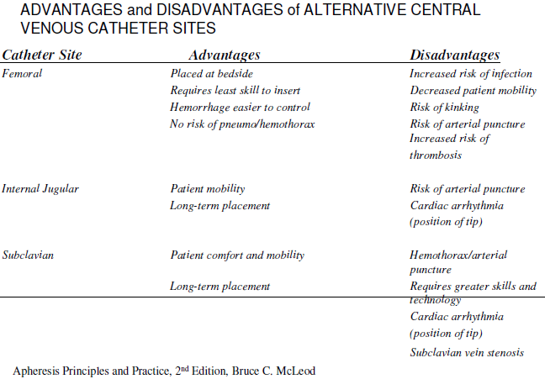

Slide 30
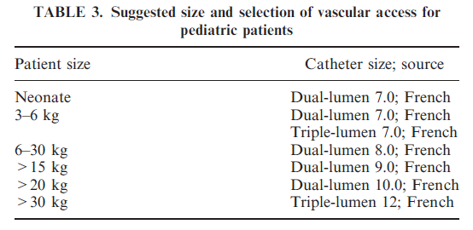
Vascular Access for pediatric Apheresis*
Apheresis Priciples & Practices – McLeod 2nd edition 2003

Slide 33
Incidence of adverse events during apheresis
World apheresis registry 2003-2007 (Stegmayr 2008):
- 12,448 procedures in 2,013 patients, of whom 838 were undergoing TPE (7:1 centrifuge: filtration)
AEs in 5.7% of procedures.
- 29% vascular access problems
- 20% paresthesia (citrate related)
- 18% hypotension
- 9% urticaria
Hypotension, fever/chills more common with filtration (Malchesky 2007, data from Asia)

Slide 34
References
Okafor C, Kalantarinia ; Vascular access considerations for therapeutic apheresis procedures. Seminars Dialysis, 2012; 25:140-4.
Noseworthy JH, Shumak KH, Vandervoort MK; Long Term use of antecubital veins for plasma exchange. The Canadian Cooperative Multiple Sclerosis Study group; Transfusion;1989; 29:610-13
Kalantari K; The choice of vascular access for therapeutic apheresis; Journal of Clinical Apheresis; 2012,27:153-9
Wang R, Snoey E, Frazee B; Ultrasound-Guided Deep Brachial and Basilic Vein Cannulation in the Emergency Department; Western Journal of Emergency care with Population Health; 2005, 6(2)38
Spergel LM, Ravani P, Roy-Chaudhury P, Besarab A; Autogenous arteriovenous fistula options; Journal of Nephrology; 2007; 20: 288-298
Barbetakis N, Asteriou C, Kleontas A, Tsilikas C. Totally implantable central venous access ports. Analysis of 700 cases. Journal of Surgical Oncology; 2011; 104:654-656
Linz W; Principles of Apheresis Technology 5th Edition; American Society for Apheresis; 2014; Vancouver
Troianos CA, Hartman GS, Glas KE et al. Guidelines for Performing Ultrasound Guided Vascular Cannulation: Recommendations of the American Society of Echocardiography and the Society of Cardiovascular Anesthesiologists. Journal of American Society of Echocardiography 2011;24:1291-318

Slide 35
Thanks for your attention

Slide 36
Thank you for participating

