Slide 1
Salvage chemotherapy in the treatment of pediatric refractory multifocal langerhans cell histiocytosis with the Japan langerhans cell histiocytosis study Group-96 Protocol: Results from Tabriz Children Hospital
Amirataollah Hiradfar, MD
Pediatric Health Research Center
Pediatric Hematology and Oncology department
Tabriz University of Medical Sciences

Slide 2
Estimates are in the range of 2.6 to 8.9 cases per million per year for children younger than 15 years, corresponding to roughly one tenth the incidence of acute leukemia in childhood.
LCH occurs in people of all races and all ages.
Although the peak age at diagnosis is 2 years.
Several studies have shown a slight male predominance.

Slide 3
Risk Organs:
Although the behavior of LCH is unpredictable, it is known that children with disease involving the hematopoietic system or liver are at highest risk for severe illness and death.
Involvement of “risk” organs is defined by the presence of organ dysfunction, such as hematopoietic system, liver, spleen, or lung.

Slide 4
Multifocal Langerhans cell Histiocytosis Risk Groups According to the Histiocyte Society LCH-III Trial
High-risk multisystem patients:
With involvement one or more risk organs
Low-risk multisystem patients:
With multiple organs involved but without
involvement of risk organs

Slide 5
No consensus exists for the optimal therapy for Langerhans cell histiocytosis, particularly in the case of multisystem organ disease.
However, there are a number of prospective, randomized control trials to study the effect of various chemotherapeutic regimens in the treatment of LCH.

Slide 6
Clinical Trials in LCH
Study group | Age group eligible | No. of pts | Initial Chemotherapy drugs and duration | *Primary response | Reactivation/ non-responders | Event-free survival at 5y+ | Mortality rate (overall)
DAL-HX 83 | ≤15 y | 78 | Prednisolone +etoposide + Vinblastine For 6 weeks | Low-risk 91% High-risk67% | Low-risk 23% / 0 % High-risk 42%/20% | Low-risk 77% High-risk 38% | 9%
DAL-HX 90 | ≤ 15 y | 63 | Prednisolone +etoposide + Vinblastine For 6 weeks | Low-risk 86% High-risk79% | Low-risk 26% / 0% High-risk 30%/14% | Low-risk 77% High-risk 35% | 9%
LCH-I | ≤ 15 y | 143 | Prednisolone +etoposide or Vinblastine for 24 weeks | Low-risk 69% High-risk58% | Low-risk 58% / ? High-risk 61%/20% | Low-risk ? High-risk 10 % | 8%
LCH-II | ≤ 15 y | 193 | Prednisolone + Vinblastine +mercaptopurine ±etoposide For 24 weeks | Low-risk 71% High-risk63% | Low-risk 52% / 0% High-risk 55%/12% | Low-risk 80% High-risk 27% | 8%
LCH-III | ≤ 15 y | > 400 | Prednisolone + Vinblastine + methotrexate For 6 weeks | Low-risk 71% High-risk63% | Low-risk 27% / 0% High-risk 37%/12% | Low-risk 84% High-risk 26% | 12%

Slide 7
Response to initial therapy appears to be a reliable prognostic predictor. Compared to the published international LCH clinical tials, more intensive initial treatment comes better outcome in non-responders.
Lack of response at 6 weeks was associated with an increased likelihood of treatment failure and a worse prognosis.

Slide 8
The best prognosis has been associated with effective and dramatic initial response to three agents (prednisolone and vinblastine plus methetrexate).
It is clearly associated with young age, because more than half of children younger than 2 years manifest risk organ involvement.

Slide 9
Reactivation Disease:
► Some children experience LCH reactivation after initial improvement or resolution of their disease.
► Most reactivations occur within 1 year of diagnosis, and almost all develop within 2 years.
Refractory Disease:
is considered as a failure to initial standard 6 weeks chemotherapy with prednisolone, vinblastine, and methotrexate according to LCH-III study.

Slide 10
Treatment of refractory multifocal LCH
LCH-S-98, a prospective, phase II Histiocyte Society study evaluated 2-chlorodeoxyadenosine (2-CdA) as salvage monotherapy for patirnts with risk-organ involovement refractory to initial therapy with three agents (excluding 2-CdA) or patients with recurrent, low-risk LCH.
Combination therapy with 2-CdA and cytosine arabinoside (ARA-C) has been studied in patients with refractory, risk-organ-positive LCH.

Slide 11
Treatment of refractory multifocal LCH
LCH-IV, an international treatment protocol sponsored by Dana-Farber Cancer Institute for children and adolescents with Langerhans cell histiocytosis is currently recruiting participants.
In this randomized, interventional study, patients who do not respond to standard first-line prednisolone and vinblastine will be switched to the combination of cytosine arabinoside and 2-chlorodeoxyadenosine.

Slide 12
The purpose of this study is to investigate effectiveness of salvage therapy with practical Japan Langerhans cell histiocytosis study Group-96 (JLSG-96) Protocol due to lack of access to 2-chlorodeoxyadenosine (2-CdA) from 2010 to 2015 in Tabriz children hospital.

Slide 13
Risk Groups According to the Histiocyte Society LCH-III Trial
Group 1—Multisystem “risk” patients:
Multisystem patients with involvement of one or more risk organs (i.e., hematopoietic system, liver, spleen, or lungs)
Group 2—Multisystem “low-risk” patients:
Multisystem patients with multiple organs involved but without involvement of risk organs
Group 3—Single-system “multifocal bone disease” or localized “special site” involvement
Patients with multifocal bone disease, that is, lesions in two or more different bones or patients with localized special site involvement, such as lesions with intracranial soft-tissue extension or vertebral lesions with intraspinal soft-tissue extension

Slide 14
*Derenzini E, Fina MP, Stefoni V, et al. MACOP-B regimen in the treatment of adult Langerhans cell histiocytosis: experience on seven patients. Ann Oncol. 2009 Oct 27.
There are a paucity of clinical trials for treatment of LCH in adults on the use of intensive chemotherapy regimens.
A report by Derenzini and colleagues, 7 adult patients were treated with MACOP-B weekly for 12 weeks.*
In this study, all patients showed a complete response and only 3 patients subsequently had reactivation of their disease.
MACOP-B : Methotrexate, Adriamycin, Cyclophosphamide, Vincristine, Prednisolone, Bleomycin

Slide 15
Salvage chemotherapy based on
Japan Langerhans Cell Histiocytosis Study Group-96 Protocol

Slide 16
Improved Outcome in the Treatment of Pediatric Multifocal Langerhans Cell Histiocytosis: Results from the Japan Langerhans Cell Histiocytosis Study Group-96 Protocol Study
No. of patients with refractory multifocal LCH | Male:female ratio | Age (year) | Follow-up (year) | Involved organs (No. of patients) | No. of patients with risk organ involvement (%) | Response to induction regimen (%) | Outcome and survival (No. of patients)
14/59 | 8/6 | 1.04±3.89 (0.3-15) | 5 (2.8-8.1) | Skin ( 11 ) Bone ( 9 ) Hematopoietic system ( 6 ) Liver/spleen ( 5 ) Lymph nodes ( 5 ) Lungs ( 4 ) Thymus ( 1 ) Pituitary stalk ( 2 ) | 13/14 (90%) | 11/14 (78.5%) | Died = 2 Alive= 12 DI = 1
Cancer, 2006 Aug 1; 107(3): 613-9

Slide 17
Induction phase
ADR, CPM, VCR, and PSL
ADR (35 mg/m² per day IV) on Day 1
CPM (10 mg/kg per day IV) on Days 1–5
VCR (0.05 mg/kg per day IV) on Day 1
PSL (2 mg/kg per day orally) on Days 1–5
Repeated every 2 weeks for totally 3 courses

Slide 18
Maintenance phase
a, b, and c courses
a) ADR, VCR, and PSL:
ADR (35 mg/m² per day IV) on Day 1
VCR (0.05 mg/kg per day IV) on Day1
PSL (2 mg/kg per day orally) on Days 1–5
b) MTX and PSL:
MTX (3 mg/kg per d as a 1-h drip) on Day1
PSL (2 mg/kg per d orally) on Days 1–3
c) CPM, VCR, and PSL:
CPM (10 mg/kg per d IV) on Day 1
VCR (0.05 mg/kg per d IV) on Day1
PSL (2 mg/kg per d orally) on Days 1–5
Alternate every 2 weeks (a,b,c,b,a,b,c,b) for 6 mo

Slide 19
Our study

Slide 20
patient | Age at DX (mo) | Sex (F/M) | Involved organs | Risk groups (LCH-III Trial) | Initial treatment | Long term Sequelae | Event-free survival at 5y+
1 | 36 | F | Skin+Skull+liver+lungs | 1 | LCH-III Study | Lung fibrosis | Dead
2 | 8 | M | Hematopoetic system +lungs+ diarrhea | 1 | LCH-III Study | None | Yes
3 | 11 | M | Skin+Skull+lungs+orbit +seizure | 1 | LCH-III Study | None | Yes
4 | 34 | F | Skin+liver+spleen +Hematopoietic system +pituitary stalk | 1 | LCH-III Study | DI | Yes
5 | 12 | F | Pituitary stalk+skull +vertebra +massive lymphadenopathies | 2 | LCH-III Study | Deformities of spinal | Yes
6 | 17.5 | F | Skin+Orbit+lung+liver +hematopoietic system +Spleen | 1 | LCH-III Study | None | Yes
7 | 37 | M | Skin+Ribs+ pituitary stalk +hematopoietic system | 1 | LCH-III Study | DI | Yes
8 | 41 | M | Ataxia+dysartheria +hydrocephalus+skull +orbit | 2 | LCH-III Study | learning disability | Dead
9 | 9 | M | Skin+Lungs+massive lymphadenopathies+skull | 1 | LCH-III Study | None | Yes
10 | 21.5 | M | Skull+ pituitary stalk +seizure+lungs | 1 | LCH-III Study | Lung fibrosis | Yes

Slide 21
Sex | Age (months) | Risk-organ | High Risk-group | Toxicity | Long-term sequelae | Mortality
Female=4 | 24.88±11.93 (12-36) | ¾ (75%) | 3 patients | Transient hepatic toxicity in three patients | Lung fibrosis (25%) DI (25%) Spinal deformity (25%) | 25%
Male=6 | 21.25±14.62 (8-41) | 5/6 (83.33%) | 5 patients | Transient hepatic toxicity in four patients One patients with transient renal toxicity | Lung fibrosis (17%) DI (17%) Learning disability (17%) | 16.66%
Total=10 | 22.70±13.03 (8-41) | 8/10 (80%) | 8 patients | 8 transient events | 6/10 patients (60%) | 20%

Slide 22
At the median 5-years follow-up, 8 patients have been survived with favorable response status.
2 patients were died with late sequelae (one patient with chronic CNS involvement and the other patient from chronic diffuse lung disease).
The JLSG-96 Protocol has been associated with low mortality and improved outcome in refractory childhood multifocal LCH in this study.

Slide 23
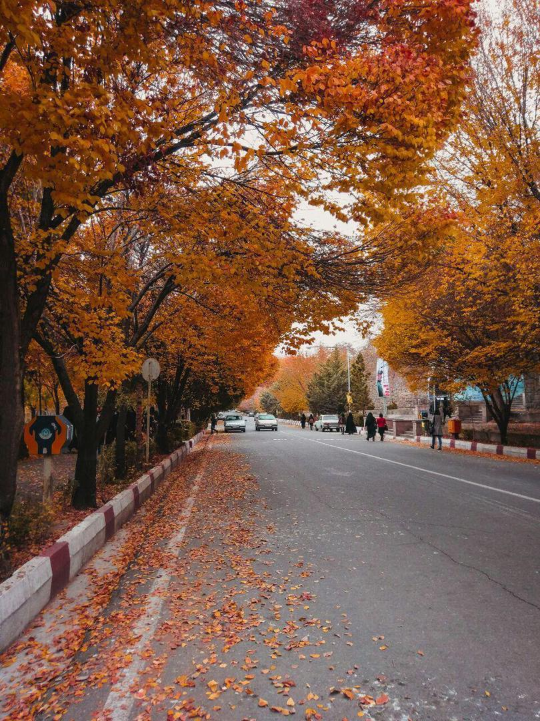
Thank you

