Slide 1
DNA viruses and Langerhans Cell Histiocytosis in Iranian Children
Maliheh Khoddami
Professor of Pathology
Pediatric Pathologist
Pediatric Pathology Research Center, Research Institute for Children’s Heath, Shahid Beheshti University of Medical Sciences, Tehran, Iran

Slide 2
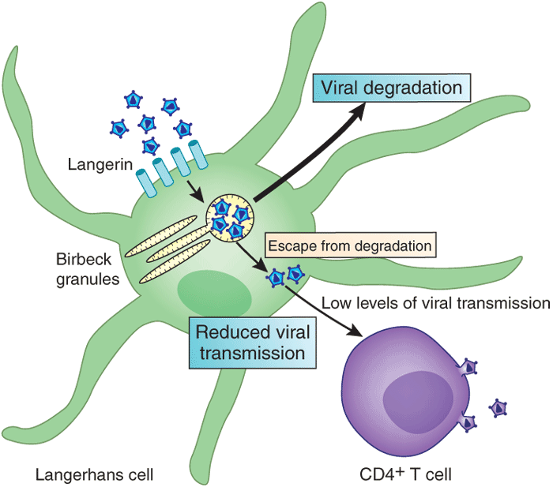
Langerhans cell (LC), a non-lymphoid mononuclear cell, a member of dendritic cell (DC) family, play a role in triggering and shaping immune responses.
LCH is a rare clonal proliferation of LC with unknown etiology.

Slide 3
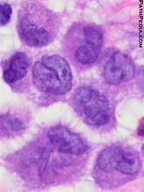
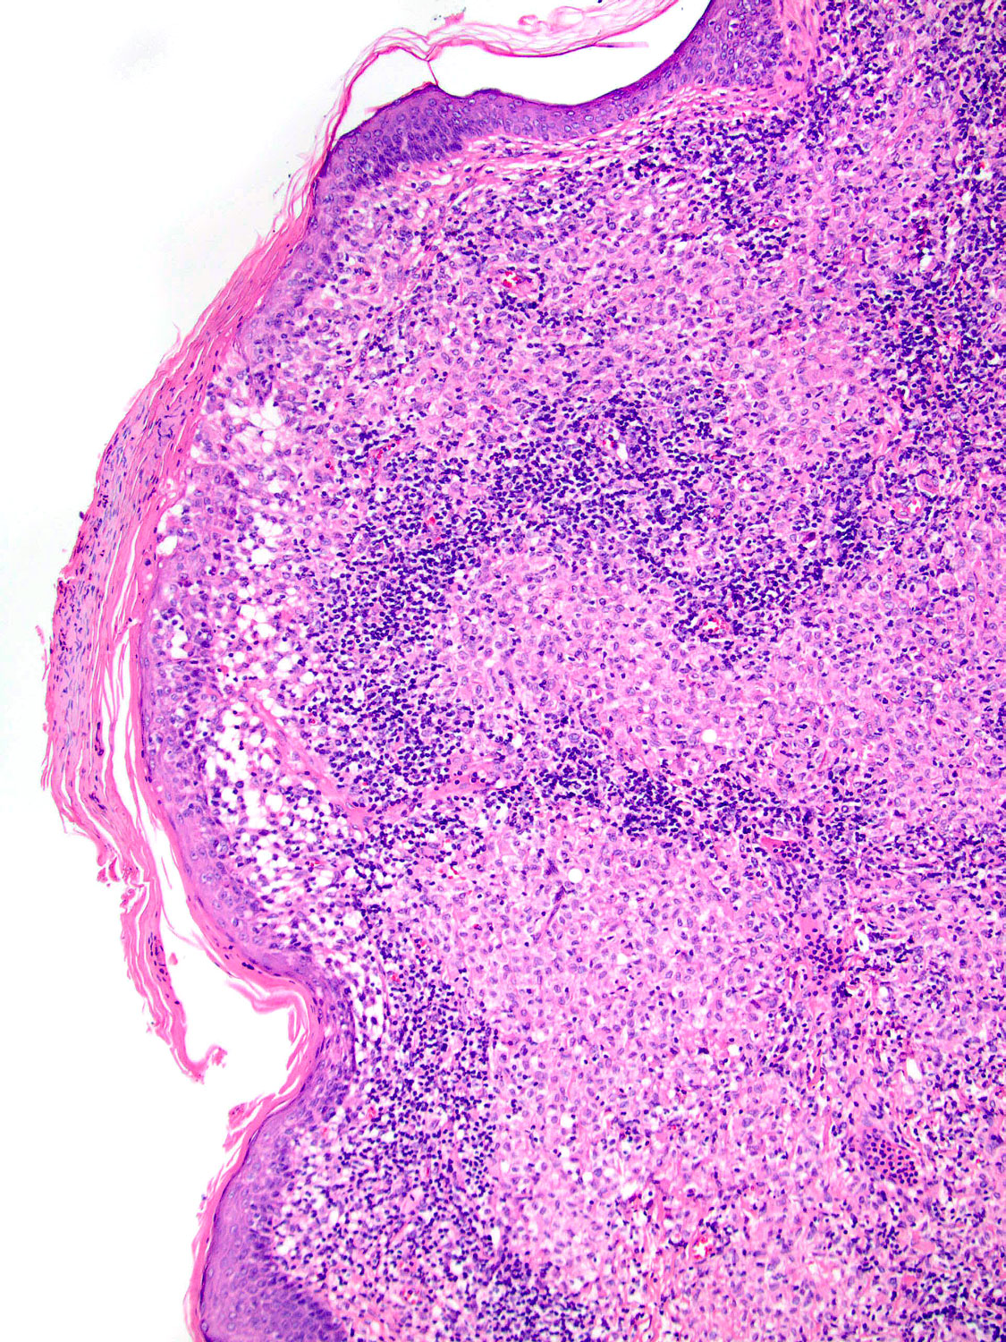
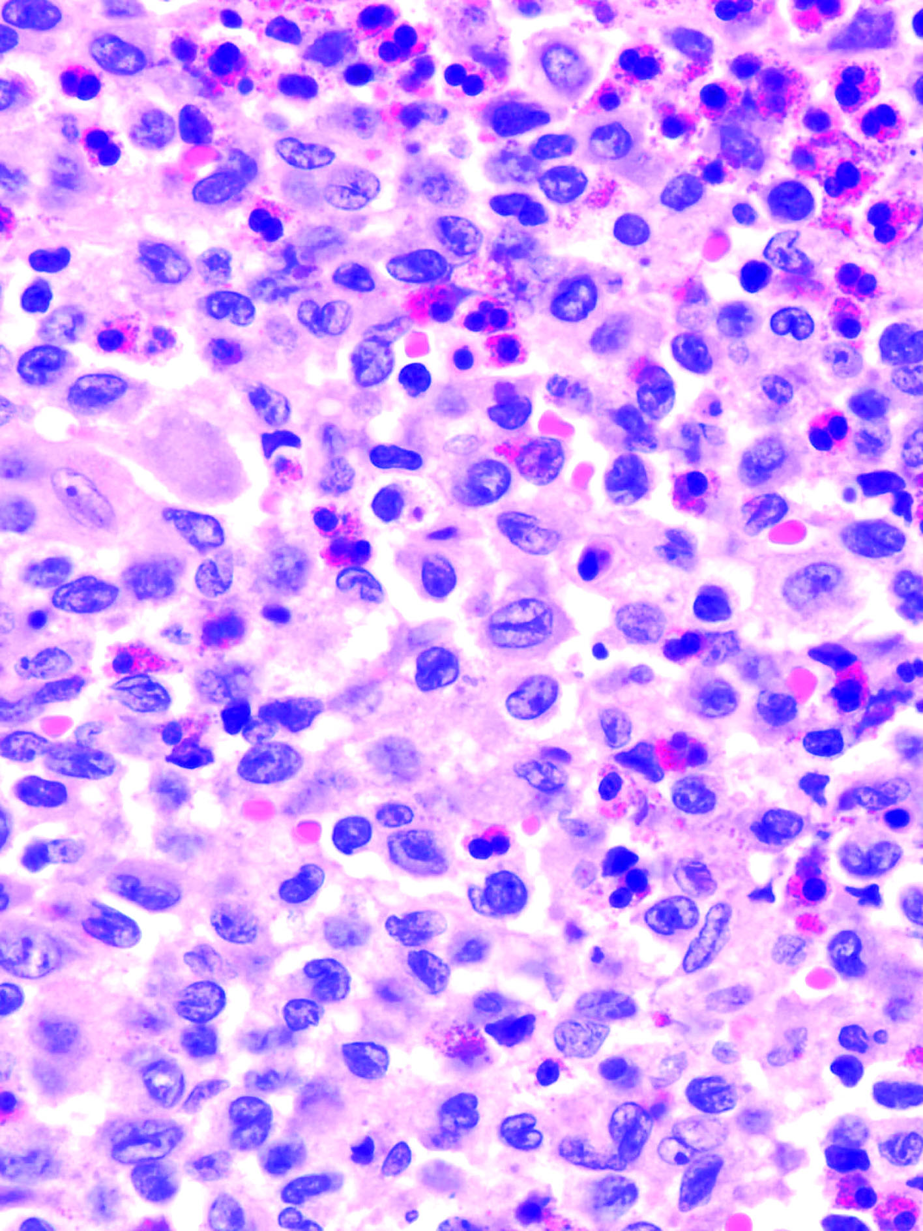
Granulomas with a mixture of Langerhans cells, eosinophils, multinucleated giant cells, macrophages, and lymphocytes

Slide 4
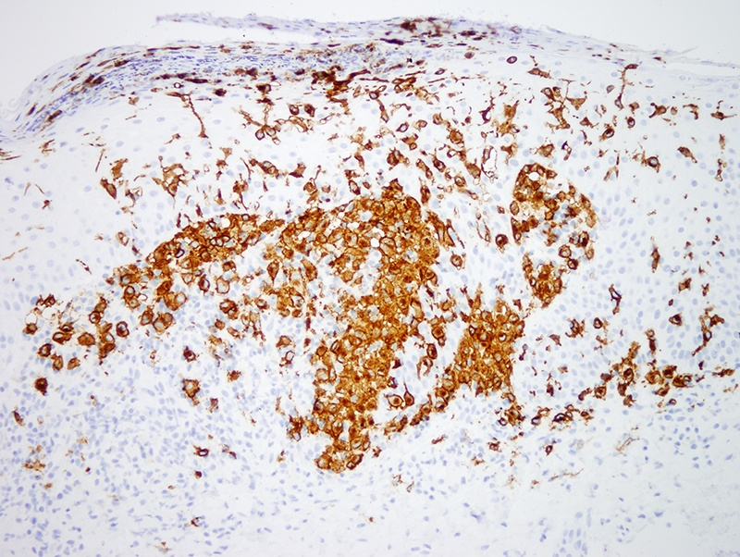
IHC: Immature DCs in LCH are positive for langerin (CD207), lysosomal enzyme CD1a, S-100 protein, and CD68

Slide 5
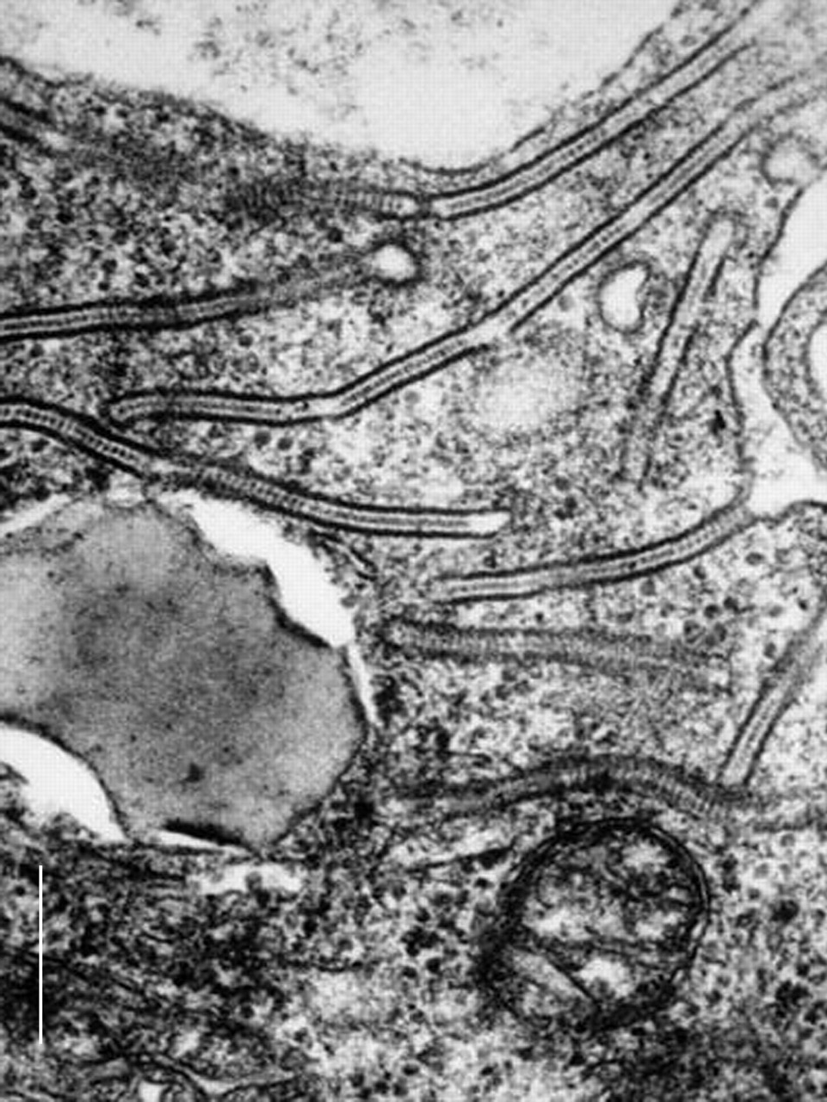
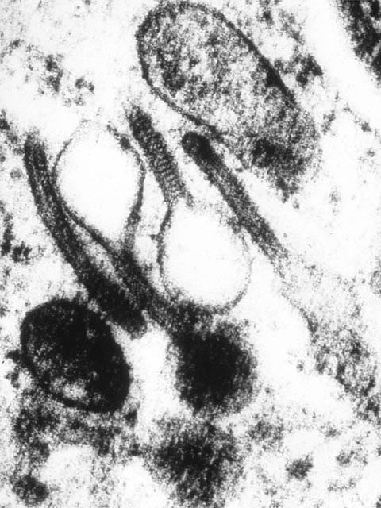
EM: Racket shaped Birbeck granules

Slide 7
Oncogenic viruses cause of about 20% of cancers in humans.
e.g. hepatocellular carcinoma, lymphoma & nasopharyngeal carcinoma, cervical cancer, breast cancer.
Controversial results.

Slide 8
Trials to prevent virus-related malignancies.
Vaccination: preventing viral infections and virus-associated cancers (e.g. HBV and HPV).
Curing virus-related cancers by a multi-dimensional attack: combination of a vaccine with a drug that prevents cancer cells to hide from immune system.

Slide 9
CMV can infect DCs & LCs and EBV infects monocytes & LCs.
EBV &CMV could be responsible in hemophagocytic syndromes in patients with several inherited IDs.
Seeking association between LCH and viruses.

Slide 10
Association of EBV, HHV-6, and CMV with LCH, suggesting possible etiologic role or contribution to pathophysiology.
Others argued against.
The etiologic role of viruses is yet to be determined.

Slide 11
Purpose
An etiologic association between LCH and environmental agents & viruses or vaccination has been suggested.
With convincing evidence, a chance of primary prevention.
No report in Iranian children.

Slide 12
Human herpesvirus-6 (HHV-6) DNA in 48 patients.
Herpes simplex virus (HSV) types 1 and 2, CMV & EBV DNA in 30 patients.
Controls from the Pathology Dept., Mofid Children’s Hospital, Tehran.
Nested-PCR for HHV-6 and HSV types 1 and 2, qualitative PCR method for CMV and qualitative TaqMan RT- PCR for EBV.

Slide 13
All patients Iranian.
Age range: 2 months - 10 years.
48 for HHV6 (24 male and 24 female).
30 for the rest of the viruses (16 male and 14 female).
Control samples: operated for reasons other than infectious diseases (pilonidal disease, anal fissure, dermatitis, hemangioma, cystic hygroma, emphysema, soft tissue cysts, enlarged lymph nodes, osteochondroma, etc.) (between the years 2002 and 2013).

Slide 14
Literature review
Jeziorski et al (2008): against a role for EBV, CMV, or HHV-6 in pathogenesis of LCH.
McClain et al (1994): no adenovirus, CMV, EBV, HSV, HHV-6, HIV, human T-cell leukemia virus types I & II, and parvovirus in 56 cases of LCH by in situ hybridization (ISH) and PCR.

Slide 15
HHV-6
Controversial results.
Leahy et al (1993): HHV-6 identified in 47% of pts by PCR.
Glotzbecker et al (2004): 71% positivity by IHC and ISH methods; no significant difference between 13 patients using qualitative & quantitative RT-PCR compared to control.

Slide 16
HHV6, cont.
Csire and colleagues (2007) introduced an LCH pt in whom HHV-6 was persistently detected through a 17-year follow up, suggesting a probable association with induction or progression of LCH.
Our study: no significant difference between LCH pts & controls (P= 0.11).

Slide 17
CMV (Human Herpes virus-5)
Kawakubo et al (1999): positive in 30% of 29 pts using IHC, ISH & PCR, might indicate that cytokines release could stimulate LC proliferation & provoke LCH.
CMV DNA detected in two (6.66%) of our pts and the P value of 1.00 (1.00>0.05) is in keeping with the negative results in the literature.

Slide 18
HSV
HSV1 associated with prostate cancer, melanoma and cervical cancer and detected in benign and malignant thyroid tumors.
No positive results reported in LCH in the literature (in 3 studies, 1993-1994).
Our results: failed to detect HSV type 1 and 2 DNA in any of LCH pts or controls.

Slide 19
EBV (Human Herpes virus -4)
EBV is known to be responsible in several malignancies and Herpes viruses are shown to have a role in persistent infection.
Sakata et al 2008, Chen et al 2004, Shimakage et al 2004 : possible etiologic function or contribution of EBV to the pathophysiology of LCH.
Our results: EBV DNA in 19 (63.33%) pts with a P value of 0.004 (0.004<0.05).

Slide 20
Other techniques not available to confirm the presence of EBV in the LCs; the etiologic position can’t be proved definitively.
The positive results in the literature, in addition to our 63.33% positivity, highly suggest the possible involvement of EBV in induction of LCH.

Slide 21
The results could be of importance; vaccination or an early diagnosis and treatment of EBV infection could likely prevent the emergence of LCH in future.

Slide 22
Variable and controversial results in the literature could be attributed to different sensitivities of the techniques or to geographic variations.

Slide 24
References
1. Lichtenstein L (1953) Histiocytosis X; integration of eosinophilic granuloma of bone, Letterer-Siwe disease, and Schuller-Christian disease as related manifestations of a single nosologic entity. AMA Arch Pathol 56:84–102. PMID:13057466.
2. French Histiocytosis study group (1996) A multicentre retrospective survey of Langerhans’ cell histiocytosis: 348 cases observed between 1983 and 1993. The French Langerhans’ Cell Histiocytosis Study Group. Arch Dis Child 75:17–24. doi:10.1136/adc.75.1.17.
3. Willman CL, Busque L, Griffith B, Favara BE, McClain KL, Duncan MH, Gilliland DG (1994) Langerhans’ cell histiocytosis (histiocytosis X): A clonal proliferative disease. New Engl J Med 331:154-160. PMID: 8008029.
4. Weiss LM (2001) Histiocytic and dendritic cell proliferations. In: Knowles DM (ed) Neoplastic Hematopathology, 2nd edn. Lippincott Williams & Wilkins, Philadelphia, pp 1815-1845.

Slide 25
5. Ladisch S (1998) Langerhans cell histiocytosis. Curr Opin Hematol 5: 54–58. PMID: 9515204.
6. Laman JD, Leenen PJ, Annels NE, Hogendoorn PC, Egeler RM (2003) Langerhans-cell histiocytosis ‘insight into DC biology’. Trends Immunol 24:190–196. PMID: 12697451.
7. Chen CJ, Ho TY, Lu JJ, Sheu LF, Lee SY, Tien CH, Cheng SN (2004) Identical twin brothers concordant for Langerhans’ cell histiocytosis and discordant for Epstein-Barr virus-associated hemophagocytic syndrome. Eur J Pediatr 163:536–539.
8. Sakata N, Toguchi N, Kimura M, Nakayama M, Kawa K, Takemura T (2008) Development of Langerhans cell histiocytosis associated with chronic active Epstein-Barr virus infection. Pediatr Blood Cancer 50:924-927. doi: 10.1002/pbc.21249.

Slide 26
9. Csire M, Mikala G, Jákó J, Masszi T, Jánosi J, Dolgos J, Füle T, Tordai A, Berencsi G, Vályi-Nagy I. (2007) Persistent long-term human herpes virus 6 (HHV-6) infection in a patient with langerhans cell histiocytosis. Pathol Oncol Res13:157-160. PMID: 17607379.
10. Glotzbecker MP, Carpentieri DF, Dormans JP (2004) Langerhans cell histiocytosis: a primary viral infection of bone? Human herpes virus 6 latent protein detected in lymphocytes from tissue of children. J Pediatr Orthop 24:123-129. PMID: 14676546.
11. Leahy MA, Krejci SM, Friednash M, Stockert SS, Wilson H, Huff JC, Weston WL, Brice SL (1993) Human herpes virus 6 is present in lesions of Langerhans cell histiocytosis. J Invest Dermatol 101:642-645. PMID: 8228322.
12. Kawakubo Y, Kishimoto H, Sato Y, Yanagimoto K, Tsuruta T, Yashihiro O, Kameya T (1999) Human cytomegalovirus infection in foci of Langerhans cell histiocytosis. Virchows Arch 434:109–115. PMID: 10071244.

Slide 27
13. Shimakage M, Sasagawa T, Kimura M, Shimakage T, Seto S, Kodama K, Sakamoto H (2004) Expression of Epstein-Barr virus in Langerhans’ cell histiocytosis. Human pathology 35:862-368. PMID: 15257550.
14. Jeziorski E, Senechal B, Molina TJ, Devez F, Leruez-Ville M, Morand P, et al (2008) Herpes-Virus Infection in patients with Langerhans Cell Histiocytosis: A Case-Controlled Sero-Epidemiological Study, and In Situ Analysis. PLoS One 3:e3262. doi: 10.1371/journal.pone.0003262.
15. McClain K, Jin H, Gresik V, Favara B (1994) Langerhans cell histiocytosis: lack of a viral etiology. Am J Hematol 47: 16–20. PMID: 8042610.
16. McClain K, Weiss RA (1994) Viruses and Langerhans Cell Histiocytosis: Is there a Link? Br J Cancer Suppl 70:S34-36. PMCID: PMC2149698.
17. Ashraf MJ, Makarempour A, Monabati A, Azarpira N, Khademi B, Hakimzadeh A, Abedi E, Valibeigi B (2012) Comparison Between Presence of Epstein Barr Virus in Nodal and Extra Nodal Diffuse Large B Cell Lymphoma of Head and Neck, an Iranian Experience. Iran Red Crescent Med J 14:764-770. doi: 10.5812/ircmj.1302.

Slide 28
18. Purtilo D (1980) Epstein-Barr-virus-induced oncogenesis in immune-deficient individuals. The Lancet 315:300-303. doi:10.1016/S0140-6736(80)90792-8.
19. Young LS, Rickinson AB (2004) Epstein–Barr virus: 40 years on. Nature Reviews Cancer 4:757-768. doi:10.1038/nrc452. doi:10.1038/nrc452.
20. Luiz CR, Machado CM, Canto CL, Christ SC, Pestana JO, Kotton CN, Camargo LF (2013) Monitoring for HHV-6 infection after renal transplantation: evaluation of risk factors for sustained viral replication. Transplantation 95:842-846. doi: 10.1097/TP.0b013e3182807ab7.
21. Saiki RK, Bugawan TL, Horn GT, Mullis KB, Erlich HA (1986) Analysis of enzymatically amplified beta-globin and HLA-DQ alpha DNA with allele-specific oligonucleotide probes. Nature 324:163-166. PMID: 3785382.

Slide 29
22. Hernandez AK, Emmons J, Wimmer DB, Payne DA (2008) Cytomegalovirus-Antigenemia-Positive and Polymerase-Chain-Reaction-Negative Transplant Patient. Lab Med 39:341-342.
23. Aurelius E, Johansson B, Sköldenberg B, Forsgren M (1993) Encephalitis in immunocompetent patients due to herpes simplex virus type 1 or 2 as determined by type-specific polymerase chain reaction and antibody assays of cerebrospinal fluid. J Med Virol 39:179-186. PMID: 8385702.
24. Fan H, Kim SC, Chima CO, Israel BF, Lawless KM, Eagan PA, Elmore S, Moore DT, Schichman SA, Swinnen LJ, Gulley ML (2005) Epstein–Barr viral load as a marker of lymphoma in AIDS patients. J Med virol 75:59-69. PMID: 15543571.
25. Berber I, Erkurt MA, Kuku I, Koroglu M, Kaya E, Unlu S (2013) A rare disease in adult: Langerhans cell histiocytosis. World J Oncol 4:165-168. doi: 10.4021/wjon663w.
26. Ninaber M, Dik H, Peters E (2014) Complete pathological resolution of pulmonary langerhans cell histiocytosis. Resp case reports 2:76-78. doi: 10.1002/rcr2.54.

Slide 30
27. Hertel L, Lacaille VG, Strobl H, Mellins ED, Mocarski ES (2003) Susceptibility of immature and mature Langerhans cell-type dendritic cells to infection and immunomodulation by human cytomegalovirus. J Virol 77: 7563–7574. doi: 10.1128/JVI.77.13.000–7563–7574.2003.
28. Lee AW, Hertel L, Louie RK, Burster T, Lacaille V, Pashine A, Abate DA, Mocarski ES, Mellins ED (2006) Human cytomegalovirus alters localization of MHC class II and dendrite morphology in mature Langerhans cells. J Immunol 177:3960–3971. doi: 10.4049/​jimmunol.177.6.3960.
29. Senechal B, Boruchov AM, Reagan JL, Hart DN, Young JW (2004) Infection of mature monocyte-derived dendritic cells with human cytomegalovirus inhibits stimulation of T-cell proliferation via the release of soluble CD83. Blood 103:4207–4215. PMID: 14962896.
30. Tugizov S, Herrera R, Veluppillai P, Greenspan J, Greenspan D, Palefsky JM (2007) Epstein-Barr virus (EBV)-infected monocytes facilitate dissemination of EBV within the oral mucosal epithelium. J Virol 81:5484-5496. PMID: 17376918.
31. Walling DM, Ray AJ, Nichols JE, Flaitz CM, Nichols CM (2007) Epstein-Barr virus infection of Langerhans cell precursors as a mechanism of oral epithelial entry, persistence, and reactivation. J Virol 81:7249-7268. doi:10.1128/JVI.02754-06. doi:10.1128/JVI.02754-06.

Slide 32
Statistical considerations
Chi-Square (or Fisher’s exact test if appropriate).
P˂0.05 indicated statistical significance.

Slide 33
Limitations of our study
IHC and ISH techniques were not available and the patients were not checked for evidence of these infections serologically.

Slide 34
LCH patients with positive result for EBV presence included 11 male and 8 female patients.
Positivity in LN (1), mediastinal & neck mass (1), soft tissue (4), bone (7), skin (5), lung (1)

Slide 35
This study was financially supported by the Pediatric Infections Research Center, Shahid Beheshti University of Medical Sciences, Tehran, Iran.

