Slide 1
Current SCD therapies and the role of Automated RBC Exchange: A review of recent literature & guidelines.
Najib Khalife, MD
Medical Affairs, Terumo BCT, Belgium
Notes:
Günaydın = Good morning

Slide 2
Disclaimer
This presentation was prepared by, and is being presented to you by the Terumo BCT Medical Affairs Department. The aim of this presentation is to provide accurate medical, scientific or clinical information as a fair balanced review of the titled subject matter. The presentation is not intended to be promotional, to provide medical advice or advise on the practice of medicine.

Slide 3
Presentation overview:
      Review of current therapies in management of SCD complications
      Update on recent ASFA 2016 guidelines for RBCx and NICE Guidance.

Slide 4
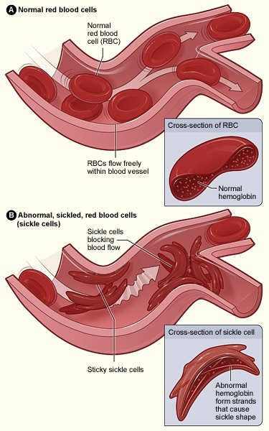
Sickle Cell Disease: Complications
Many SCD complications (acute chest syndrome & stroke,) are due to the obstruction of small vessels by the abnormally shaped RBCs:
Lack of tissue oxygenation (ischemia) can cause painful crises, damage to body organs and even death
    Elevated HbS levels correlate with increased blood viscosity,¹ which can decrease blood flow and oxygen transport
    Other complications (anemia) have to do with the premature destruction of the abnormal RBCs in the spleen
    All the above mentioned complications among others, impose a disease burden and challenges that impact the patients, their families, & the Health Care Providers.
There are also evidence of:
1. Platelet & Endothelial Cell Activation
2. Increased Thrombin Generation
3. Increased levels of Tissue Factor
4. Increased plasma markers of coagulation
5. SS RBC adhesion to activated Endothelial Cells
6. Activation markers that correlate with RBC hemolysis
4
Hilliard L, et al., “Erythrocytapheresis Limits Iron Accumulation in Chronically Transfused SCD Patients.” Am J Hematol 1998; 59: 28-35.
Boga et al, Transfusion & Apheresis Science 2010
Notes:
The obstruction of small blood vessels by sickled, sticky RBCs, is responsible for many of the SCD complications. These complications include pain crisis, acute chest syndrome and stroke. All of these complications can cause tissue ischemia (lack of oxygen in the tissues).
Additionally, the continuous destruction of sickled RBCs in the spleen, that happens faster than the bone marrow can make new RBCs. This destruction frequently causes SCD patients to be chronically anemic [low hemoglobin (Hb) levels].

Slide 5

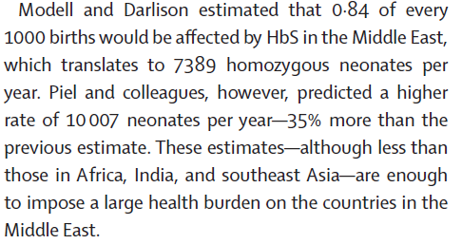
Epidemiology
Confidential - Internal Use Only - Do Not Distribute

Slide 6
Clinical syndromes
Disease Severity is Genotype–Dependent
Hgb SS
Hgb S / β⁰ thalassemia
Hgb SC
Hgb S / α thalassemia
Hgb S / D
Hgb S / A
Hgb S / E
Hgb S / β⁺ thalassemia
Hgb S / HPFH
Worsening Disease
Severity
Asymptomatic
+ / - Mild Anemia

Slide 7
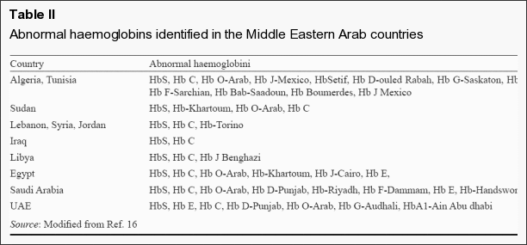
Al Hazmi et al, Indian J Med Res. 2011 November; 134(5): 597–610.
Confidential - Internal Use Only - Do Not Distribute

Slide 8
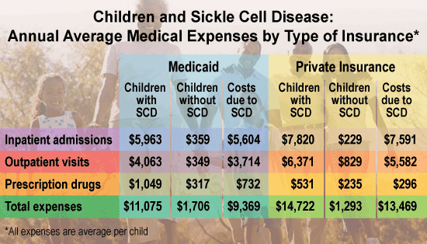
Social & Economic Burden of SCD
During 2005, medical expenditures for children with SCD averaged $11,702 for children with Medicaid coverage and $14,772 for children with employer-sponsored insurance. About 40% of both groups had at least one hospital stay
An average of 75,000 hospitalizations per year due to SCD occur in the United States, costing approximately $475 million.
Notes:
PI

Slide 9
Sickle Cell Disease: Patient Treatment Options
Hydroxyurea
      Stimulates the production of hemoglobin F (HbF). By 5-15 %.
      HbF inhibits the sickling of RBCs containing HbS naturally in the fetus and infants
      Transfusion Therapy (iron chelation therapy may be required)
    Simple transfusion: infusion of normal RBCs (HbA), without removal of HbS
    Red Blood Cell Exchange (erythrocytapheresis): removes “defective” RBCs while infusing healthy RBCs
      Automated – “simultaneous” removal and infusion of RBCs
      Manual – “sequential” removal and infusion of RBCs
Stem cell transplantation
      Only known potential cure for sickle cell disease¹
1. Krishnamurti L, et al., “Stable Long-Term Donor Engraftment following Reduced-Intensity Hematopoietic Cell Transplantation for Sickle Cell Disease.” Blood Marrow Transplant 2008; 14: 1270-1278.
9
Notes:
Treatment goals for sickle cell disease aim to relieve pain, prevent further complications and decrease mortality.
Hydroxyurea is a drug that reduces the severity of sickle cell disease by stimulating production of HbF.
Hemoglobin F (HbF), also called fetal hemoglobin, is the form of hemoglobin present in the fetus and small infants. Fetal hemoglobin is able to inhibit the sickling of RBCs containing HbS. Because of this, infants with sickle cell disease do not develop symptoms of the illness until later in life when HbF levels have dropped.
Hydroxyurea is recommended as frontline therapy to treat adults and adolescents with SCD that meet specific criteria.
It is taken daily by mouth and can be taken indefinitely. Not all patients respond to hydroxyurea, and the best candidates for the treatment are not yet clear.
If hydroxyurea treatment fails, patients are typically transitioned to some form of transfusion therapy (simple, manual exchange or automated exchange).
Transfusion therapy is another patient treatment option. In some cases, iron chelation therapy is required to manage iron overload. Chelation describes the way that molecules bind to metal ions, like iron in this case. Basically chelation removes excess iron accumulation in the tissues and organs.
Simple transfusion involves the infusion of RBCs and lowers the percentage of HbS by dilution therefore does not decrease the total amount of HbS in a patient.
Exchange transfusion involves removing a patient's blood and exchanging with donor RBCs. The process is used to decrease HgS levels, restore desired hemoglobin levels and increase oxygen-carrying capacity. Exchange transfusion can be performed manually or with automated systems such as the Spectra Optia system
Stem cell transplantation is the only potential cure, however it is used in only a small number of cases as few patients are able to find matched donors, or not eligible because of age or status of the disease.

Slide 10
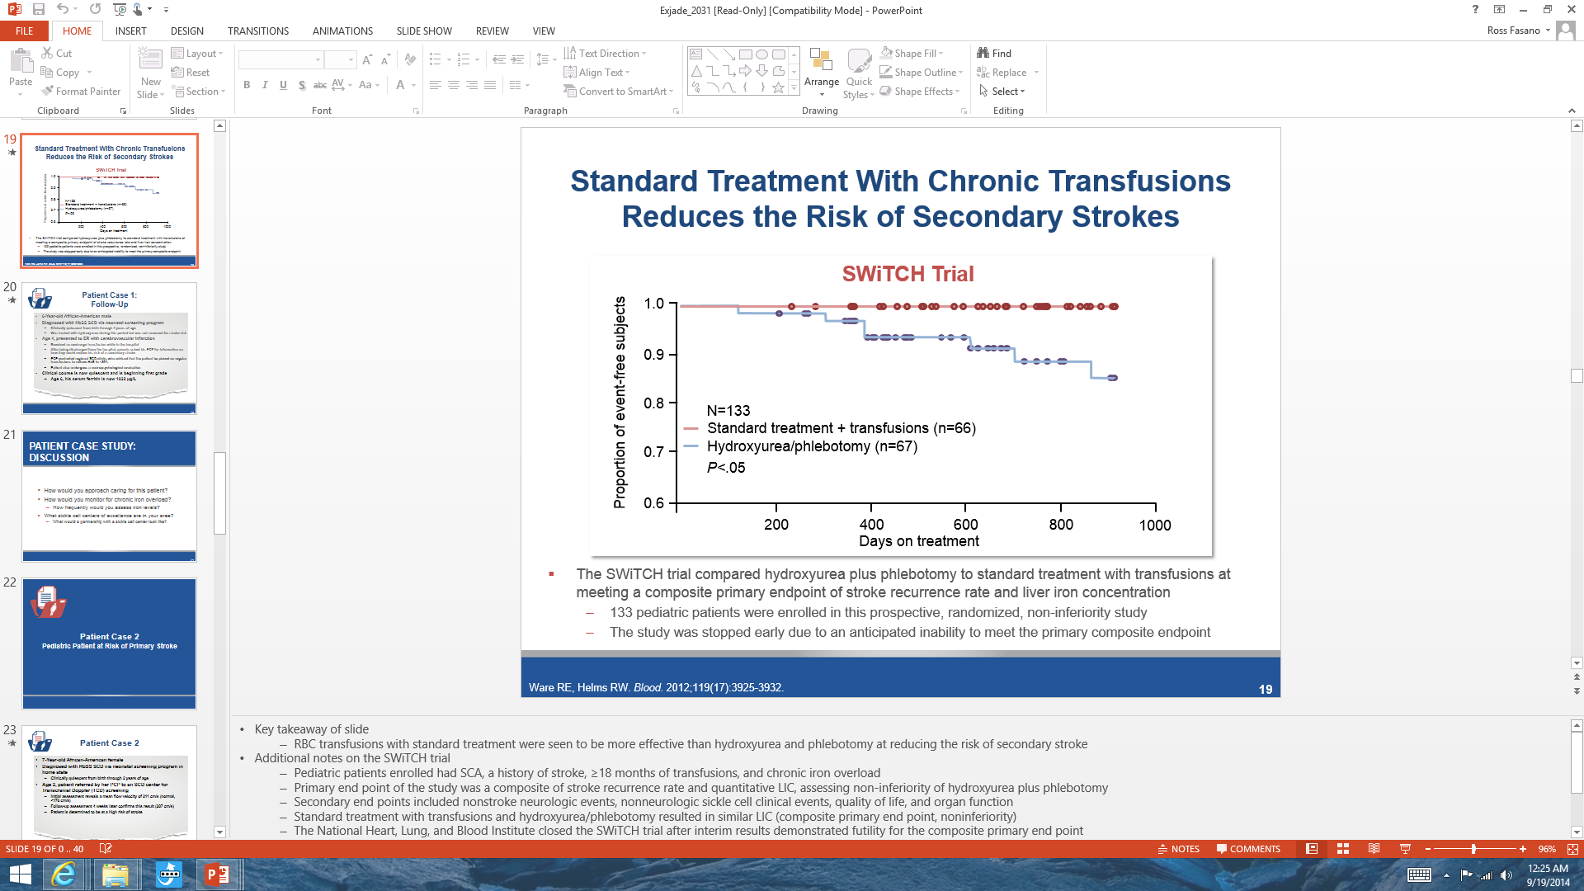
SWITCH study investigated non-inferiority of HU+phlebotomy vs. CTRXN+chelation in prevention of Stroke & iron overload
Study stopped early due to anticipated
inability to meet composite primary endpoint.
Ware RE, et al. Blood. 2012; 119(17):3925-32
Notes:
Pediatric SCD pts with a history of a stroke, >/= 18 mths on CTRXNS, and chronic iron overload
Primary endpoint: non-inferiority of HU+phlebotomy vs. CTRXN+chelation: composite primary endpoint of stroke recurrence AND LIC
Study stopped early due to anticipated inability to meet composite primary endpoint.

Slide 11
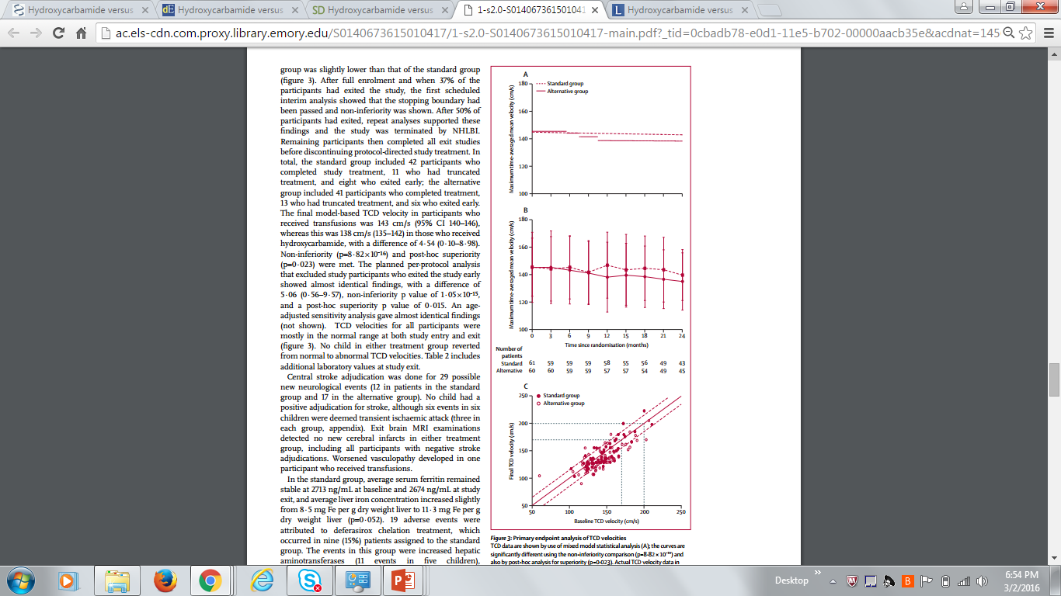
TWITCH study: non-inferiority of HU to simple transfusion in stroke prevention & iron overload.
159 pediatric patients followed for 24 months
Brain MRI and MRA at exit showed no new cerebral infarcts in either treatment group, but worsened vasculopathy in one patient who received standard transfusions.
Ware RE, et al. Lancet. 2016
Notes:
The primary goal of the Phase III TWiTCH trial is to compare 24 months of alternative therapy (hydroxyurea) to standard therapy (transfusions) for pediatric subjects with sickle cell anemia and abnormally high (≥200 cm/sec) Transcranial Doppler (TCD) velocities, who currently receive chronic transfusions to reduce the risk of primary stroke. For the alternative treatment regimen (hydroxyurea) to be declared non-inferior to the standard treatment regimen (transfusions), after adjusting for baseline differences, the hydroxyurea-treated group must have a mean TCD velocity similar to that observed with transfusion prophylaxis.

Slide 12
Hydroxyurea:
SWiTCH Trial
TWiTCH Trial
Phase III multicenter RCT, non inferiority.
N= 133 patients. Thirty month follow up.
Hydroxyurea & phlebotomy vs. Transfusion & Chelation
Primary End Points: stroke recurrence & iron burden.
12% had a reccurrent stroke prior to enrollment.
Interim data analysis was performed after 1/3
No difference in LIC
Stroke recurrence rate 7/67 vs 0/66 transfusion & chelation.
Conclusion: Hydroxyurea failed to prevent stroke recurrence
N= 148 planned enrollment (ages 4 – 15)
SCA + abnormal TCD
Transfusion + Chelation vs. Hydroxyurea + Phlebotomy
Treatment duration 24 months
Outcome measurements: LIC, TCD, MRI
Terminated in Jan. 2016

Slide 13
Adverse events associated with Hydroxyurea:
Side effects
  Nausea, vomiting, GI upset
  Skin rash
  Hyperpigmentaion of nails
  Mouth ulcers
  Headaches
  Abnormal LFTS
  Renal impairment
Haematological effects
  Leucopenia
  Anaemia
  Thrombocytopenia
  Increased MCV and MCHC
Theoretical effects
  Teratogenicity
  Leukaemogenesis

Slide 14
Therapy Goals for Transfusion Therapy
Common goal of transfusion therapy and exchange transfusion is to decrease the level of hemoglobin S to less than 30% of the total hemoglobin depending on disease severity and patients risk factors^{1,2,3,4}
Other goals include:^{5,6}
      Improve oxygen carrying capacity by increasing amount of hemoglobin A
      Decrease blood viscosity and increase oxygen saturation by decreasing percent HbS
      Suppress production of RBCs containing HbS by increasing tissue oxygenation
Cabibbo S, et al., “Chronic RBC Exchange to Prevent Clinical Complications in Sickle Cell Disease.” Transfus Apher Sci 2005; 32: 315-321.
Adams D, et al., “Erythrocytapheresis Can Reduce Iron Overload and Prevent the Need for Chelation Therapy in Chronically Transfused Pediatric Patients.” J Pediatr Hematol Oncol 1996; 18 (1): 46-50.
Kozanoglu I, et al., “Automated Red Cell Exchange Procedures in Patients with SCD.” Transfus Apher Sci 2007; 36: 305-312.
Vichinshy EP, et al., “Causes and Outcomes of the Acute Chest Syndrome in Sickle Cell Disease.” N Engl J Med; 2000;342:1855-1865.
Swerdlow PS, “Red Cell Exchange in Sickle Cell Disease.” American Society of Hematology, 2006 pp, 48 - 53.
Danielson C, et al., “The Role of Red Blood Cell Exchange Transfusion in the Treatment and Prevention of Complications of Sickle Cell Disease.” Ther Apher, 2002; 6 (1): 24-31.
14
Notes:
This slide discusses transfusion therapy in more detail.
There is evidence suggesting that decreasing HbS to less than 30% of the total hemoglobin content, may help prevent complications of SCD. Therefore maintaining HbS below this level is the most common goal for transfusion therapy and, in particular, for RBCX. The other three goals described here are a direct consequence of the above mentioned:
Maintaining HbS below 30% means maintaining HbA above 70%, which improves the oxygen carrying capacity (and oxygen saturation) of SCD patients to relatively normal hemoglobin levels.
Maintaining HbS below 30% is associated with a decrease in blood viscosity, which allows for a better blood flow to the tissues.
Normal tissue and blood oxygen levels slow down the production of erythropoietin, which in turn slows down the production of RBCs by the bone marrow.

Slide 15
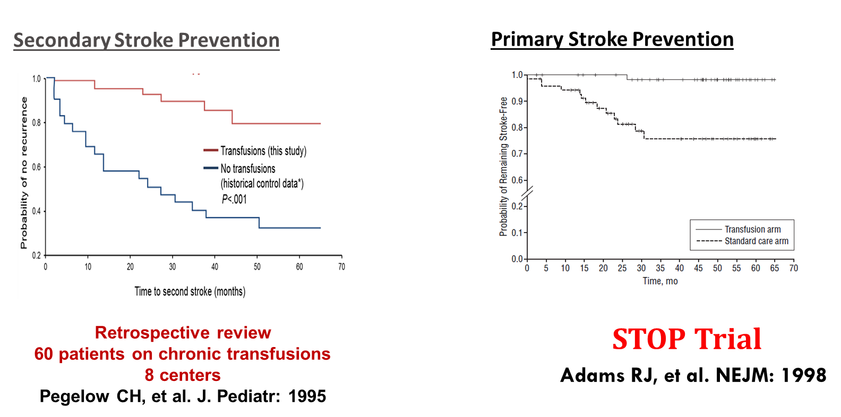
Chronic Transfusion Therapy for SCD

Slide 16
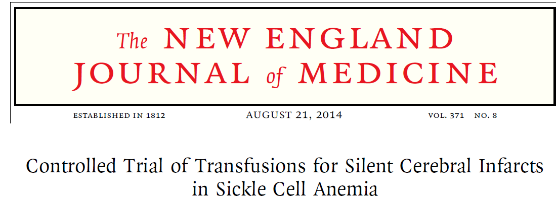
196 patients enrolled to observation or transfusion groups. Note in Table 1 there was some crossover between groups.
The primary endpoint was recurrence of an infarct, defined as stroke or new or enlarged silent cerebral infarct.
6 of 99 children had an end point event (6%), while 14 of 97 patients (14%) had an end point event. These results were statistically significant.

Slide 17
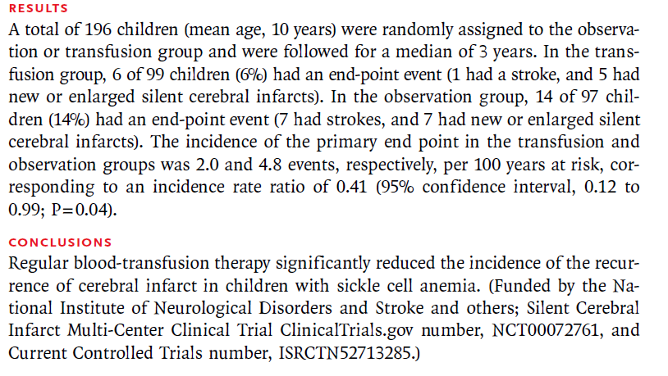
Conclusion of SIT trial

Slide 18
Complications of Transfusion
Iron overload
Allo / autoantibody formation
Delayed Hemolytic Transfusion Reactions
Transfusion reactions (allergic, febrile)
Transfusion-transmitted infections
CVL thrombosis/infection
Immune dysregulation
Others yet to be identified
Notes:
R2-LIC versus biopsy LIC. The R2-LIC values are derived from the calibration equation described in the text of the article (St. Pierre et al. Blood: 2005).
The solid line is a straight line fitted through the origin and has a gradient of 0.980 +/- 0.018. The different data symbols differentiate between the different fibrosis stages: stages 0 and 1, E; stages 2 to 4,; and stages 5 and 6, .

Slide 19

Impact of Iron Overload
Growth Failure
Pubertal Delay
Diabetes
Heart/Liver Failure
Hypothyroid
Birth 5 yr 10 yr 15 yr 20 yr 25 yr 30 yr
1995 1998 2015
Pegelow CH, et al.
Adams RJ, et al. (STOP)
Today
Notes:
Much of what we know about the natural history of iron overload in regard to end organ toxicity comes from data from Thalassemia major patients.
This slide depicts that CTRXN therapy for patients with SCD is relatively “recent” in comparison to the Thalassemia major population.
Although SCD patients still suffered from iron overload prior to 1995, it wasn’t until the Pegelow et al retrospective review that made CTRXN therapy standard for secondary stroke ppx, and the STOP trial (1998) that made CTRXN therapy standard of care for primary stroke ppx.
Approximately 10% of children with SCD will have an abnml TCD, necessitating long-term CTRXN therapy….
QUESTION: Will we see more end organ effects as the CTRXN population ages (i.e. in 2020, 2025)?

Slide 20
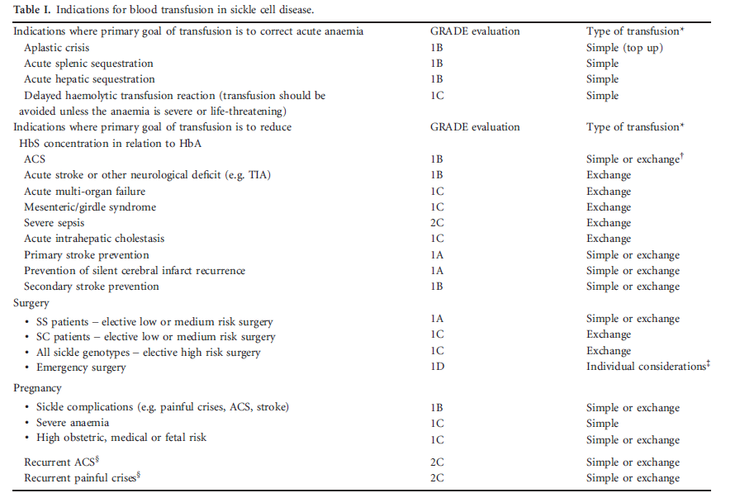

Slide 21
Benefits of ARBCX compared to Manual / Partial Exchange Transfusion and Simple Transfusion (“Top Up”)
Automated RBCX provides the following advantages over simple transfusion and manual exchange:
      rapidly removes RBCs containing hemoglobin S and replaces them with normal (HbA) RBCs^{1,2,3,4,5}
      manages iron overload and blood viscosity^{1,4,9}
      allows for precise control of hemoglobin S and hematocrit^{3,4,6,7,8}
      maintains isovolemia^{3,4,9}
Adams D, et al., “Erythrocytapheresis can reduce iron overload and prevent the need for chelation therapy in chronically transfused pediatric patients.” J Pediatr Hematol Oncol 1996; 18 (1): 46-50.
Danielson C, et al., “The role of Red Blood Cell Exchange transfusion in the treatment and prevention of complications of sickle cell disease.” Ther Apher, 2002; 6 (1) : 24-31.
Wahl S, et al., Lower alloimmunization rates in pediatric sickle cell patients on chronic erythrocytapheresis compared to chronic simple transfusions.” Transfusion 2012; 52:2671-2676.
Lawson, et al., “Red cell exchange in sickle cell disease.” Clin. Lab. Haem.1999; 21: 99–102.
Wayne, S, et al., “Transfusion Management of Sickle Cell Disease” Blood 1993; 81: 1109 -1123.
Cabibbo S, et al., “Chronic RBC exchange to prevent clinical complications in sickle cell disease.” Transfus Apher Sci 2005; 32: 315-321.
Hilliard L, et al., “Erythrocytapheresis limits iron accumulation in chronically transfused SCD patients.” Am J Hematol 1998; 59: 28-35.
Duclos C, et al., “Long-term red blood cell exchange in children with sickle cell disease: Manual or automatic?” Transfus Apher Sci 2013: 219–222 .
Singer S, et al., “Erythrocytapheresis for chronically transfused children with sickle cell disease: An effective method for maintaining a low HbS level and reducing iron overload.” J Clinical Apher 1999; 14:122-125.
21

Slide 22
Other possible benefits of
Automated Red Blood Cell
Exchange
RBCx also rapidly decreases the rate of haemolysis which can decrease liver processing of bilirubin, damage to renal tubular cells and the scavenging of nitric oxide by free hemoglobin released from sickle cells.
The beneficial effects on blood viscosity, elasticity, and relaxation time, and reduction of adhesion molecule level like sVCAM-1 has been documented after RBC exchange
Reduces Circulating Endothelial Cells (CEC)
Possible social benefits: patients ownership of the disease & improved quality of life.
Boga, et al. Transfusion & Apheresis Science 2010

Slide 23
Regular / Maintenance RBCx (Erythrocytapheresis):
Reducing Iron Burden
Study | Number (on chelation) | Target HbS% | RBCX Freq | Post-RBCX Hct | Reduction in Ferritin (on chelation) | Stable Ferritin (Not on chelation
Kim HC, et al 1994 | 14 (8) | 50% | 4 wks | 27% | N/A | 6/6
Adams DR, et al. 1996 | 10 (3) | N/A | 4 wks | N/A | 3/3 | 7/7
Hilliard LE et al. 1998 | 11 (7) | 50% | 5 wks | 35% | N/A | 4/4
Singer ST, et al. 1999 | 8 (5) | 30% | 4 wks | 28-30% | 5/5 | 3/3
Sarode R, et al. 2010 | 20 (17) | 50% | 7 wks (IHD) | 31% | 7/17 | 3/3
Notes:
Hilliard LE:
Reported that those with pre-RBCX serum ferritin levels >5,000 ng/ml stabilized, but did not have a dramatic decrease in iron load.
No patient on chelation was able to discontinue deferoxamine
Notable: Post-RBCX Hct goal of 35%. (high)
Sarode R:
Utilized Isovolemic Hemodilution (aka red cell depletion) which is available on Optia as one-step program.
Conclusions:
In these small series, iron overload (based on ferritin measurements) was stable in pts on erythrocytapheresis (not on iron chelation)
In these small series, iron overload (based on ferritin measurements) was shown to improve in pts on erythrocytapheresis (on concurrent iron chelation therapy)
Different Erythrocytapheresis parameters exist (Target HbS, Post-RBCX Hct, +/- IHD, etc…)

Slide 24
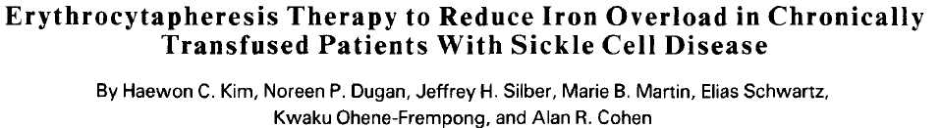
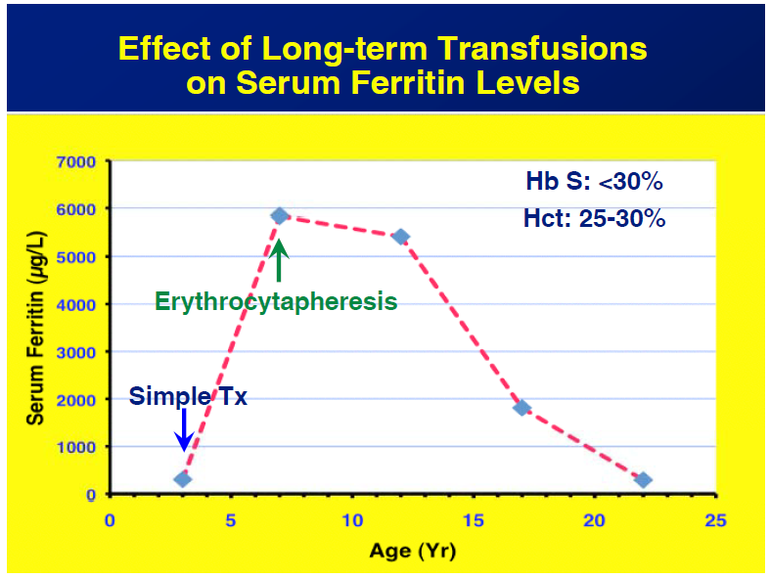

Slide 25
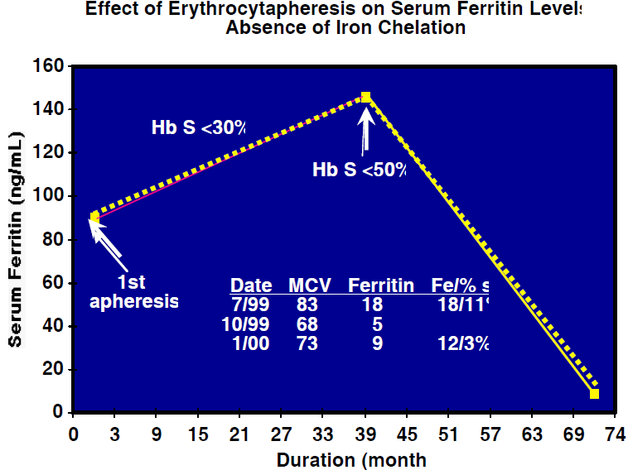

Slide 26
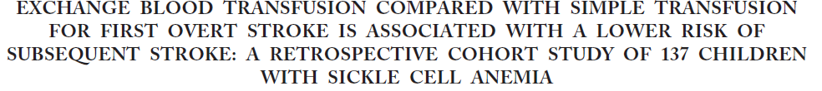
Hulbert et al
J. Pediatrics
2006
Main points:
Retrospective, Multiple centers (14) and N= 137
Patients followed at least 5 years for chronic transfusions after stroke.
Exchange Transfusion (manual & automated) is more effective initial treatment for stroke than ST.
  possible benefit of RBCX as the preferred transfusion method
  may prevent recurrent stroke
Limitations :
Retrospective – possible differences between the groups (e.g. severity of first stroke)
A cause and effect relationship between the type of treatment and subsequent stroke could not be determined

Slide 27
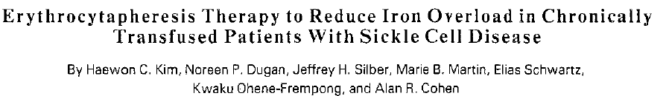
Haewon C. Kim
1994
Main points
The rate of patient iron was significantly reduced with long-term RBCX in comparison with those for simple transfusion.
Preliminary data show that RBCX can be used with a target HbS level of 30% rather than of 50% without increasing ferritin levels
The additional cost of $20,000 to $25,000 (US $) per year associated with RBCX, in comparison with simple or manual exchange transfusion, is partially or fully offset by the reduction or elimination of the cost of iron chelation therapy.
Limitations
Small sample size (14 patients)
Study was conducted 20 years ago (cost saving calculaution is no longer applicable)

Slide 28
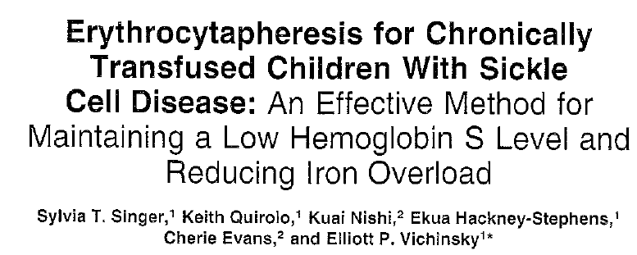
Singer et al.
J. of clinical
Apheresis
1999
Main points:
Retrospectively evaluated 8 patients (mean age 12.1y) at risk of first or recurrent stroke.
Targeted Hb S < 30% for 9 months of automated RBCX.
None of the patients developed complications related to the procedure or to the increased blood use.
Mean ferritin levels decreased by mean of 26.5% in all patients.
Patients who remained on iron chelation therapy & RBCX, had a 32% decrease in ferritin levels.
Conclusion: The procedure is safe & effective in reducing iron overload & can obviate the need of chelation therapy even when the target HbS is maintained at a standard of 30%.
Limitaions: small number of patients.

Slide 29
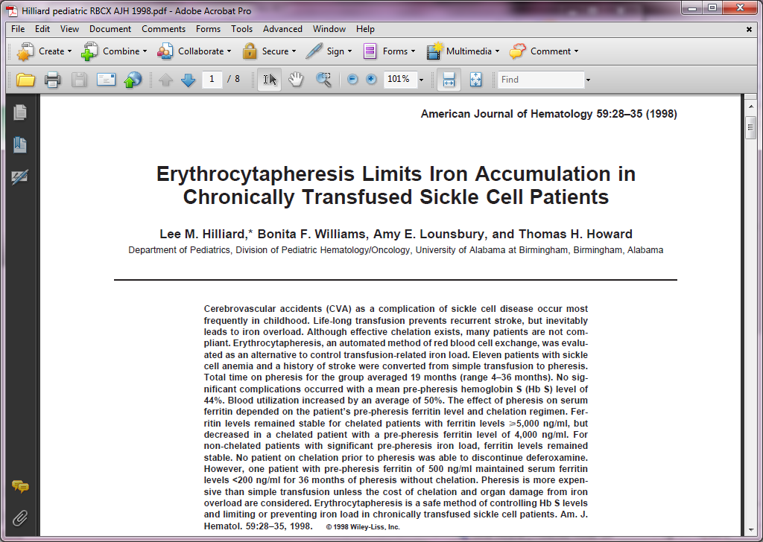
Hilliard et al 1998
Iron overload
Main points:
  11 SCD patients with history of stroke converted to automated RBCX (COBE)
  Used peripheral access. Targeted HB S < 35. Average procedure frequency every 35 days for an average of 19 months (4-36 months).
  Simple transfusion (ST) - 12 procedures per year vs RBCX 10 procedures per year
  RBCX – used 50% more RBC
  No alloantibodies or infection or other complications related to ARBCX were recorded.
  Conclusion: RBCX maintains HbS and limits iron overload, especially if started early. ST is more expensive if cost of chelation and organ damage is considered
Limitations:
  11 patients; history of stoke;11 – 24 years of age.
  Iron chelation compliance was not tracked
  Subset of patients remained on chelation therapy even when transitioned to RBCX
  RBCX not standardized

Slide 30
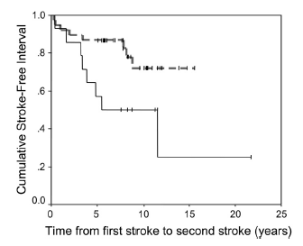
Simple Transfusion vs. RBCx in Stroke prevention
A retrospective cohort study of 137 children with SCD and strokes compared RBCx and Simple Transfusion in their ability to prevent the occurrence of a second stroke
Children receiving simple transfusion had a 5-fold greater relative risk of second stroke than those receiving RBCx
RBCx
Simple Transfusion
ML Hulbert et al. EXCHANGE BLOOD TRANSFUSION COMPARED WITH SIMPLE TRANSFUSION FOR FIRST OVERT STROKE IS ASSOCIATED WITH A LOWER RISK OF SUBSEQUENT STROKE: A RETROSPECTIVE COHORT STUDY OF 137 CHILDREN WITH SICKLE CELL ANEMIA. J Pediatr. 2006

Slide 31
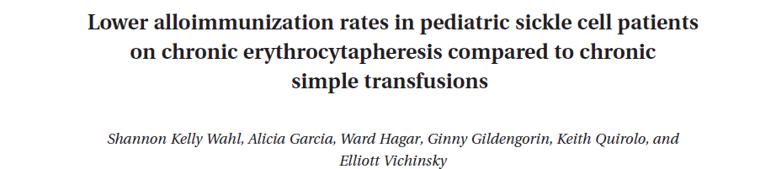
Wahl et al.
Transfusion
2012
Main points: RBCX vs ST
  Retrospective (n=45): 23 patients on ST and 22 on RBCX
  benefits: isovolemic, lower hyperviscosity, more effective in lowering HbS, limits iron overload
  Stroke patients preferentially on RBCX to prevent future iron overload and to better control percent HbS
With limited phenotype matching RBCX lower alloimmunization rates vs ST:
  The ARBCX group received significantly more blood & 3 patients developed antibodies, while 4 patients developed antibodies in the ST group.
  mechanism not known
  alloimmunization concerns may be unjustified
Limitations:
  reporting of patient reactions was voluntary (underreported)
  inconsistencies on number of RBCX versus ST procedures from patient to patient
  further prospective trials are needed
Notes:
Chronic RBCX with limited phenotype matching was associated with lower rate of alloimmunization than simple transfusions. Concerns about alloimmunization due to increased RBC usage may be unjustified. The mechanism for lower alloimmunization rates was not clear. Potentially simultaneous exposure to a large number of antigens overwhelmed the patient’s immune system, or the removal of inflammatory cells and proteins with RBCX may have contributed to the phenomenon.
Allogeneic blood transfusion is a form of temporary transplantation. This procedure introduces a multitude of foreign antigens and living cells into the recipient that persist for a variable time. A recipient who is immunocompetent often mounts an immune response to the donor antigens, resulting in various clinical consequences, depending on the blood cells and specific antigens involved. The antigens most commonly involved are classified in the following categories: (1) human leukocyte antigens (HLAs), class I shared by platelets and leukocytes and class II present on some leukocytes; (2) granulocyte-specific antigens; (3) platelet-specific antigens (human platelet antigen [HPA]); and (4) RBC-specific antigens.
The consequences of alloimmunization to blood include the following clinical manifestations:
Alloimmunization against RBCs Acute intravascular hemolytic transfusion reactions (rarely a consequence of alloimmunization and almost always caused by ABO antibodies)^{[1]}
Delayed hemolytic transfusion reactions (DHTRs) (hemolysis caused by RBC alloantibodies at least 24 hours posttransfusion)
Hemolytic disease in newborns (mother's alloimmunization against fetal antigens, most often resulting from previous pregnancies)

Slide 32
Wahl – repetitive same as slide 7 and 8 combine
COMBINE slide 7 and 8
RBCX requires increased blood exposure, compared to simple transfusion, therefore increasing the risk of alloimmunization and other complications. This study therefore compares alloimmunization rates between patients receving simple transfusion and RBCX.
45 SCD patients; 23 simple transfusion and 22 RBCX
Their data indicate chronic RBCX with limited phenotypically matched RBCs is associated with lower rates of alloimmunization compared with simple transfusion
HbS is consistently reduced with RBCX as shown previously and since
As opposed to simple transfusion, which dilutes the HbS, exchange transfusion removes the abnormal Hb in addition to white blood cell, platelets, and plasma containing inflammatory cytokines. Reductions in some of these markers with a manual exchange were shown (*) to be transient in a small series of patients with acute chest syndrome but how consistently these may be reduced with chronic exchange is not known.

Slide 33
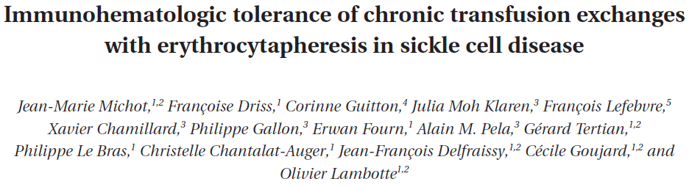
Michot, et al
2014
MAIN POINTS:
188 SCD followed over the period 2006 – 2011, The RBCX and conventional transfusion groups comprised 49 and 139 patients, respectively.
RBCX enrollment was based on : Severity of SCD, any history of stroke, the degree of iron overload and ability to establish intravenous access. RBCX was used primarily in long-term exchange programs and occasionally before surgery or during pregancy. RBCX was also used in emergency situations : Acute chest syndrom, sever vasocclusive crisis, stroke and priapism. RBCX each 5 to 6 weeks, received 15 to 25 ml of RBCs/kg
All the SCD patients underwent the same pretransfusion procedures, including rhesus and Kell RBC phenotyping and a systematic cross-matching test for detecting any Abs. Cross matching test was performed no more than 72 hours before transfusion
The alloimmunization/RBC unit (RBCU) ratio was lower in the RBCX group than in the conventional transfusion group (1.6 and 11.6 par 1000, respectively)
Patients in the RBCX group received 10 times more RBCUs than patients in the conventional transfusion group (206 vs. 19 RBCUs per patient, respectively)
RBCX exhibits a good immunohematologic safety profile relative to conventional transfusion in a large SCD mainly adult cohort.
Hemolytic transfusion reactions occurred after conventional transfusion in three cases and after an ECP session in one case, all four patients belonged to the “conventional transfusion” group
LIMITATIONS :
Difference between the two groups and the retrospective nature of the study.

Slide 34
Michot, et al
2014
HYPOTHESES to explain that result
A hemolytic reaction corresponds to the accelerated destruction of transfused RBCs, caused by the presence of alloantibodies. Preliminary data suggest that the presence of baseline inflammatory conditions at the time of transfusion may enhance the incidence of hemolytic transfusion reactions. In this study, the low prevalence of hemolytic transfusion reactions in patients in the RBCX group argues in favor of this hypothesis; one can reasonably assume that patients in an RBCX program are more likely to have “controlled” SCD and low levels of baseline inflammation. The RBCX technique per se might also have an impact on the prevalence of hemolytic transfusion reactions. We estimate that between 500 and 1000 mL of plasma are removed during RBCX of 4 to 6 RBCUs in an adult patient. The removal of plasma cytokines or inflammatory proteins may help to limit immune activation. Some preliminary data even suggest that RBCX itself or plasma exchange may be an effective treatment for severe hemolytic transfusion reactions. Along with baseline inflammation, an existing autoimmune condition has been mentioned as a risk factor for hemolytic transfusion reactions.
Another hypothesis is that regular and large blood volume exchanges with RBCX induce immune tolerance against RBC antigens. Exposure to large amounts of RBC antigens overwhelms the immune system and leads to immune tolerance.

Slide 35
Velasquez et al.
2009 paediatric blood cancer journal
Main points:
44 patients with 53 episodes of ACS/. Ages:18 months to 19 years
RBCX safe/effective treatment for ACS
  No alloantibodies. No venous thrombosis or other complications related to procedure
  RBCX beneficial when respiratory distress was severe or with concurrent stroke.
  RBCX increases blood exposure & has a higher cost (did not address cost of chelation).
Limitations:
Retrospective / no control group.
No published studies that describe objective indications for RBCX in ACS patients.
Continued development of ACS clinical practices need to be addressed to fully assess objective treatments.

Slide 36
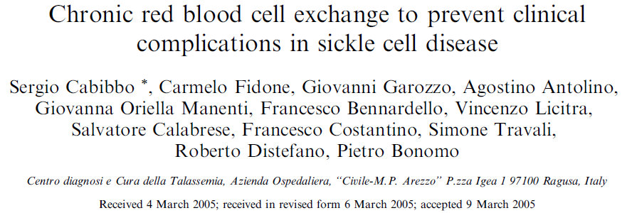
Cabibbo et al.
2005
Retrospective (1999-2004): tracked for an average of 6 years a 394 (manual & automated =206) procedures (CS3000, MCS+ & COBE) exchanges performed on n=20 SCD ages 10 – 50 with high risk of recurrent complications (Pain crises, ACS, & Stroke).
Vascular access mostly peripheral, few central or femoral placed for other reasons not related to RBCX procedure.
Outcomes:
none of the patients developed complications related to the procedure or to increased blood use.
It was safe & effective in preventing SCD complications.
When done automatically, RBCX decreased ferritin levels & reduced iron overload.
Limitations:
Retrospective, using three platforms of devices & manual exchange

Slide 37
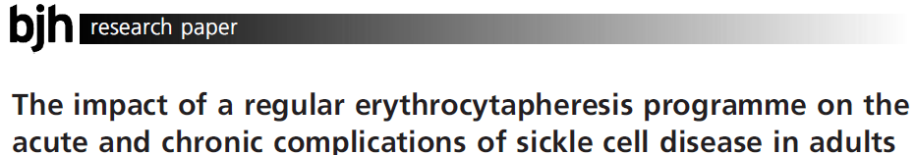
Kalff, et al.
BJH 2010
MAIN POINTS:
N=13 adult patients (aged 22-63) enrolled in regular erythrocytapheresis for a median duration of 70 months.
In patients on exchanges every 6 weeks, HbS% was <42% in two and between 47% and 53% in four patients
No patient experienced stroke or multi-organ crises, evidence of end-organ dysfunction while on RBCX. No patient stopped RBCX during treatment.
Estimated hospital savings (Aus $) $6682 per patient per year (see next slide)
Conclusions:
RBCX for patients with SCD was an effective, well-tolerated therapy for both acute and chronic complications of SCD, reducing hospital admissions for sickle related acute events.
Long term RBCX shown benefit in primary and secondary stroke prevention in children with SCD
Alloimmunization rates were comparable to the literature.
RBCX was confirmed to be effective at iron control.
Limitations:
This data is a single centre retrospective study on a small number of patients with no control,
Vascular access was an issue in a few patients requiring placement of catheters.

Slide 38
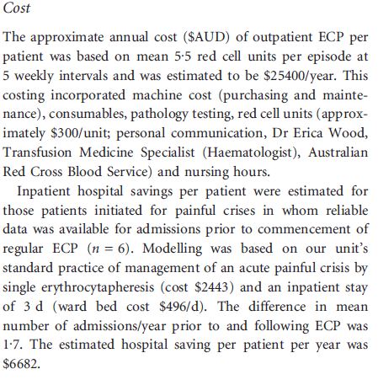
Kalff, et al.
BJH 2010

Slide 39
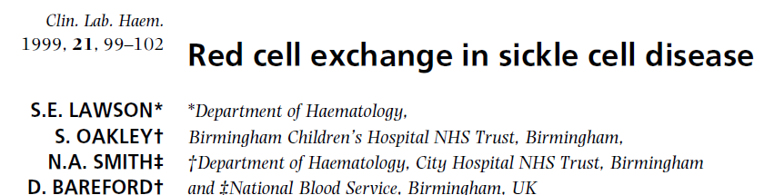
Lawson et al
1999
Main points:
21 patients (age 21-54) treated with a series of 66 automated RBCX (COBE)
The mean increase in Hb A was 77% and in the majority of patients 90%
Procedures were safe & well tolerated in the majority of patients. Very few had mild hypocalcemia
Main duration of procedure: 2 hrs.

Slide 40
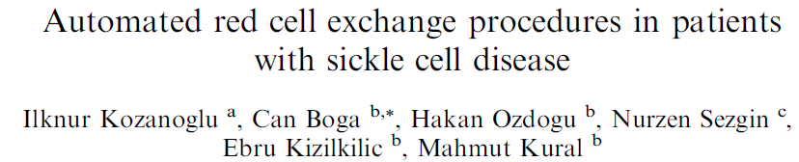
I. Kozanoglu & Boga
2007 Trasfusion and Apheresis
Main points:
N=83 patients with SCD in Turkey (age 17 – 49). Underwent 196 automated RBCX between 2003-2006.
Indications for RBCX were cerebrovascular, priapism, pregnancy, surgery, bone necrosis, & unhealed leg ulcers.
HbS target <30 % was achieved in most of the procedures.
Used 20 gauge needle for peripheral access (flow rate 15-60 ml/min). Only 10 procedures required central line catheterization.
Measured mean transcutaneous oxygen saturation pre & post RBCX: 93% & 97% respectively.
Measured mean Nitric Oxide (in correlation with plasma nitrite concentration) pre & post: 21 & 19.7 micro mol respectively (improved post RBCX)
Measured free Hb in plasma (hemolysis) pre & post RBCX: 28.3 & 19.8 mg dl respectively.
Followed up the patients post RBCX up to 10 months & assessed quality of life related variables besides the clinical outcome.
Conclusion: RBCx prevented VOC & improve QoL.

Slide 41
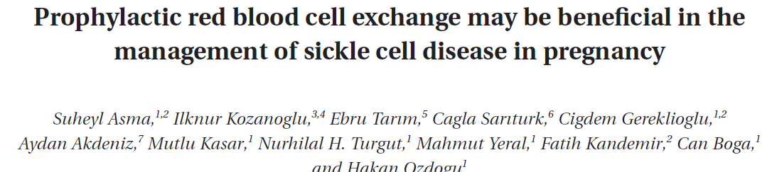
Asma et al.
May 2014
Transfusion
Retrospectively evaluated the complications of SCD in 37 pregnant patients who underwent 43 automated RBCX procedures.
Patients who had undergone prophylactic RBCX (n=24) were compared to a control group (13 patients) who had not undergone RBCX during pregnancy.
Results:
Four patients in the control group developed Vaso-occlusive events & died.
Maternal complication were recorded in 21 patients of the study group compared to 7 in the control group.
Fetal complications were recorded: 1 in control & 1 in study group.
Conclusion: This study demonstrated that prophylactic RBCX during pregnancy is a feasible & safe procedure for prevention of complications & therefore warrants further studies.

Slide 42
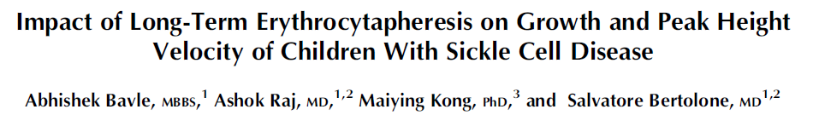
They conducted a retrospective chart review of 36 patients with SCD who received long term erythrocytapheresis for on average 5 years. They measured anthropometric data such as weight, height and BMI from the subjects charts to determine if this treatment impacted these measurements.
Results were compared to measurements prior to erythrocytapheresis.
Slopes of the curves from height, weight, and BMI all improved with red cell exchange therapy.
Of the 36 patients in the study, 8 received hydroxyurea prior to being started on erythrocytapheresis. There was no significant improvement on these measures in patients on HU therapy.
This result is similar to a French paper showing similar information

Slide 43
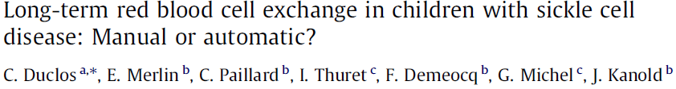
Duclos, C. et al
2012 Transfusion and Aphersis
MAIN POINTS:
10 children (5 treated with manual exchange for 124 procedures; 5 children with automated exchange for 60 procedures
Some difficulty with venous access (14 occurrences from 60 procedures) related to impaired blood flow but not requiring cessation or placement of central venous access.
  Statistically significant (p<0.0001) increase in number of days needed between exchanges. 63 days ARBCX compared to 28 for manual exchange.
  Chronic erythrocytapheresis was well tolerated overall. No significant increase in iron overload.
Conclusion:
  The ARBCX procedure is shorter and a nurse can handle two or three patients at the same time.
  Difficulties of venous access are relatively infrequent.
  The cost per session was high, but the lower number of sessions, & hence requiring less patients visits and possibly the long-term impact on the disease of annual hospitalisations must be taken into account.
  Data support the use of RBCX rather than manual exchanges for children with long-term programs of red cell exchange.
  Limitations: Small study, 10 children (5 treated with manual exchange for 124 procedures; 5 children with automated exchange for 60 procedures). The fact it is a paediatric study may negate the small numbers.

Slide 44
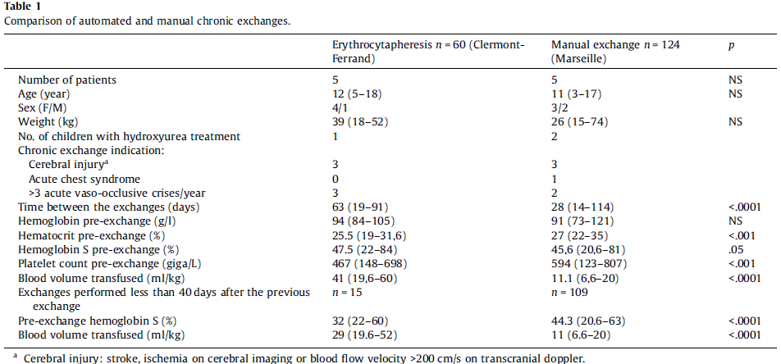

Slide 45
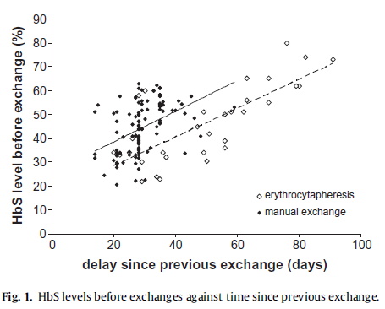

Slide 46
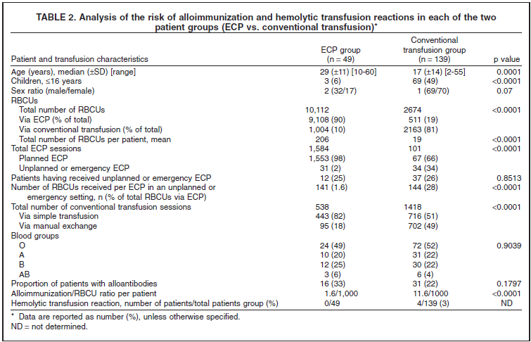

Slide 47
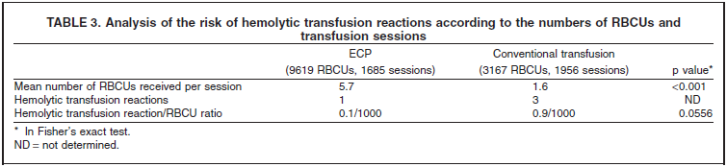
Results:
Four hemolytic transfusion reactions (occurring between 5 and 10 days after the transfusion) were recorded in four different patients.
The patients’ SCD phenotypes were SS (n = 3) and SC (n = 1). Three of the four patients had a B(+) blood group and two had a history of autoimmune hepatitis. Two of the transfusions were planned and two were unplanned. Although the hemolytic transfusion reactions occurred after conventional transfusion in three cases and after an RBCX session in one case, all four patients belonged to the “conventional transfusion” group.

Slide 48
Discussion :
Once an exchange program has been prescribed, the patient and physician can choose between conventional transfusions and RBCX.
The choice in favor of RBCX (isovolumetric method, control of iron overload, more effective lowering of HbS) is balanced against its disadvantages, in particular the theoretical risk of alloimmunisation.
The authors were concerned about the risk for hemolytic transfusion reactions and alloimmunisation in patients in the RBCX program, due to elevated transfused blood exposure.
However, they observed a lower alloimmunisation rate in patients in the RBCX group than in the conventional transfusion group.
Moreover, no hemolysis transfusion reactions occurred in the RBCX group, even though patients in this group received 10 times more RBCUs than patients in the conventional group did.
The basis for the lower observed incidence of hemolytic transfusion reactions in the RBCX group is unclear.

Slide 49
Hypotheses : Baseline Inflammatory condition induced alloimmunisation
Hemolytic transfusion reactions corresponds to the accelerated destruction of transfused RBCs, caused by the presence of alloantibodies.
Preliminary data in humans and murine models suggest that the presence of baseline inflammatory conditions at the time of transfusion may enhance the incidence of hemolytic transfusion reactions.
In this study, the low prevalence of hemolytic transfusion reactions in patients in the RBCX group argues in favor of this hypothesis. One can reasonably assume that patients in an RBCX program are more likely to have “controlled” SCD and low levels of baseline inflammation. Immunomodulatory mecanism
The RBCX technique might also have an impact on the prevalence of hemolytic transfusion reactions. The authors estimate that between 500 to 1000 mL of plasma are removed during RBCX of 4 to 6 RBCUs in an adult patient. The removal of plasma cytokines or inflammatory proteins may help to limit immune activation. Some preliminary data even suggest that RBCX itself or PLEX may be an effective treatment for severe hemolytic transfusion reactions.

Slide 50
Hypotheses : Immune system saturation and induced tolerance.
Another hypothesis is that regular and large blood volume exchanges with RBCX induce immune tolerance against RBC antigens. Exposure to large amounts of RBC antigens overwhelms the immune system and leads to immune tolerance.
Smith et al (Blood 2012) demonstrate that RBCUs transfused in the absence of inflammation induce immune tolerance in a murine model.

Slide 51
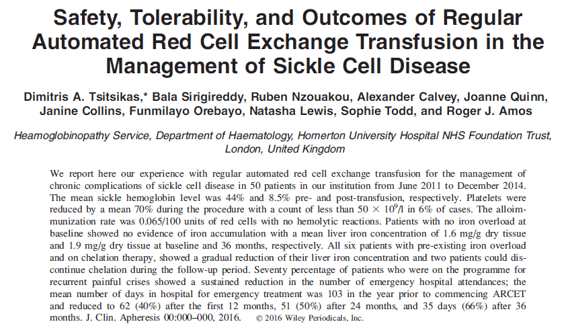

Slide 52
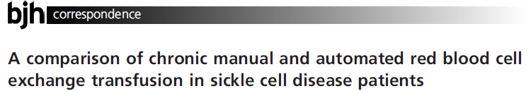
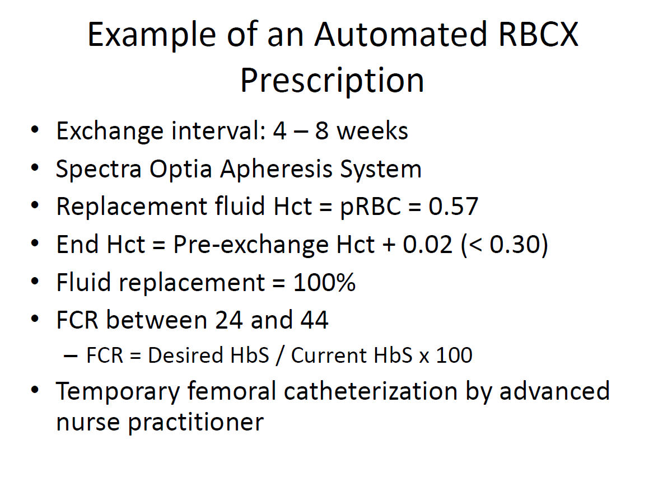
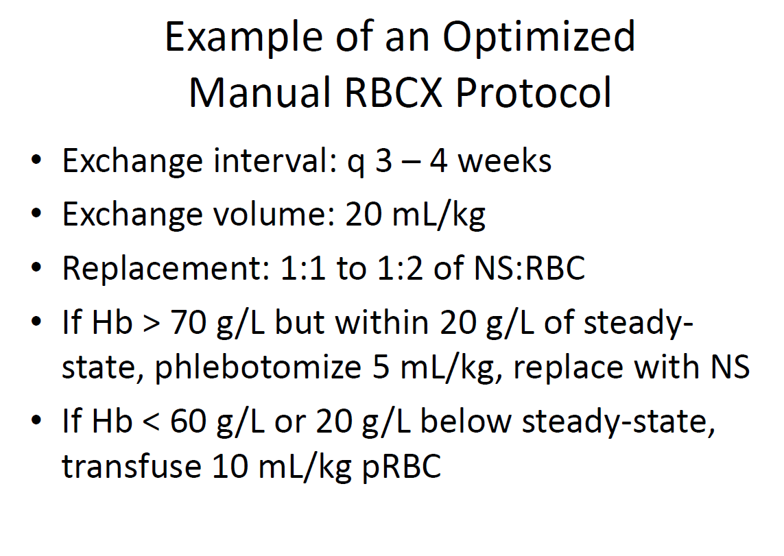
Kuo, Howard, & Telfer. BJH 2015

Slide 53
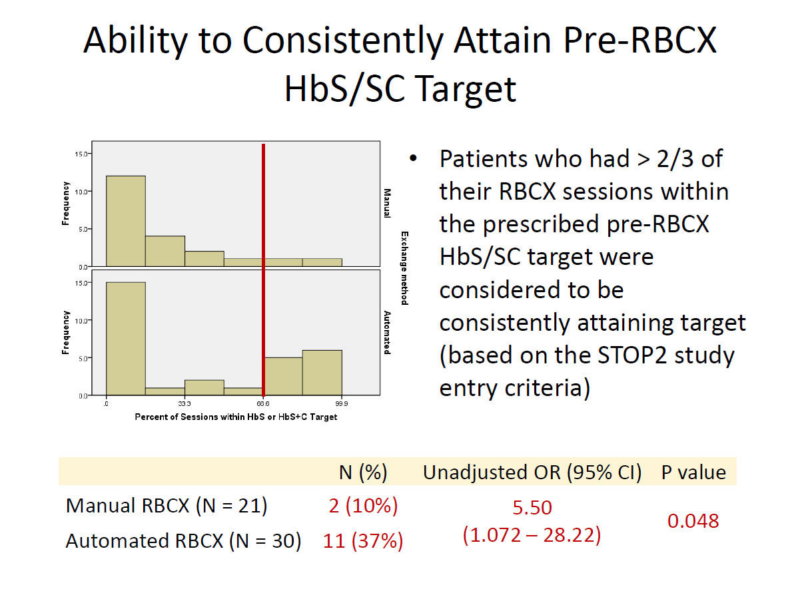
Kuo, Howard, & Telfer. BJH 2015

Slide 54
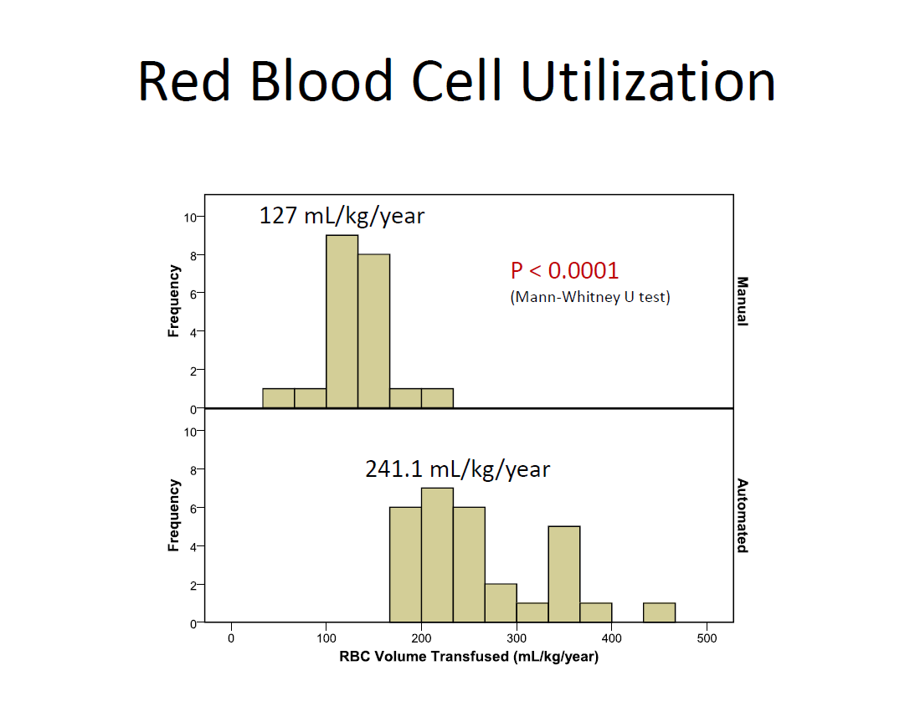
Kuo, Howard, & Telfer. BJH 2015

Slide 55

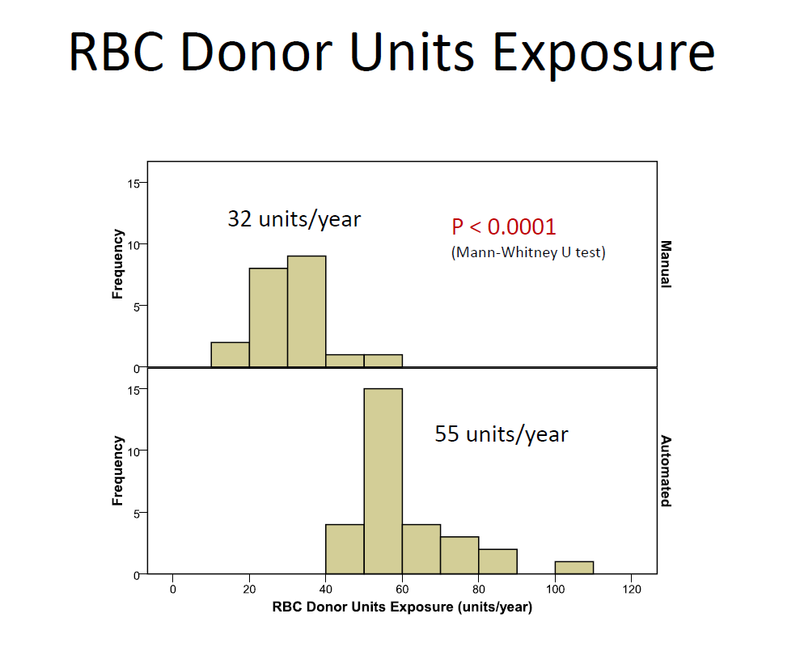
Kuo, Howard, & Telfer. BJH 2015

Slide 56
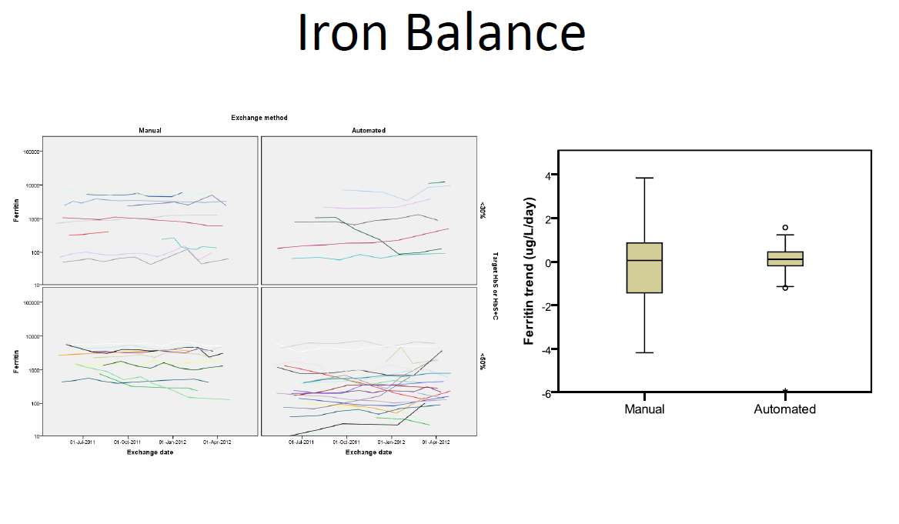
Kuo, Howard, & Telfer. BJH 2015

Slide 57
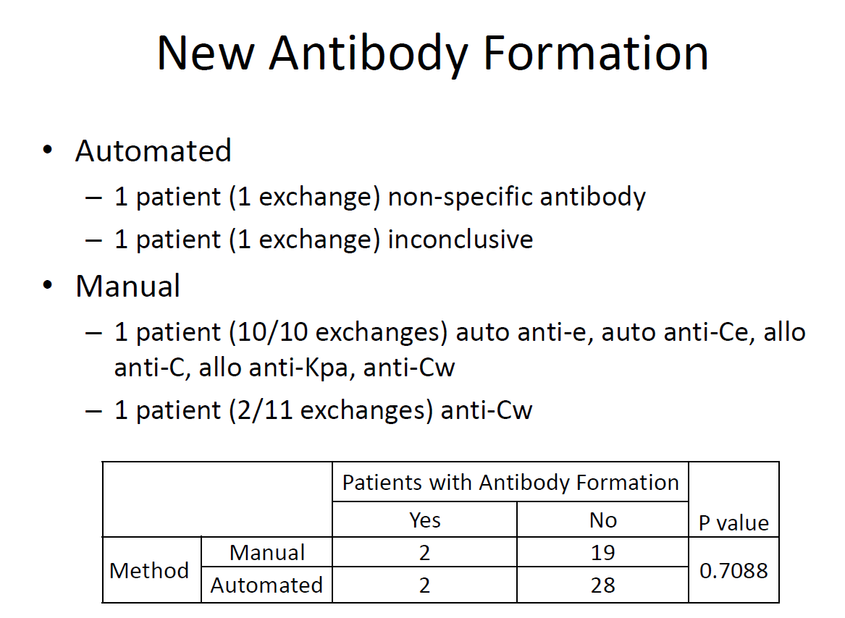
Kuo, Howard, & Telfer. BJH 2015

Slide 58
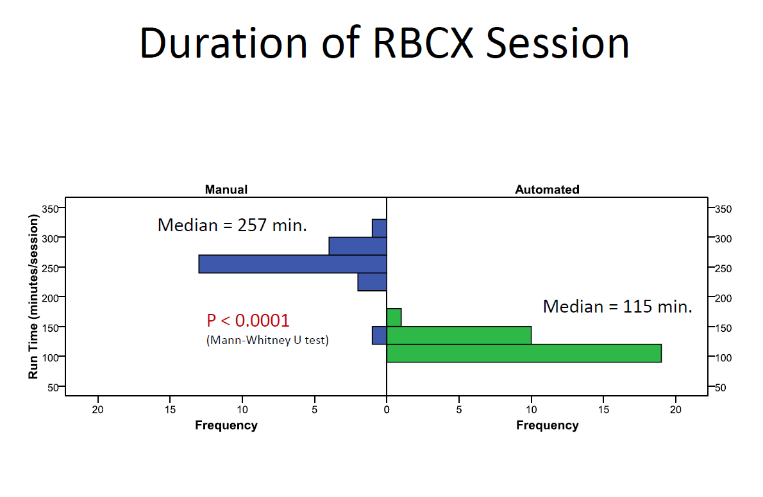
Kuo, Howard, & Telfer. BJH 2015

Slide 59
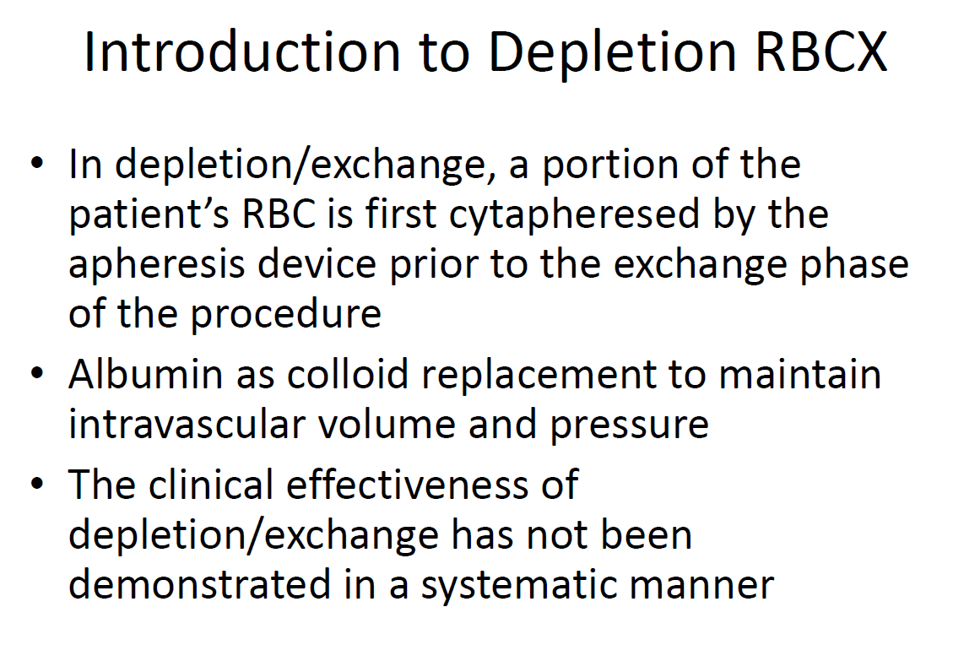
Kuo, Howard, & Telfer. BJH 2015

Slide 60
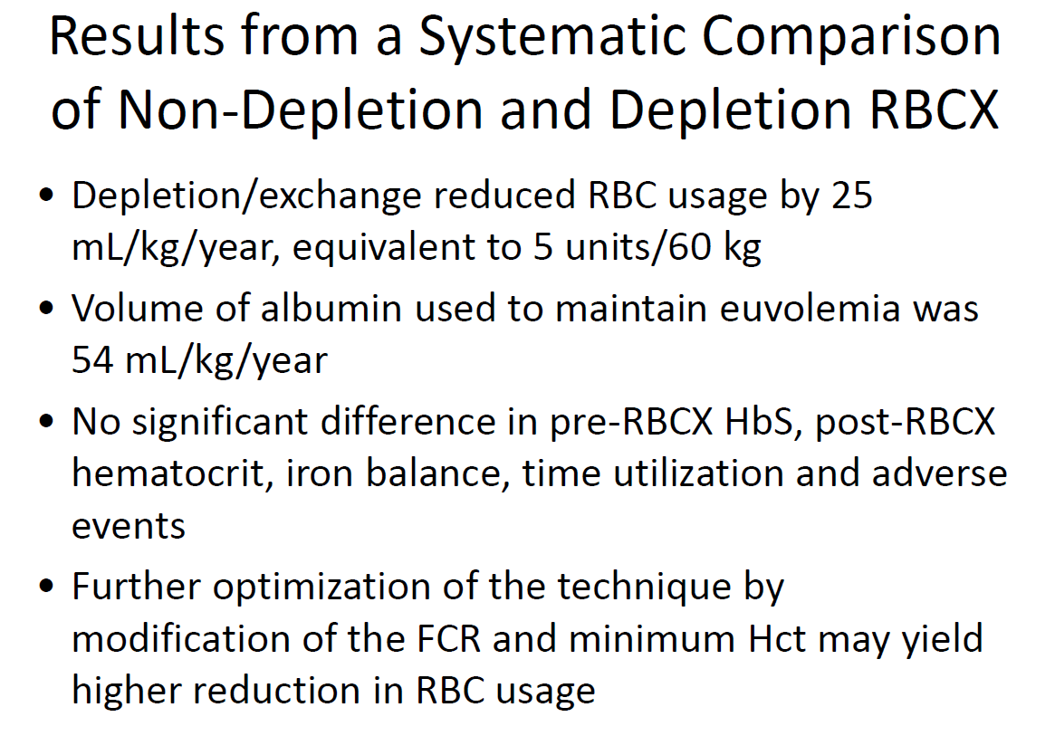
Kuo, Howard, & Telfer. BJH 2015

Slide 63
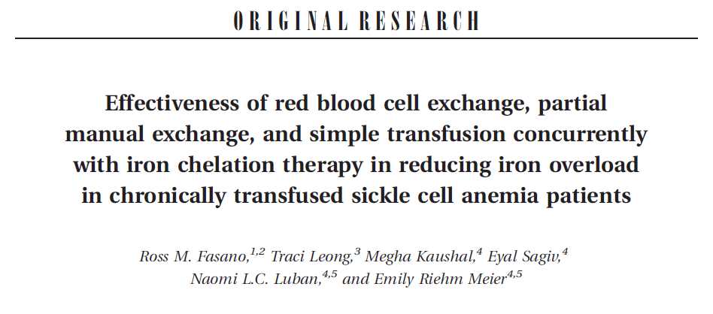

Slide 64
Review of clinical trials clinical trials

Slide 65
STOP Trial (1 & 2)
Outcome from both trials show, in children, overwhelming evidence for transfusion in patients with elevated TCD velocity
Most centres start transfusion at TCD velocity > 200 cm/s but one can argue for starting transfusion at a lower threshold (> 175 cm/s)
Limitations
  Hemoglobin SC disease and other sickle variants were excluded
  Both studies were conducted in the paediatric population
  Although risk of infarctive stroke falls in adulthood, haemorrhagic stroke risk increases
  Role of transfusion in adults for primary and secondary prophylaxis not defined

Slide 66
SWiTCH Trial
Phase III multicenter RCT, non inferiority.
N= 133 patients. Thirty month follow up.
Hydroxyurea & phlebotomy vs. Transfusion & Chelation
Primary End Points: stroke recurrence & iron burden.
12% had a reccurrent stroke prior to enrollment.
Interim data analysis was performed after 1/3
No difference in LIC
Stroke recurrence rate 7/67 vs 0/66 transfusion & chelation.
Conclusion: Hydroxyurea failed to prevent stroke recurrence

Slide 67
TWiTCH Trial
N= 148 planned enrollment (ages 4 – 15)
SCA + abnormal TCD
Transfusion + Chelation vs. Hydroxyurea + Phlebotomy
Treatment duration 24 months
Outcome measurements: LIC, TCD, MRI

Slide 68
196 patients enrolled to observation or transfusion groups. Note in Table 1 there was some crossover between groups.
The primary endpoint was recurrence of an infarct, defined as stroke or new or enlarged silent cerebral infarct.
6 of 99 children had an end point event (6%), while 14 of 97 patients (14%) had an end point event. These results were statistically significant.

Slide 69
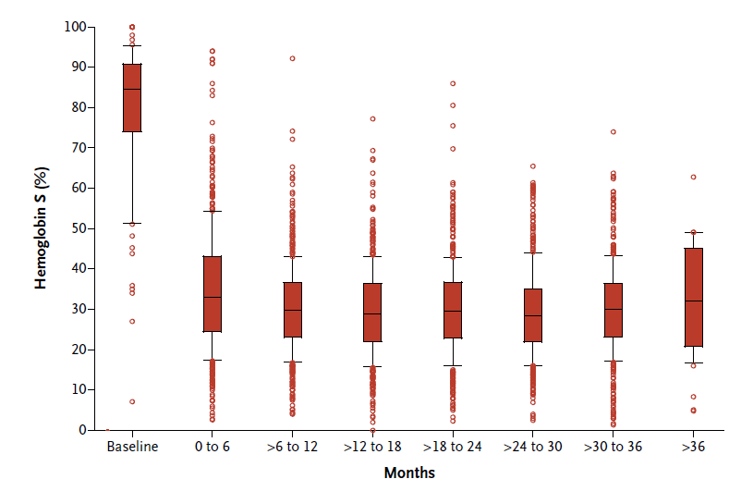
SIT trial: Impact of transfusion on Hb S

Slide 70
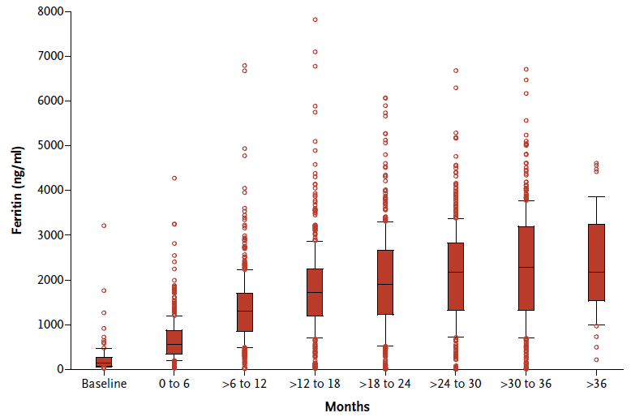
SIT trial: impact of transfusion on Ferritin level

Slide 71
Conclusion of SIT trial

Slide 72
Updates on recent guidelines & recommendations

Slide 73
ASFA 2016 Categories
Category I
  Apheresis is considered primary or standard therapy.
Category II
  There is sufficient evidence to suggest efficacy, usually in an adjunctive role.
Category III
  Insufficient data to determine effectiveness.
  Isolated published studies have indicated that it
  may be of benefit as a “last-ditch” effort.
Category IV
  Controlled trials have not shown benefit.

Slide 74
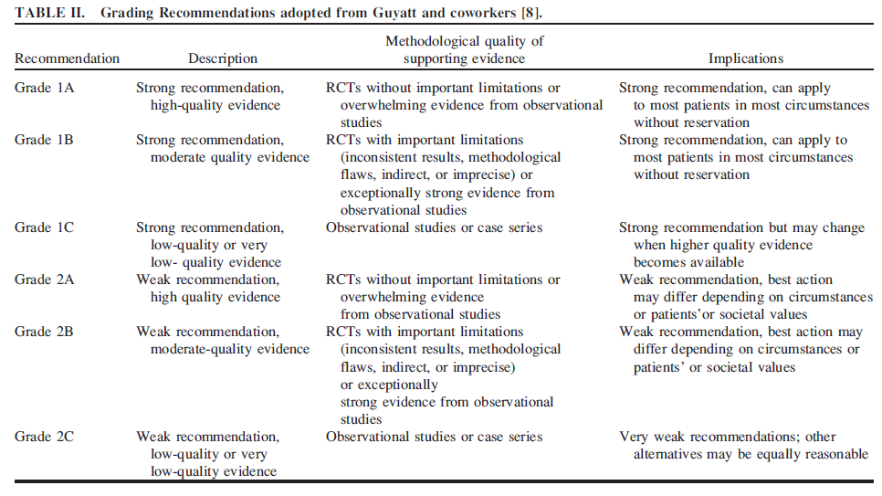

Slide 75
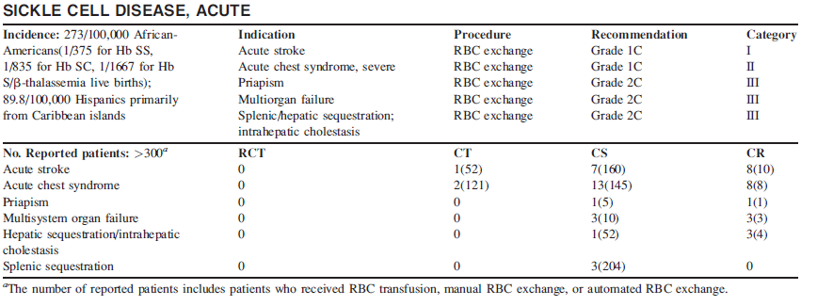
ASFA 2016 guidelines for RBCx in acute SCD
1. Schwartz J, Guidelines on the Use of Therapeutic Apheresis in Clinical Practice—Evidence-Based Approach from the Writing Committee of the American Society for Apheresis: J Clin Apher 2016.

Slide 76
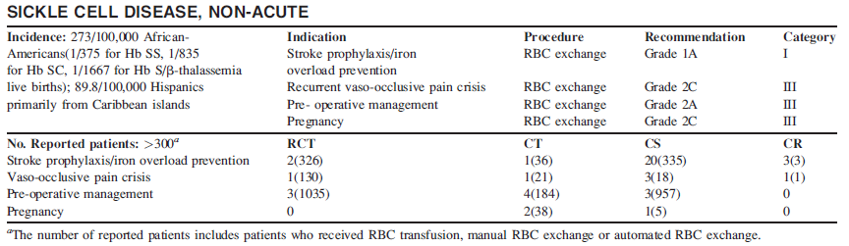
ASFA 2016 guidelines for RBCx in chronic SCD http://apheresisguidelines.com/
1. Schwartz J, Guidelines on the Use of Therapeutic Apheresis in Clinical Practice—Evidence-Based Approach from the Writing Committee of the American Society for Apheresis: J Clin Apher 2016.

Slide 77


Slide 78


Slide 79




Slide 80


Slide 81
“Do Not Do Recommendations” by NICE
Top-up transfusion is not generally suitable as a long-term regime for sickle cell disease because it is iron positive.
Do Not Do Recommendation Details
Recommendation:
Top-up transfusion is not generally suitable as a long-term regime for sickle cell disease because it is iron positive.
Interventions:
Top-up transfusion
www.nice.org.uk/donotdo/top-up-transfusion-is-not-generally-suitable-as-a-long-term-regime-for-sickle-cell-disease-because-it-is-iron-positive

Slide 82

The Newcastle and York External Assessment Centre (EAC) has summarized the patient pathway for people with SCD based on the UK national clinical guidelines ^{1,2} and feedback from clinical experts.

Slide 83
Bone Marrow Transplantation
Bone marrow transplantation as a treatment for SCD was first used in Europe for patients from Africa, on the assumption that the risks of disease justified the hazards of transplantation
Since then additional patients have undergone transplantation in Europe and US
Children and adolescents younger than 16 years of age who have severe complications (stroke, recurrent acute chest syndrome, or refractory pain) and have an HLA-matched donor available are the best candidates for transplantation:
  1% of patients with SCD meet these requirements
  100 patients with SCD have undergone bone marrow transplantation
  90% of the patients survived, 70-85% had event-free survival, and 15% had graft rejection
  Neurologic complications (seizures or intracranial bleeding) were common in the first transplant recipients
Piomelli S. Bone marrow transplantation in sickle cell diseases. Bone Marrow Transplant 1992; Weatherall D. Bone marrow transplantation for thalassemia and other inherited disorders of hemoglobin. Blood 1992; Vermylen C, Bone marrow transplantation in sickle cell anaemia. Blood Rev 1993; Vermylen C, et al. Bone marrow transplantation in sickle cell disease: the Belgian experience. Bone Marrow Transplant 1993; Bernaudin F, et al. Bone marrow transplantation (BMT) in 14 children with severe sickle cell disease (SCD). Bone Marrow Transplant 1993

Slide 84

Thank you for your attention

Slide 85
Round table discussion:
What are the common challenges in managing SCD patients?
How blood is sourced, screened, and phenotyped?
What about patients access to therapy, logistics, and education about SCD.
Collaboration between service providers & clinical hematology network
What about national guidelines or patients treatment pathway.
How automated RBCx perceived by patients & their family perspective but also by referring physicians.

Slide 86
WORKSHOP #1: KEY CHALLENGES
Vascular Access (***)
      SN access?
      Poor venous access
      Adults / Peds
      Custom Prime
    Physician / Nurse Awareness and Education about SCD treatment options (***)
    Availability of (matched) blood (***)
    Extended phenotyping (to prevent allo-immunization)
    Finding Resources / Skilled – Trained Staff (**)
    Patient Support and Education
    Blood Safety
    Switching from Manual to Automatic

