Slide 1

Dr M Rahbar
Pathologist
Fall 2019

Slide 2
Introduction
Primary germ cell tumors )GCTs) arise by the malignant transformation of primordial germ cells
Primary GCTs of testes constitute 95% of all testicular tumors
Infrequently, GCTs arise from an extragonadal site

Slide 3
GERM CELL TUMORS
90% are testicular in origin
10% are extragonadal:
Mediastinal Retroperitoneal
Intra-cranial(Pineal gland)
Of the extragonadal sites, predominent site of occurrence is mediastinal

Slide 4
Epidemiology
Most commonly seen in the age group of 15-35 years
Most common tumors in males in this age group
Contributes to upto 10% of all cancer deaths
Familial clustering has been observed, particularly among siblings

Slide 5
Risk Factors
Cryptorchidism:
Associated in 2% of cryptorchids
Abdominal cryptorchids more likely to develop GCTs than inguinal cryptorchids
Klinefelter’s Syndrome:
Testicular atrophy, gynecomastia, 47XXY karyotype
Increased likelihood of developing mediastinal GCT(upto 50 times normal) but not testicular tumors

Slide 6
Risk Factors(contd.(
Familial predisposition:
Strong familial predisposition in testicular GCT
The relative risk of development of these tumors in fathers and sons of patients with testicular germ cell tumors is 4 times higher than normal, and is 8 to 10 times higher between brothers

Slide 7
Classification(in males(
 Seminatous GCT Seminoma Spermatocytic seminoma
 Non-seminomatous GCT(NSGCT)
Embryonal carcinoma
Yolk sac(endodermal sinus) tumor
Teratoma: mature
Immature with malignant transformation

Slide 8
Classification(in females)(WHO(
Dysgerminoma
Endodermal sinus tumor
Embryonal carcinoma
Polyembryoma
Choriocarcinoma
Immature teratoma
Mature dermoid cyst with malignant transformation
Monodermal and highly specialized
Struma ovarii
Carcinoid
Struma ovarii and carcinoid
Others
Mixed forms

Slide 9
ITGCN
 Intra Tubular Germ Cell Neoplasm
Considered as carcinoma-in-situ phase of GCT
This phase precedes all adult cases of testicular GCT, frequently present in retroperitoneal presentations, but rarely in mediastinal presentations
Patologically, the ITGCN preceding both seminoma and nonseminoma is identical

Slide 10
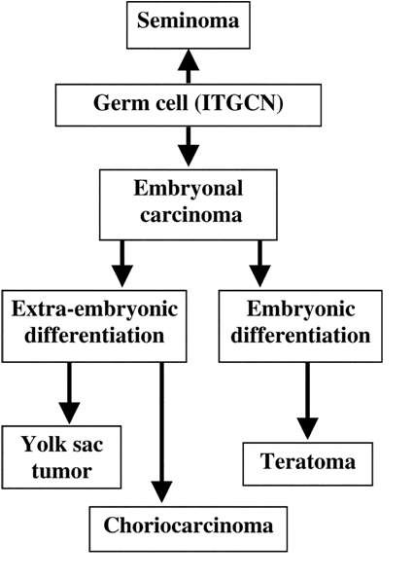

Slide 11
SEMINOMA
Accounts for approximately 50% of GCTs
Most frequently appears in the fourth decade of life
Pathology:Classic type:The typical or classic form consists of large-cell sheets with abundant cytoplasm, and round, hyperchromatic nuclei with prominent nucleoli; frequently associated with a lymphocytic infiltrate

Slide 12
Variants of Seminoma
 Atypical: lymphocytic infiltration absent; necrosis more common in the tumor mass; higher nucleo- cytoplasmic ratio
 Spermatocytic: rare variant; seen in older men; not associated with ITGCN; minimal metastatic potential

Slide 13
NSGCT
Represent approx. 50% of all GCTs
Most frequently present in third decade of life
Most tumors show mixed histo-pathological cell types; consisting of two or more cell lines(including Seminoma(

Slide 14
NSGCT: Embryonal Carcinoma
Most undifferentiated type of NSGCT
Histopath: Epithelioid cells arranged in the form of nests or tubulo-glandular structures or as sheets
Necrosis and hemorrhage are frequently observed in the tumor

Slide 15
NSGCT: Choriocarcinoma
By definition, consists of both syncytiotrophoblasts and cytotrophoblasts
Show high levels of hCG
Usually associated with widespread hematogenous metastases

Slide 16
NSGCT: Yolk Sac Tumor
Mimics the yolk sac of an embryo
Produces an alpha-fetoprotein
Pure yolk sac component is uncommon in adult testes, but accounts for significant percentage in primary mediastinal GCTs

Slide 17
NSGCT: Teratoma
Composed of somatic cell types from two or more germ layers (ectoderm, mesoderm, or endoderm(
Derived from a totipotential, malignant precursor (embryonal carcinoma or yolk sac tumor(
Usually are solid or cystic in appearance
Refered to as dermoid cysts if unilocular

Slide 18
Teratoma-mature
Teratomas contain elements from all three germ cell layers, with a predominance of the ectodermal component
Ectodermal component: skin, hair, sweat glands, sebaceous glands, and teeth
Mesodermal component: fat, smooth muscle, bone, and cartilage
Endodermal component: Respiratory and intestinal epithelium

Slide 19
Teratoma-immature
Malignant tumor, whose tissue resembles embryonal or fetal tissue
Usually prepubertal or young women (mean 18 years)
Most recurrences within 2 years; presence of yolk sac component is best predictor of recurrence in pediatric tumors
Usually neurogenic elements (GFAP+); mesodermal elements common; some tumors derived primarily of esophageal, liver and intestinal structures (endodermal)

Slide 20
Teratoma-immature(contd.)
Grading: histologic grade is based on proportion of tissue containing immature neuroepithelium
Norris grading system
1: abundant mature tissue, loose mesenchymal tissue with occasional mitoses, immature cartilage and tooth
2: less mature tissue than grade 1, rare foci of neuroepithelium with < 4 low power fields in any one slide
3: little / no mature tissue; numerous neuroepithelial elements merging with cellular stroma occupying 4+ low power fields

Slide 21
Ovarian immature Teratoma
Grading
0 mature tissue only
1 mature tissue with some immature tissue
Neuroepithelium or other immature tissue limited to 1 low-power field per slide
Moderate immature tissue
Neuroepithelium or other immature tissue occupied 1-3 low-power field per slide
Abundant immature tissue
Neuroepithelium or other immature tissue occupied ≥4 low-power field per slide

Slide 22
Serum Tumor Markers
α- FetoProtein(αFP(
Major fetal plasma protein produced by yolk sac and fetal liver
Serum t1/2: 5 - 7 days
Normal range in adults: < 5.4 ng/mL
Serum levels elevated in:
NSGCT
Hepatocellular carcinoma
Omphalocele
Ataxia Telangectasia
Serum levels reduced in:
Down syndrome

Slide 23
Serum Tumor Markers(contd.)
Human Chorionic Gonadotropin(hCG)
A glycoprotein produced by the syncytiotrophoblast
It is made up of α and β subunits
αhCG- is identical to the subunit of LH, FSH, and TSH
Serum half-life: 36 – 72 hrs
Normal range <5 mili IU/ml
Immunoassay techniques are used to quantify the presence of β subunit of the molecule
Diagnosis and monitoring treatment response in germ cell tumors

Slide 24
Serum Tumor Markers(contd.)
Lactate dehydrogenase (LDH)
Increases in the serum concentration of LDH are a reflection of tumor burden, growth rate, and cellular proliferation
Normal range:newborn 160-450,infant 100-250,child 60-170U/L
Usually the first serum marker to show a rising trend
Increased serum LDH concentrations are observed in approx. 60% of patients with advanced NSGCT and up to 80% of patients with advanced seminoma
But less specific compared to the other hCG and αFP

Slide 25
Risk Stratification: Seminoma
Good Risk:
Any hCG
Any LDH
Non-pulmonary Visceral Metastases absent
Intermediate Risk:
Any hCG
Any LDH
Non-pulmonary Visceral Metastases present
Poor Risk:
Not defined

Slide 26
Risk Stratification: NSGCT
 Good Risk:
α- FP <1000ng/mL
hCG <5000 mIU/mL
LDH <1.5XN
NPVM: absent
Gonadal or retroperitoneal primary tumor
 Intermediate Risk:
α- FP : 1000 – 10000
hCG: 5000 – 50000
LDH: 10-1.5XN
NPVM absent
Gonadal or retroperitoneal primary tumor

Slide 27
Risk Stratification: NSGCT(contd.)
 Poor Risk:
Mediastinal- primary site
Extrapulmonary visceral mets + ( brain, liver , etc (
α- FP <10,000 ng/mL
hCG <50,000 mIU/mL
LDH > 10xN

Slide 28
TNM Classification: T Staging
pTX | Primary tumor cannot be assessed (if no radical orchiectomy has been performed, TX is used)
pT0 | No evidence of primary tumor (e.g., histologic scar in testis)
pTis | Intratubular germ cell neoplasia )carcinoma in situ)
pT1 | Tumor limited to the testis and epididymis without vascular/lymphatic invasion. Tumor may invade into the tunica albuginea but not the tunica vaginalis
pT2 | Tumor limited to the testis and epididymis with vascular/lymphatic invasion or tumor extending through the tunica albuginea with involvement of the tunica vaginalis
pT3 | Tumor invades the spermatic cord with or without vascular/lymphatic invasion
pT4 | Tumor invades the scrotum with or without vascular/lymphatic invasion

Slide 29
TNM Classification: N staging
Nx | Regional lymph nodes cannot be assessed
N0 | No regional lymph node metastasis
N1 | Metastasis with a lymph node mass ≤2 cm in greatest dimension; or multiple lymph nodes, none >2 cm in greatest dimension
N2 | Metastasis with a lymph node mass 2 cm but not >5 cm in greatest dimension; or multiple lymph nodes, any one mass >2 cm but not >5 cm in greatest dimension
N3 | Metastasis with a lymph node mass >5 cm in greatest dimension

Slide 30
TNM Classification: M Staging
Mx | Distant metastasis cannot be assessed
M0 | No distant metastasis
M1a | Non regional nodal or pulmonary metastases
M1b | Distant metastasis other than to nonregional lymph nodes and lungs

Slide 31
TNM Classification: ‘S’ Staging
Stage | LDH | hCG | AFP
S1 | <1.5xN | <5000 | <1000
S2 | 1.5-10xN | 5000 – 50000 | 1000 – 10000
S3 | >10xN | >50000 | >10000

Slide 32
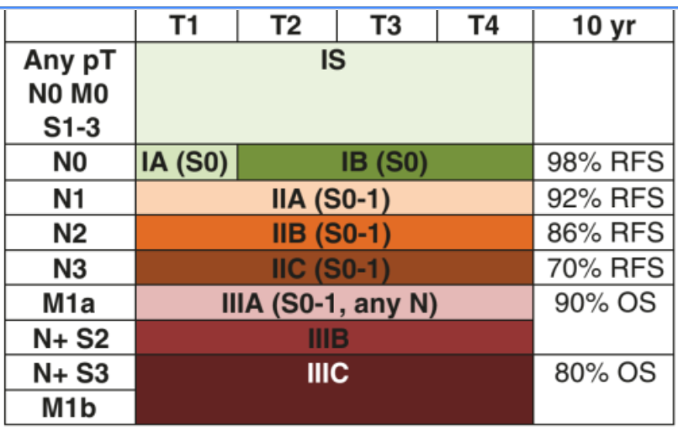

Slide 33
Ovarian GCT staging
I limited to ovary or ovaries,peritoneal washing -
Tumor marker normal
II Mic residual or + LN≤2cm , peritoneal washing –
Tumor marker normal±
III + LN>2cm .gross residual or biopsy only , visceral involvement ( omentum, GI, bladder )
peritoneal washing +
Tumor marker normal±
IV distance met including liver

Slide 34
Evaluation of treatment response
In GCTs the prognostic relevance of the rate of decline of serum AFP and beta-HCG for patients with nonseminomatous GCT represents an easy tool in the therapeutic management of these patients

Slide 35
THANK YOU

