Slide 2
Hb F Stimulants: state of the art & future prospective Qeshm Iland Seminar
Mahdi Shahriari :
Pediatric Hematologist-Oncologist
Associate Prof. of Pediatrics
Shiraz University of Medical Sciences

Slide 3
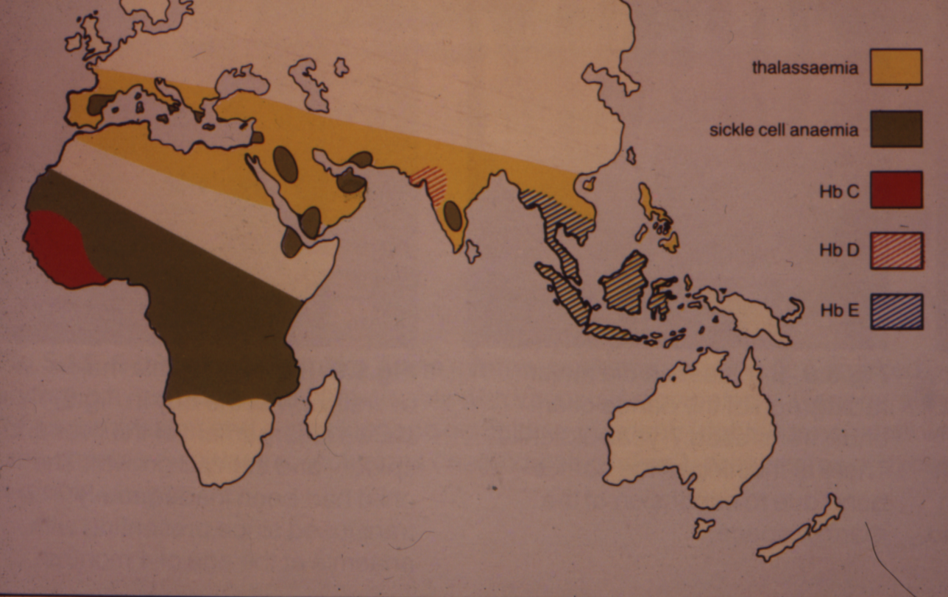
DISTRIBUTION OF ABNORMAL Hb GENES in ancient world

Slide 4
Role of Hb F level in the natural history of Sickle cell
Elevated Hb F levels in the majority of patients with Sickle cell disease (SCD) in our region is a prognostic factor of clinical severity. Sustained Hb F levels ≥20% reduces clinical events (1). In contrast, low Hb F concentration is a predictor of early mortality among them (2).
1- Powars, D.R., et al : Is there a threshold level of fetal hemoglobin that ameliorates morbidity in sickle cell anemia? Blood 1994; 63: 921–926.
2- Platt, O.S., et al : Mortality in sickle cell disease. Life expectancy and risk factors for early death. New England Journal of Medicine.1994; 330: 1639–1644.

Slide 5
Role of Hb F level in the natural history of Sickle cell
Hb F α2/γ2 homo-tetramers and even α2/γ/βs hetero-tetramers do not polymerize, therefore an increase in the intracellular concentration of Hb F offers a molecular advantage for the prevention of sickling. Any drug with every mechanism of action that substantially increases the HbF production and pancellular Hb F distribution; has the potential to improve clinical outcomes in patients with SCD.

Slide 6
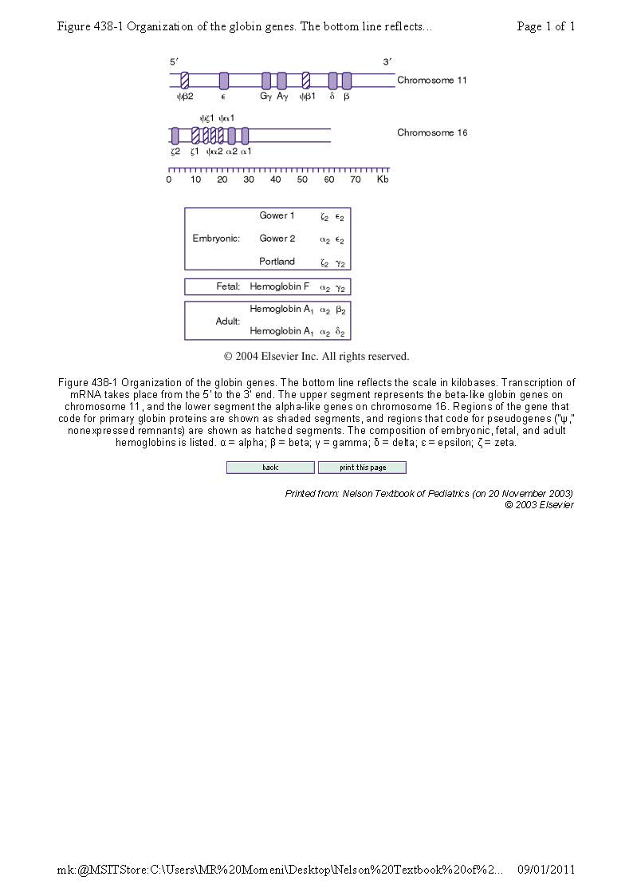
Nelson

Slide 7
: γ مکانیسم عمل القا کننده تولید زنجیره
با توجه به شکل مقابل اگر بتوانیم کفه چپ ترازو را سنگینتر کنیم ، شدت علائم تالاسمی کمتر خواهد شد.
کفه راست که بطور طبیعی تولید میکند و راهکاری جهت کاهش ان موجود نیست.
βS,δ,γ
α

Slide 8
:γ مکانیسم عمل القا کننده تولید زنجیره
زنجیره بتا (β)که با جانشینی اسید گلوتامیک بجای والین معیوب شده و باعث ایجاد بیماری شده است. افزایش آن فایده ای ندارد.
زنجیره دلتا(δ) که قابلیت افزایش فراوان ندارد.
اگر بتوانیم تولید زنجیره گاما (γ) را افزایش دهیم ، شدت علائم کاهش می یابد.
ترازو به تعادل نزدیکتر میشود!
βS,δ,γ
α

Slide 10
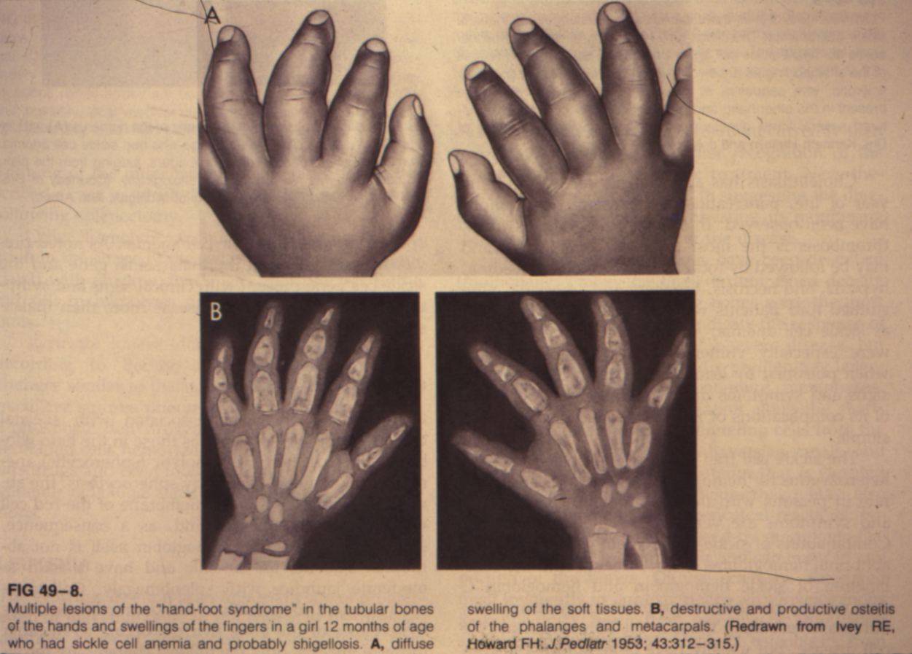
SICKLE DACTILITIS: HAND FOOT SYNDROME

Slide 11
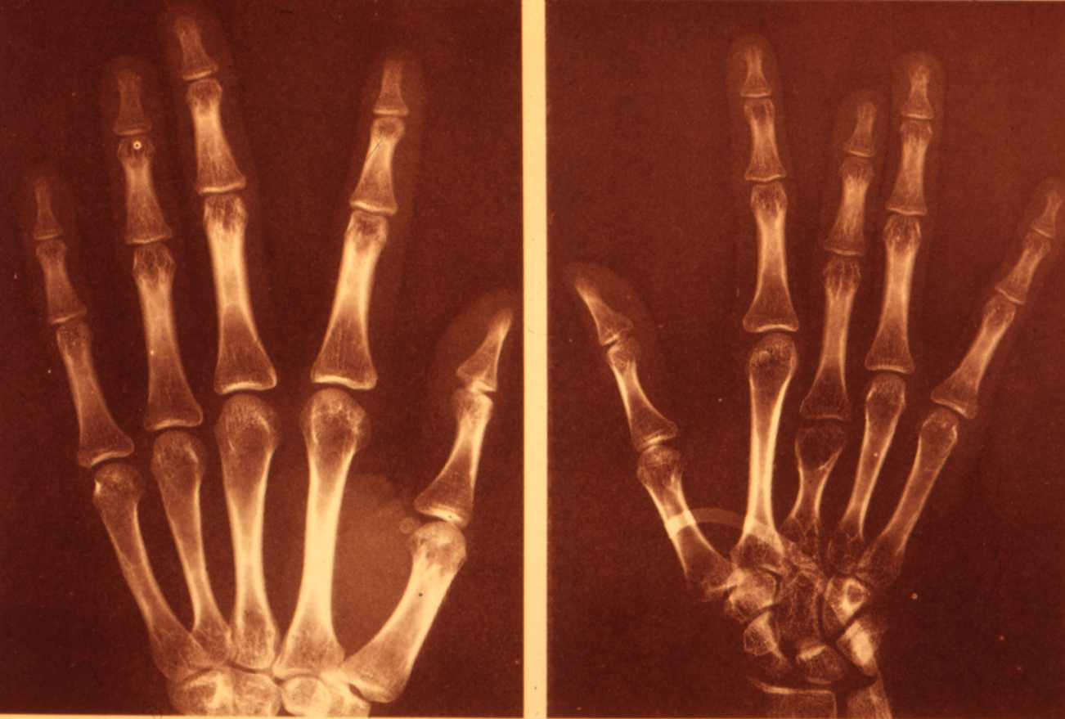
COMPLICATION OF DACTILITIS

Slide 12
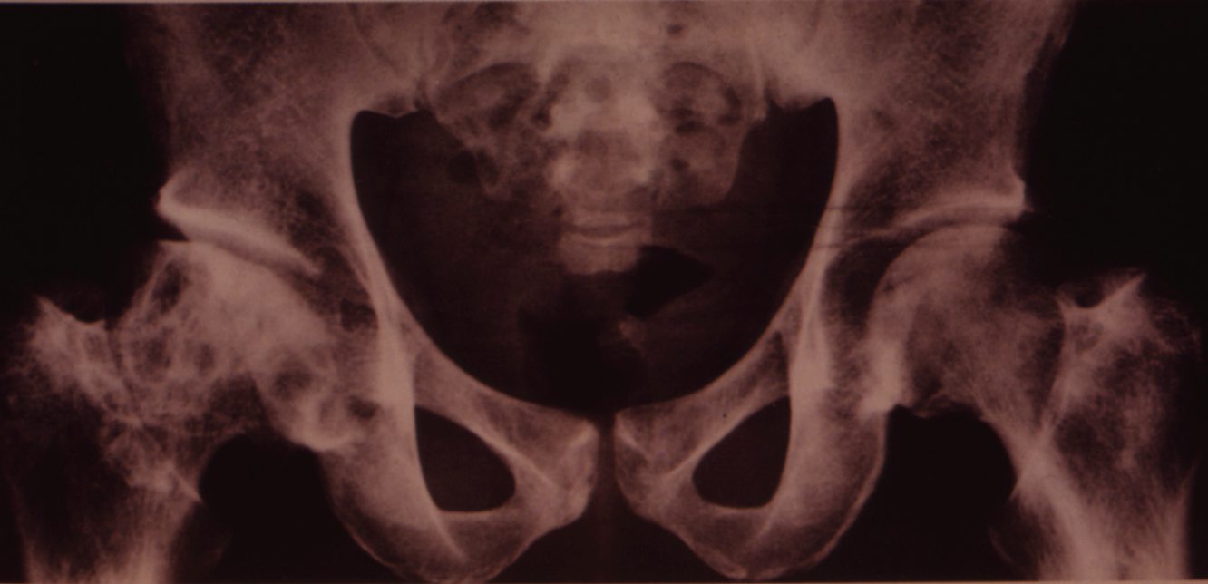
Avascular necrosis of the head of Femur

Slide 13
300 600 900 1200

Slide 14
Hb F inducers: 1- Hydroxycarbamide (Hydroxyurea):
The only Federal Drug Administration (FDA)-approved drug for use in patients with SCD, hydroxyurea, is an antimetabolite chemotherapeutic agent known to stimulate fetal hemoglobin production, therefore offering therapeutic benefit in this disease. It has the ability to raise Hb concentration and Hb F values, as well as promote a parallel increase in red cell mean corpuscular volume (MCV) (3). The myelosuppressive and cytotoxic effects of hydroxyurea induce erythroid regeneration and the recruitment of earlier progenitors programmed to produce higher levels of Hb F(4).
3- Ferster, A., et al: Five years of experience with hydroxyurea in children and young adults with sickle cell disease. Blood. 2001; 97: 3628–3632.
4- Dover, G.J.,et al : Hydroxyurea induction of hemoglobin F production in sickle cell disease: relationship between cytotoxicity and F cell production. Blood. 1986; 67: 735–738.

Slide 15
Mechanism of action of Hydroxyurea:
The exact mechanism by which hydroxyurea increases Hb F levels seems to be mediated through a NO-dependent activation of soluble guanylyl cyclase in erythroid cells (5). It has additional effects, including lowering white blood cell count (WBC), reticulocytes, and platelets, increasing NO production (6), improving RBC hydration (7), and decreasing RBC adhesiveness to endothelium (8).
5- Cokic, V.P., Andric, S.A., Stojilkovic, S.S., Noguchi, C.T. & Schechter, A.N.: Hydroxyurea nitrosylates and activates soluble guanylyl cyclase in human erythroid cells. Blood. 2008; 111: 1117–1123.
6- Nahavandi, M., Tavakkoli, F., Wyche, M.Q., Perlin, E., Winter, W.P. & Castro, O.: Nitric oxide and cyclic GMP levels in sickle cell patients receiving hydroxyurea. British Journal of Haematology. 2002; 119: 855–857.
7- Orringer, E.P., Blythe, D.S., Johnson, A.E., Phillips, Jr, G., Dover, G.J. & Parker, J.C.: Effects of hydroxyurea on hemoglobin F and water content in the red blood cells of dogs and of patients with sickle cell anemia. Blood.1991; 78: 212–216.
8- Hillery, C.A., Du, M.C., Wang, W.C. & Scott, J.P.: Hydroxyurea therapy decreases the in vitro adhesion of sickle erythrocytes to thrombospondin and laminin. British Journal of Haematology. 2000; 109:322–327.

Slide 16
Major effects of Hydroxyurea
Hydroxyurea can decrease the rate of pain and acute chest syndrome (ACS) events in severely affected adults and children(9,10).
9- Charache, S., Terrin, M.L., Moore, R.D., et al: Effect of hydroxyurea on the frequency of painful crises in sickle cell anemia. Investigators of the Multicenter Study of Hydroxyurea in Sickle Cell Anemia. New England Journal of Medicine.1995; 332: 1317–1322.
10- Jayabose, S., Tugal, O., Sandoval, C., et al: Clinical and hematologic effects of hydroxyurea in children with sickle cell anemia. Journal of Pediatrics. 1996; 129: 559–565.

Slide 17
Hydroxyurea and stem cell transplantation
The usual starting dose is 15–20 mg/kg/day given once daily orally. Hydroxyurea has been used in the pre-conditioning regimen of bone marrow transplantation of patients with SCD and its use seems to be associated with a lower incidence of rejection and engraftment failure (11).
11- Brachet, C., Azzi, N., Demulder, A., et al.: Hydroxyurea treatment for sickle cell disease: impact on haematopoietic stem cell transplantation’s outcome. Bone Marrow Transplantation. 2004; 33: 799–803.

Slide 18
Hydroxyurea and preservation of organs
In young children with sickle cell anemia, splenic function was preserved and in some cases regained when hydroxyurea was escalated to the maximum tolerated dose (approximately 30 mg/kg/day) (12). Similar benefits in other organs, such as improvement of proteinuria, resolution of hypoxemia, and protection against recurrent stroke have been reported ( 13, 14, 15).
12- Hankins, J.S., Helton, K.J., McCarville, M.B., et al.: Preservation of spleen and brain function in children with sickle cell anemia treated with hydroxyurea. Pediatric Blood & Cancer. 2008; 50: 293–297.
13- Ware, R.E., Zimmerman, S.A., Sylvestre, P.B., et al.: Prevention of secondary stroke and resolution of transfusional iron overload in children with sickle cell anemia using hydroxyurea and phlebotomy. Journal of Pediatrics.2004; 145: 346–352.
14- Fitzhugh, C.D., Wigfall, D.R. & Ware, R.E.: Enalapril and hydroxyurea therapy for children with sickle nephropathy. Pediatric Blood & Cancer.2005; 45: 982–985.
15- Singh, S.A., Koumbourlis, A.C. & Aygun, B.: Resolution of chronic hypoxemia in pediatric sickle cell patients after treatment with hydroxyurea. Pediatric Blood & Cancer. 2008; 50: 1258–1260.

Slide 19
Ongoing organ preservation studies
The BABY HUG study (http://www.clinicaltrials.gov # NCT00006400), is investigating the potential effects of hydroxyurea in splenic and renal function preservation in very young children.
The stroke with transfusions changing to hydroxyurea (SWiTCH) study (http://www.clincaltrials.gov # NCT00122980), is examining hydroxyurea for secondary stroke prevention.
These two important trials may expand the role of hydroxyurea therapy beyond reducing the frequency of vaso-occlusive events, to include the protection of organs from the progressive and inevitable damage caused by SCD.

Slide 20
Hydroxyurea and renal function
Considering the pharmacokinetics of hydroxyurea , in a small cohort of SCD patients, there were no significant differences in pharmacokinetic parameters among adult and pediatric individuals (16). Because hydroxyurea undergoes renal clearance, its dose adjustment in individuals with renal impairment is needed. A reduced initial dose of hydroxyurea (7·5 mg/kg/day) is recommended to individuals with a creatinine clearance <60 ml/min (17). Close monitoring of myelotoxicity is essential in SCD patients with renal impairment.
16- De Montalembert, M., Bachir, D., Hulin, A., et al.: Pharmacokinetics of hydroxyurea 1,000 mg coated breakable tablets and 500 mg capsules in pediatric and adult patients with sickle cell disease. Haematologica. 2008; 91: 1685–1688.
17- Yan, J.H., Ataga, K., Kaul, S., et al.: The influence of renal function on hydroxyurea pharmacokinetics in adults with sickle cell disease. Journal of Clinical Pharmacology. 2005; 45: 434–445.

Slide 21
Safty of hydroxyurea
Long-term safety of hydroxyurea such as concerns with genotoxicity and carcinogenesis continue to be a topic of discussion among clinicians and patients. To date, there is no evidence pointing toward an increased rate of malignancy associated with hydroxyurea therapy (18).
Despite years of research and extensive evidence of its efficacy, hydroxyurea remains a vastly underutilized drug. This underutilization is due to some concerns, including concerns of patients, families, and providers about cancer, birth defects, infertility, and questions regarding the drug’s long-term benefits and toxicities (19).
18- Brawley, O.W., Cornelius, L.J., Edwards, L.R., et al.: National Institutes of Health Consensus Development Conference statement: hydroxyurea treatment for sickle cell disease. Annals of Internal Medicine. 2008; 148: 932–938.
19- Zumberg, M.S., Reddy, S., Boyette, R.L., Schwartz, R.J., et al: Hydroxyurea therapy for sickle cell disease in community-based practices: a survey of Florida and North Carolina hematologists/oncologists. American Journal of Hematology. 2005; 79: 107–113.

Slide 23
Decitabine and 5- Azacytidine:
They form covalent bonds with DNA methyltrasferase (DNMT), leading to depletion of this enzyme, and resulting in DNA hypomethylation (21). Hypomethylation of the γ-globin gene promoter triggers its expression and induces γ-globin synthesis, resulting in the so called ‘γ-globin reverse switch’, they induce selective degradation of DNMT1, also resulting in re-expression of γ-globin genes (22).
21- Creusot, F., Acs, G. & Christman, J.K.: Inhibition of DNA methyltransferase and induction of Friend erythroleukemia cell differentiation by 5-azacytidine and 5-aza-2′-deoxycytidine. Journal of Biological Chemistry. 1982; 257: 2041–2048.
22- Ghoshal, K., Datta, J., Majumder, S., et al.: 5-Aza-deoxycytidine induces selective degradation of DNA methyltransferase 1 by a proteasomal pathway that requires the KEN box, bromo-adjacent homology domain, and nuclear localization signal. Molecular and Cellular Biology. 2005; 25: 4727–4741.

Slide 24
5 Azacytidine
Following reports of success in baboons, an increase in F-cell and Hb F production was observed in patients with SCD and thalassemia with 5-azacytidine use, in addition to a reduction in the proportion of dense RBCs in patients with SCD (24). These initial reports were very encouraging, however concerns related to a presumed 5-azacytidine proclivity to causing malignant transformation in rats, halted future investigation (25).
24- Dover, G.J., Charache, S., Boyer, S.H., Vogelsang, G. & Moyer, M.: 5-Azacytidine increases HbF production and reduces anemia in sickle cell disease: dose–response analysis of subcutaneous and oral dosage regimens. Blood. 1985; 66: 527–532.
25- Carr, B.I., Reilly, J.G., Smith, S.S., Winberg, C. & Riggs, A. (1984) The tumorigenicity of 5-azacytidine in the male Fischer rat. Carcinogenesis. 1984;5: 1583–1590.

Slide 25
5 Azacytidine versus Decitabine
But the 5-azacytidine analogue, decitabine (2-deoxy 5-azacytidine), was shown to promote similar molecular and cellular effects to its counterpart, with no apparent tumorigenic risks (26). Considering the fact that some of the hydroxyurea-treated patients will not attain Hb F ≥ 20%, (i.e. hydroxyurea low responders), more effort recently has been focused on the development of decitabine as an alternative or adjunct therapy in SCD. Low dose subcutaneous use of decitabine (0·2 mg/kg 1–3 times/week) was tested in small group of adult patients who responded poorly to hydroxyurea and promoted a marked increase in Hb F, F cell proportion, and Hb concentration, and decreased reticulocyte and absolute neutrophil counts (27).

Slide 26
Decitabine po in baboons were as effective as SQ & IV
26- Koshy, M., Dorn, L., Bressler, L., et al.: 2-deoxy 5-azacytidine and fetal hemoglobin induction in sickle cell anemia. Blood. 2000; 96: 2379–2384.
27- Saunthararajah, Y., Hillery, C.A., Lavelle, D., et al.: Effects of 5-aza-2′-deoxycytidine on fetal hemoglobin levels, red cell adhesion, and hematopoietic differentiation in patients with sickle cell disease. Blood. 2003; 102: 3865–3870.
28- Saunthararajah, Y., Molokie, R., Saraf, S., et al.: Clinical effectiveness of decitabine in severe sickle cell disease. British Journal of Haematology. 2008; 141: 126–129.
29- Lavelle, D., Chin, J., Vaitkus, K., et al: Oral decitabine reactivates expression of the methylated gamma-globin gene in Papio anubis. American Journal of Hematology. 2007; 82: 981–985.

Slide 28
Butyrate:
Infants of diabetic mothers have more than 90% HbF at birth; Ketone bodies, especially Butyric acid as an example of short chain fatty acid; inhibit histone deacetylase and promote elevated levels of core histone acetylation, affecting chromatin structure and transcription rates of γ-globin genes. After de-repressing γ-globin genes, increased gene transcription and γ-globin synthesis will follow, thereby increasing Hb F levels (30).
30- McCaffrey, P.G., Newsome, D.A., Fibach, E., Yoshida, M. & Su, M.S.: Induction of gamma-globin by histone deacetylase inhibitors. Blood. 1997; 90: 2075–2083.
31- Perrine, S.P., Greene, M.F. & Faller, D.V. : Delay in the fetal globin switch in infants of diabetic mothers. New England Journal of Medicine. 1985; 312: 334–338.
32- Perrine, S.P., Rudolph, A., Faller, D.V., Roman, C., Cohen, R.A., Chen, S.J. & Kan, Y.W.: Butyrate infusions in the ovine fetus delay the biologic clock for globin gene switching. Proceedings of the National Academy of Sciences of the United States of America.1988; 85: 8540–8542

Slide 29
Butyrate therapy
More encouraging results were obtained with ‘pulse’ butyrate therapy (250–500 mg/kg/day IV infused over 6–12 h at a maximum of 6 d per month) with sustained Hb F production and higher Hb concentration (35, 36, 37).
The magnitude of Hb F production with butyrate use seems dependent on elevated levels of Hb F pre-therapy (36) that reflect increased baseline activity of fetal globin genes. Thus, young children would be good candidates for butyrate therapy due to their elevated Hb F levels. In fact, this may be the case, as children with Hb SS had significant increases of F-reticulocytes and Hb F levels when given relatively low doses of oral sodium phenylbutyrate (38).
35- Ikuta, T., Atweh, G., Boosalis, V., et al.: Cellular and molecular effects of a pulse butyrate regimen and new inducers of globin gene expression and hematopoiesis. Annals of the New York Academy of Sciences 1998; 850: 87–99.
36- Atweh, G.F., Sutton, M., Nassif, I., et al.: Sustained induction of fetal hemoglobin by pulse butyrate therapy in sickle cell disease. Blood.1999; 93: 1790–1797.
37- Hines, P., Dover, G.J. & Resar, L.M. : Pulsed-dosing with oral sodium phenylbutyrate increases hemoglobin F in a patient with sickle cell anemia. Pediatric Blood & Cancer. 2008; 50: 357–359.
38- Resar, L.M., Segal, J.B., Fitzpatric, L.K.,et al.: Induction of fetal hemoglobin synthesis in children with sickle cell anemia on low-dose oral sodium phenylbutyrate therapy. Journal of Pediatric Hematology/Oncology.2002; 24: 737–741.

Slide 30
Butyrate derivatives
The disadvantages of butyrate is its short half-life, requiring continuous IV dosages through a central line. Oral butyrate analogues would overcome this problem, but they require very high doses (as many as 40 tablets per day, in addition to having an unpleasant taste). Taken together, the route and inconvenience of oral use will limit patient acceptance, will cause low adherence. If used for a definite period (from a few weeks to a few months), butyrate may be better accepted by patients. One possible scenario would be in the care of indolent leg ulcers, since butyrate heals intractable cases in patients with SCD (39).
39- Sher, G.D. & Olivieri, N.F. : Rapid healing of chronic leg ulcers during arginine butyrate therapy in patients with sickle cell disease and thalassemia. Blood1994; 84: 2378–2380.

Slide 32
Erythropoietin:
Recombinant human erythropoietin is another compound with Hb F augmenting properties. In vitro and in vivo experiments have demonstrated erythropoietin’s ability to raise the percentage of F cells and Hb F concentration when used alone (41). Subsequently, studies combining hydroxyurea and erythropoietin in adults with SCD showed mixed results in promoting a significant increase in F cells (42, 43).
42- Goldberg, M.A., Brugnara, C., Dover, G.J., et al: Treatment of sickle cell anemia with hydroxyurea and erythropoietin. New England Journal of Medicine. 1990; 323: 366–372.
43- El-Hazmi, M.A., Al-Momen, A., Kandaswamy, S., et al: On the use of hydroxyurea/erythropoietin combination therapy for sickle cell disease. Acta Haematologica. 1995; 94: 128–134.
44- McDonagh, K.T., Dover, G.J., Donahue, R.E., et al: Hydroxyurea-induced HbF production in anemic primates: augmentation by erythropoietin, hematopoietic growth factors, and sodium butyrate. Experimental Hematology. 1992; 20: 1156–1164.

Slide 33
Erythropoietin
In patients receiving erythropoietin in combination with hydroxyurea, high levels of F-cells and Hb F were achieved very rapidly (within 4 weeks). When erythropoietin was discontinued and hydroxyurea alone was continued, the effect was sustained (47). It is conceivable that the benefit of recombinant erythropoietin lies in accelerating the response to hydroxyurea, however, given the body of information gained over years with hydroxyurea use, the end result of sustained Hb F production seems to be similarly achieved even without upfront erythropoietin use (48).
47- El-Hazmi, M.A., Al-Momen, A., Warsy, A.S., Kandaswamy, S., Huraib, S., Harakati, M. & Al-Mohareb, F.: The pharmacological manipulation of fetal haemoglobin: trials using hydroxyurea and recombinant human erythropoietin. Acta Haematologica. 1995; 93: 57–61.
48- Zimmerman, S.A., Schultz, W.H., Davis, J.S., et al.: Sustained long-term hematologic efficacy of hydroxyurea at maximum tolerated dose in children with sickle cell disease. Blood. 2004; 103: 2039–2045.

Slide 34
Erythropoietin
In 13 adult patients, either hydroxyurea-intolerant (due to reticulocytopenia) or with renal insufficiency, benefited from the combination of erythropoietin and higher hydroxyurea doses. This resulted in increased Hb F production and few side effects (49). This report illustrates the important role of erythropoietin in allowing patients to tolerate hydroxyurea dose escalation, while preventing erythroid toxicity from hydroxyurea in the setting of endogenous erythropoietin deficiency.
49- Little, J.A., McGowan, V.R., Kato, G.J., Partovi, K.S., Feld, J.J., Maric, I., Martyr, S., Taylor, J.G., Machado, R.F., Heller, T., Castro, O. & Gladwin, M.T.: Combination erythropoietin-hydroxyurea therapy in sickle cell disease: experience from the National Institutes of Health and a literature review. Haematologica. 2006; 91: 1076–1083.
50- Bennett, C.L., Silver, S.M., Djulbegovic, B., Samaras, A.T., et al: (2008) Venous thromboembolism and mortality associated with recombinant erythropoietin and darbepoetin administration for the treatment of cancer-associated anemia. JAMA. 2008; 299: 914–924.

Slide 35
Erythropoietin
At present, an NIH phase I clinical trial is investigating the role of erythropoietin in combination with hydroxyurea in adult patients with SCD and renal dysfunction and/or evidence of pulmonary hypertension (http://www.clinicaltrials.gov # NCT00270478). This study will be important to help define the optimal role of erythropoietin in the management of patients with SCD. In addition, this study may offer some information regarding the possible increased risk of thrombosis with erythropoietin use, a finding recently observed in patients with cancer (50)
50- Bennett, C.L., Silver, S.M., Djulbegovic, B., Samaras, A.T., et al: (2008) Venous thromboembolism and mortality associated with recombinant erythropoietin and darbepoetin administration for the treatment of cancer-associated anemia. JAMA. 2008; 299: 914–924.

Slide 36
Thank you for attention, is there any comment or question?

