Slide 1
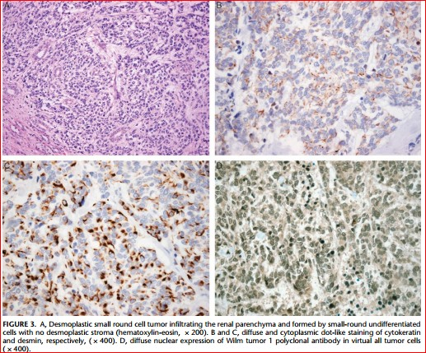
Case presentation
Desmplastic Small Round cell Tumor
(DSRCT)
دکتربابک عبدالکریمی
هماتولوژیست آنکولوژیست کودکان

Slide 2
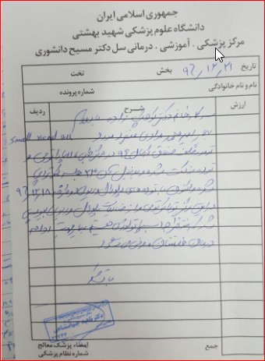
Case presentation:
A 5 –y old boy with subacute intermitent abdominal pain.
abdominopelvic US: retroperitoneal tumor since 3 years ago.(retroperitoneal mass)
First Pathology:{desmoplastic} small round cell tumor
chemtherapy courses:12-13
IHC:?

Slide 3
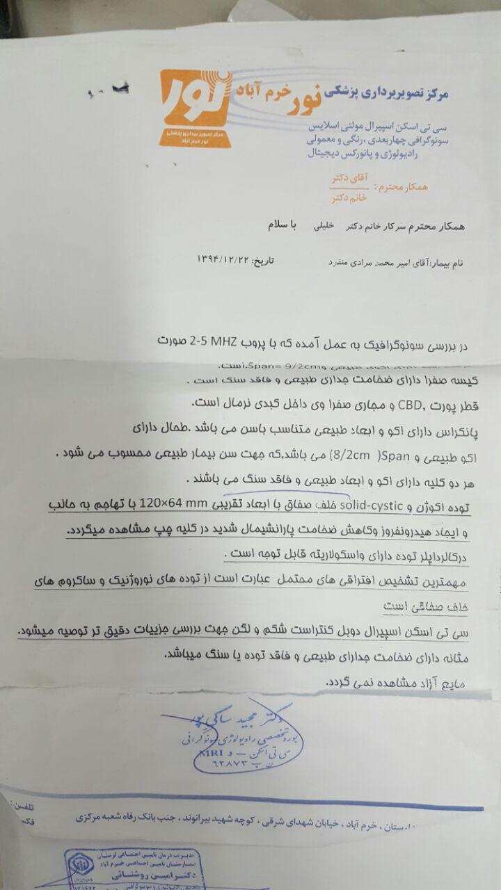
22/12/96 retroperitoneal mass DDX: 1.neurogenic tumors 2.retroperitoneal sarcoma

Slide 4
26/12/94 8 biopsy samples: around ureter pelvic mass

Slide 5
Pathology:malignant small round cell tumor

Slide 6
Treatment Protocol
Only chemotherapy with:
VCR+DOX+CPM+VP16
during 23 Admitions(chemo+FNP)

Slide 7
درخرم آباداواخر کورسهای کموتراپی Whole body bone scan: multiple lesions in left kidney

Slide 8
درخرم آباداواخر کورسهای کموتراپی Bilateral BMA/B
Durning chemotherapyin Tehran -→ was not involved in Lorestan

Slide 9
CT scan بعدازقطع درمان: 96/6/15 نرمال

Slide 10
آیا اسکن تکنسیوم بیماررویت شده؟
آیا درانتهای درمان اسکن هسته ای یا درانتهای درمانPET scan انجام شده است؟

Slide 11
Relapse 5.5 months after end of chemotherapy

Slide 12
96/12/16 ریپورت توام توراکس وشکم ولگن

Slide 13
Pathology after relapse

Slide 14
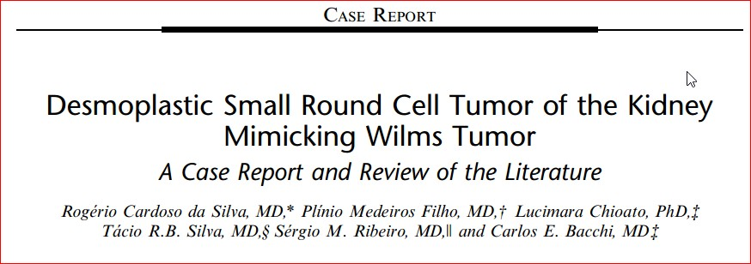
DSRT primary of the kidney was first described by Su et al in 2004, and since then only a total of 8 cases have been reported in literature. Herein, we report the ninth case of DSRCT arising in the kidney of a child mimicking both clinically and pathologically Wilm tumor (nephroblastoma) including review of the literature.

Slide 15
WT & DSRCT diffrentiation BY molecular biology:
DSRCT: EWSR1-WT1 rearrangement (+)
WT1 mutation carboxy-terminus (+)
WT: WT1 mutation amino-terminus (+)
WT1 carboxy-terminus(+)
EWSR1- WT1 fusion prot due to t(11; 22) is characteristic of DSRCT

Slide 16
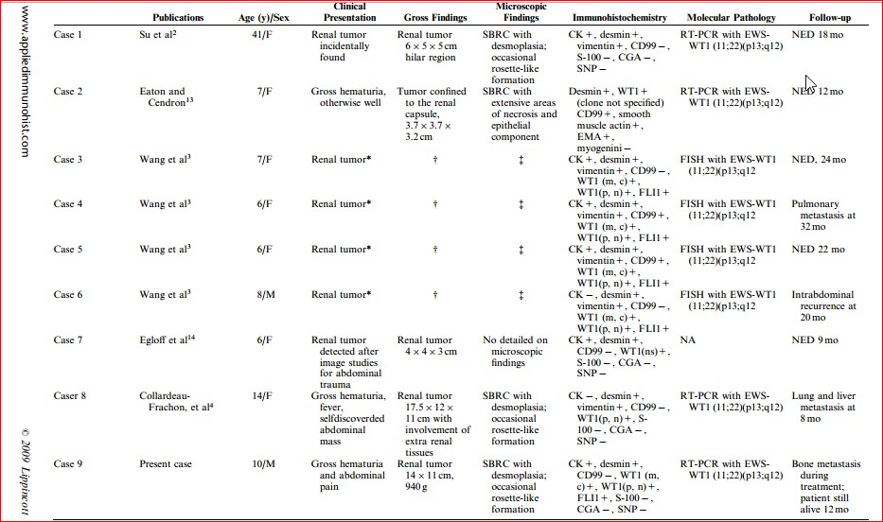

Slide 17
خصوصیات تومور:
Rare-highly aggressive mesenchymal
Age ranges : 6 to 49 years, M/F: 4 : 1 tumor typically involves : abdominalcavity(multiple peritoneal implantation)+ diaphragm
2 common sites for metastatic disease beyond the peritoneum: lung-liver
staging :PET-CT: may be a helpful adjunct to evaluate distant metastasis

Slide 18
Staging base on CT scan:

Slide 20
Immunohistochemistry:
Epithelial membrane antigen (EMA)(+),
desmin (DES)(+),
neuron specific enolase (NSE)(+), synaptophysin[weakly positive (+/-)],
calretinin (+/-),
cytokeratin (CK)(-),
chromogranin-A(-)
CD 99(-).

Slide 21
Several transcriptional targets of the EWSR1-WT1 chimera have been identified such as (for immunotherapy)
Platelet Derived Growth Factor A (PDGF-A),
IL2 receptor β,
Myeloid Leukemia Factor-1 (MLF1)
Insulin-like Growth Factor 1 receptor (IGF1-1)

Slide 22
ROUTIN chemotherapy protocol

Slide 24
Radiation Therapy:
whole-abdomen radiotherapy at a dose of 30Gy, +/-focal boost, was initially utilized after debulking surgery.
Memorial Sloan Kettering center:
IMRT+ debulking surgery
IMRT+ debulking surger+ HIPEC
sub-optimal disease-free survival of <1 year

Slide 26
AHSCT
Thiotepa (900 mg/m2) plus carboplatin (1500 mg/m2) with stem cell rescue

Slide 27
Our actual treatment strategy:
1. Neoadj chemotherapy(ICE-5/ 3 courses)/
Secondlook surgery(?)
3.chemotherapy(TMZ+Irinot+VCR+Avastin-5/(2 courses)
Secondlook surgery(?)
4.ICE-5/cis or ICE-3 ( 3 course)(Titration therapy)
RT
PET-CT/MRI AHSCT

Slide 28
باتشکرازتوجه همکاران واساتید

